Slide 1
INFN ONGOING ACTIVITIES
And INITIAL INTENTS
Contalbrigo Marco
INFN Ferrara
INFN Meeting on EIC
March 1, 2018 - Presidenza INFN, Roma

Slide 2
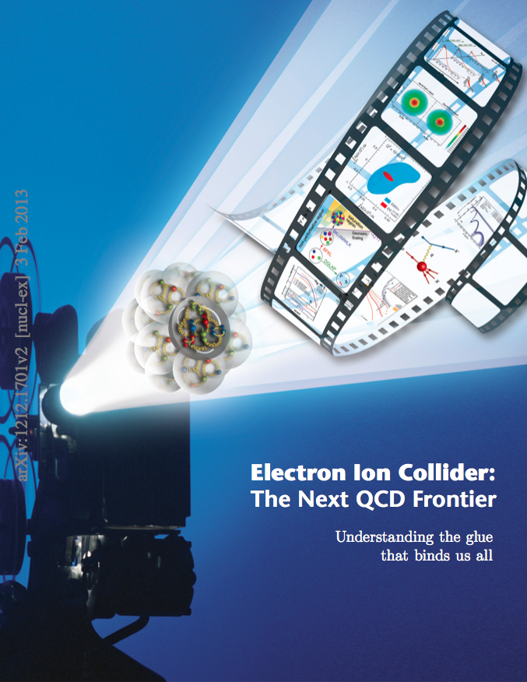
EXECUTIVE SUMMARY
The Next QCD Frontier
EIC is a unique opportunity
for a comprehensive QCD study
and possible breakthroughs
This projects deserve the strongest
support as we may all benefit !!
EIC offers immediate opportunities
for supported R&D activities
on science and technology
At this early stage can still be
synergic with INFN current programs
(here detector R&D only)
In Italy: wide interest and a motivated
community already supporting the project
Contalbrigo M.
EIC Activity, 1st March 2018, Rome
Contalbrigo M.
2
2
Notes:
Aggiungere range di validita’ per fattorizzazione GPDs

Slide 3
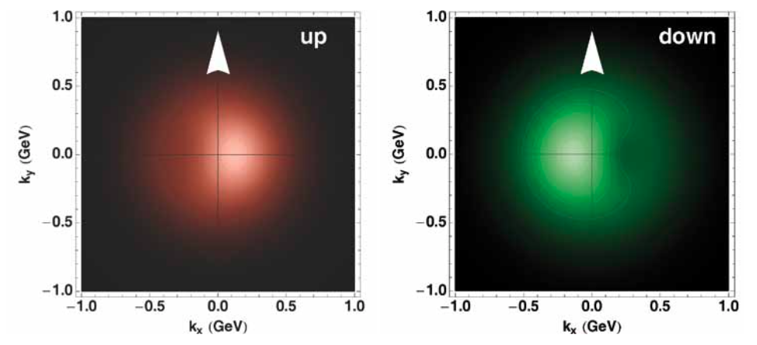
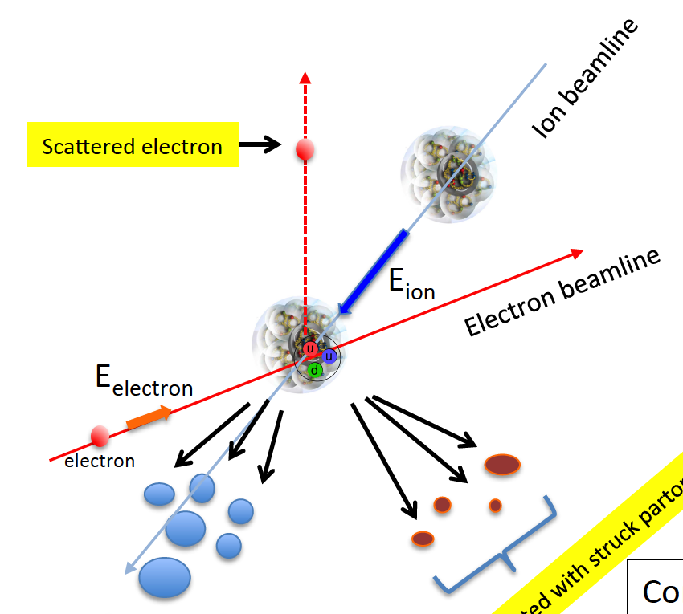
EIC Detector Challenges
Specific requirements to move
beyond the longitudinal description
Resolve partons in nucleons
  high beam energies and luminosities
  Q² up to ~1000 GeV²
Need to resolve quantities (k_{t}, b_{t}) of the order a few hundred MeV in the proton
Correlated quantitites, multi-D analyses
➔ High Granularity, wide dynamic range
Need to detect all types of remnants
to seek for correlations:
  scattered electron
  particles associated with initial ion
  particles associated with struck parton
Large acceptance, Forward particle
detection, Excellent PID
Scattered electron
Particles associated with struck parton
Partecle associated with initial ion
Contalbrigo M.
EIC Activity, 1st March 2018, Rome
3

Slide 4
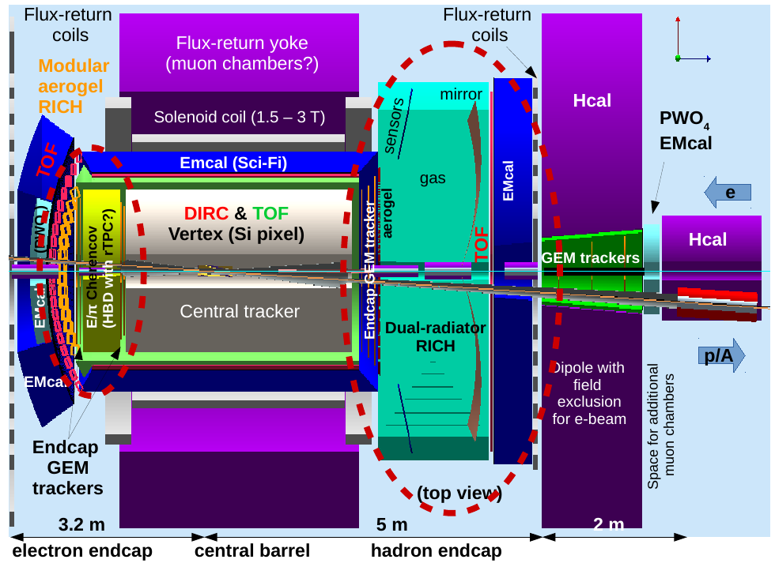
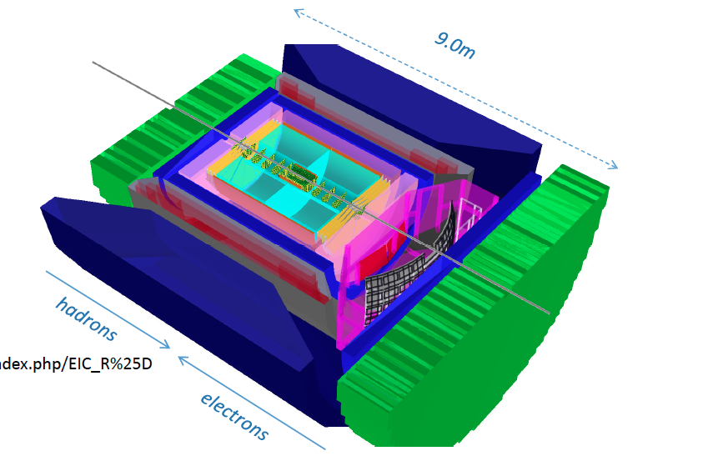
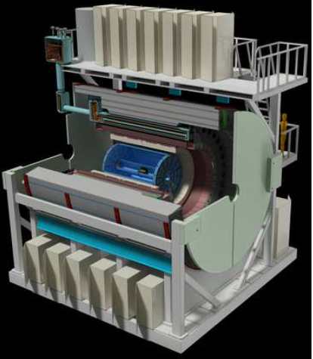
The Detector R&D Program
Still focus on generic technology advance
Not yet targeted on specific solutions
Open to foreign Institutions
Flexible support: Funds for hardware and personnel
Post-doc positions (3 years maximum) to promote career progresses
Summer meeting: review reports and call for new proposals
Last Meeting held in July 12-13, JLAB
Winter meeting: progress report
FY18 Mid-term review on January 18-19, BNL
JLEIC
eRHIC
sPHENIX
Contalbrigo M.
EIC Activity, 1st March 2018, Rome
4

Slide 5
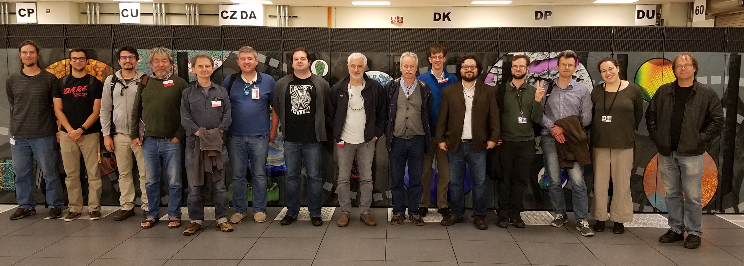
EIC Software Consortium (ESC)
ESC in front of MIRA at ANL
ANL, BNL, FNAL, INFN Trieste, JLab, SLAC, William & Mary
ESC initiative from 16 scientists from 7 institutions
Contalbrigo M.
EIC Activity, 1st March 2018, Rome
Contalbrigo M.
5
5
Notes:
Aggiungere range di validita’ per fattorizzazione GPDs

Slide 6
Global Objectives
Interfaces and integration
connect existing frameworks / toolkits
identify the key pieces for a future EIC toolkit
collaborate with other R&D consortia
Planning for the future with future compatibility
workshop to discuss new scientific computing developments and trends
incorporating new standards
validating our tools on new computing infrastructure
Organizational efforts with an emphasis on communication
build an active working group and foster collaboration
documentation about available software
maintaining a software repository
workshop organization
Current focus
  MCEG and self-descriptive MC file format (EicMC, HDF5)
  Geant4 validation
  Interoperability: unified tracking with universal geometry and detector interface
  start HPC and (D)NN initiatives
Contalbrigo M.
EIC Activity, 1st March 2018, Rome
Contalbrigo M.
6
6
Notes:
Aggiungere range di validita’ per fattorizzazione GPDs

Slide 7
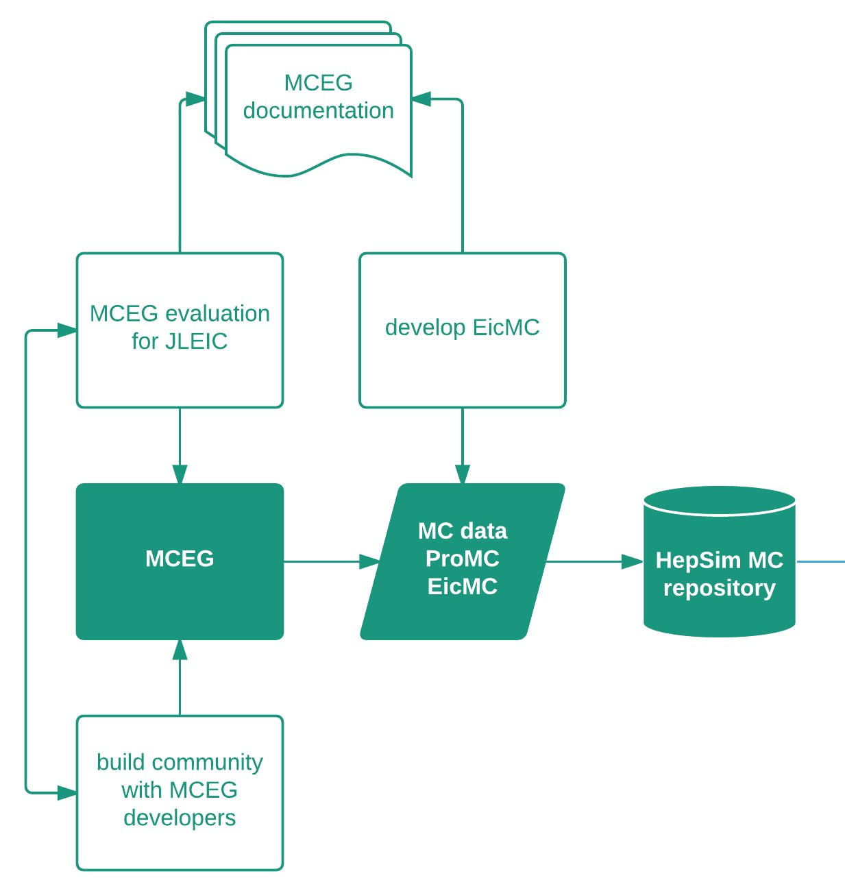
User Requirements & Strategy
EIC MCEG initiative
strong interplay experiment–theory
connect MCEG efforts NP-HEP
Modern, flexible and comprehensive
Use case 1 Physics studies
Requirements
interface to MCEG
open access to accelerator specifications
open access to detector information and simulation
documentation
ESC MC format
self-descriptive
data format
HPC compatible
Use case 2 Detector studies
Requirements
open access to physics simulations or interface to MCEG
open access to accelerator specifications
open access to detector information and simulation
documentation
eRHIC – JLEIC
interplay and comparison
INFN Trieste contributing to
radiative correction library
with H. Spiesberger (HERA)
Contalbrigo M.
EIC Activity, 1st March 2018, Rome
Contalbrigo M.
7
7
Notes:
Aggiungere range di validita’ per fattorizzazione GPDs

Slide 8
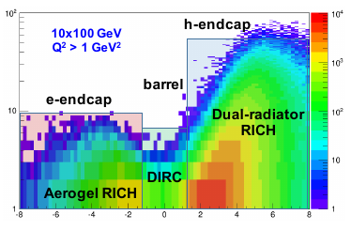
Particle Identification @ EIC
Asymmetric detector
Compact solutions to contain the cost
new high-tech materials
new technologies with emerging markets
in medical imaging and homeland security
e-endcap:
medium momentum (< 10 GeV/c)
aerogel modular Cherenkov
h-endcap:
medium and high momentum (3-50 GeV/c)
gaseous and dual radiator Cherenkov
Contalbrigo M.
EIC Activity, 1st March 2018, Rome
8

Slide 9
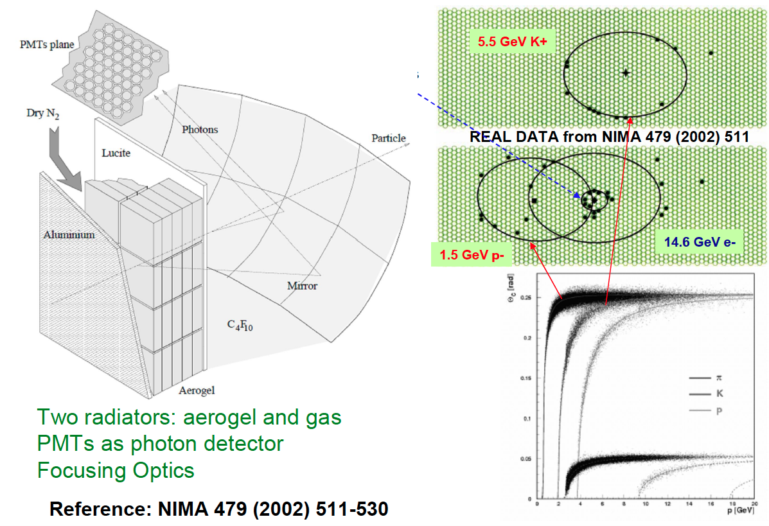
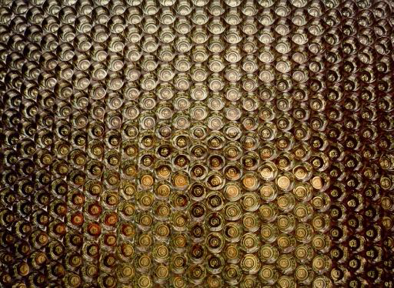
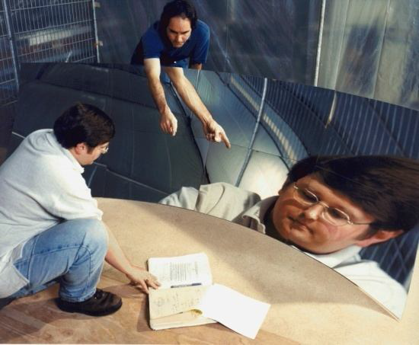
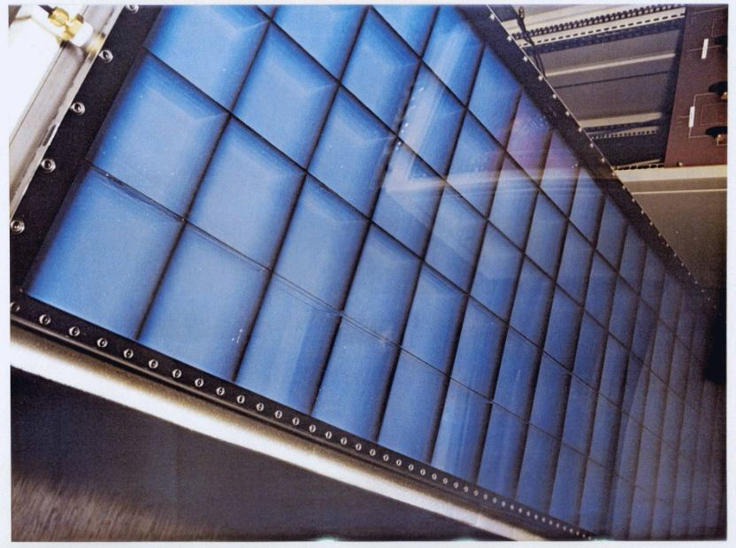
INFN Roma
Construction, operation
of the dual radiator
HERMES RICH
Reused in Hall-A at JLab
Contalbrigo M.
EIC Activity, 1st March 2018, Rome
9
Notes:
Va detto che ora sta al Jlab….

Slide 10
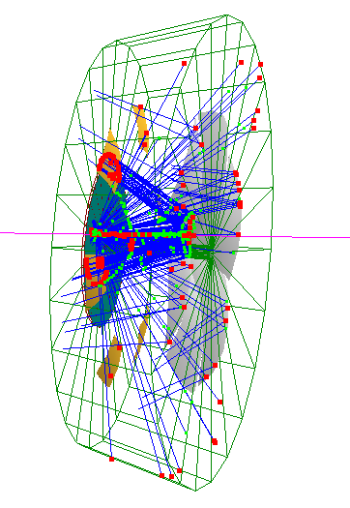
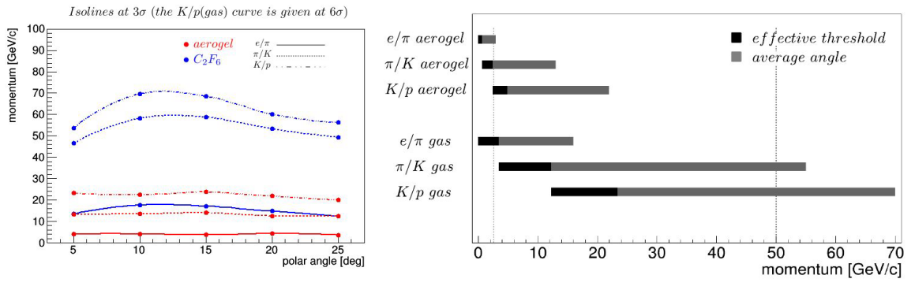
INFN Roma R&D for experiments @ EIC
Dual-Radiator RICH within eRD14 - PID
GOAL: Discriminate Hadrons in 3 to 50 GeV/c
  need to operate in magnetic field
Proposed configuration fitting the spectrometer constraints (evaluated by detailed GEANT4 simulations)
  -- dual radiator RICH: aerogel and C_{x}F_{y} gas -- focusing mirror
  -- 6 open sectors -- curved detector surface
≥3σ π/k separation
∼ 2 ÷ 50 GeV/c
Work in progress (as in FY18 eRD14 submitted proposal)
  dRICH PID performances in exteded physics context of EIC
  Adapt dRICH devel. framework to BNL (ePhenix) concept detectors
Contalbrigo M.
EIC Activity, 1st March 2018, Rome
10
Notes:
Dire che Alessio deve arrivare a definire il prototipo, vedere ultimi aggiornamenti

Slide 11
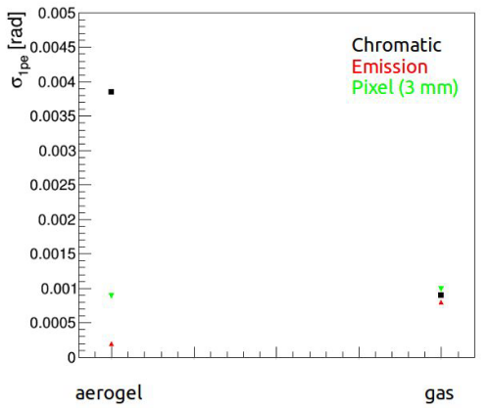
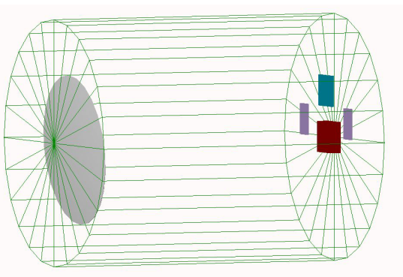
Past Funding, Future Activities
Feasibility study funded by DOE in 2015-2018: 3 year Post-DOC
Potential ≥2019 activities (synergies with mRICH, CLAS12 and ePhenix), part of funding may come from EIC/USA.
  Prototyping (draft system simulated – see below)
    Investigate aerogel performances and aging (which are fundamental!)
    SiPM feasibility
    Operation in magnetic field of the gas
    Non planar focal plane optimization
  Evaluate performances of a «dRICH like detector» as ePhenix RICH
  Develop rubust and global (event based) PID reconstruction algorithm(s)
Proposed small scale «essential» prototype
1 p.e. resolution for 30 GeV/c electrons in prototype
Contalbrigo M.
EIC Activity, 1st March 2018, Rome
11
Notes:
Dire che Alessio deve arrivare a definire il prototipo, vedere ultimi aggiornamenti

Slide 12
INFN Trieste
  Expertise in high momentum RICHes and MPGDs
  design, project coordination, construction, operation of COMPASS RICH-1
  most recently the construction of
  novel photon detectors by MPGD technologies
  for an upgrade of the RICH:
Thick GEM Multiplication
MicroMegas Detection
Contalbrigo M.
EIC Activity, 1st March 2018, Rome
Contalbrigo M.
12
12
Notes:
MPGD micropattern gaseous detector:w

Slide 13
INFN Trieste R&D for Experiments @ EIC
GEM detectors within eRD6 – Tracking and PID
Goal hadron discrimination in the range 6 < p < 60 GeV/c
Hadron endcap:
  Radiator: gas is mandatory
  Collider implementation: short (~ 1 m) radiator length
  In literature, so far, only two attempts, both requiring deeper exploration
    High pressure, studied for ALICE upgrade VHMPID
    Towards the very far UV with window-less approach (prototype tested at Fermilab)
    In both approaches gaseous photon detectors are mandatory:
    further development of up-to-date gaseous photon detector
    A strategic sector for experimental set-ups at EIC matching our expertise and with open issues
Contalbrigo M.
EIC Activity, 1st March 2018, Rome
Contalbrigo M.
13
13
Notes:
Aggiungere range di validita’ per fattorizzazione GPDs

Slide 14

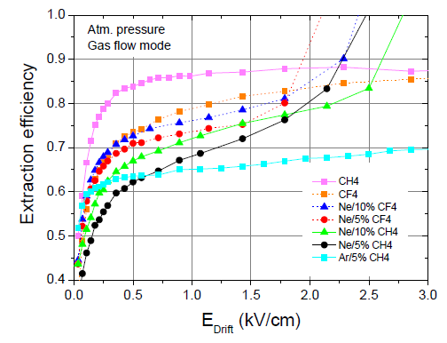
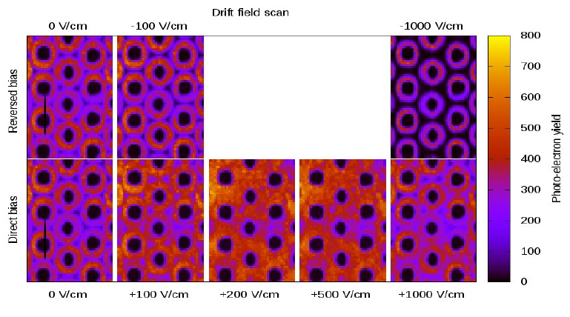
A Summary of the R&D Program
resistive MM
with small
pad size
O(10 mm²)
Further reduction of the Ion
BackFlow (IBF) rate:
presently ~ 5%
HV is applied here through a resistor (mesh @ ground)
For RICH, also
SYNERGIC
with TPC
0.15 mm
fiberglass
Signal read-out from this pad
ALREADY
ON GOING
next slide
Issues related to hybrid MPGD-based PDs operated in C-F atmosphere:
photoelectron extraction
Detector gain
ageing
PCB
GEM vs THGEM as photocathodes
Photoelectron
extraction
studies
RICH specific
C. D. R. Azevedo et al., 2010 JINST 5 P01002
Contalbrigo M.
EIC Activity, 1st March 2018, Rome
Contalbrigo M.
14
14
Notes:
Aggiungere range di validita’ per fattorizzazione GPDs

Slide 15
Prototype: Small PAD-Size Micromegas
The development of the resistive MICROMEGAS prototype with miniaturized pad-size
Design & construction completed
Pad size: 3 x 3 mm², pitch 3.5 mm
Modularity for extendibility: for each group of 128 pads, read-out and services make use of an area as large as the pad group itself
Read-out via SRS by the original DAQ system Raven
  LabView based, developed for larger band width (up to the saturation rate of the Gigabit Ethernet when the UPD protocol with Jumbo Frame format)
  it takes care of APV25 setting (FE chips), data collection and visualization, including pedestal subtraction and zero suppression
  user friendly graphical interface
Preliminary test of the prototype
(MICROMEGAS stable up to large gain!)
Contalbrigo M.
EIC Activity, 1st March 2018, Rome
Contalbrigo M.
15
15
Notes:
Aggiungere range di validita’ per fattorizzazione GPDs

Slide 16
A Very Recent New Option for the R&D
CsI, the only standard photoconverter compatible with gaseous atmospheres, has problematic issues, main ones:
It does not tolerate exposure to air (water vapour, oxygen)
Ageing by ion bombardment
47 % (!)
From Antonio Valentini – Sezione INFN di Bari (2016)
Italian patent application n. 102015000053374
Photocatodes: hydrogenized diamon film obtained with Spray Technique making use of NC powder
  Spray technique: T ~ 120° (instead of ~800° as in standard techniques)
Coupling of ND photoconverter and MPGDs?
an exiting perspective with several open questions
Radiation hardness ?
Ageing ?
Compatibility and performance with gas atmospheres ?
L.Velardi, A.Valentini, G.Cicala al.,
Diamond & Related Materials 76 (2017) 1
PRELIMINARY EVALUATION
OF A POSSIBLE R&D,
starting in these weeks:
first THGEMs with ND film produced
Contalbrigo M.
EIC Activity, 1st March 2018, Rome
Contalbrigo M.
16
16
Notes:
NC nano crystallized

Slide 17
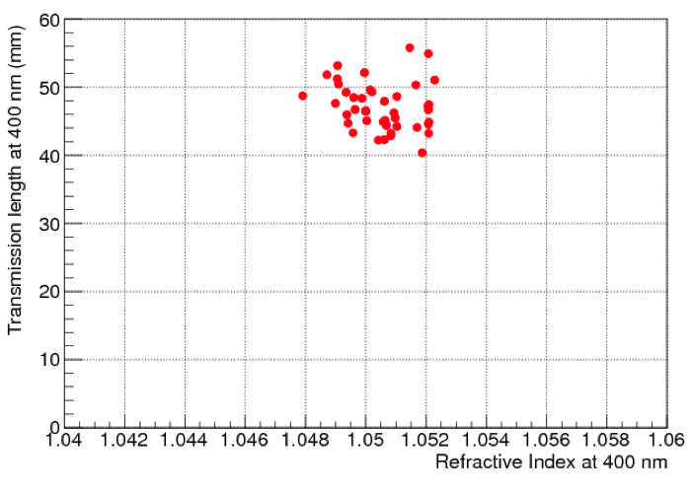
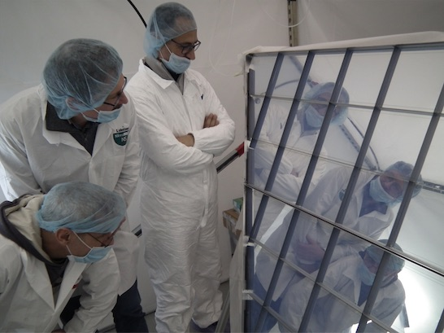
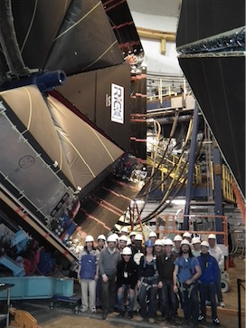
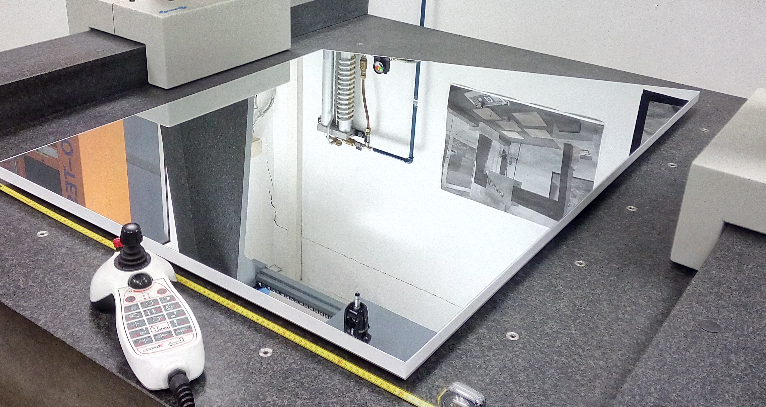
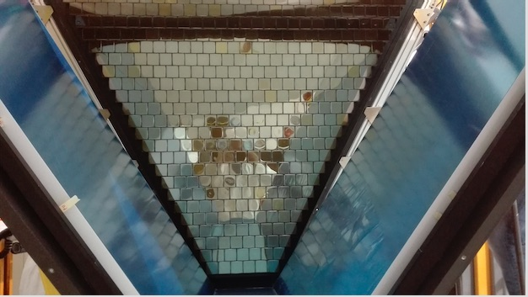
INFN Ferrara
  Design, project coordination, construction, operation of the large-area hybrid-optic design CLAS12 RICH
High-transmittance Aerogel
Unprecedented optical quality
CLAS12 (n=1.05)
<L_{sc}> ~ 50 mm
Glass-skin planar mirrors
Derived from terrestrial telescopes
~ 1 % X₀ (comparable to carbon fiber)
1st with Large-area MAPMTs
SPE detection even with
not-optimized devices
Contalbrigo M.
EIC Activity, 1st March 2018, Rome
17
Notes:
Vanno messi studi innovativi e pubblicazioni

Slide 18
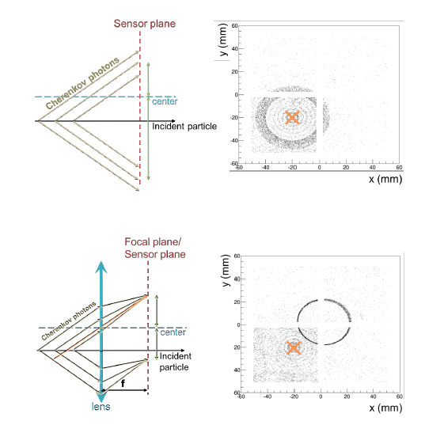
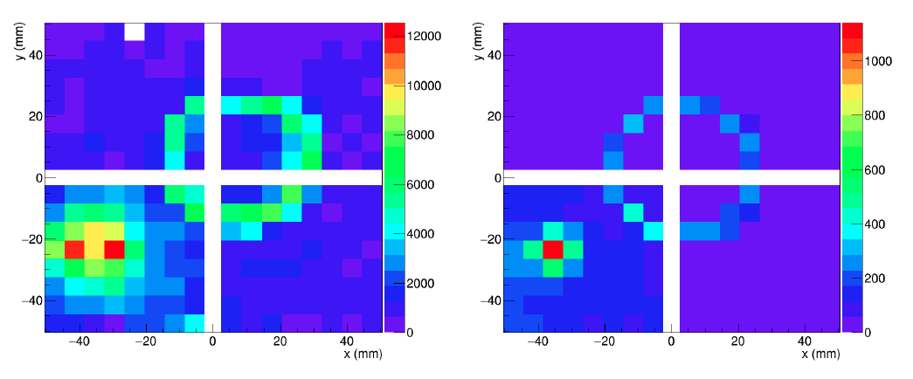
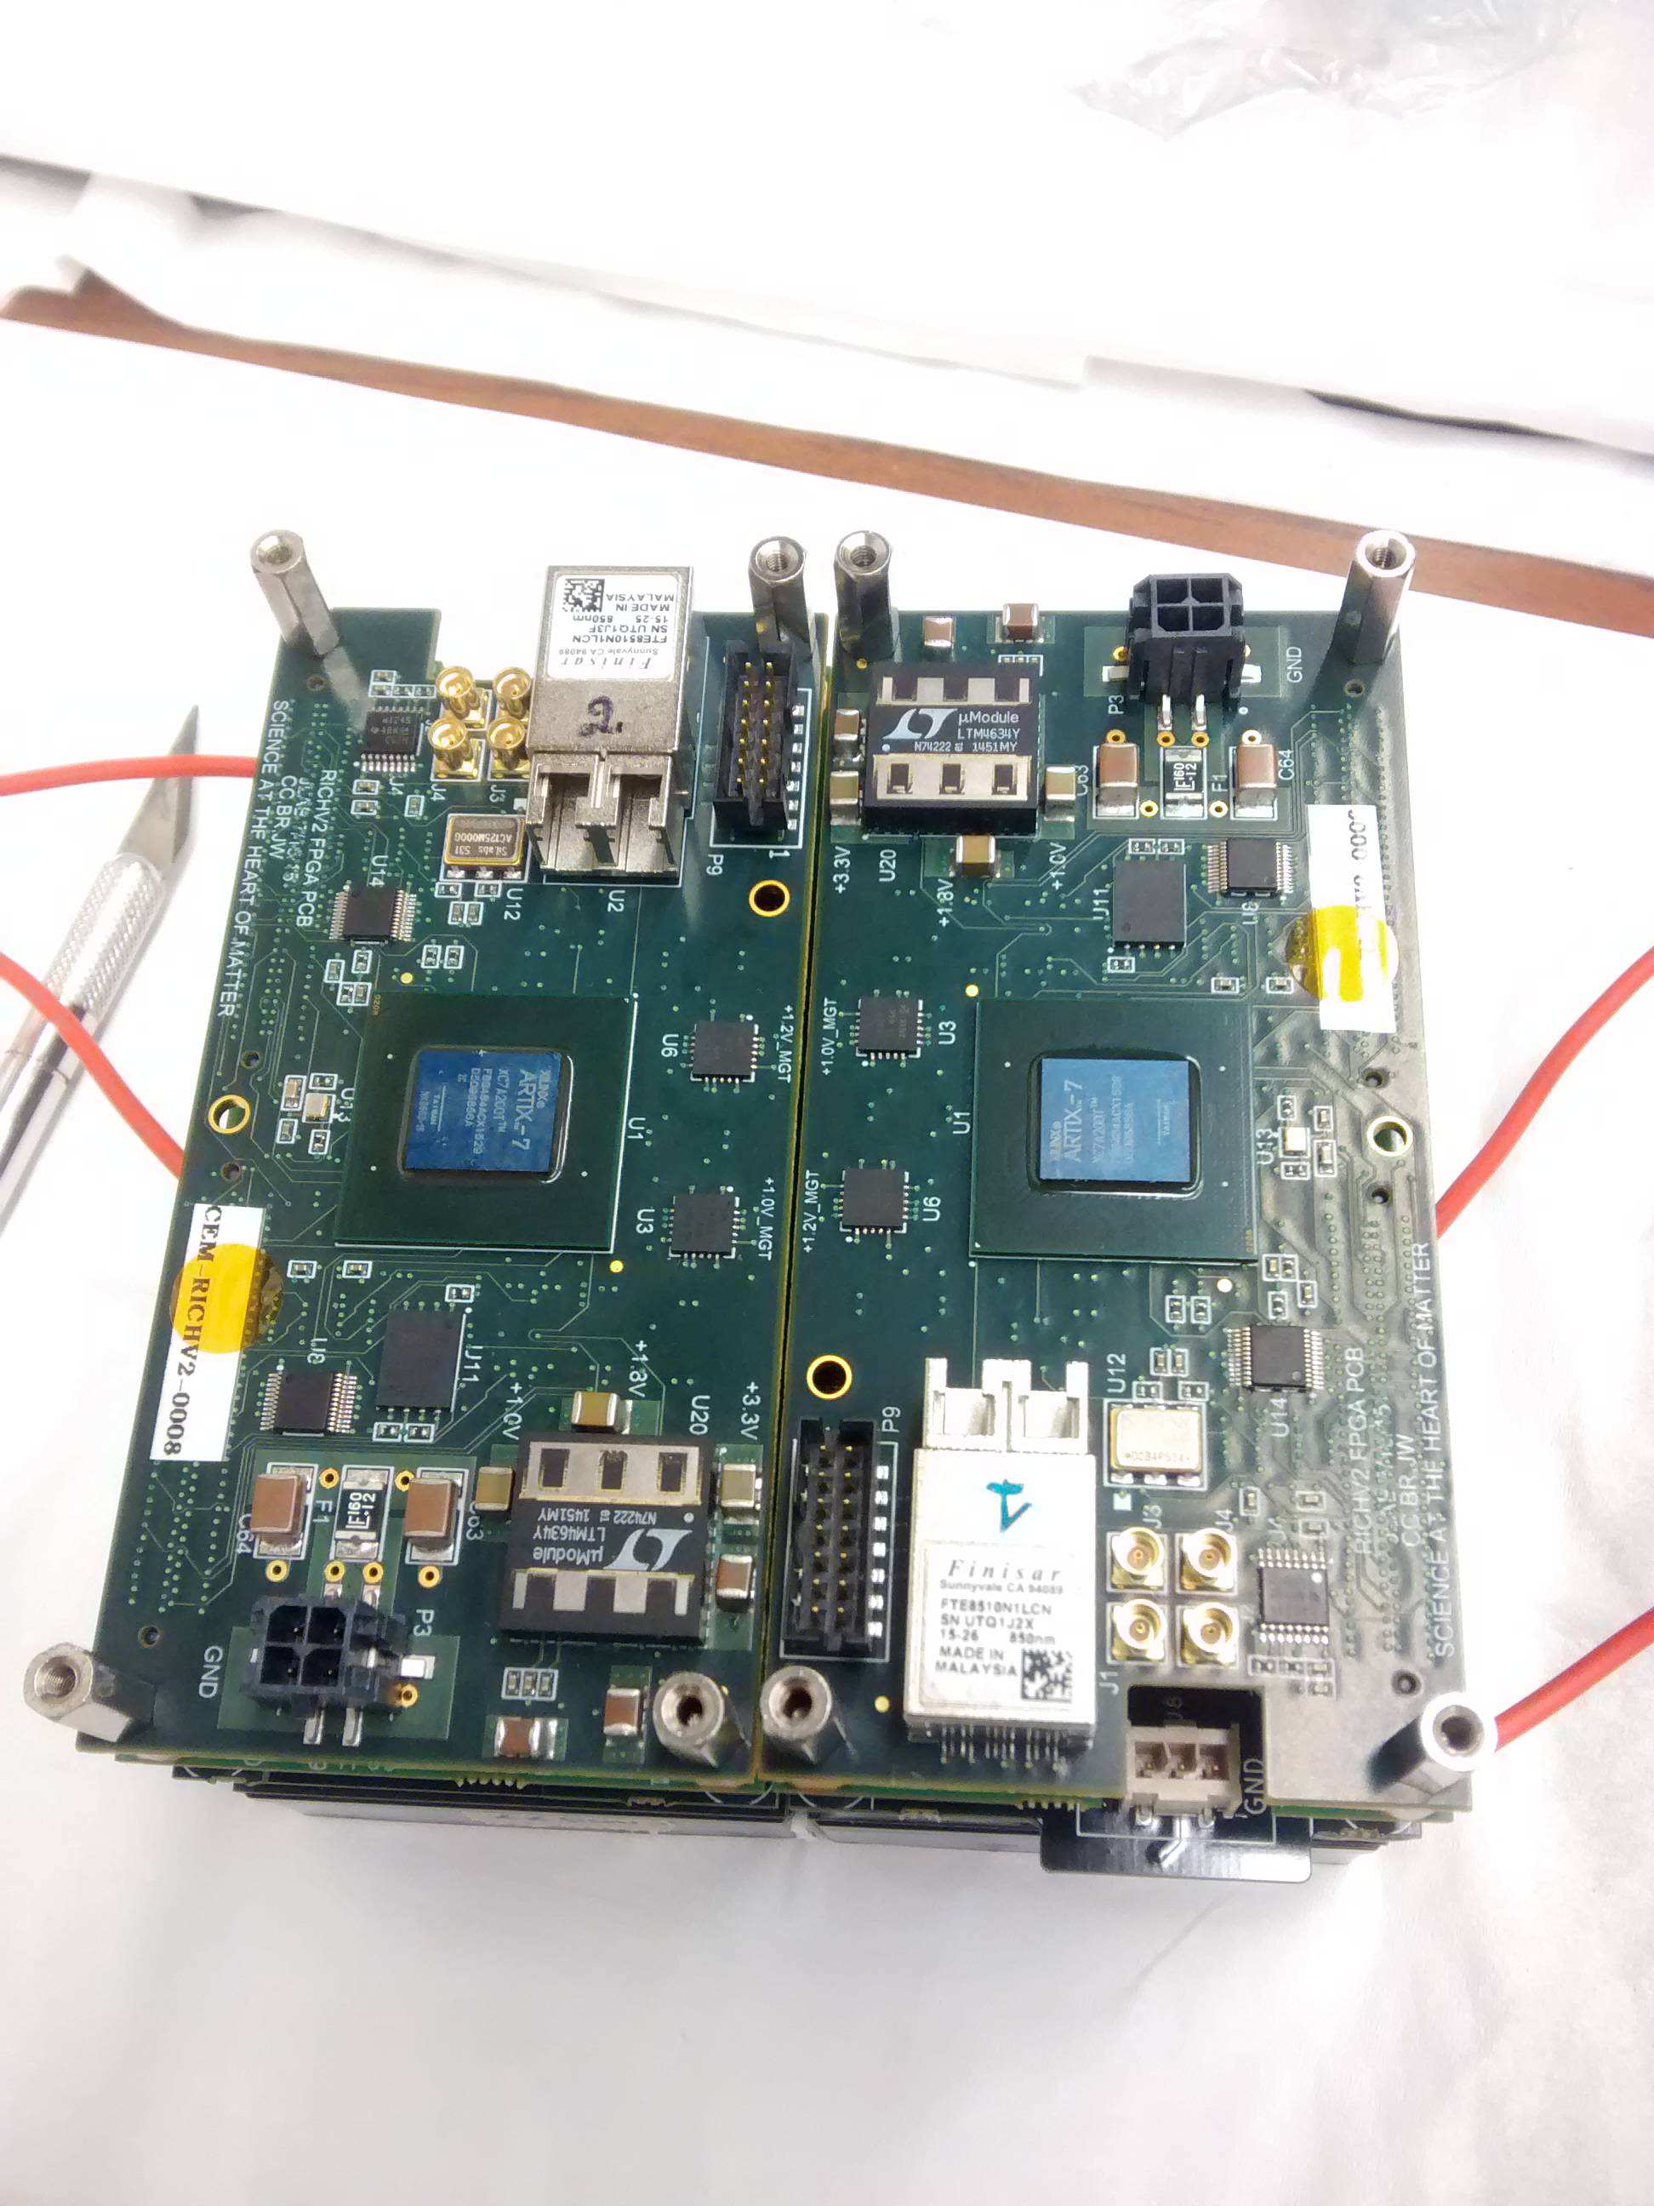
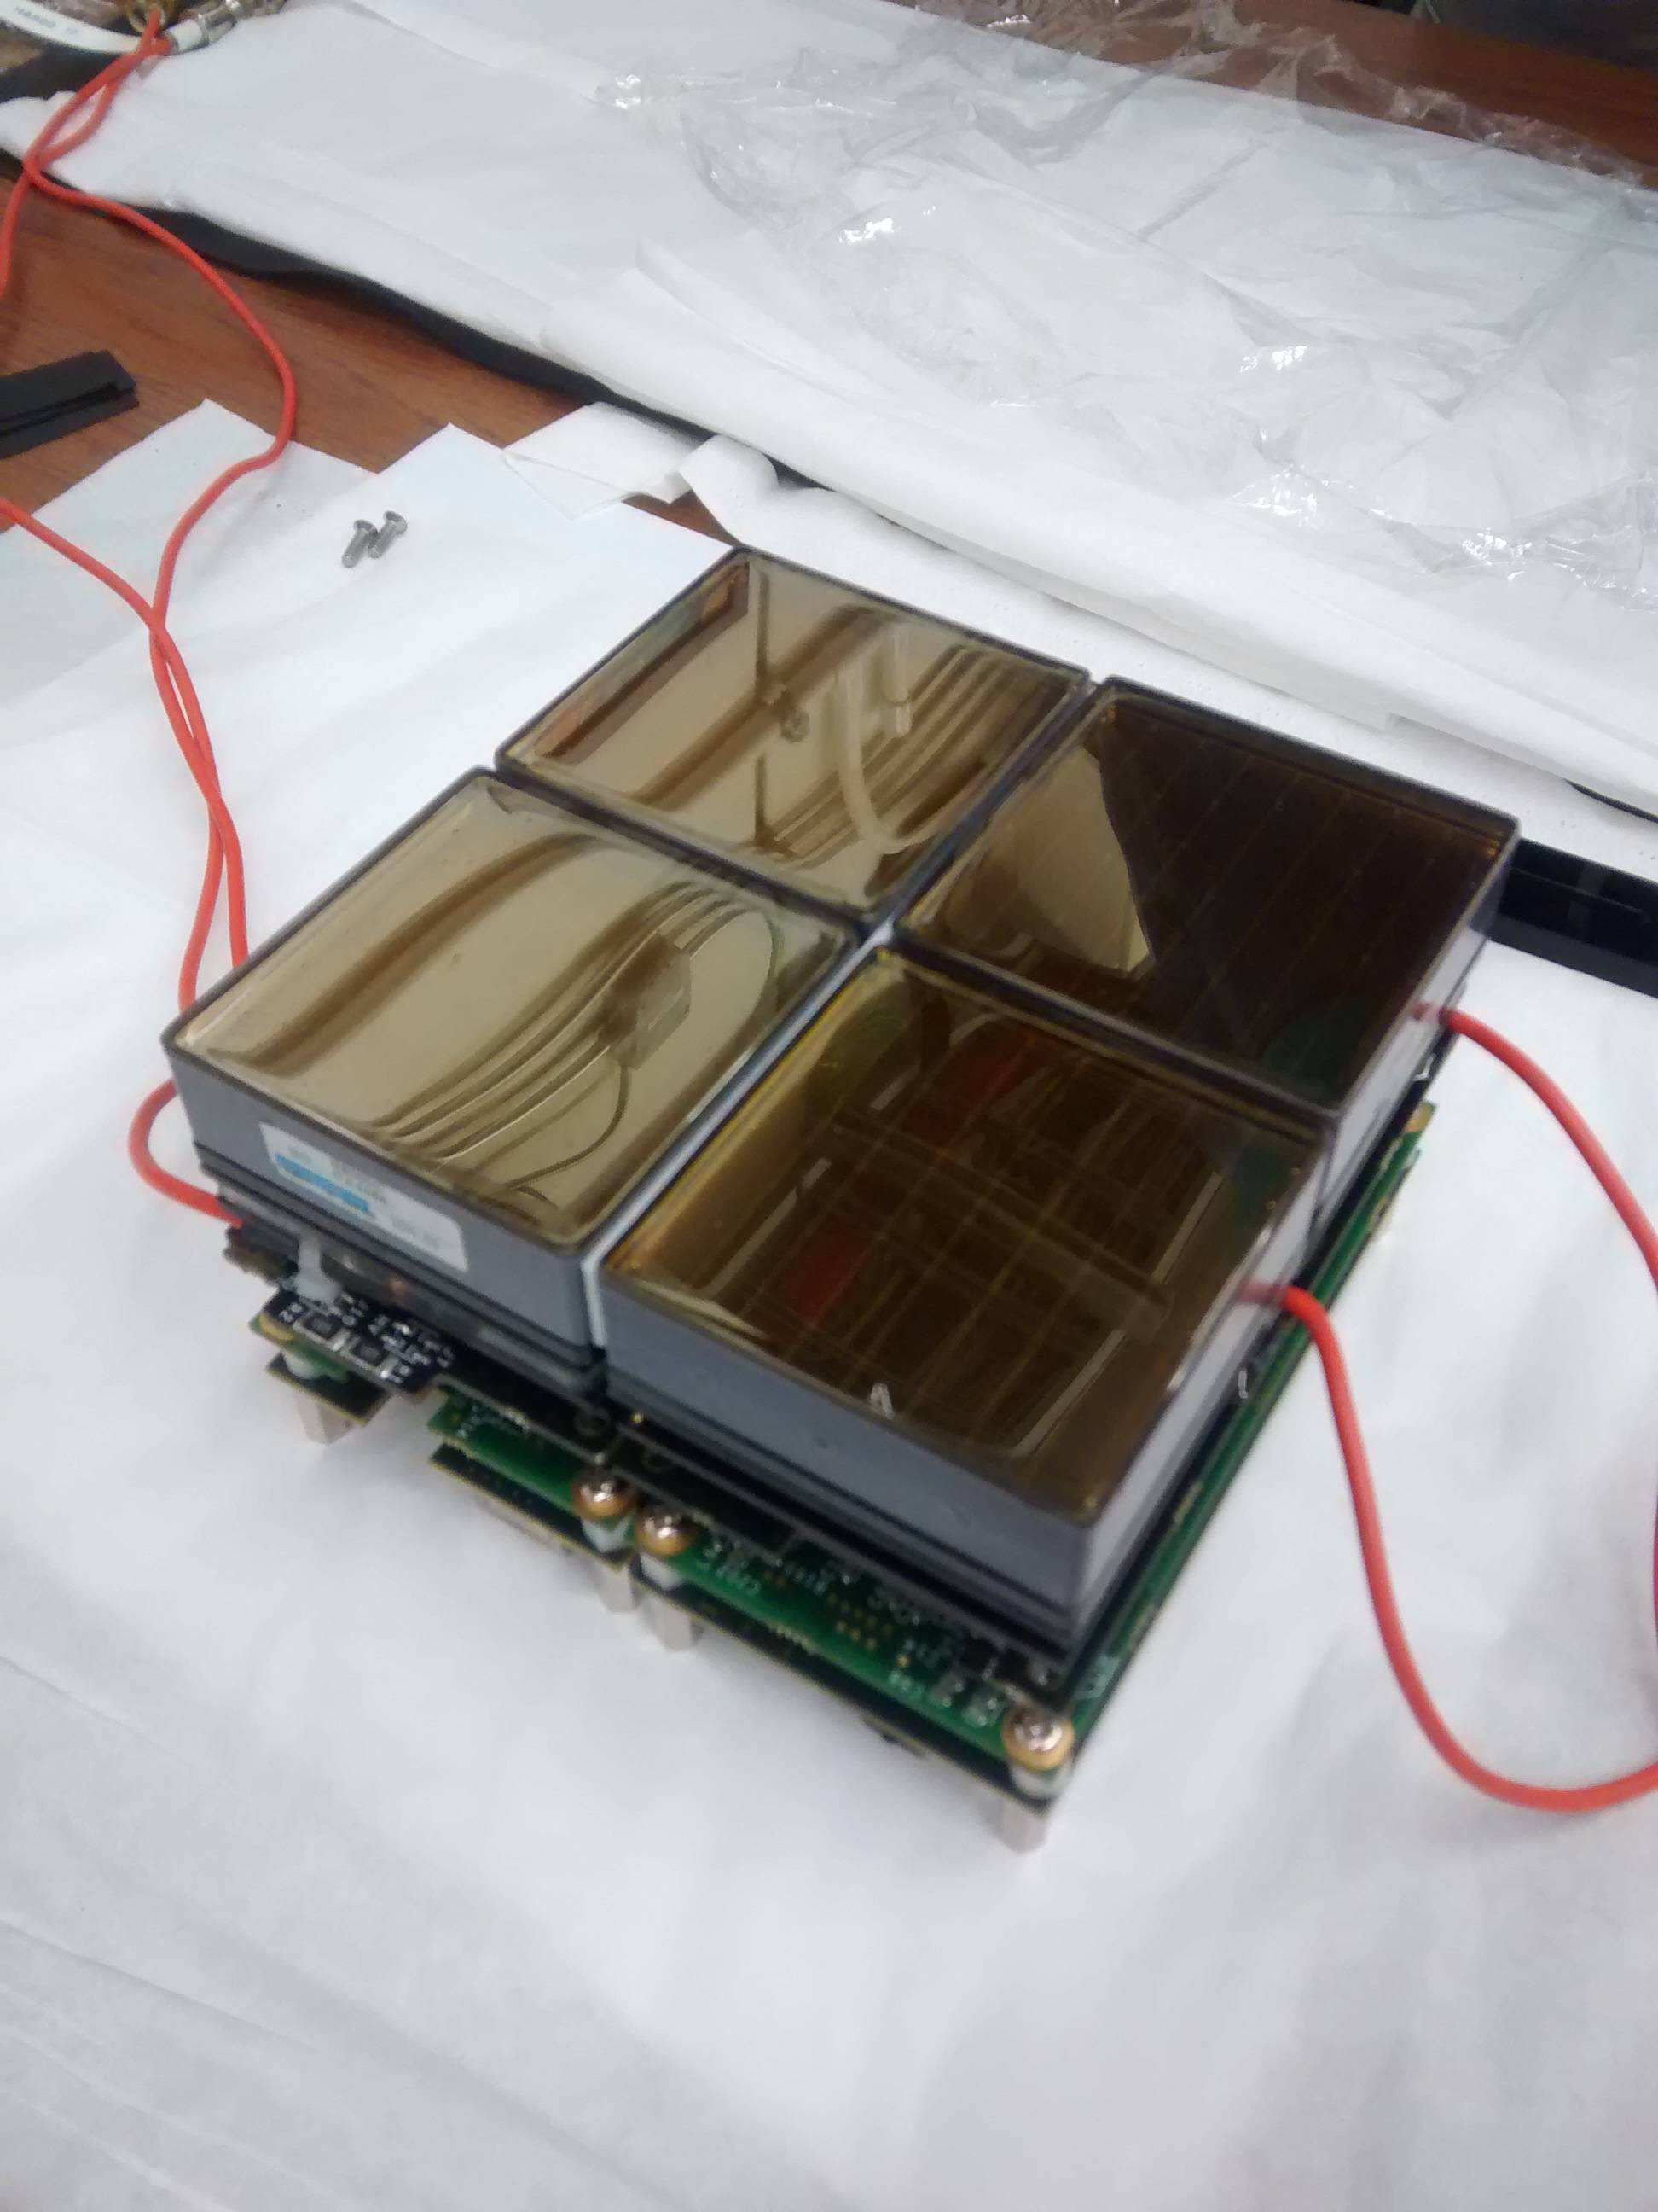
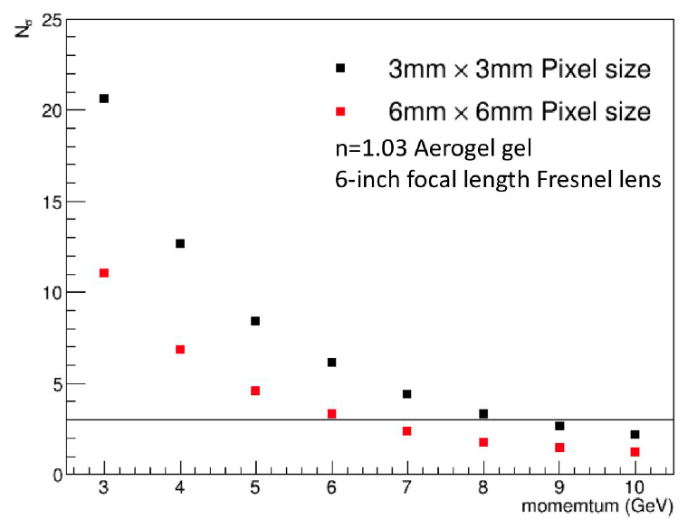
INFN Ferrara R&D for Experiments @ EIC
Modular RICH within eRD14 - PID
Test beam of small EIC mRICH prototype
Fermilab – April 2016
GOAL: Discriminate Hadrons in 3 to 10 GeV/c
DATA
MC
Impinging
particles
Fresnel lens focalization for a compact device
Cherenkov detector expertise from CLAS12
for aerogel radiator and readout electronics
Contalbrigo M.
EIC Activity, 1st March 2018, Rome
18

Slide 19
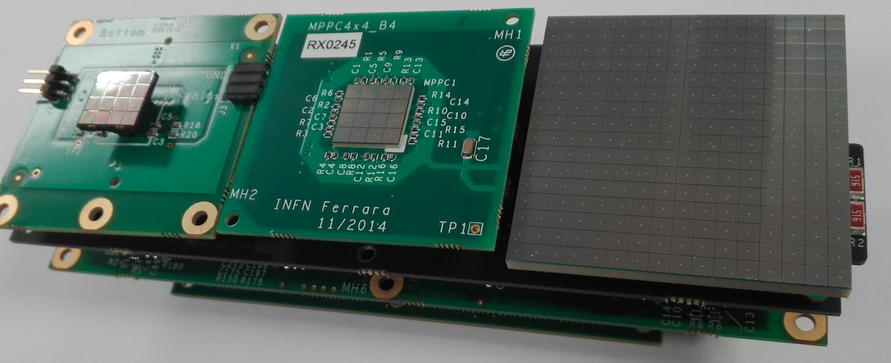
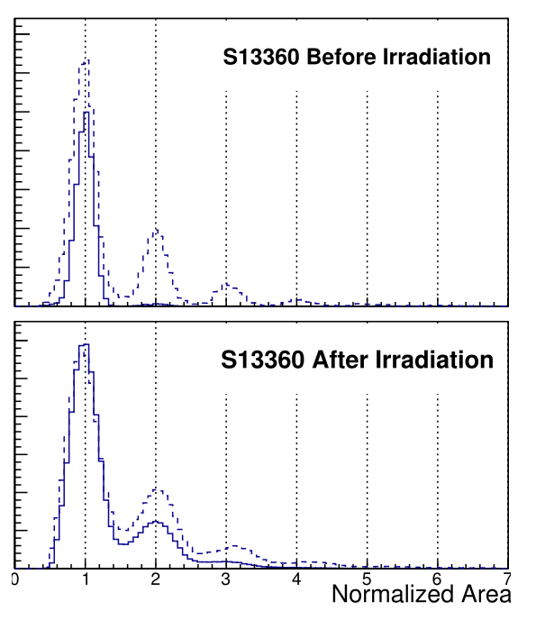
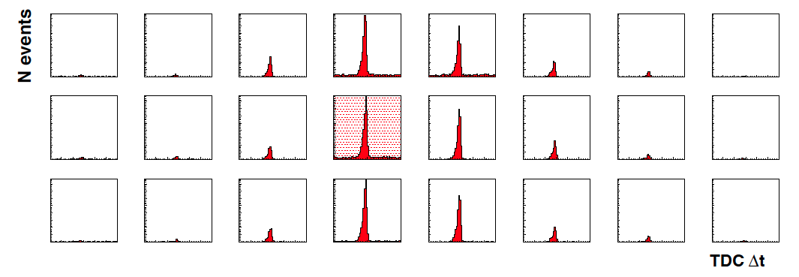
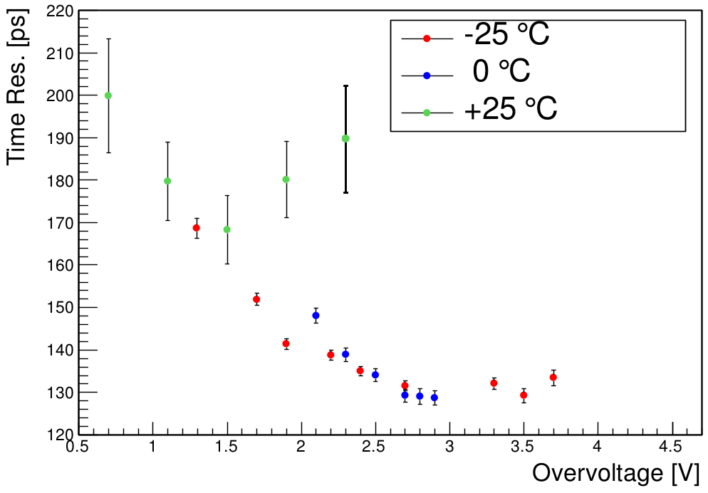
Next Steps
Readout electronics for 3 mm pixel
DAQ electronics
New sensors (SiPM, LAPP)
SiPM SPE capability after irradiation ?
Several CLAS12 years
Contalbrigo M.
EIC Activity, 1st March 2018, Rome
19

Slide 20
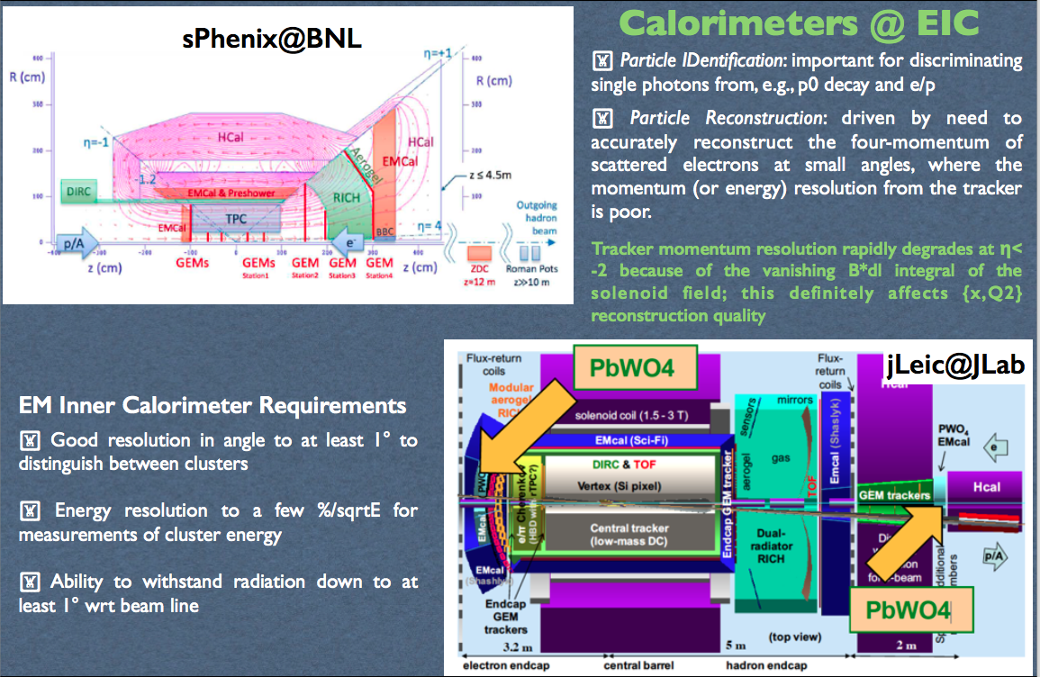
Calorimeters @ EIC
Contalbrigo M.
EIC Activity, 1st March 2018, Rome
20
Notes:
Tungstato di piombo

Slide 21
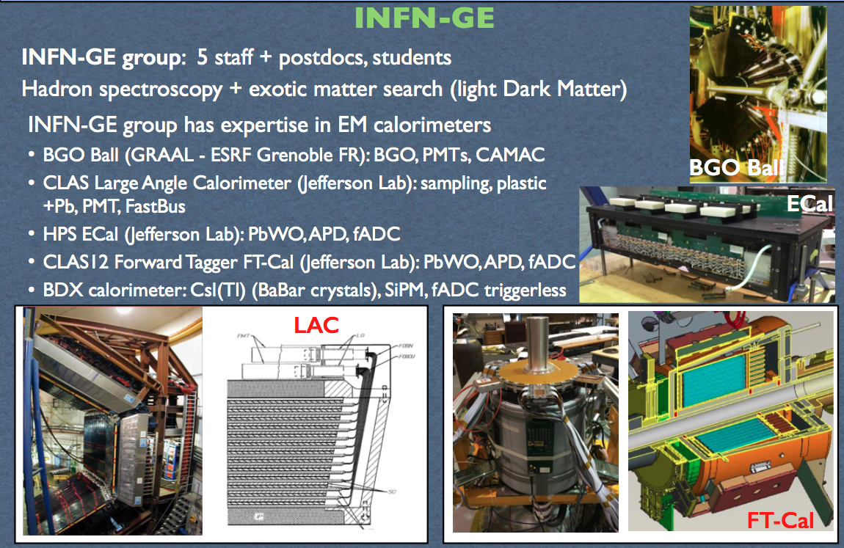
INFN Genova
Contalbrigo M.
EIC Activity, 1st March 2018, Rome
21

Slide 22
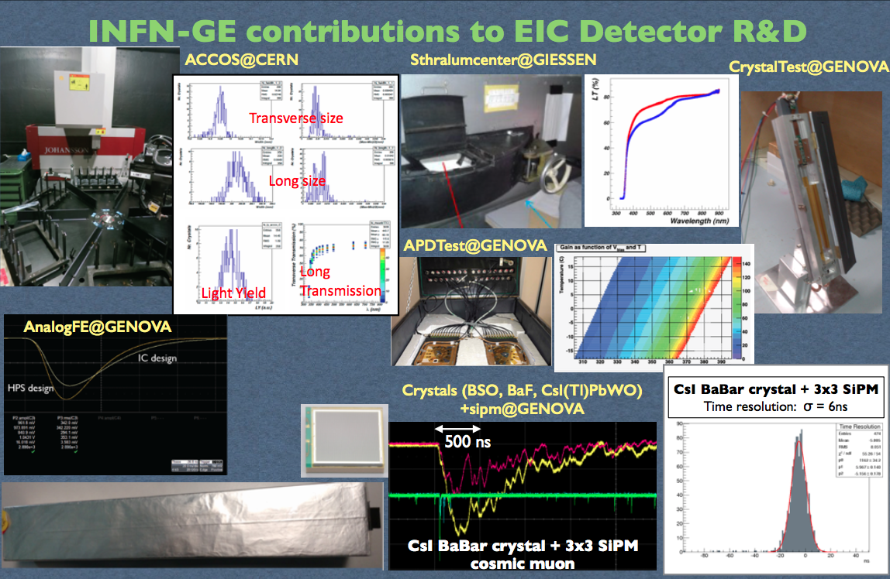
INFN Genova R&D for Experiments @ EIC
Contalbrigo M.
EIC Activity, 1st March 2018, Rome
22

Slide 23
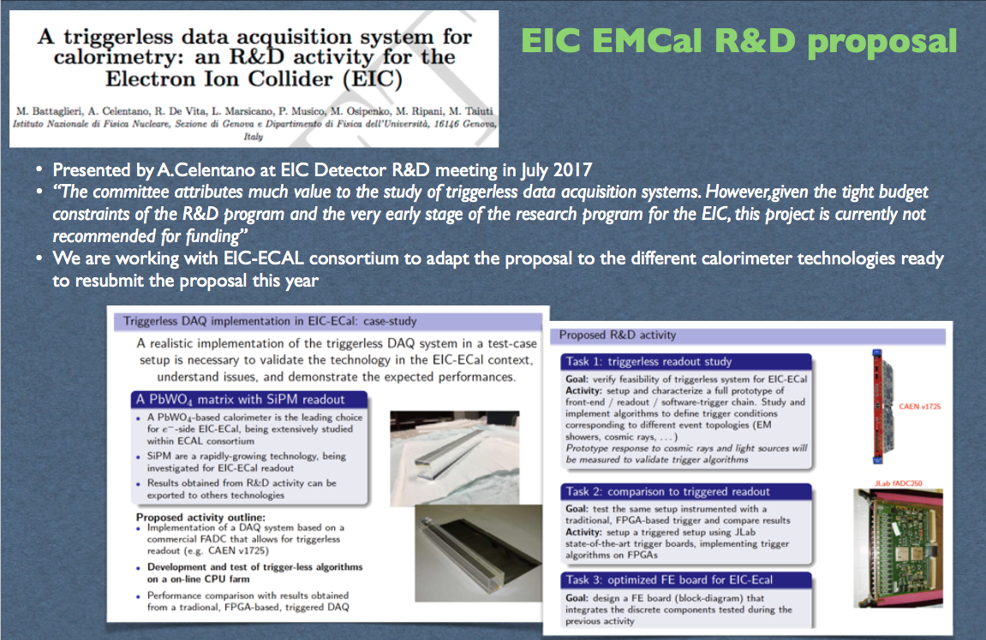
Triggerless DAQ
Contalbrigo M.
EIC Activity, 1st March 2018, Rome
23

Slide 24
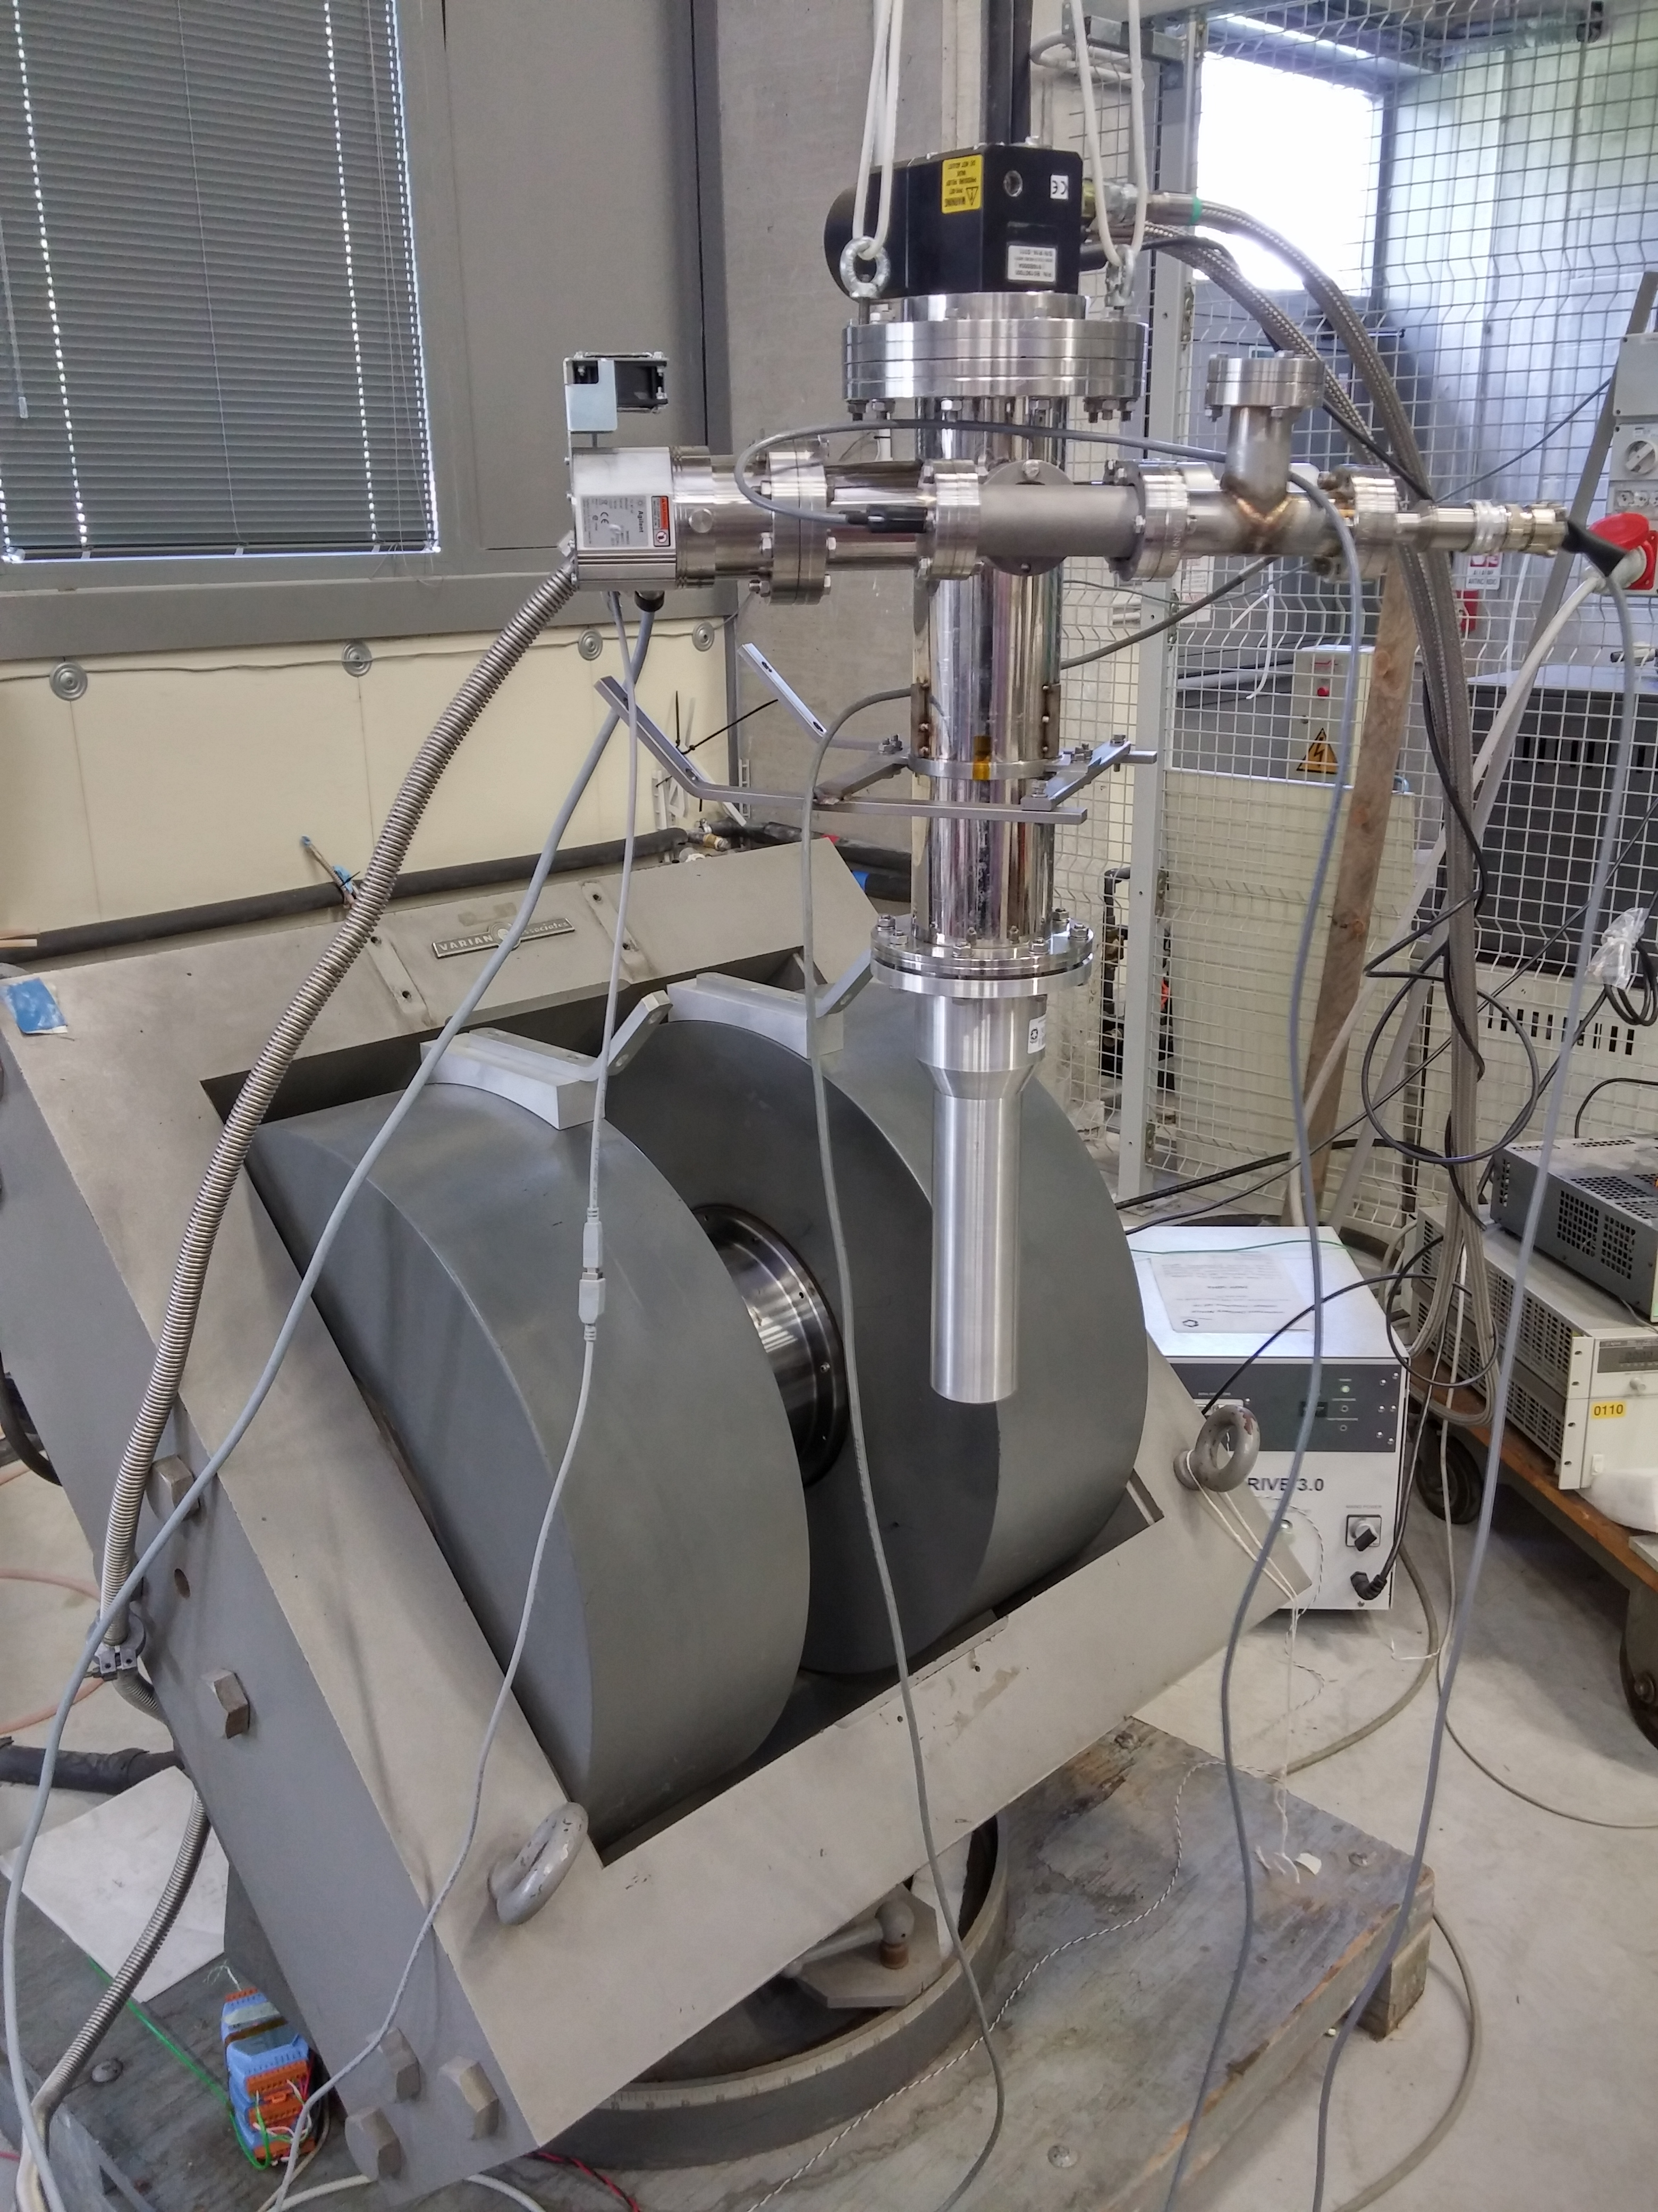
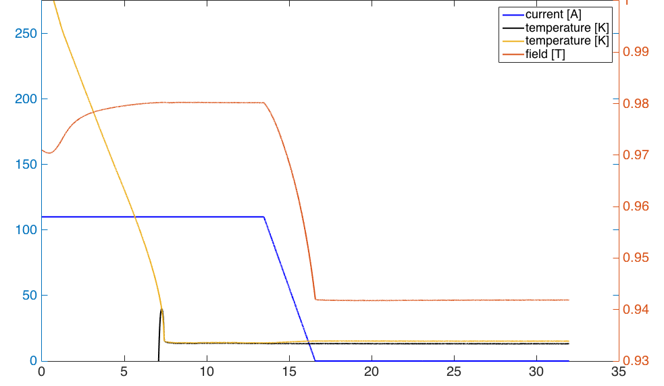
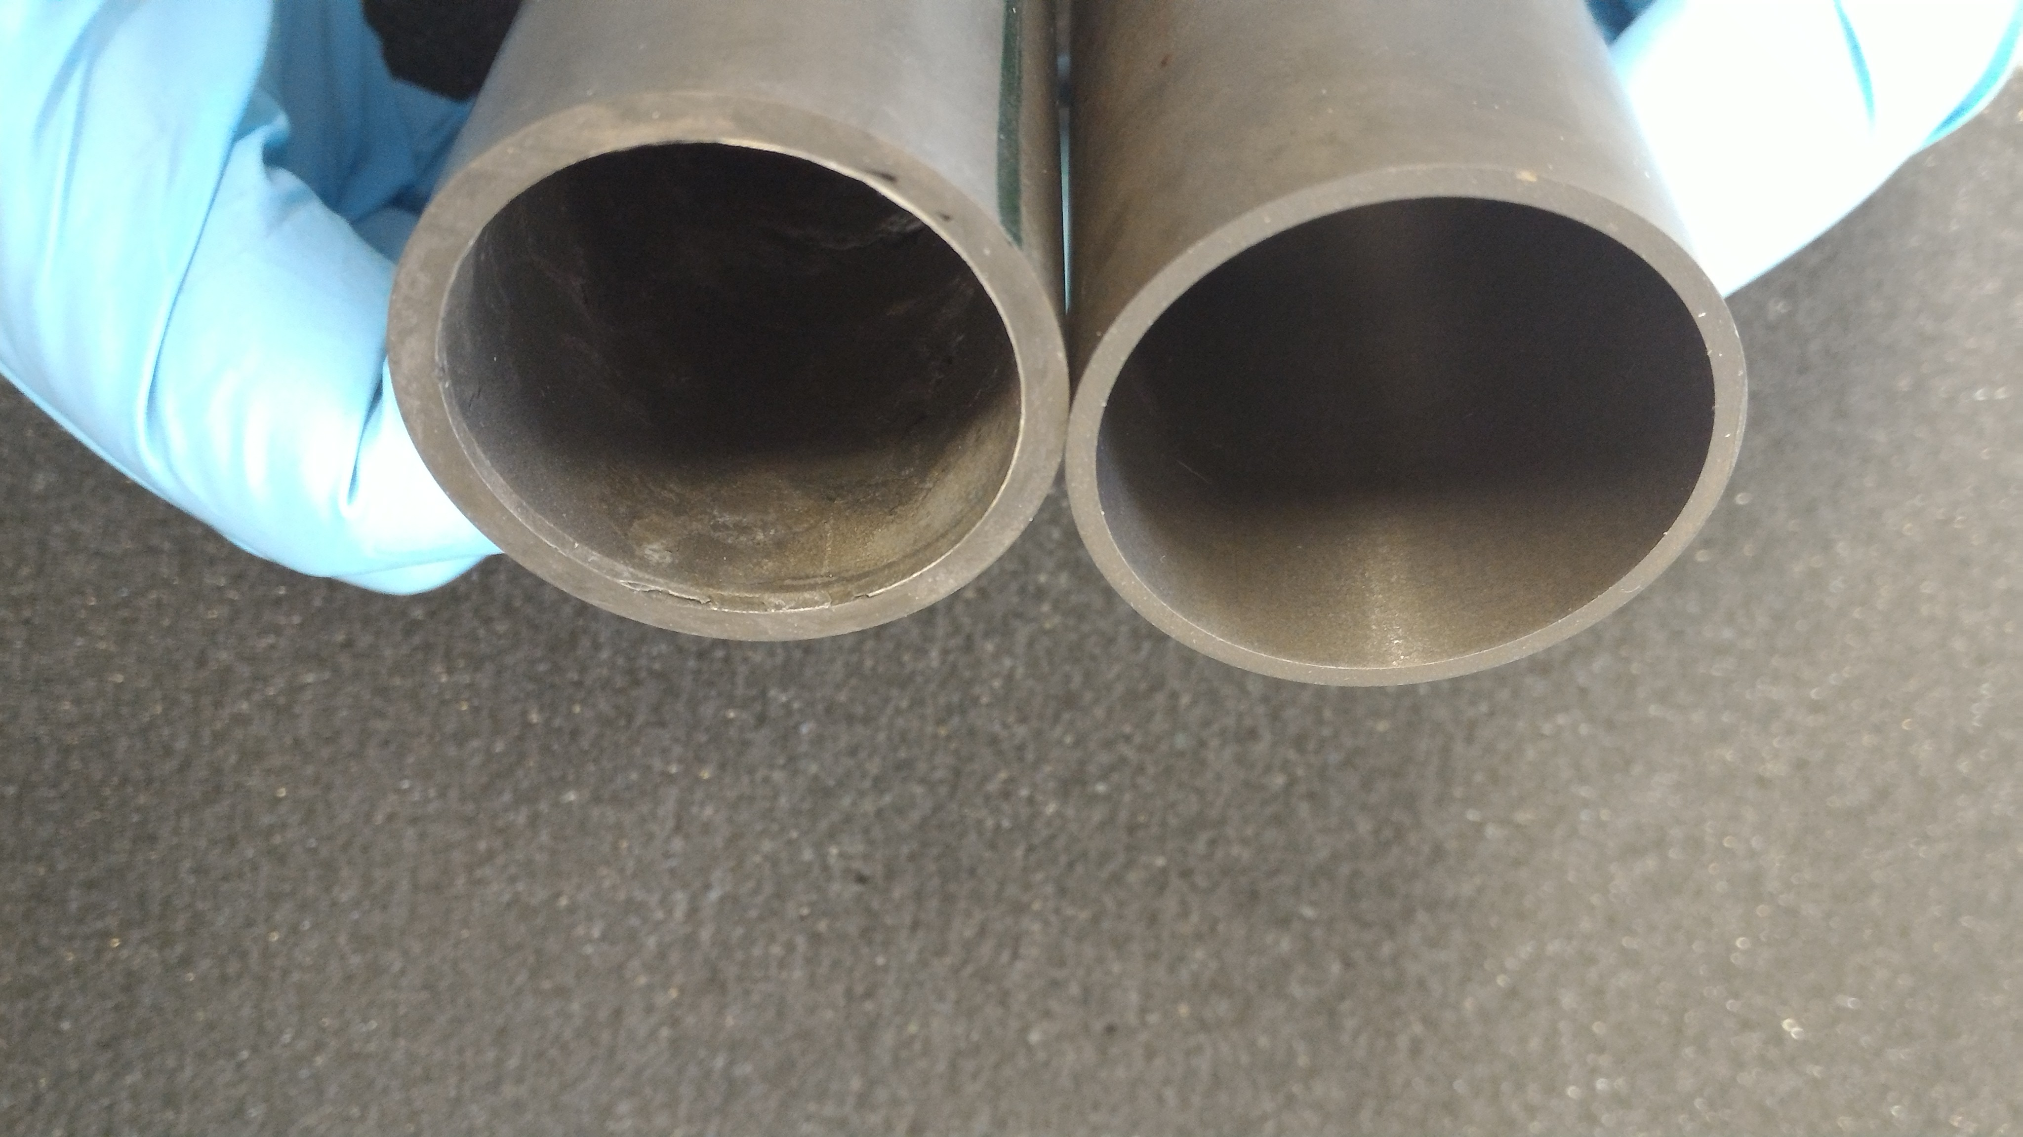
Of Potential Interest
Torino: large area trackers and FE electronics
(derived from COMPASS)
Roma Tor Vergata: calorimetry in collaboration with Genova
Bologna: Monte Carlo and TOF for PID
Bari: vertex detector and PID
Ferrara: bulk superconducting magnets and screens
(complementary to eRD2 – Magnetic Field Cloaking Device)
[K]
[A]
T
hours
Contalbrigo M.
EIC Activity, 1st March 2018, Rome
24
Notes:
TOF MRPC multi gap resisteive chambers
HMPID multiiwire + CsI

Slide 25
Financial Support
So-far growing external DOE fund support valuable for
* Promoting INFN expertise for future facilities
* Pursuing advances synergic with the ongoing activities (JLab, ALICE,…)
 | Roma | Trieste | Ferrara | …
FY2015 DOE | 16 k$ (post-doc)⁺
FY2016 DOE | 48 k$ (post-doc) ⁺
FY2017 INFN** |  | 17 keuro
DOE | 48 k$ (post-doc) ⁺ | 80 k$*
FY2018 INFN** |  | 12 keuro (10 s.j.)
DOE | 32 k$ (post-doc) ⁺ | 44 k$* (post doc) | 27 k$ (post-doc)⁺
FY2019 INFN** | … | … | … | …
DOE | … | … | … | …
* No overhead INFN
** RD_FA CSNI ⁺ via USA Institutions
Contalbrigo M.
EIC Activity, 1st March 2018, Rome
Contalbrigo M.
25
25
Notes:
Aggiungere range di validita’ per fattorizzazione GPDs

