Slide 1
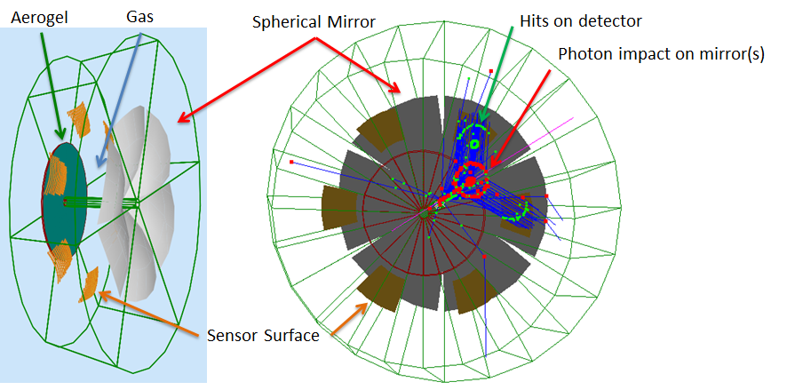
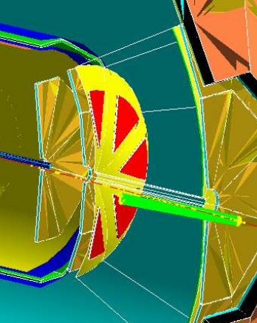
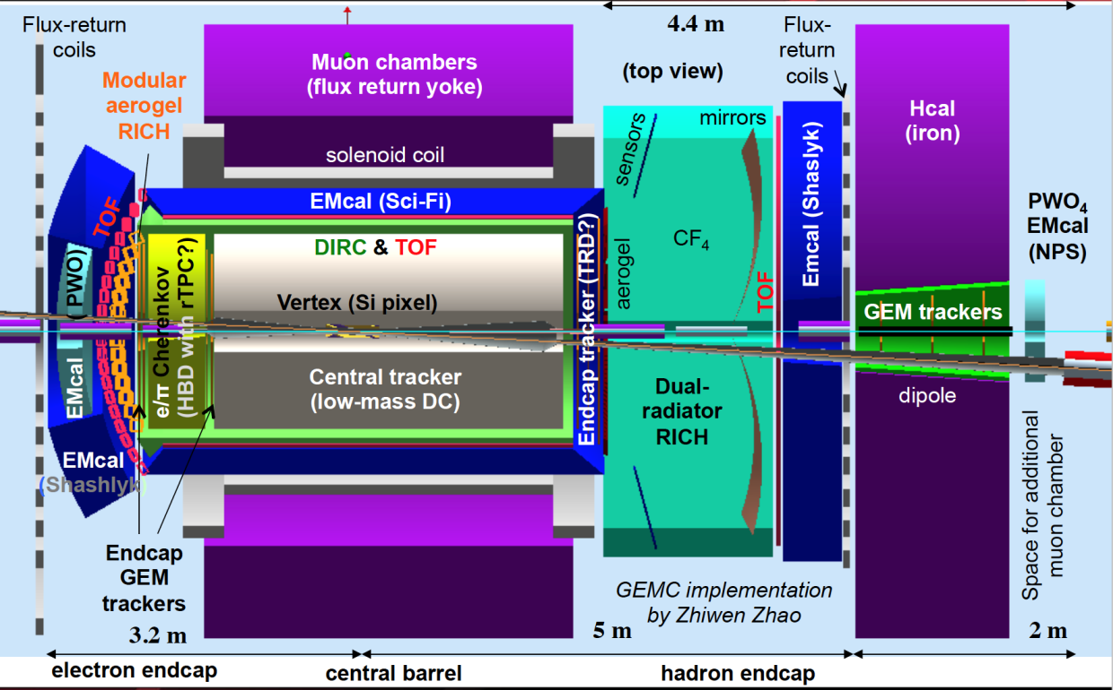
Dual Radiator RICH in EIC Hadron-endcap
Hit on detector
ePHENIX
Photon impact
on mirror(s)
dRICH: flexible configuration (JLEIC, ePHENIX)
Radiators: Aerogel (n_{AERO}~1.02) + Gas (n_{C2F6} ~ 1.0008)
Detector: 0.5 m²/sector , 3x3 mm² pixel
Single-photon detection in ~1T magnetic field
Outside acceptance, reduced constraints
→ best candidate for SiPM option
JLEIC
Phase Space:
- Polar angle: 5-25 deg
Momentum: 3-60 GeV/c

Slide 2
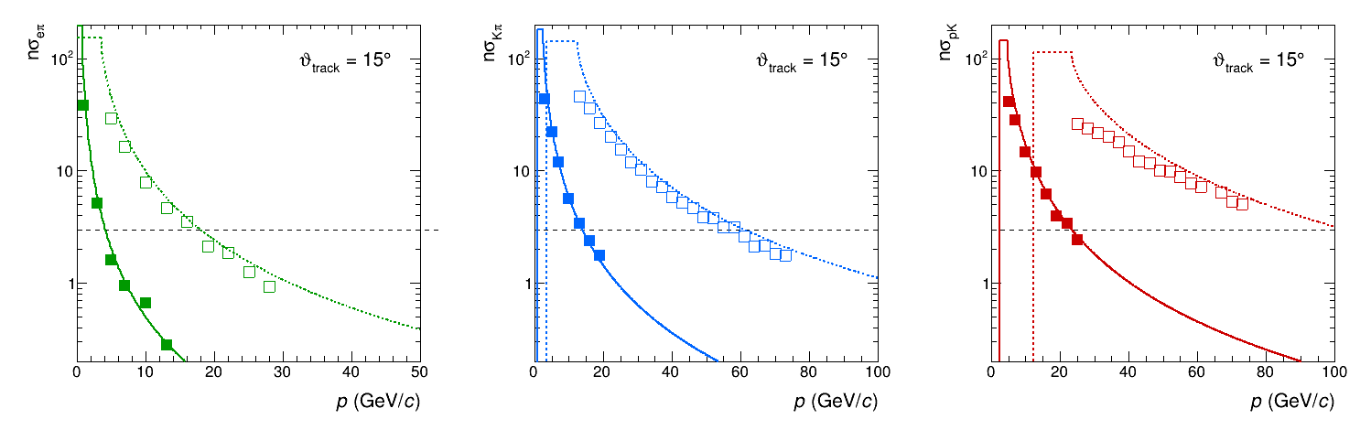
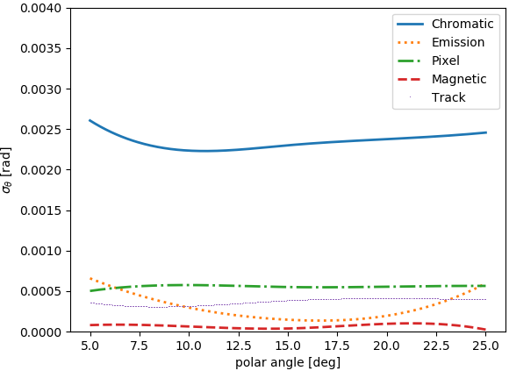
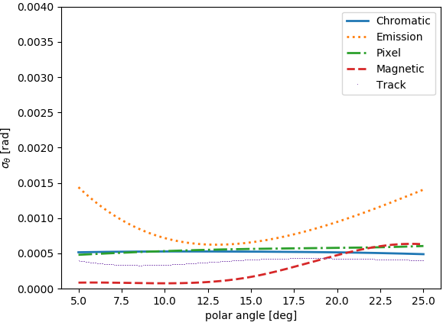
dRICH Feasibility Study
Compact and cost-effective solution for continuous momentum coverage (3-60 GeV/c)
Strong interest in the dRICH electron-pion separation capability
e-π
π−k
p-k
Studied with full Geant4 simulation, with Bayesian L. Barion et al., JINST 15 (2020) 02, C02040
optimization and analytic parameterizations E. Cisbani et al., JINST 15 (2020) 05, P05009
Aerogel SPE
Gas SPE
Gap length / Sensor surface
Refractive index / UV filters

Slide 3
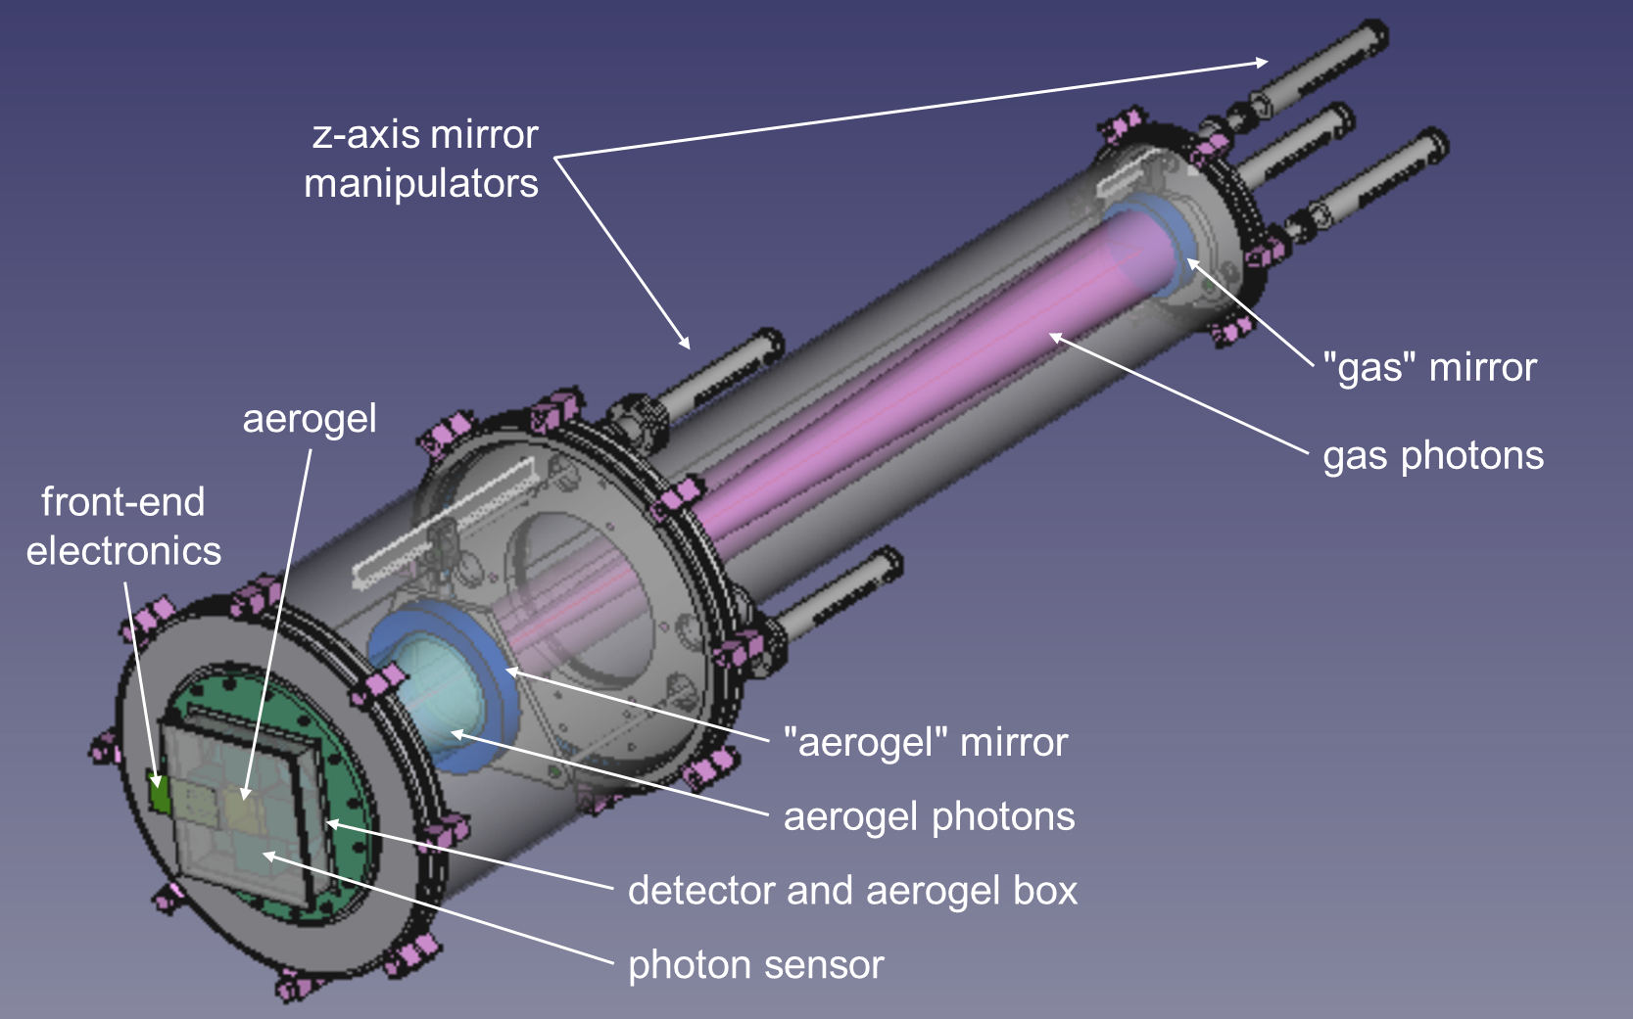
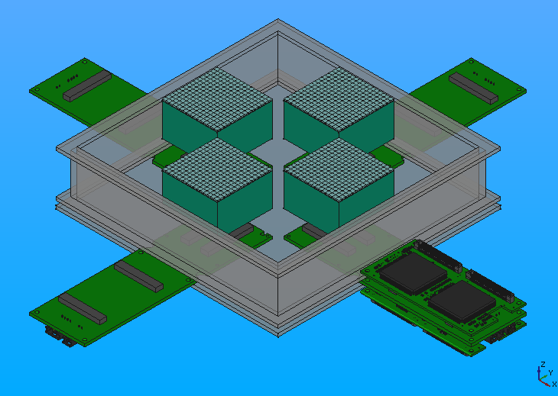
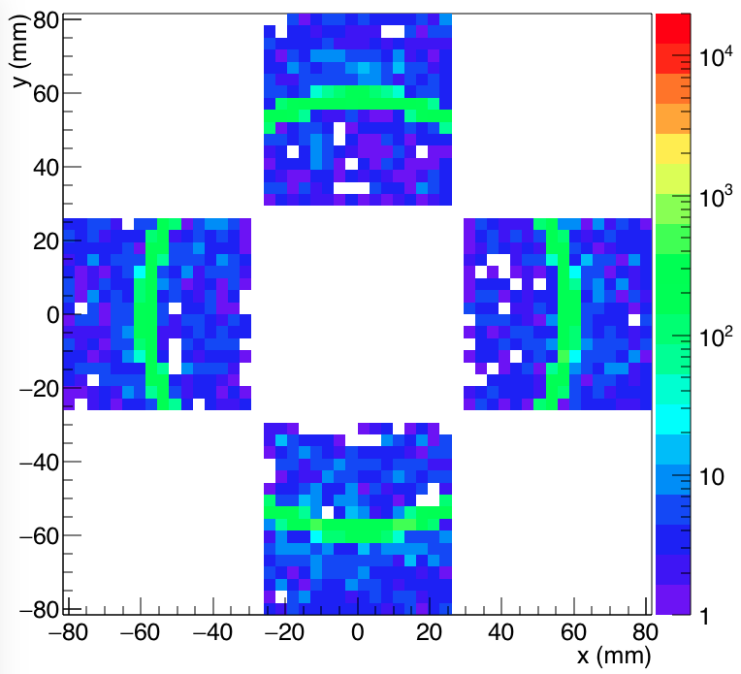
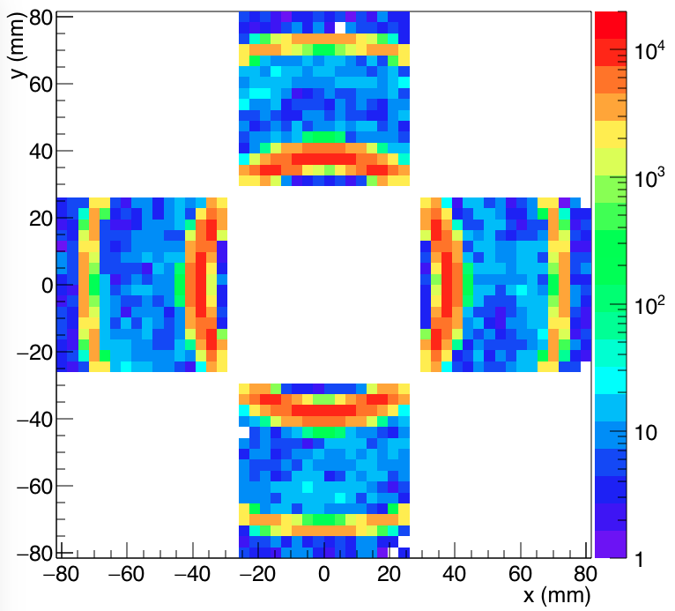
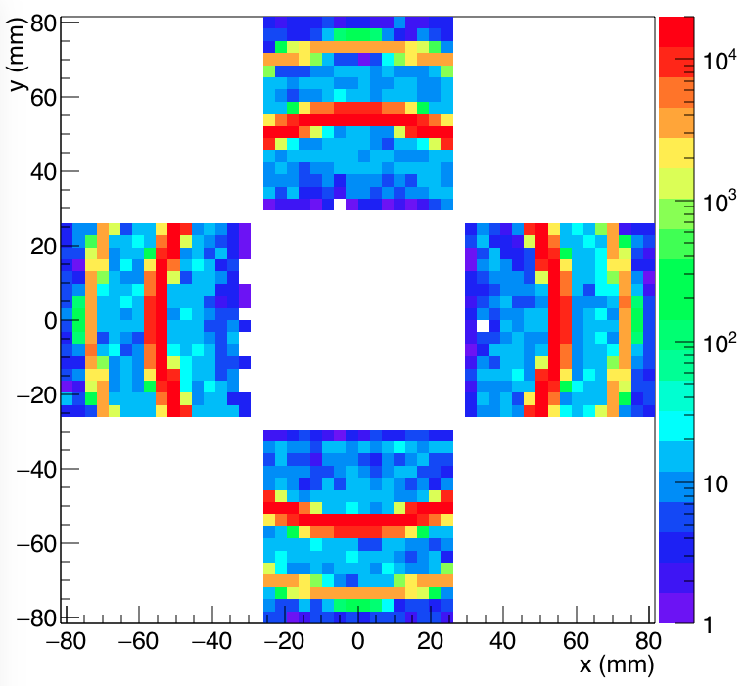
dRICH Prototype
Dual radiator imaging
Pressure vessel for gas & n tune
Sensor & readout friendly
4 x H13700
Kaon
4 GeV/c
Kaon
15 GeV/c
Kaon
25 GeV/c

Slide 4
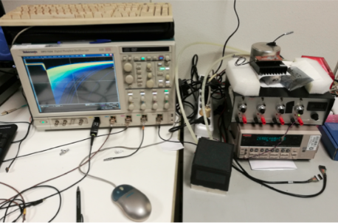
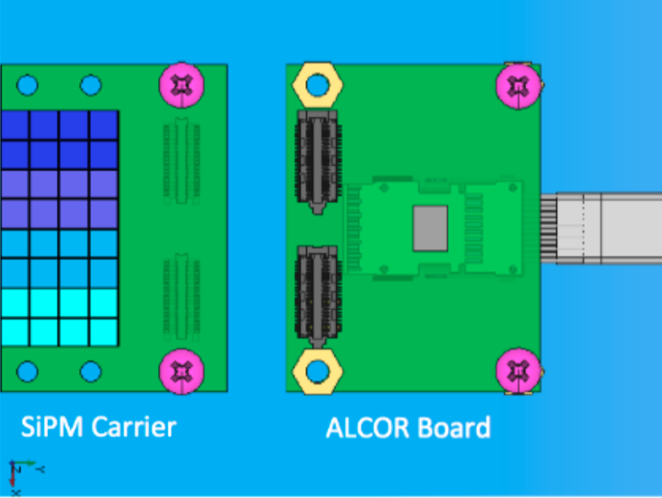
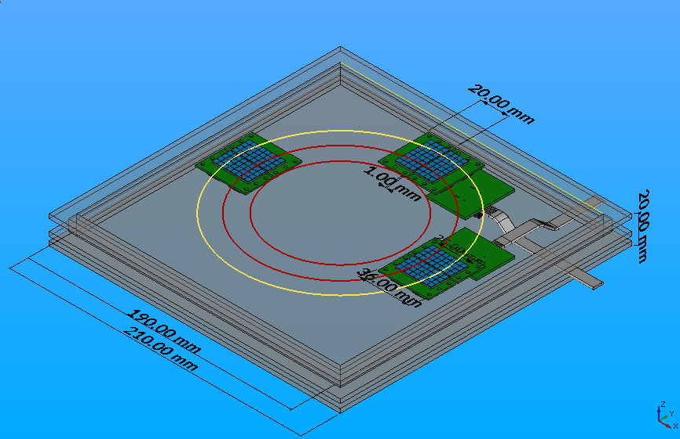
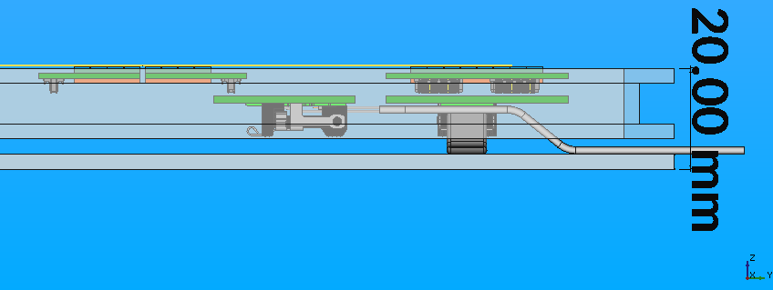
SiPM Program
Laboratory characterization
SiPM: sampled for vendor, type and dose (at groups of 4)
organized in 8 x 4 matrices for imaging
to be irradiated up to 10¹¹ n_{eq}/cm²
ALCOR: ASICS under development at INFN:
ToT architecture for cryogenic application
32 channels, 50 ps TDC, >500 kHz/channel
Readout: bias distributors and signal pre-conditioning
compatible with temperature treatments,
laboratory characterization, and firefly
high-data rate DAQ
Readout test with ALCOR chip
Imaging test with dRICH prototype

