Slide 1
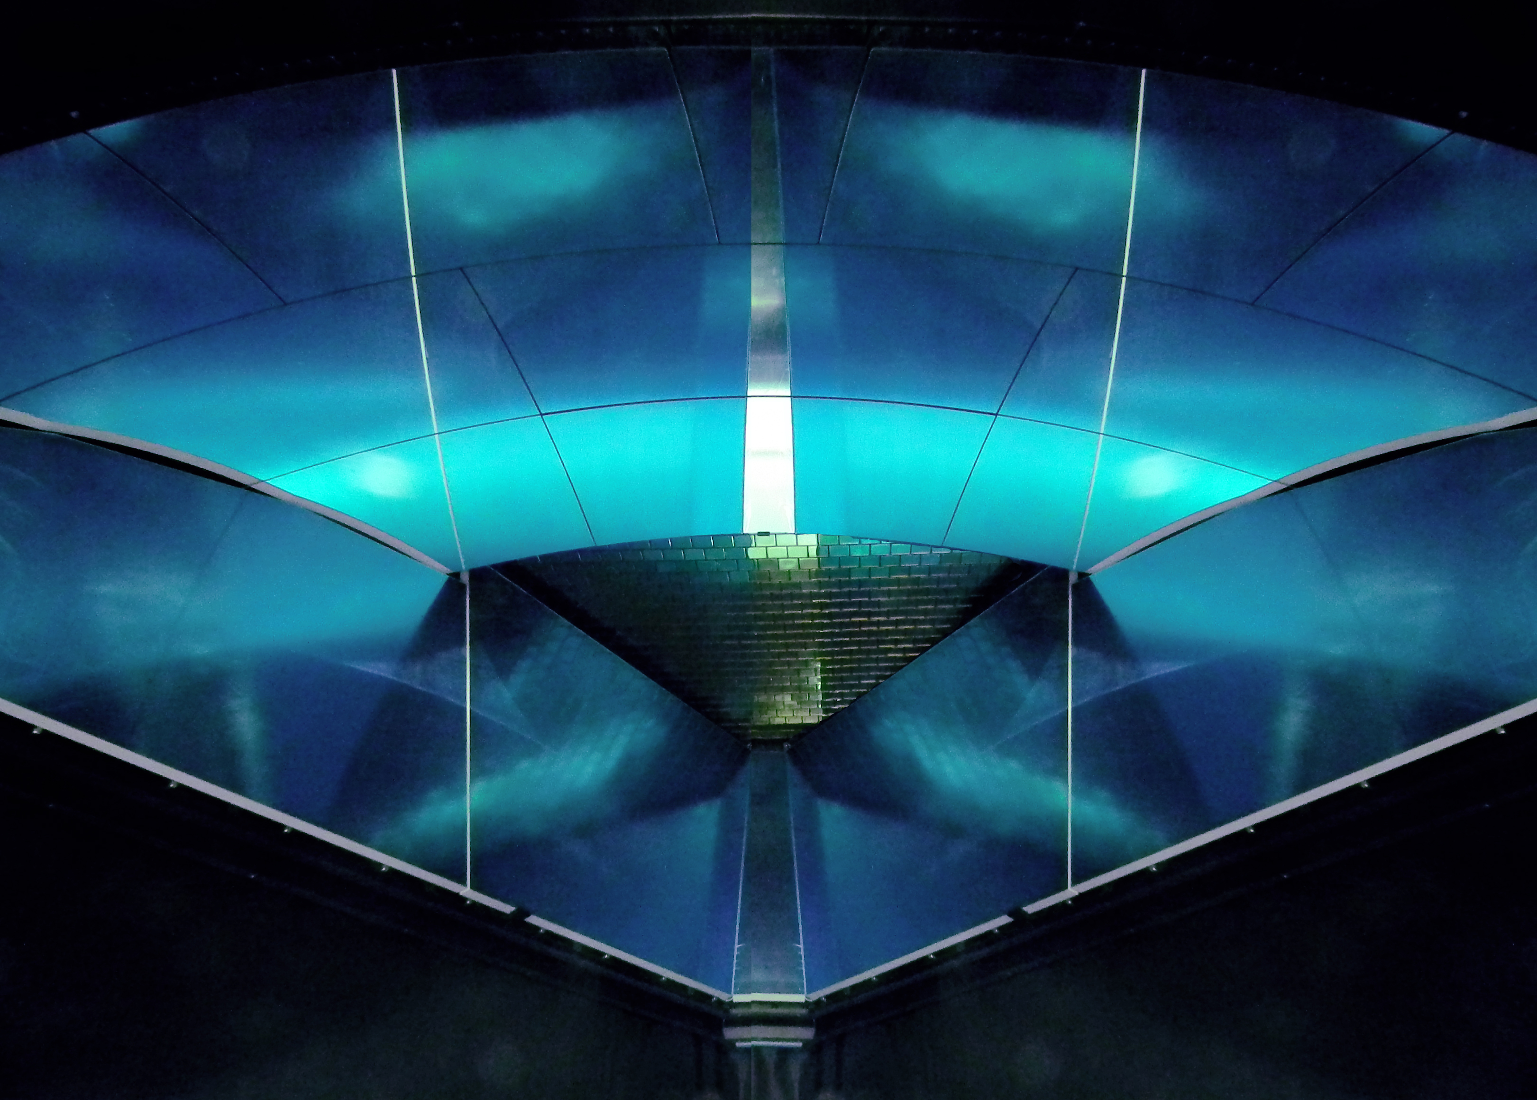
Flavor Separation Instruments for Nucleon Tomography
M. Contalbrigo – INFN Ferrara
25th October 2019,
Dip. Fisica and Astronomia, Bologna
Aperitivi Scientifici
Notes:
Vanno messi studi innovativi e pubblicazioni

Slide 2
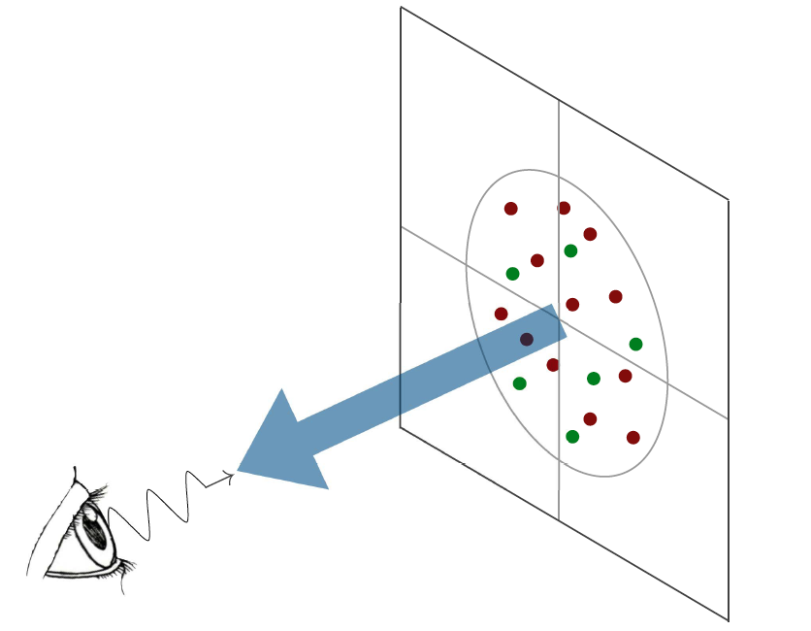
The Nucleon Structure
d²b_{T}
d²k_{T}
d²k_{T}
d²b_{T}
High Energy Probe
Hard Scale
Longitudinal momentum
k⁺=xP⁺
l
Photon Virtuality
Q²
l
Contalbrigo M.
Flavor Sensitive Instruments, 24^{5d} October 2019, Bologna
2
Notes:
Discutere che servono spin (fin dall’iniio → metter qualche simbolo nel disegno ?) e scala perturbativa

Slide 3
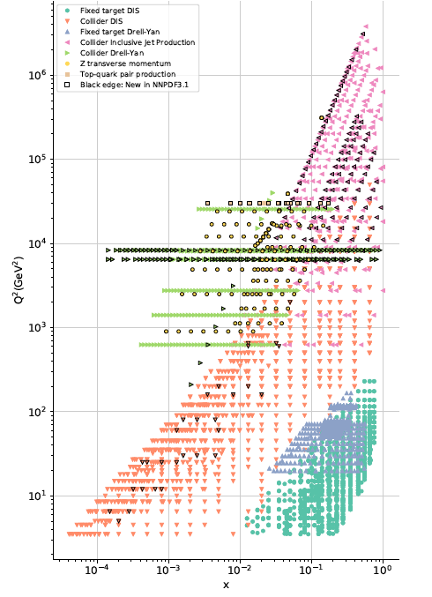
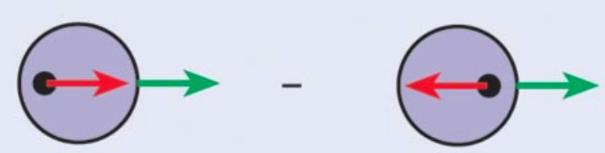
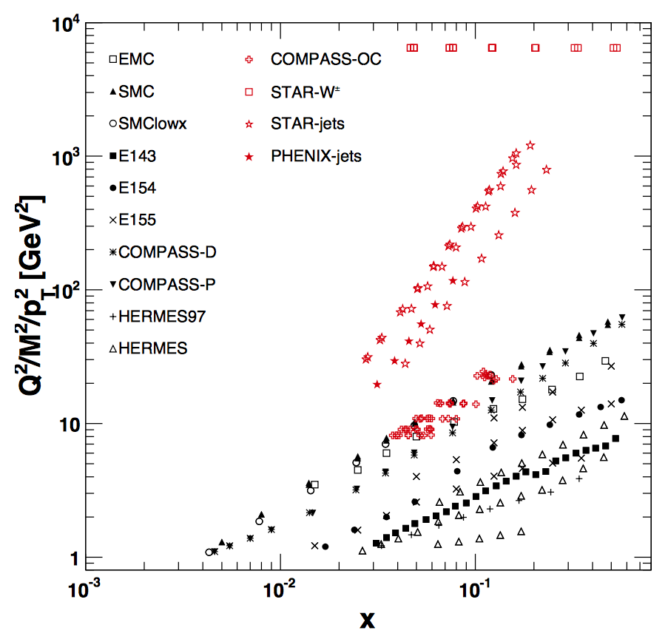
Kinematic Coverage
H-W Lin++ [1711.07916]
Contalbrigo M.
Flavor Sensitive Instruments, 24^{5d} October 2019, Bologna
3
Notes:
Mettere quello per polarizzato ?

Slide 4

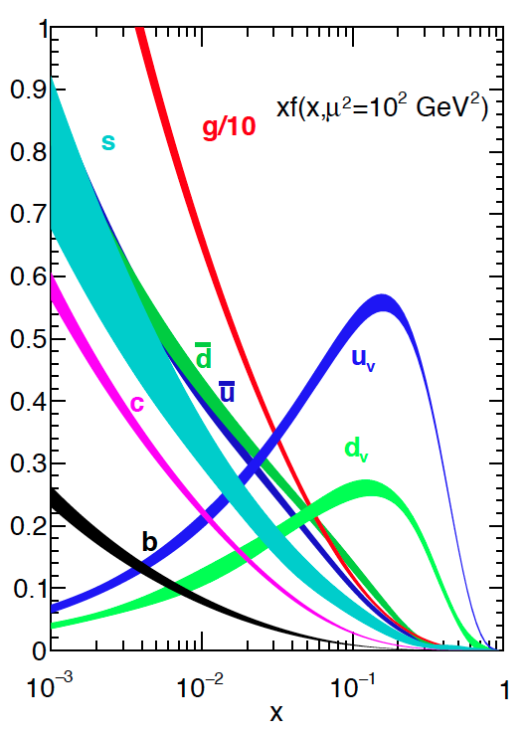
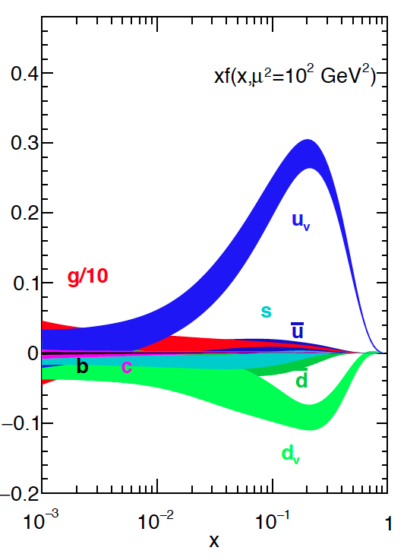
Parton Content
MMHT [arXiv 1412.3989]
HERAPDF2.0 [arXiv 1506.06042]
CT14 [arXiv 1506.07443]
CJ15 [arXiv 1602.03154]
ABMP16 [arXiv 1701.05838]
NNPDF3.1 [arXiv 1706.00428]
BB [arXiv 1005.3113]
LSS [arXiv 1010.0574]
DSSV [arXiv 1404.4293]
BS [arXiv 1408.7057]
NNPDF [arXiv 1406.5539]
JLAM [arXiv 1601.07782]
H-W Lin++ [1711.07916]
Contalbrigo M.
Flavor Sensitive Instruments, 24^{5d} October 2019, Bologna
4
Notes:
RICH: contributo a Delta_g > 0 con jets e pi0, contributo a Delta_qbar con W+/-
Mettere una slide per hadronici ?

Slide 5
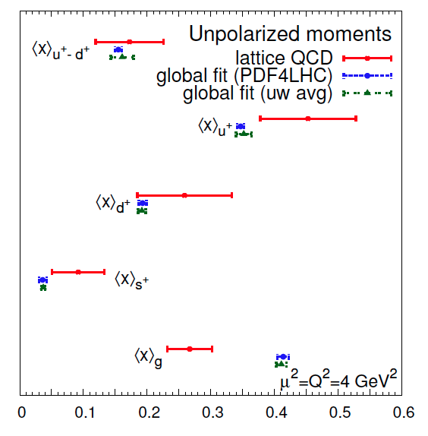
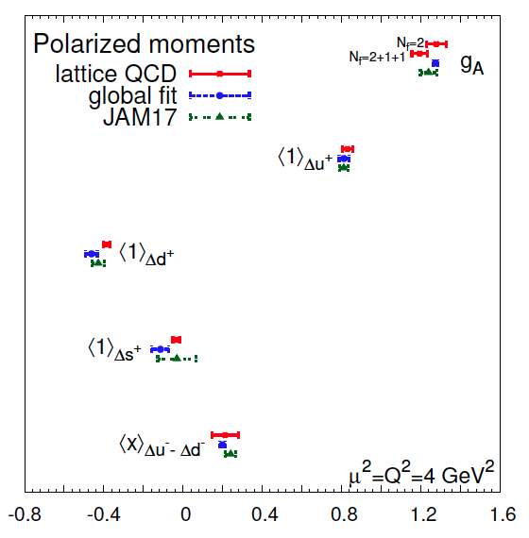
Parton Content & Lattice
Unpolarized moments
Polarized (helicity) moments
H-W Lin++ [1711.07916]
Contalbrigo M.
Flavor Sensitive Instruments, 24^{5d} October 2019, Bologna
5
Notes:
Vedere come fanno la media fra le varie PDF
JAM17 a parte in Delta_q perche’ non impone gA SU(3) e fitta PDF/FF insieme
Baccehtta parla di rinormalizzazione non completa e parte di calcoli ancora pertubativa …. Non e’ che e’ il mare ?
Lattice could be used for extrapolation in unmeasured regins!!

Slide 6
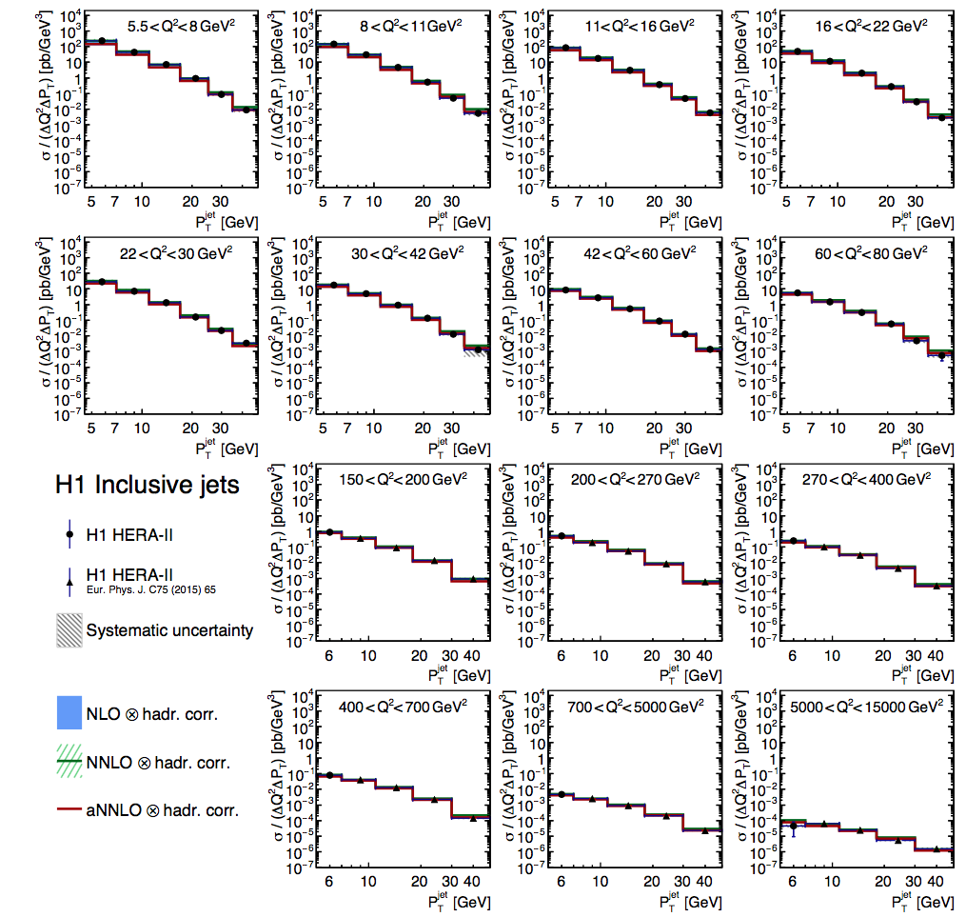
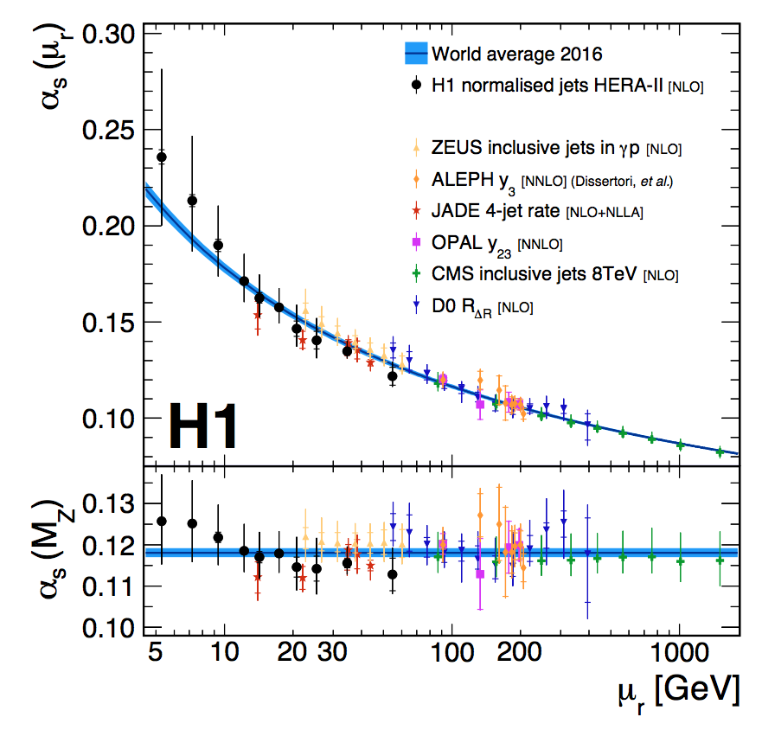
Inclusive Jets @HERA
Good perturbative description
(hard gluon emission)
p_{T}>5 GeV Q²>5 GeV²
Part in a p_{T}<<Q TMD regime
H1 [arXiv: 1611.03421]
Contalbrigo M.
Flavor Sensitive Instruments, 24^{5d} October 2019, Bologna
6

Slide 7

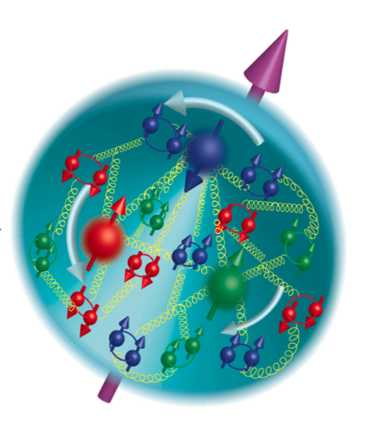
The Strong Force Confined Universe
Dynamic Spin
- Parton polarization
- Orbital motion
- Form Factors
- Magnetic Moment
Parton Correlations
- dPDFs
- Short range
- MPI
Hadronization
Spin-orbit effects
Parton energy loss
- Jet quenching
Color charge density
- Nucleon tomography
- Diffractive physics
- Gluon saturation
- Color force
Flavor Sensitive Instruments, 24^{5d} October 2019, Bologna
7

Slide 8
The 3D Nucleon Structure
Confinement Scale
d²b_{T}
d²k_{T}
Transverse momentum
k_{T}
d²k_{T}
d²b_{T}
b_{T}
Transverse position
High Energy Probe
Hard Scale
Longitudinal momentum
k⁺=xP⁺
Spin
l
Photon Virtuality
Q²
Transverse plane
l
Contalbrigo M.
Flavor Sensitive Instruments, 24^{5d} October 2019, Bologna
Contalbrigo M.
8
Notes:
Discutere che servono spin (fin dall’iniio → metter qualche simbolo nel disegno ?) e scala perturbativa

Slide 9
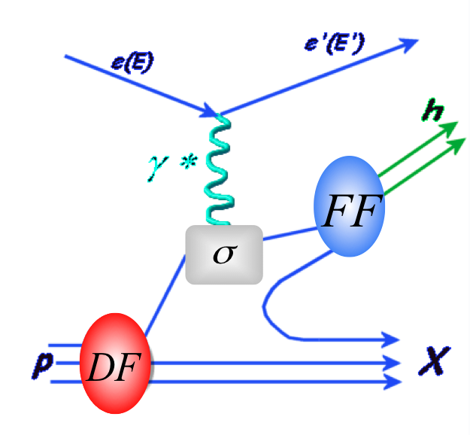
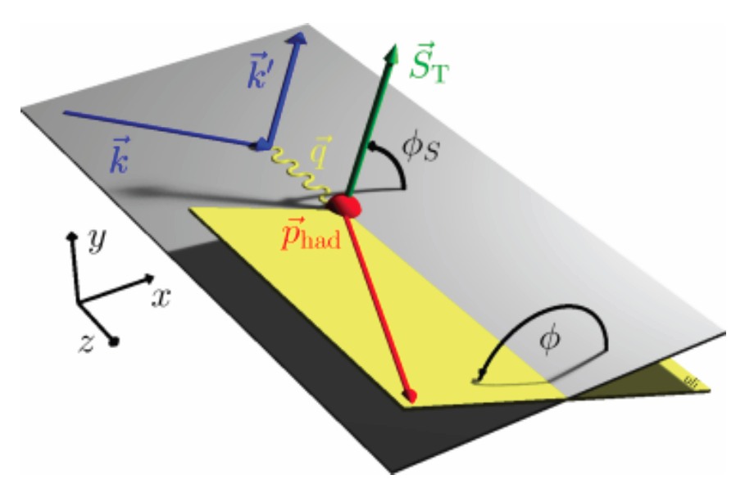
SIDIS & TMDs
TMDs: Transverse Momentum Parton Distributions
Parton kinematics and flavor from observed hadron kinematics and type
Access to:
3D momentum and spin-orbit effect:
Distribution and fragmentation convoluted:
Contalbrigo M.
Flavor Sensitive Instruments, 24^{5d} October 2019, Bologna
Contalbrigo M.
9

Slide 10
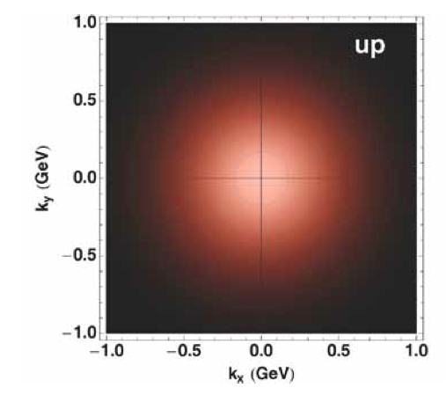
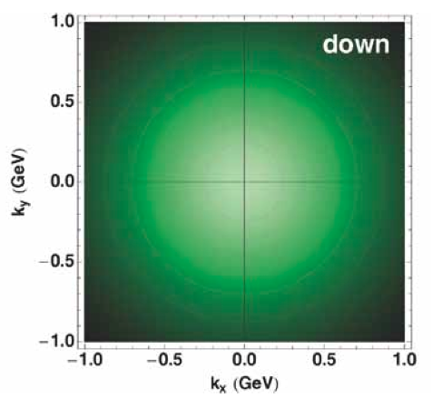




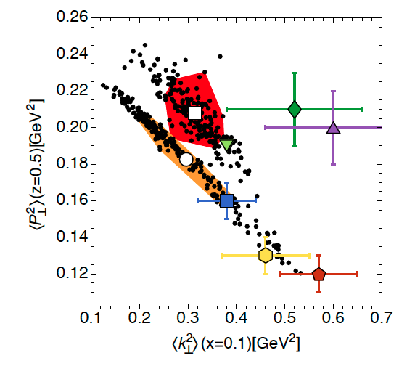
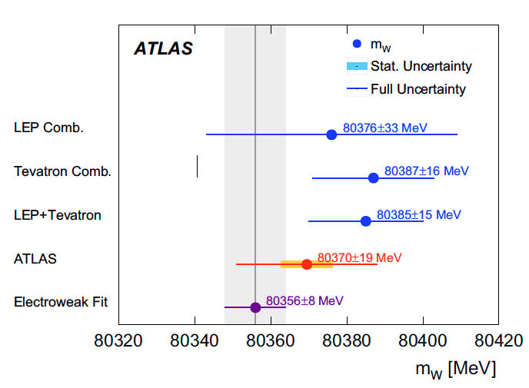
Unpolarised TMDs
+9 / -6 (TMDs)
A. Bacchetta++ [arXiv:1703.10157]
ATLAS++ [arXiv:1701.07240]
TMDs
Contalbrigo M.
Flavor Sensitive Instruments, 24^{5d} October 2019, Bologna
10
Notes:
Bacchetta reference!

Slide 11
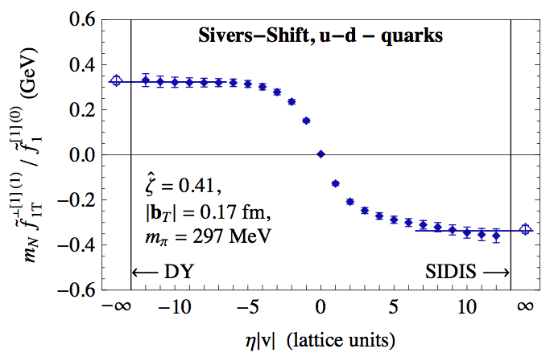
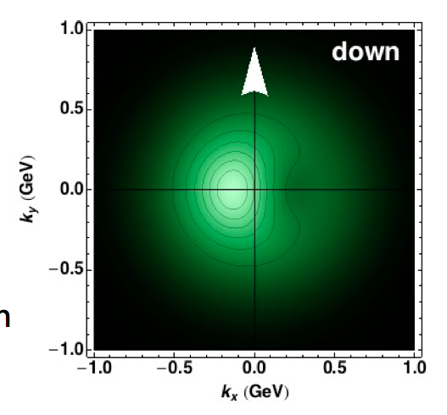
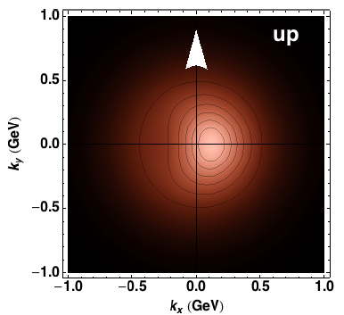
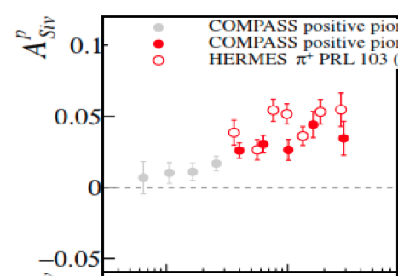
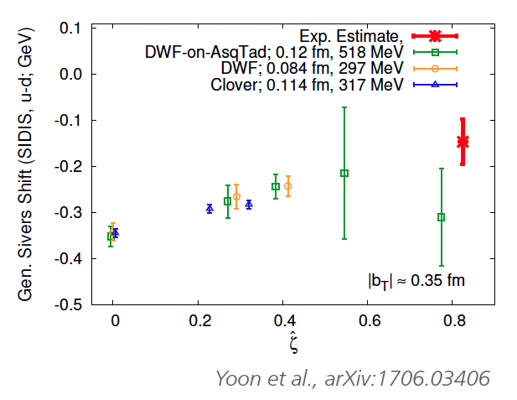

Spin-Orbit Effects: Sivers
Yoon++ [arXiv: 1706.03406]
Sivers from polarized SIDIS
HERMES [arXiv:0906.3918]
COMPASS [arXiv:1205.5122]
x
Contalbrigo M.
Flavor Sensitive Instruments, 24^{5d} October 2019, Bologna
11
11
Notes:
oCapire storia del segno
Che modello segue AFTER ?

Slide 12
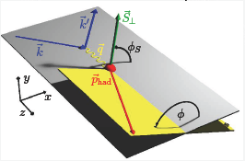
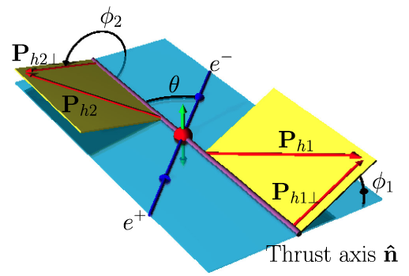
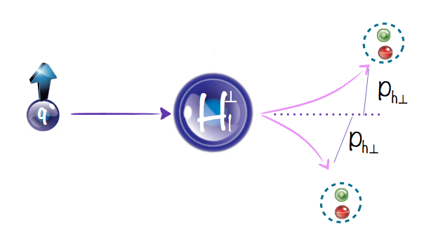
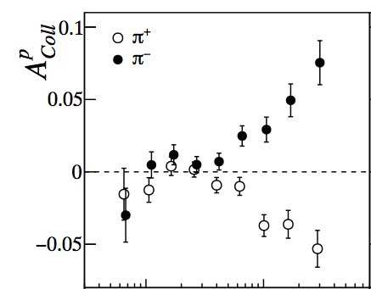
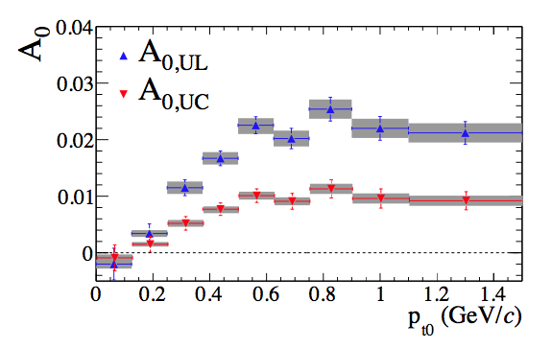

Spin-Orbit Effects: Collins
Q² ~ 5-7 GeV²
Q² ~ 110 GeV²
HERMES [arXiv 0408013]
HERMES [arXiv 0906.3918]
Belle [talk at DIS2014]
COMPASS [arXiv 1005.5609]
BESIII [arXiv 1507.06824]
COMPASS [arXiv 1408.4405]
Babar [arXiv 1309.5278]
Contalbrigo M.
Flavor Sensitive Instruments, 24^{5d} October 2019, Bologna
12
Notes:
Aggiungere riferimenti

Slide 13
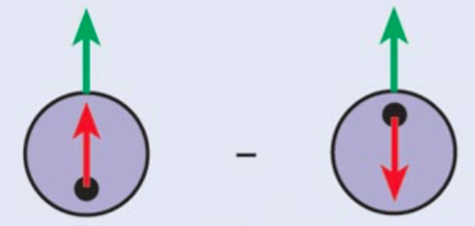
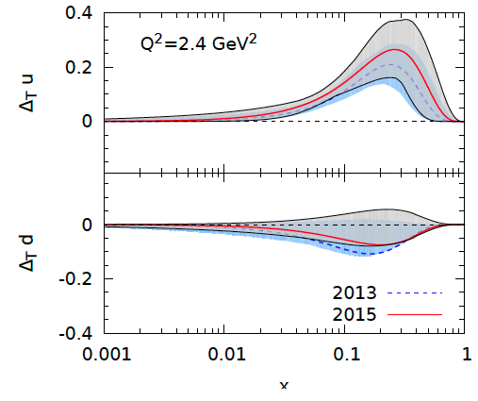

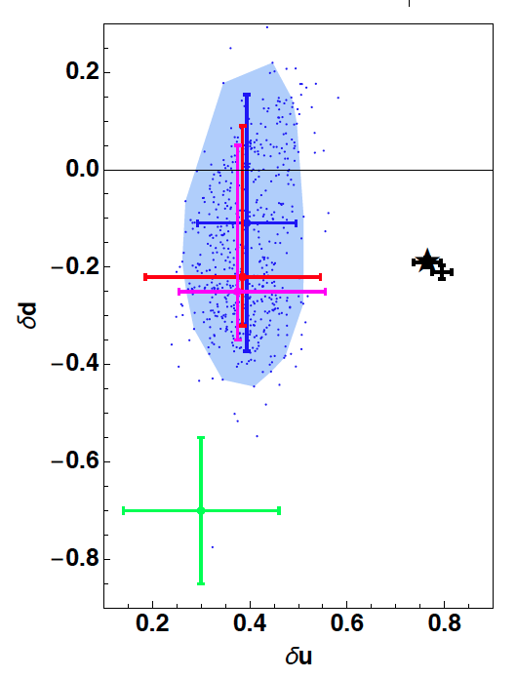
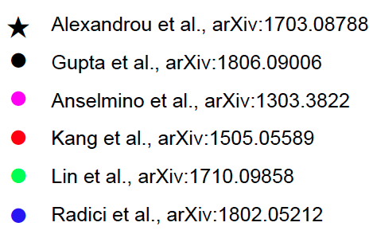
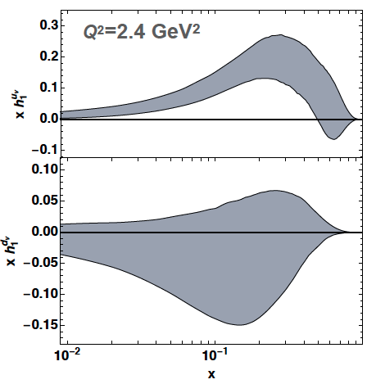
Transversity & Tensor Charge
Distributions:
Charges:
A. Bacchetta @ DIS219
Helicity
x
x
Contalbrigo M.
Flavor Sensitive Instruments, 24^{5d} October 2019, Bologna
13
Notes:
Trova quale e’ Lattice ed eventualmente che modelli

Slide 14

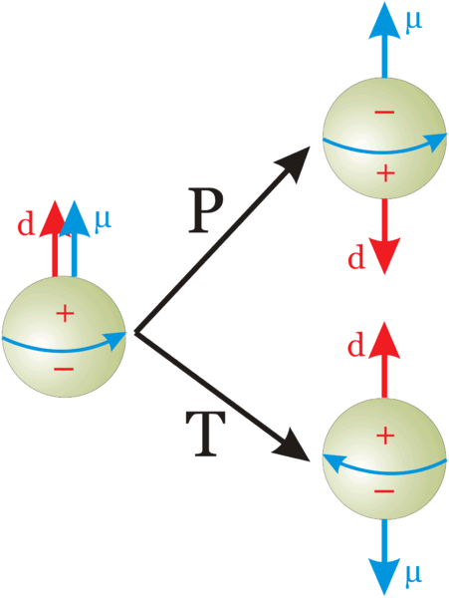
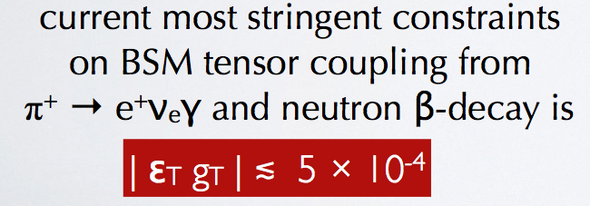
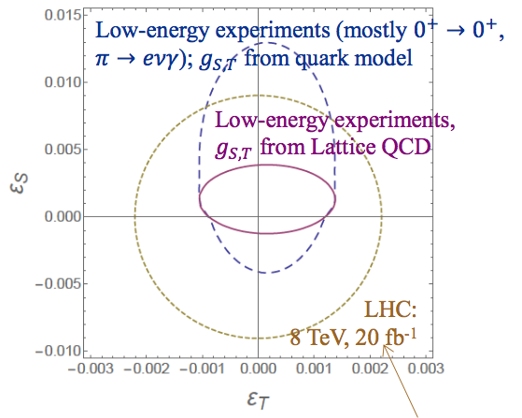
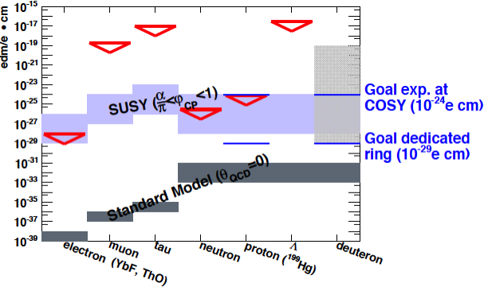
Tensor Charge & BSM Physics
EDM violates P and T and CP (if CPT holds)
Bychkov++ [arXiv:0804.1815]
Pattie++ [arXiv:1309.2499]
Baessler++ @ this Conf.
Contalbrigo M.
Flavor Sensitive Instruments, 24^{5d} October 2019, Bologna
14
Notes:
Mettere il plot con confronto low energy vs LHC!!
Mettere il caso pi0 ?

Slide 15
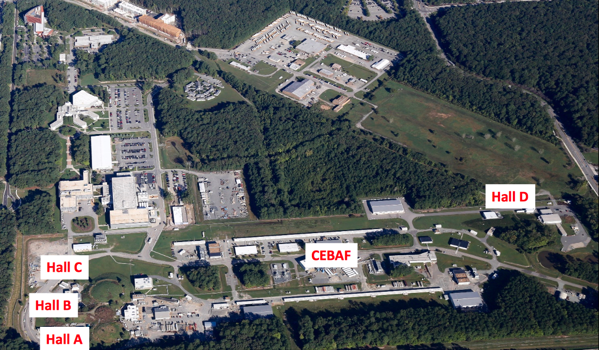
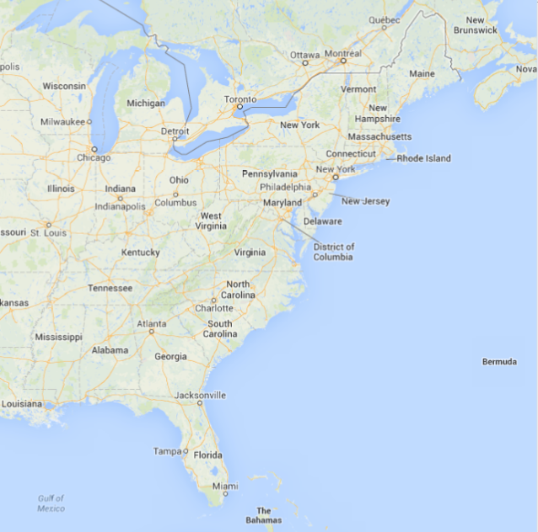
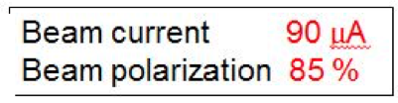
Jefferson Lab
Thomas Jefferson National Accelerator Facility, Newport News, VA, USA
6 → 12 GeV Beam
Contalbrigo M.
Flavor Sensitive Instruments, 24^{5d} October 2019, Bologna
15

Slide 16
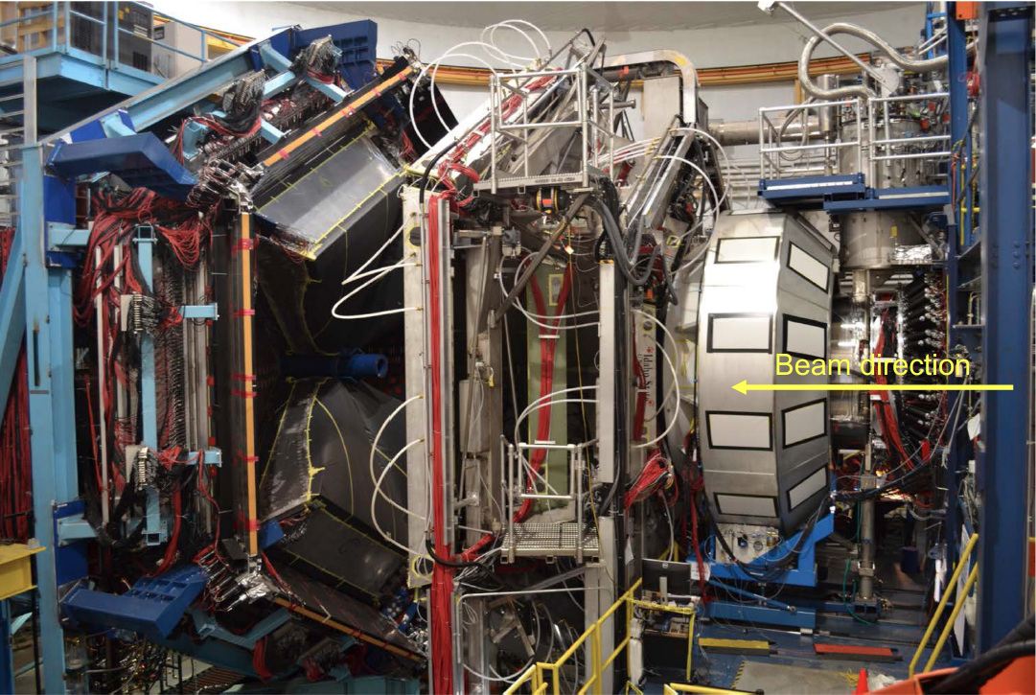
CLAS12 in Hall-B
Large acceptance spectrometer. Operative since 02/18
Main INFN contributions to CLAS12: FT, RICH, HDice
10 m
Contalbrigo M.
Flavor Sensitive Instruments, 24^{5d} October 2019, Bologna
16

Slide 17
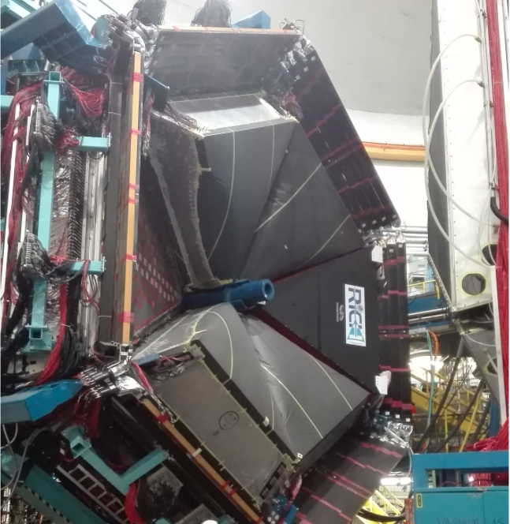
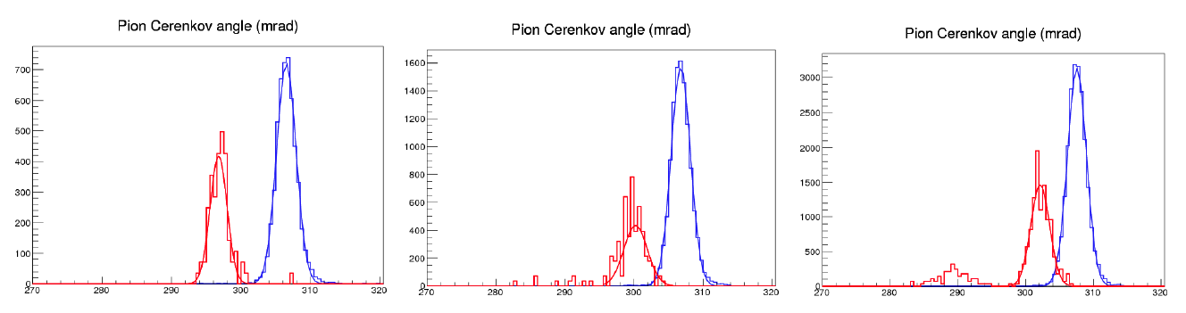
CLAS12 RICH
INSTITUTIONS
INFN (Italy) Bari, Ferrara, Genova, L.Frascati, Roma/ISS
Jefferson Lab (Newport News, USA)
Argonne National Lab (Argonne, USA)
Duquesne University (Pittsburgh, USA)
George Washington University (USA)
Glasgow University (Glasgow, UK)
Kyungpook National University, (Daegu, Korea)
University of Connecticut (Storrs, USA)
UTFSM (Valparaiso, Chile)
Goal kaon-pion separation up to 8 GeV/c (prototype results):
6 Gev/c
π
7 Gev/c
8 Gev/c
k
p
Cherenkov angle (mrad)
Contalbrigo M.
Flavor Sensitive Instruments, 24^{5d} October 2019, Bologna
17
Notes:
Vanno messi studi innovativi e pubblicazioni

Slide 18
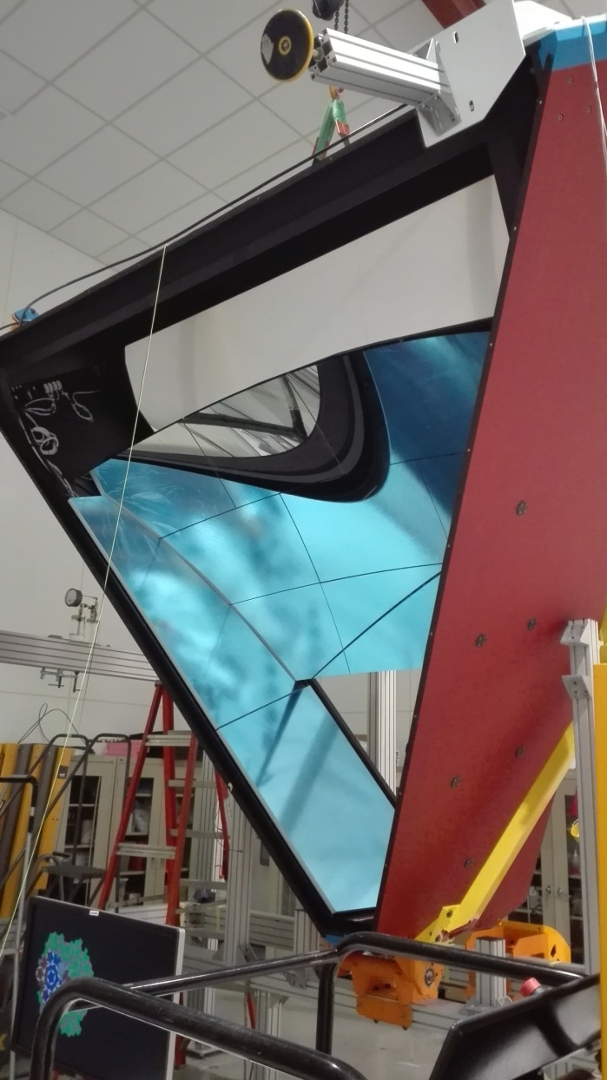
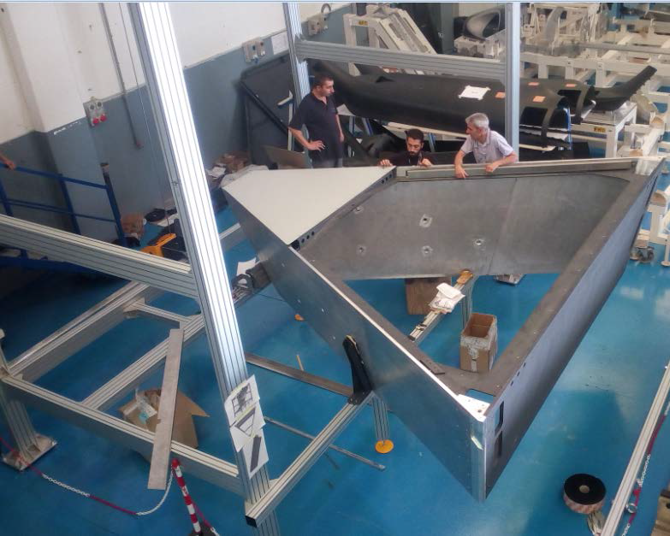
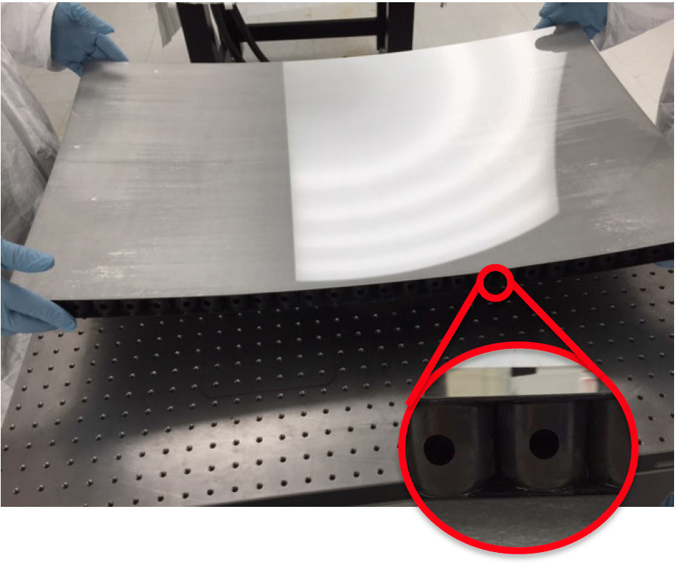
RICH Components
Aeronautic technology for structure
to maximize lightness and stiffness. Trapezoid of composite materials: CFRP inside acceptance, Aluminum outside
Carbon Fiber Mirrors (spherical)
to maximize lightness and stiffness. Consolidate technology (HERMES, AMS, LHCb) but ~ 30 % material budget reduction
Contalbrigo M.
Flavor Sensitive Instruments, 24^{5d} October 2019, Bologna
18
Notes:
Immagine electronic panel e scheda ottica

Slide 19
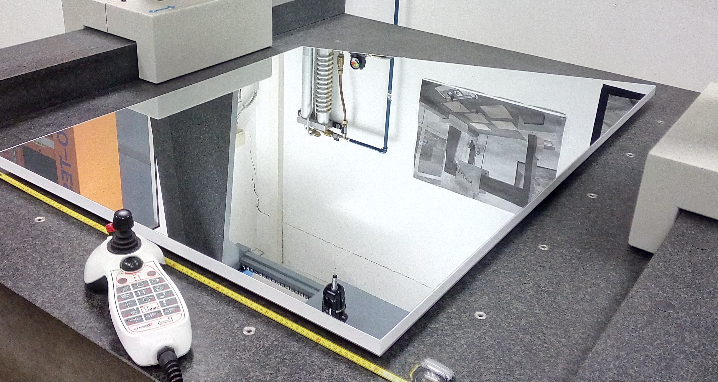
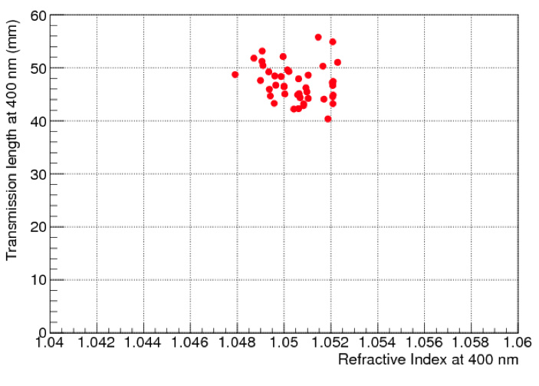
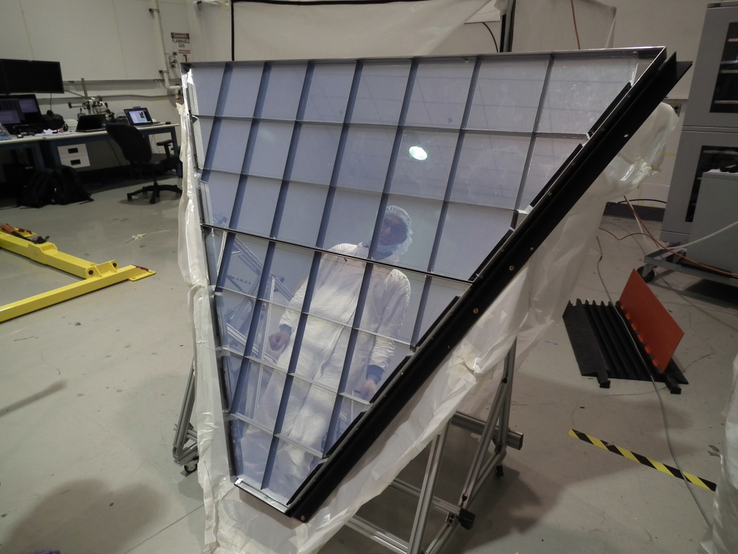
RICH Components
Glass-Skin Mirrors (planar)
Innovative technology never used in nuclear experiments.
1.5 mm outside, 0.7 mm inside acceptance
~ 1/5 cost for squared meter vs CFRP
Large refractive index aerogel radiator
Tiles up to 20x20x3 cm² at n=1.05.
World leading transparency
At such large n and volumes
Contalbrigo M.
Flavor Sensitive Instruments, 24^{5d} October 2019, Bologna
19
Notes:
Immagine electronic panel e scheda ottica

Slide 20
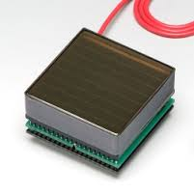


Photo Sensor: MA-PMT
80 H8500 + 350 H12700
< 1 cm spatial resolution
< 1 ns time resolution
Compatible with the low torus fringe field
Average MA-PMT gain ~ 2.7 10⁶
Corresponds to SPE ~ 400 fC
✓ 64 6x6 mm² pixels cost effective device
✓ High sensitivity on VIS towards UV light
✓ Mature and reliable technology
✓ Large Area (5x5 cm²)
✓ High packing density (89 %)
✓ Fast response
✓ Expensive technology
~ 1 m² active surface
Contalbrigo M.
Flavor Sensitive Instruments, 24^{5d} October 2019, Bologna
20
Notes:
Dire meglio chi fa cosa.

Slide 21





RICH Readout Electronics
Readout Electronics
Compact (matches sensor area)
Modular Front-End (Mechanical adapter, ASIC, FPGA)
Scalable fiber optic DAQ (TCP/IP or SSP)
Tessellated (common HV, LV and optical fiber)
Optical
Fiber
HV
LV
SSP Fiber-Optic DAQ
Tile power dissipation ~ 3.5 W
Contalbrigo M.
Flavor Sensitive Instruments, 24^{5d} October 2019, Bologna
21
Notes:
Immagine electronic panel e scheda ottica

Slide 22





RICH Front-End Electronics
Test pulse
Charge
Analog: Charge (1 fC)
Digital: Time (1 ns)
Trigger latency (8 μs)
Optical ethernet (2.5 Gbps)
Trigger: external
internal
self
On-board pulser
Test
Slow shaper
Slow shaper
Linear response
Multiplexed readout
Limited holding time delays
Used for calibrations
Digital pulse
Contalbrigo M.
Flavor Sensitive Instruments, 24^{5d} October 2019, Bologna
Contalbrigo M.
22
Notes:
Aggiungere range di validita’ per fattorizzazione GPDs

Slide 23



ADC Charge Measurement
Multiplexed readout up to 50 kHz
High resolution SPE spectrum
Viable for efficiency and gain monitors
In conjunction with timing, allows the
study of PMT discharge and cross-talk
Gain
Contalbrigo M.
Flavor Sensitive Instruments, 24^{5d} October 2019, Bologna
23
Notes:
Dire meglio chi fa cosa.

Slide 24
RICH Front-End Electronics
Digital response
Working in saturated regime
64 parallel channel readout
8 μs FIFO and delays
1 ns time resolution
Test pulse
Analog: Charge (1 fC)
Digital: Time (1 ns)
Trigger latency (8 μs)
Optical ethernet (2.5 Gbps)
Trigger: external
internal
self
On-board pulser
Test
Slow shaper
Slow shaper
Digital pulse
Start time
Stop time
Contalbrigo M.
Flavor Sensitive Instruments, 24^{5d} October 2019, Bologna
Contalbrigo M.
24
Notes:
Aggiungere range di validita’ per fattorizzazione GPDs

Slide 25


TDC Digital Readout
During Acceptance tests
During Internal Pulser Calibration
Pedestal rms as seen by a test-point
As seen by RICH readout
Discrimination down to 20 fC, i.e. few % of SPE, allows sensor characterization
Contalbrigo M.
Flavor Sensitive Instruments, 24^{5d} October 2019, Bologna
25
Notes:
Vedere presentazione Matteo

Slide 26




Optical and Electric Cross-talk
Sensor
Gain x 4
THR ~ 1/80 SPE
Electronic
Signal
Cross-talk
Sampling time
Contalbrigo M.
Flavor Sensitive Instruments, 24^{5d} October 2019, Bologna
26
Notes:
Dire meglio chi fa cosa.

Slide 27




Single Photon Discrimination
Relative efficiency map
Relative gain map
x ¼
x ½ MAROC
x 1 GAIN
x 2
x 4
Eff. ratio
Eff. ratio
Maroc
Gain
Threshold
0 0.5 1 2 4
Contalbrigo M.
Flavor Sensitive Instruments, 24^{5d} October 2019, Bologna
27
Notes:
Mettere relazione con blue luminosity ?

Slide 28


RICH Installation
January 2018
Contalbrigo M.
Flavor Sensitive Instruments, 24^{5d} October 2019, Bologna
28
Notes:
Fare una immagine del PMT sulla risoluzione

Slide 29




Electronic Pedestal
Pixel
Jan 18
-- off
-- 1000 V
Mar 18
-- off
-- 1000 V
Pixel #
Pedestal rms [DAC unit]: without and with grounding grid
Pixel
Pixel
Pixel #
Pixel #
Contalbrigo M.
Flavor Sensitive Instruments, 24^{5d} October 2019, Bologna
29
Notes:
Fare una immagine del PMT sulla risoluzione

Slide 30

Online Equalization
After equalization: distributions narrower and less sensitive to the common threshold
saturate signals and cross-talk well separate
Contalbrigo M.
Flavor Sensitive Instruments, 24^{5d} October 2019, Bologna
30
Notes:
Fare una immagine del PMT sulla risoluzione

Slide 31


Single Photon Time Analysis
CLAS12 Reconstructed Time and Position:
Photons are traced using information
from other CLAS12 detectors
RICH Measured Time and Position:
Defined by the RICH DAQ
Other bunch
Good photons should match
in time and space
Time analysis allows to
separate spurious signals
Dark counts
Contalbrigo M.
Flavor Sensitive Instruments, 24^{5d} October 2019, Bologna
31
Notes:
Fare una immagine del PMT sulla risoluzione

Slide 32


Time Offsets
Contalbrigo M.
Flavor Sensitive Instruments, 24^{5d} October 2019, Bologna
32
Notes:
Vanno messi studi innovativi e pubblicazioni

Slide 33


Single Photon Time Resolution
Single-photon time resolution better than the 1 ns specification
PMT 270
σ = 0.58 ns
PMT 52
σ = 0.66 ns
before time-walk correction
after time-walk correction
Contalbrigo M.
Flavor Sensitive Instruments, 24^{5d} October 2019, Bologna
33
Notes:
Fare una immagine del PMT sulla risoluzione

Slide 34



Single Photon Time Resolution
Contalbrigo M.
Flavor Sensitive Instruments, 24^{5d} October 2019, Bologna
34
Notes:
Vanno messi studi innovativi e pubblicazioni

Slide 35


Cherenkov Angle Reconstruction
Analytic solution for direct photons
“Exact” solution for the Cherenkov Angle
Only direct photons
Ray traced solution for direct photons
Assume knowledge of aerogel ref index
Any photon
GOAL: get a Cherenkov angle estimate for each photon for detailed PID optimization
Contalbrigo M.
Flavor Sensitive Instruments, 24^{5d} October 2019, Bologna
35
Notes:
Vanno messi studi innovativi e pubblicazioni

Slide 36

Cherenkov Angle Reconstruction
Contalbrigo M.
Flavor Sensitive Instruments, 24^{5d} October 2019, Bologna
36
Notes:
Vanno messi studi innovativi e pubblicazioni

Slide 37



Cherenkov Angle Resolution
RGA data, direct photons No alignment of internal components
Number of photons and single photon resolution close to TDR
TDR: ~ 18 Npe
Raw RICH alignment (not for internal components)
TDR:
~ 4.5 mrad
4.5 mrad
Contalbrigo M.
Flavor Sensitive Instruments, 24^{5d} October 2019, Bologna
37
Notes:
Fare una immagine del PMT sulla risoluzione

Slide 38

Hadron Separation
Hadron separation, direct photon, RGA data, raw alignment
PRELIMINARY
Contalbrigo M.
Flavor Sensitive Instruments, 24^{5d} October 2019, Bologna
38
Notes:
Fare una immagine del PMT sulla risoluzione

Slide 39




Application: DIRC @ GlueX
J. Stevens @ DIRC19
H12700 +
CLAS12
readout
Contalbrigo M.
Flavor Sensitive Instruments, 24^{5d} October 2019, Bologna
39
Notes:
Dire meglio chi fa cosa.

Slide 40



The Future: EIC
The ultimate machine fro QCD
Well Beyond HERA:
x 1000 Lumi
Variable CM energy
Polarized Beams
Ion Beam
Precision Detectors
CD0 + Site Decision
Expected Soon
JLEIC
Contalbrigo M.
Flavor Sensitive Instruments, 24^{5d} October 2019, Bologna
Contalbrigo M.
40
40
Notes:
Aggiungere range di validita’ per fattorizzazione GPDs

Slide 41


EIC Detector Challenges
Specific requirements to move
beyond the longitudinal description
Resolve partons in nucleons
  high beam energies and luminosities
  Q² up to ~1000 GeV²
Need to resolve quantities (k_{t}, b_{t}) of the order a few hundred MeV in the proton
Correlated quantitites, multi-D analyses
➔ High Granularity, wide dynamic range
Need to detect all types of remnants
to seek for correlations:
  scattered electron
  particles associated with initial ion
  particles associated with struck parton
Large acceptance, Forward particle
detection, Excellent PID
Scattered electron
Particles associated with struck parton
Partecle associated with initial ion
Contalbrigo M.
Flavor Sensitive Instruments, 24^{5d} October 2019, Bologna
41

Slide 42


Particle Identification @ EIC
Asymmetric detector
Compact solutions to contain the cost
New high-tech materials
New technologies with emerging markets
in medical imaging and homeland security
Activity linked to eRD14 EIC R&D consortium
e-endcap:
medium momentum (< 10 GeV/c)
aerogel modular Cherenkov
h-endcap:
medium and high momentum (3-50 GeV/c)
dual radiator Cherenkov
Sensors
Workign at 1 T magnetic field ?
Radiation Tolerant ?
Contalbrigo M.
Flavor Sensitive Instruments, 24^{5d} October 2019, Bologna
42

Slide 43

Next PID Solutions: Modular RICH
Contalbrigo M.
Flavor Sensitive Instruments, 24^{5d} October 2019, Bologna
43
Notes:
Fare una immagine del PMT sulla risoluzione

Slide 44


Next PID Solutions: Modular RICH
Compact / modular solution for few-GeV range
Fresnel lens
mRICH: An aerogel RICH with Fresnel lens focalization for compact and projective imaging
π/K sepration up to ~ 10 GeV/c
Aerogel
Sensor plane
Proposed also for sPHENIX @ BNL
Contalbrigo M.
Flavor Sensitive Instruments, 24^{5d} October 2019, Bologna
44

Slide 45





mRICH Test Beam
H13700 to reach the 3 mm spatial resolution
Contalbrigo M.
Flavor Sensitive Instruments, 24^{5d} October 2019, Bologna
45
Notes:
Fare una immagine del PMT sulla risoluzione

Slide 46



Next PID Solutions: Dual Radiator RICH
Solution optimized for JLEIC
Contalbrigo M.
Flavor Sensitive Instruments, 24^{5d} October 2019, Bologna
46
Notes:
Fare una immagine del PMT sulla risoluzione

Slide 47

Dual RICH So Far
Contalbrigo M.
Flavor Sensitive Instruments, 24^{5d} October 2019, Bologna
47
Notes:
Fare una immagine del PMT sulla risoluzione

Slide 48



dRICH Prototype Design
Gas Exchange
Aerogel Conf.
Commercial vacuum technology for safety and cost effectiveness
Overlapping rings for parallel beam particles
Contalbrigo M.
Flavor Sensitive Instruments, 24^{5d} October 2019, Bologna
48
Notes:
Fare una immagine del PMT sulla risoluzione

Slide 49



dRICH Prototype Performance
Montecarlo simulation
Aerogel
Gas
Filters to study and
control chromatic
dispersion
@EIC
@EIC
(2.9)
(0.5)
(0.5)
(0.8)
(1.2)
(0.5)
Contalbrigo M.
Flavor Sensitive Instruments, 24^{5d} October 2019, Bologna
49
Notes:
Fare una immagine del PMT sulla risoluzione

Slide 50





Development: Sensor and Readout
Readout Independent element
for flexibility: supports various
detectors with integrated cooling
Reference:
MAROC + SSP/VSX
Dedicated:
SiREAD + SSP/ethernet
Sensors Reference B-field tolerant:
MA-PMTs MCP-PMTs (LAPPDs) SiPMs
Contalbrigo M.
Flavor Sensitive Instruments, 24^{5d} October 2019, Bologna
50
Notes:
Fare una immagine del PMT sulla risoluzione

Slide 51



Development: SiPMs
Pixel #
Pixel #
Peltier cell cooling
Down to -30º in N₂
Contalbrigo M.
Flavor Sensitive Instruments, 24^{5d} October 2019, Bologna
51
Notes:
Fare una immagine del PMT sulla risoluzione

Slide 52





SiPM Radiation Tolerance
T. Tsang et al.
JINST 11 (2016) P12002
I. Balossino et al.
NIMA 876 (2017) 89
Paolo Carniti
@ RICH 2018
T= 84 K
10⁹ n_{eq} cm²
Annealing at 250 ºC
T= 0 C
few 10⁹ n_{eq} cm²
Contalbrigo M.
Flavor Sensitive Instruments, 24^{5d} October 2019, Bologna
52
Notes:
Fare una immagine del PMT sulla risoluzione

Slide 53



Development: SiREAD Chip (HU)
Contalbrigo M.
Flavor Sensitive Instruments, 24^{5d} October 2019, Bologna
53
Notes:
Fare una immagine del PMT sulla risoluzione

Slide 54




Development: Back-End (JLab)
Optical bridge / PC Desktop
Few FPGA units ~ 500 channels
SSP board / VSX crate
2 RICH sectors ~ 50 k channels
Optical ethernet (2.5 Gbps)
Small setups:
TCP/IP
Optical bridge / PC Desktop
Full experiment:
SSP protocol
SSP board / VSX crate
Next:
Ethernet Switches
Contalbrigo M.
Flavor Sensitive Instruments, 24^{5d} October 2019, Bologna
Contalbrigo M.
54
Notes:
Aggiungere range di validita’ per fattorizzazione GPDs

Slide 55





Nucleon Structure Landscape
Data in the much needed “intermediate” energy region matching “pure” pQCD with “pure” TMD regime.
EIC
JLab12
Contalbrigo M.
Flavor Sensitive Instruments, 24^{5d} October 2019, Bologna
55

Slide 56

Executive Summary
The Next QCD Frontier
EIC (and JLab) is a unique opportunity
for a comprehensive QCD study
and possible breakthroughs
Potential impact on many
fields of investigation
EIC offers immediate opportunities
for supported R&D activities
on science and technology
PID is crucial to achieve
flavor separation
Seek for cost-effective
solutions with potential application
In other fields
Contalbrigo M.
Flavor Sensitive Instruments, 24^{5d} October 2019, Bologna
Contalbrigo M.
56
56
Notes:
Aggiungere range di validita’ per fattorizzazione GPDs

Slide 57

Pulsed Laser Test Benches
Detailed characterization
Sensors: gain, efficiency, cross-talk, radiation tolerance
Electronics: gain, cross-talk, thresholds, time resolution
JLab
632 nm picosecond pulsed laser light
Light diffuser to illuminate the whole MAPMT surface
Standardized system with CLAS12 electronics
H8500 6x6 mm² pixel sensor so far
Laser head +
diffuser
MAPMT holder
INFN
632 nm and 407 nm picosecond pulsed laser light
Light concentrator to scan the sensor surface
Flexible layout supporting various sensors and
Front-End electronics
Laser head +
collimator
MAPMT holder
Contalbrigo M.
Flavor Sensitive Instruments, 24^{5d} October 2019, Bologna
57
Notes:
Fare una immagine del PMT sulla risoluzione

Slide 58











HDice: Frozen Spin Polarized Target
Polarized targets of solid HD in frozen spin mode.
Longitudinal and Transverse Polarizations: up to 60% H or 35% D.
Physics program rated as High-Impact by PAC41
Advantages:
Dilution factors ~ 1
Low holding magnetic fields
FE: frozen B field on a
bulk SC MgB₂ magnet
RM1: dewars & cryostats
HD gas purity by Raman
distillation and analysis
ML
Contalbrigo M.
CSN3, Torino 9 settembre 2020
58
Very pure HD gas is needed to produce polarized targets.
Raman spectrosopy is used to analyze the content of H₂ and D₂ contaminants in the HD gas.

