Slide 1
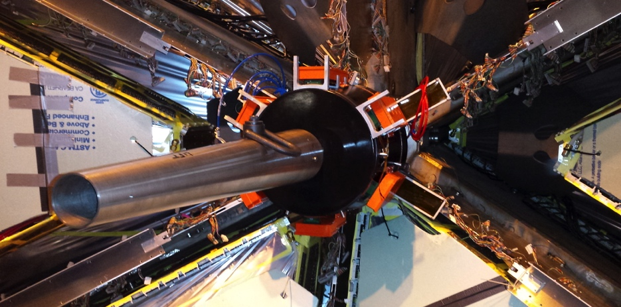
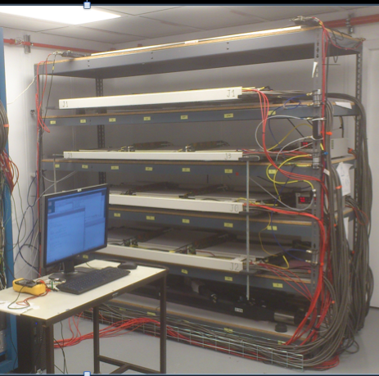
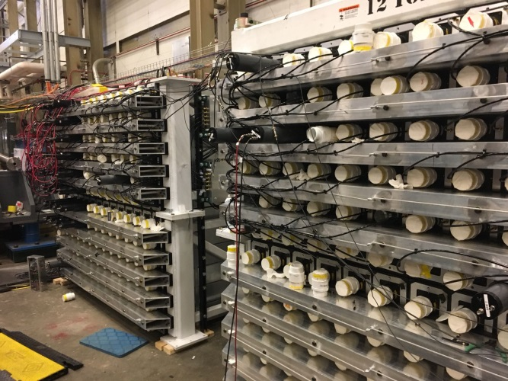
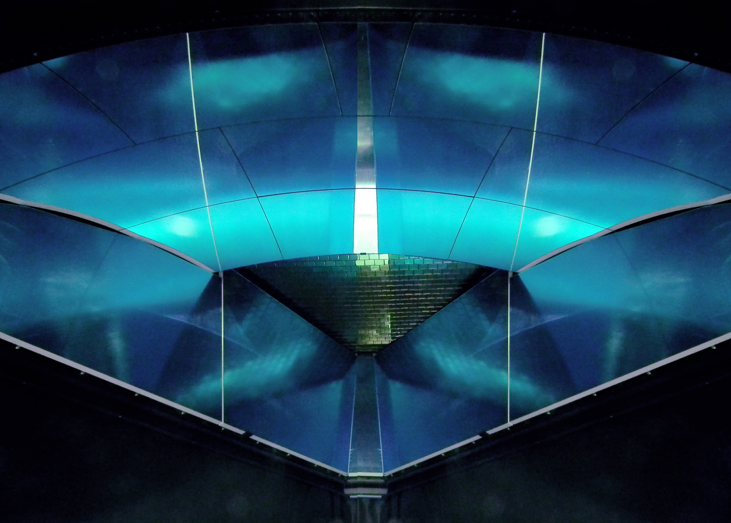
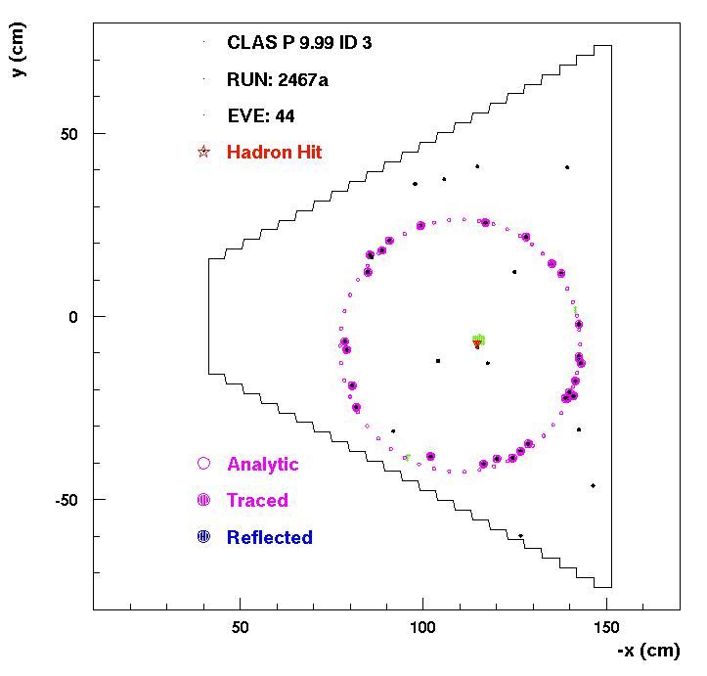
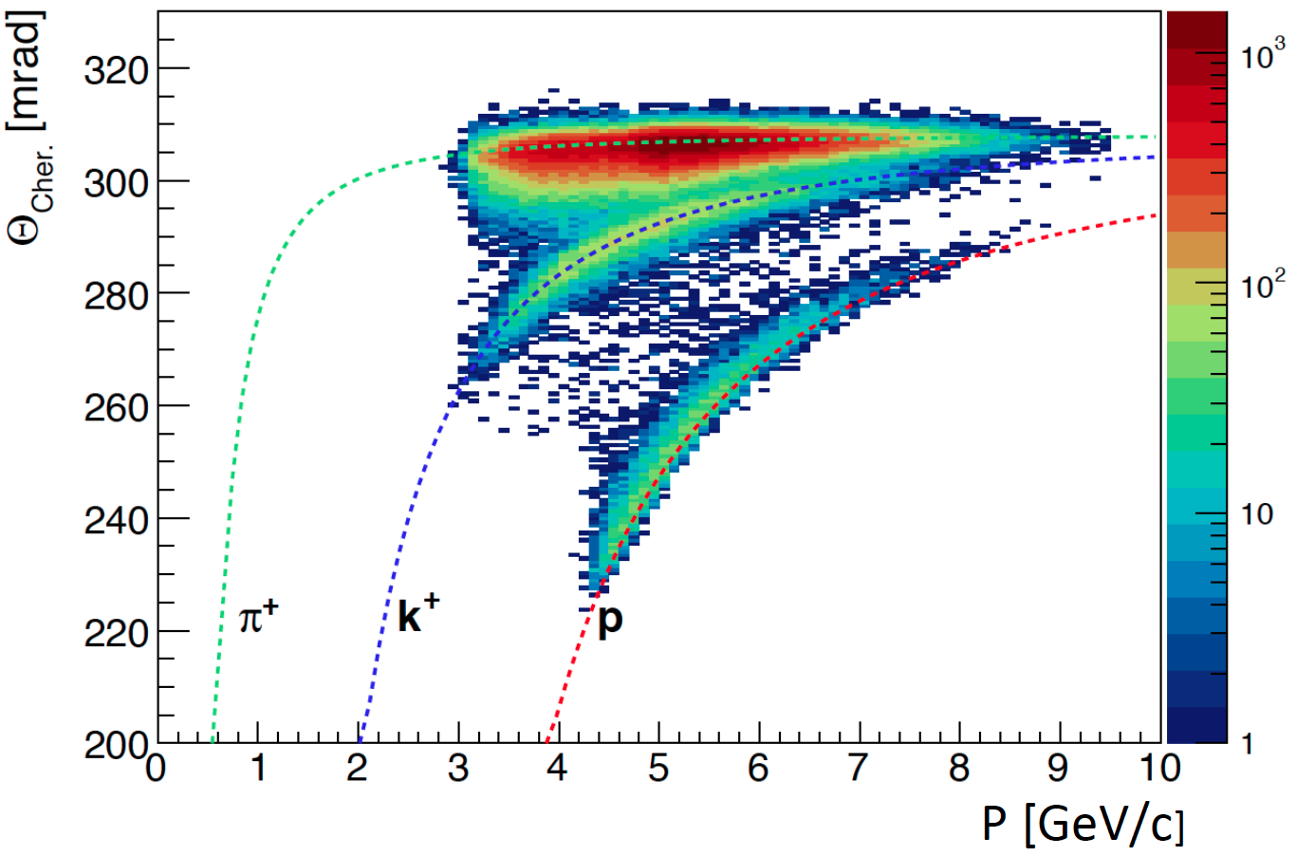
Forward Tagger in Hall-B (CLAS12): e, γ, trigger
INFN @ JLAB
Spokes-persons of > 20 % approved experiments
Chair roles in management, hardware and analysis
GEM tracker & HCAL-J under cosmic test before installation in Hall-A
2 photon invariant mass at 10.6 GeV
σ ~ 4.4 MeV
Ring Cherenkov Detector in Hall-B (CLAS12): Hadron ID

Slide 2
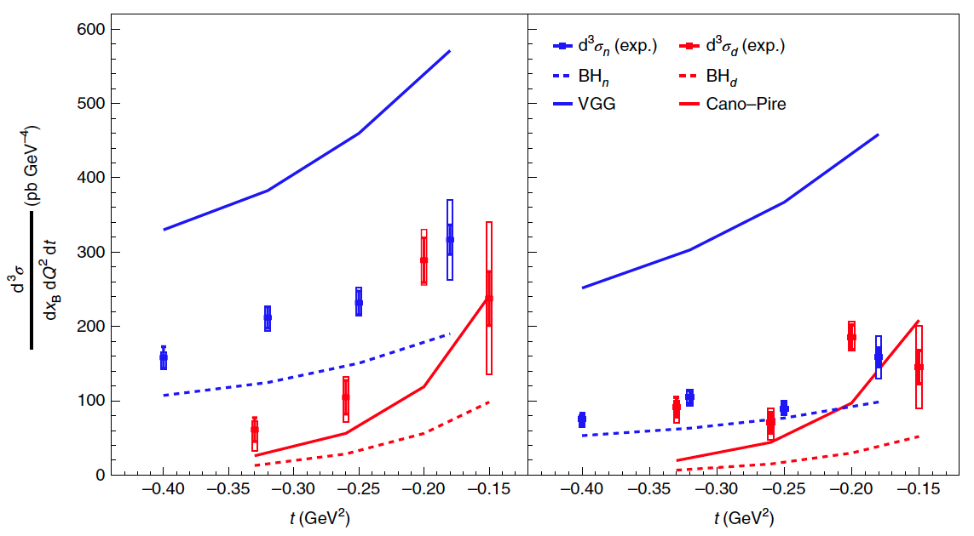
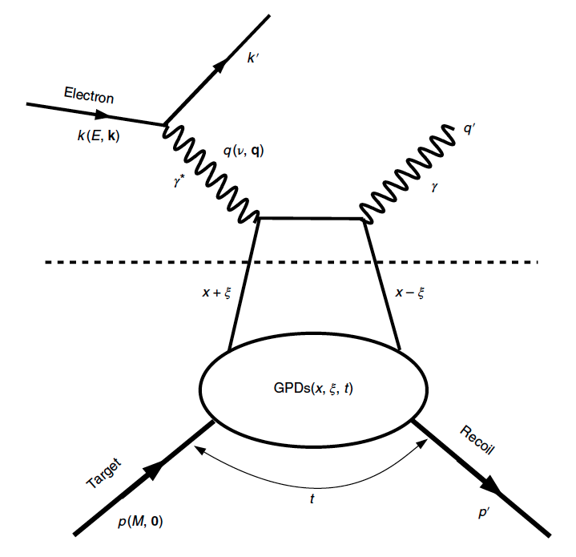


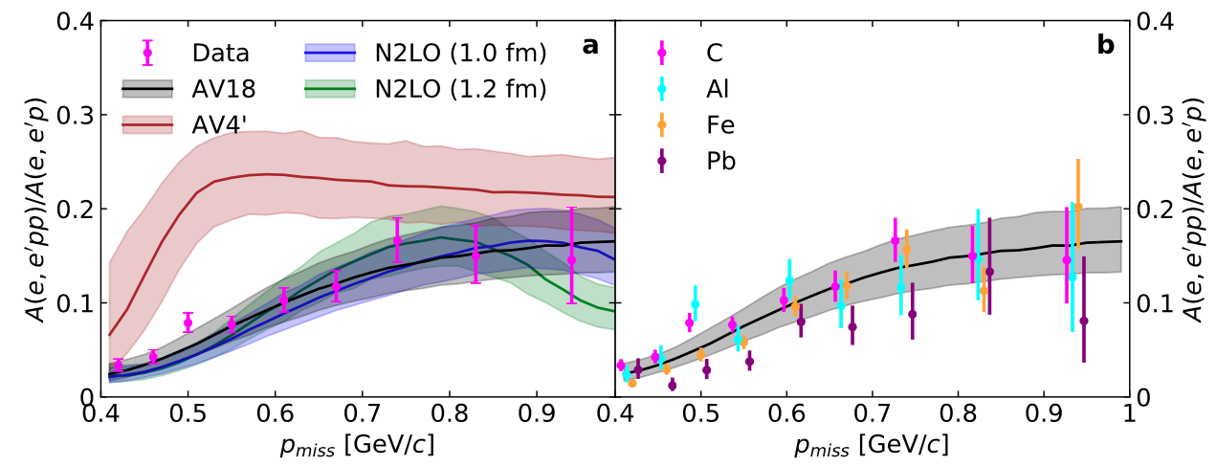
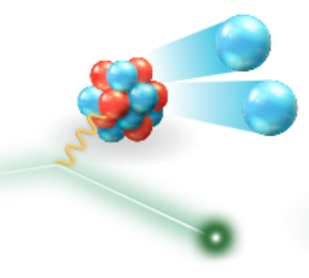
Hall-A deep-virtual Compton scattering measurement on deuteron (ed→edγ)
determines elusive quark flavor contributions to the hadron spin structure
Nature 16 (2020) 191, 198
E^{beam}=4.5 GeV
E^{beam}=5.5 GeV
CLAS scattering measurements on short-range
correlated nucleon pairs probe nuclear interaction
at unprecedented short distances
578 (2030) n.7796, 540-544

Slide 3
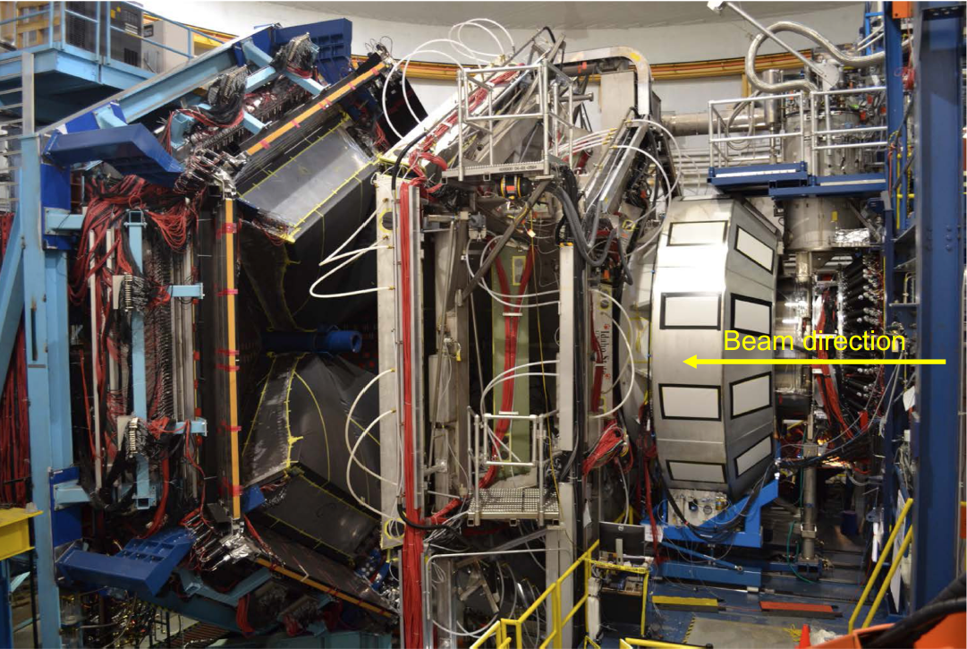
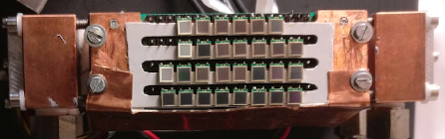
PREX: parity violation in DIS
lead neutron skin and neutron star EoS
CLAS12 and Hall-A:
spin-orbit parton correlations
Strong-commitment in
EIC Precursor Physics
Hadron 3D Structure in the valence
Strong-Force correlations and dynamics
Exotic Hadronic States
Beyond Standard Model Search
GW interferometry
Light dark matter searches
CLAS12: large acceptance spectrometer
SBS: high luminosity spectrometer
& New Technology
Developments:
Luminosity frontier (10³⁹ cm⁻²s⁻¹)
Bulk superconducting magnets
Large-area ring-Imaging detectors
Cost-effective Single Photon Detectors
Trigger-less streaming readout
CLAS12
SBS
HPS
RICH: silicon photomultipliers

