Slide 1
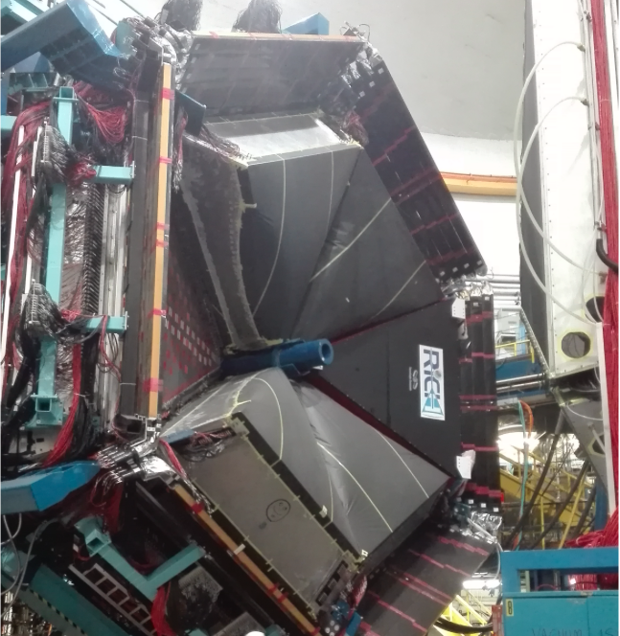

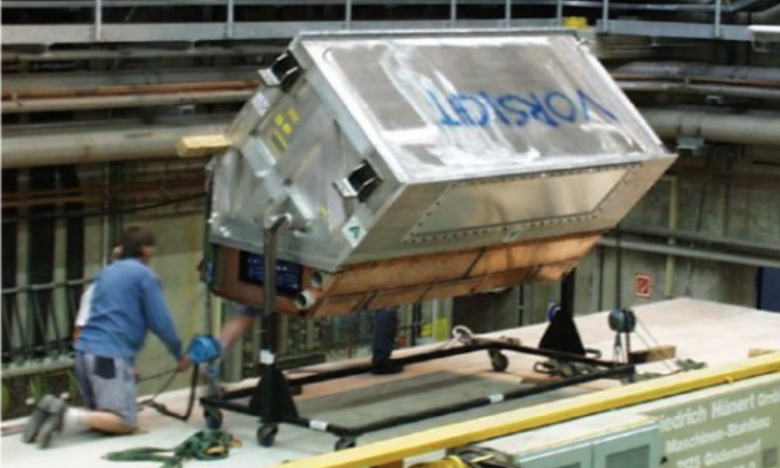
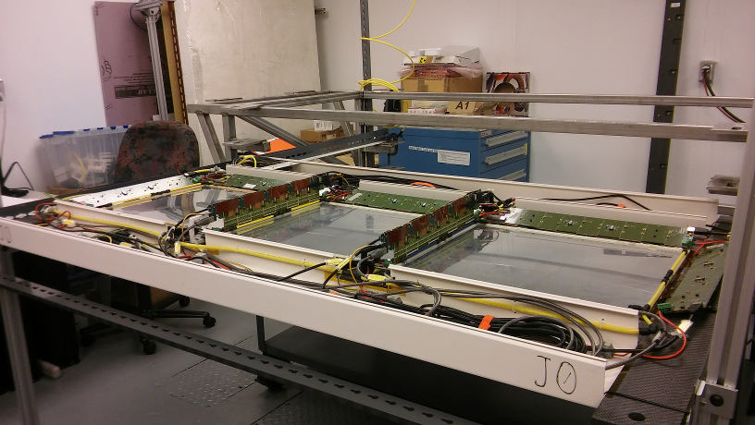
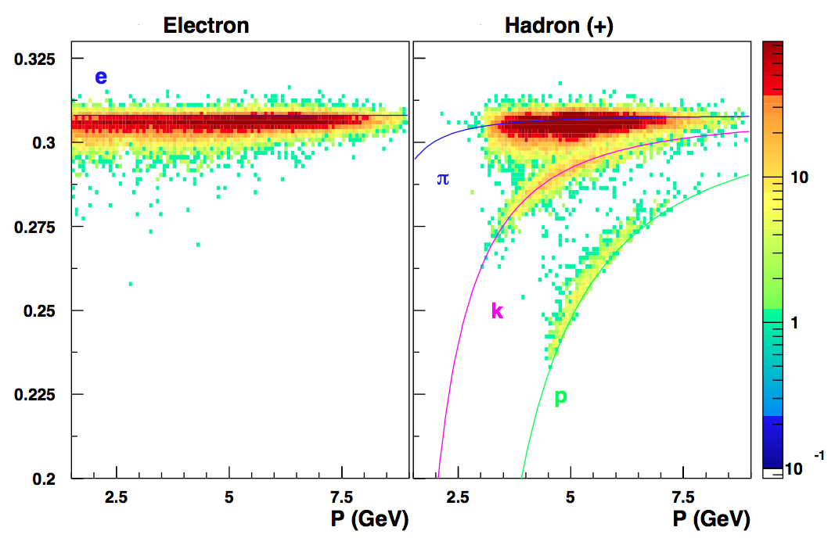
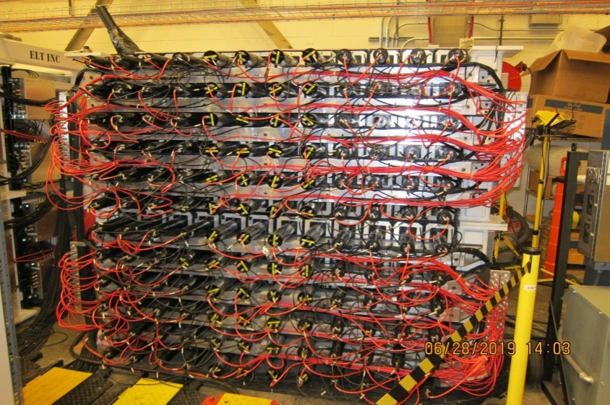
INFN Groups and eRD14
INFN-FE
CLAS12 RICH
Several INFN groups interested to pursue dRICH
and other activities within the eRD14 Consortium
INFN-RM1
HERMES RICH
Hall-A Tracking
INFN-LNF
CLAS12 RICH
INFN-CT
Hall-A HCAL
Contalbrigo M.
EIC eRD14, 19th September 2019
1

Slide 2
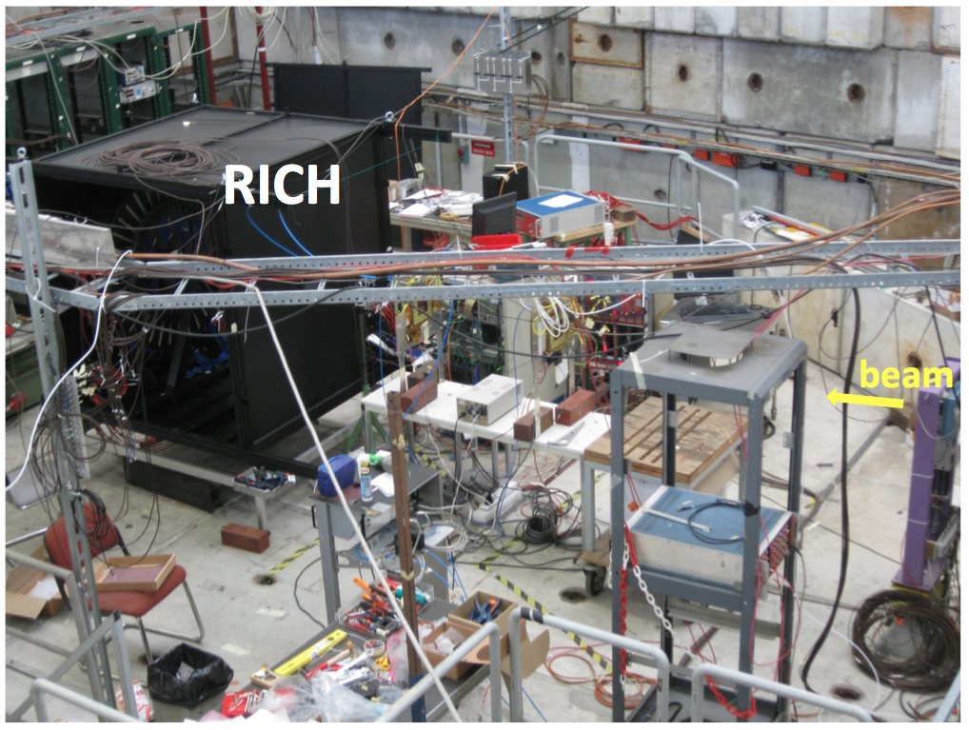
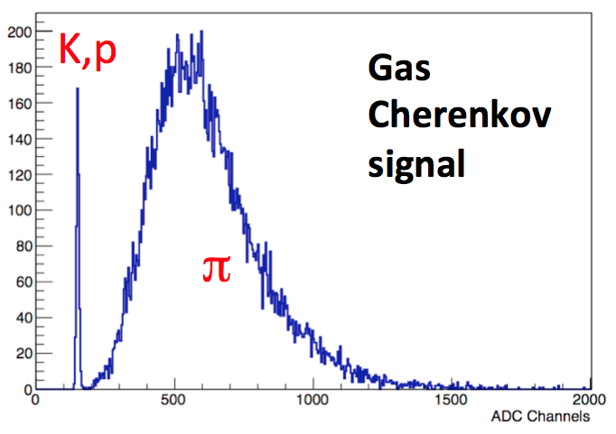
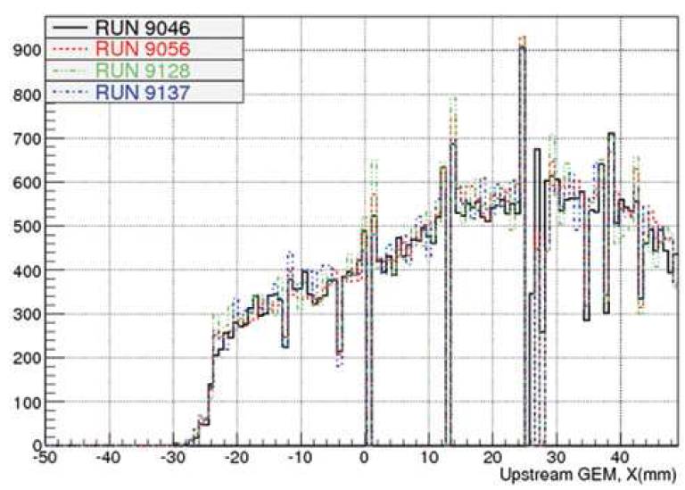
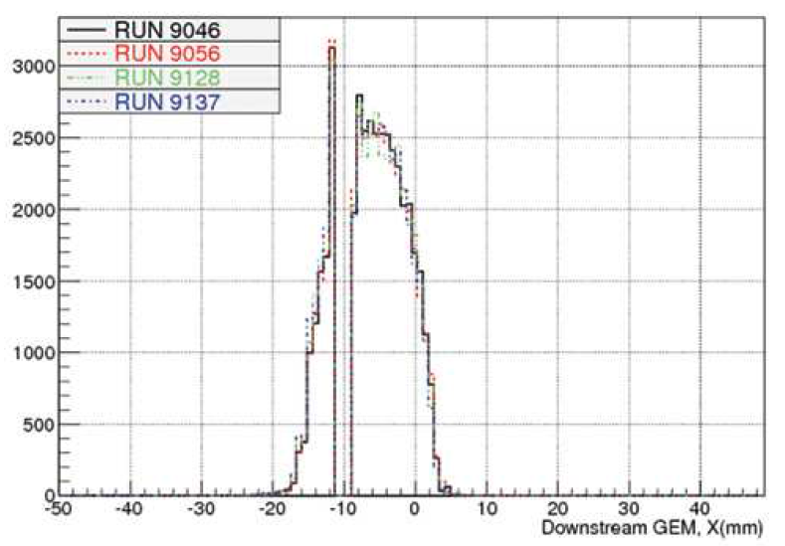
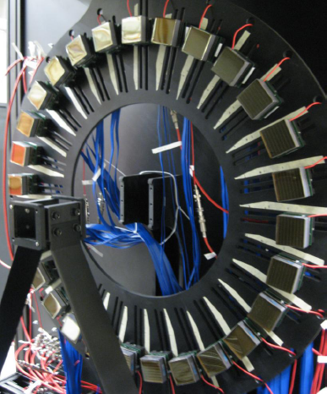
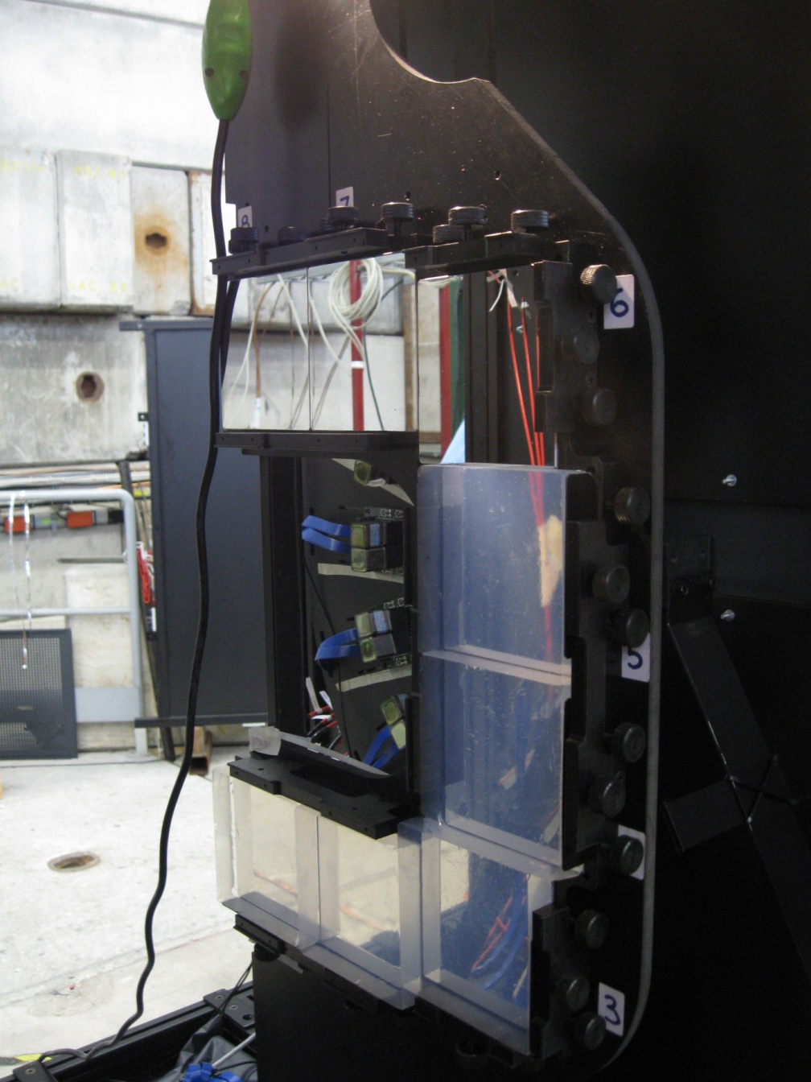
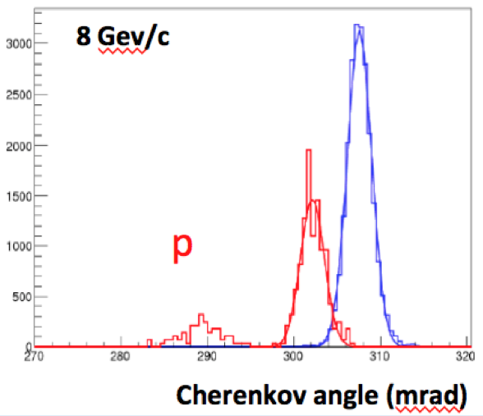
CLAS12 RICH Prototype @ CERN T9
GEM chamber
Front
Back
Goal:
Separation
up to 8 GeV/c
Contalbrigo M.
EIC eRD14, 19th September 2019
2

Slide 3
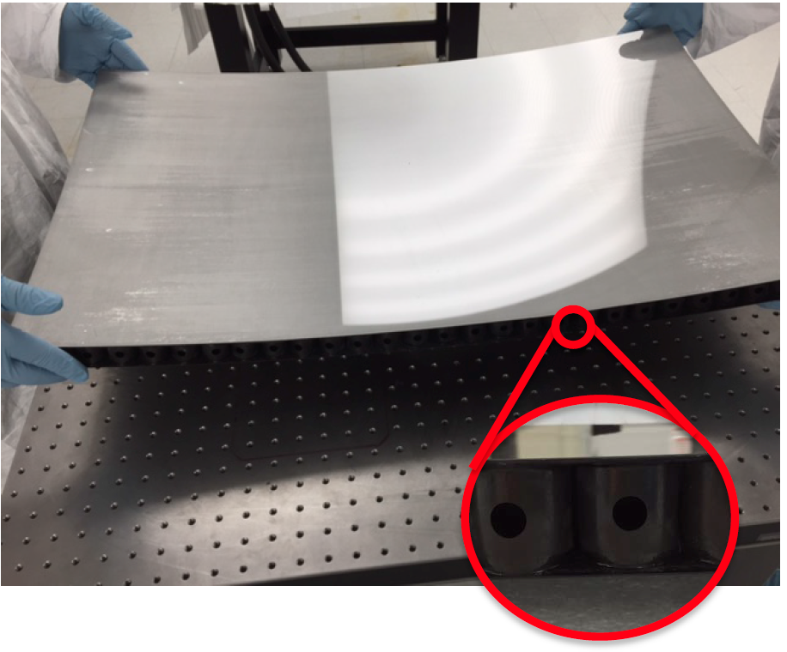
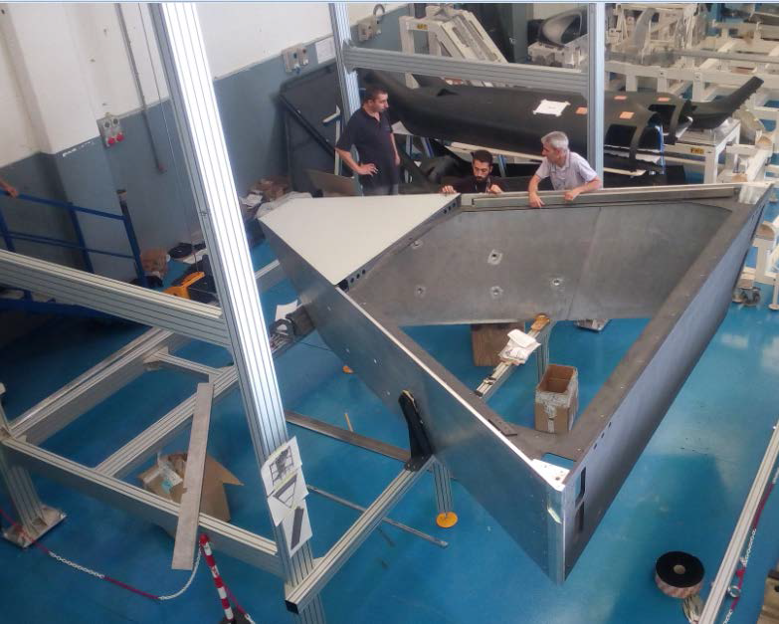
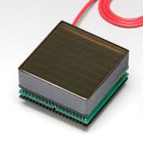
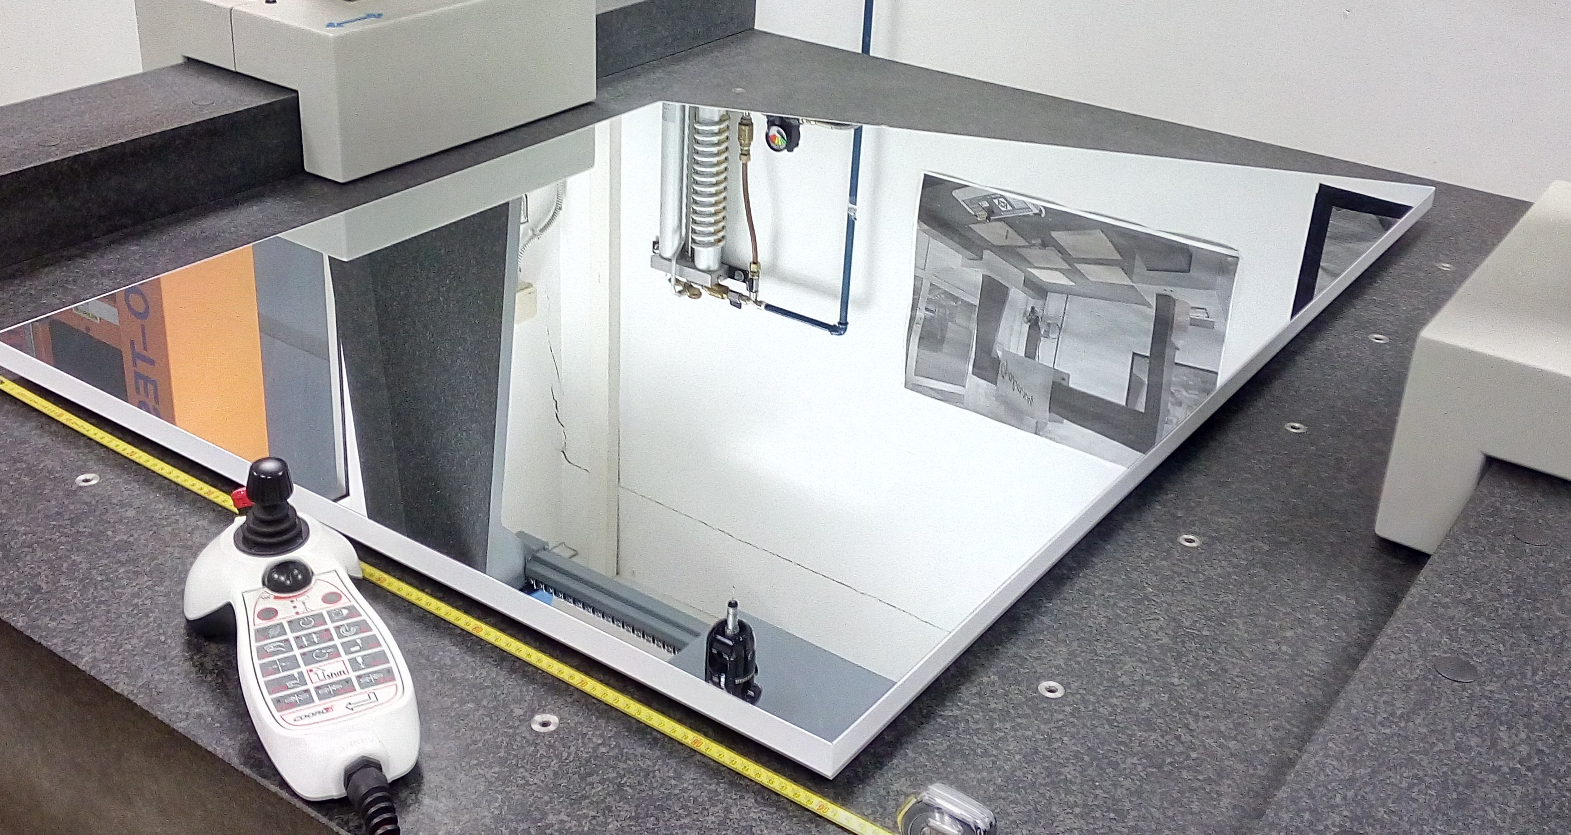
CLAS12 RICH Advances
Aeronautic technology for structure
to maximize lightness and stiffness. Trapezoid of composite materials: CFRP inside acceptance, Al outside
Carbon Fiber Mirrors (spherical)
to maximize lightness and stiffness. Consolidate technology (HERMES, AMS, LHCb) but ~ 30 % material budget reduction
Photon Detector
First use of H8500/H12700
flat panel multi-anode PMTs
64 pixels on a 5x5 cm² area
Glass-Skin Mirrors (planar)
Innovative technology never used in nuclear exps.
~ 1/5 cost for squared meter vs CFRP
Contalbrigo M.
EIC eRD14, 19th September 2019
3
Notes:
Immagine electronic panel e scheda ottica

Slide 4
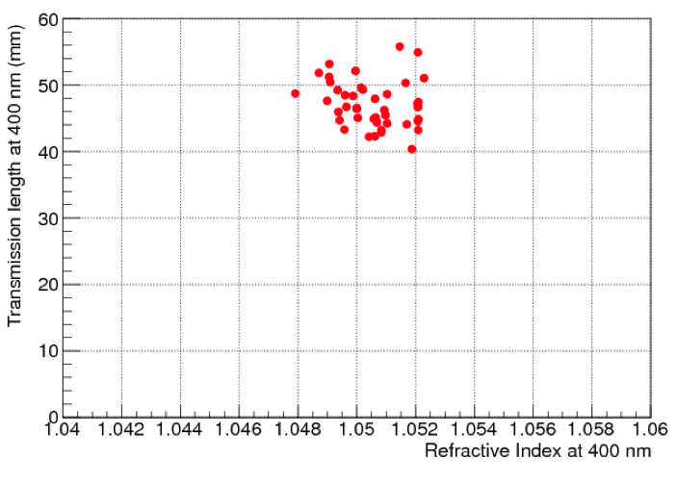
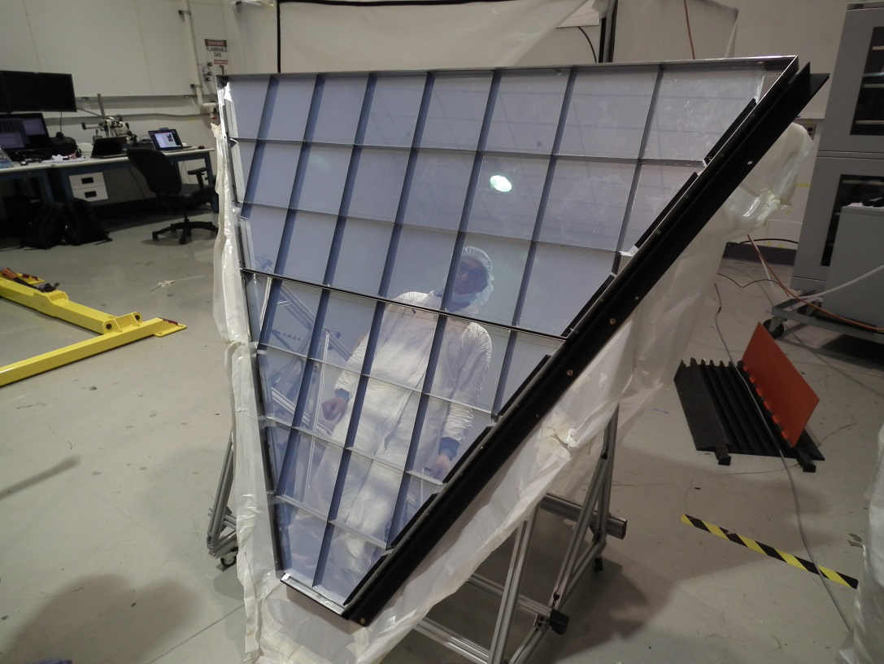
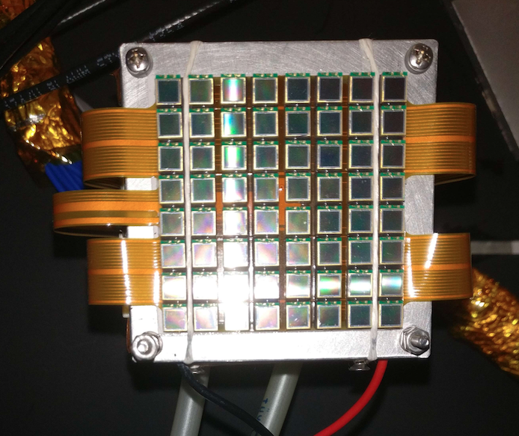
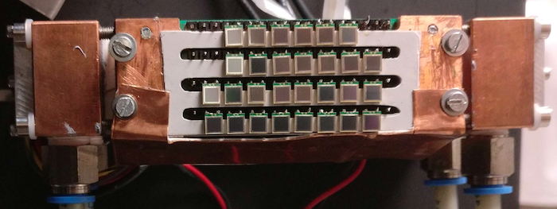
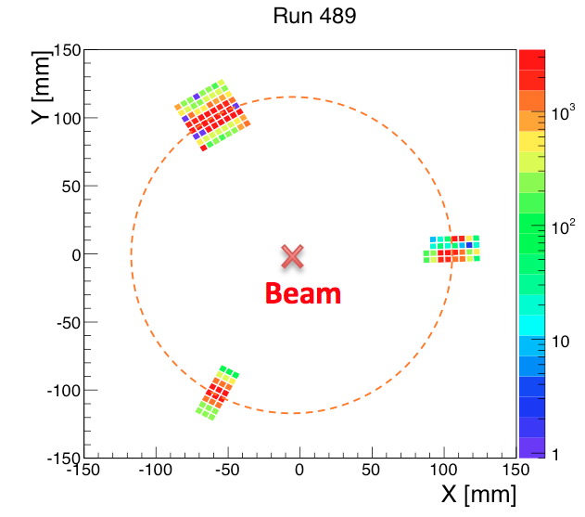
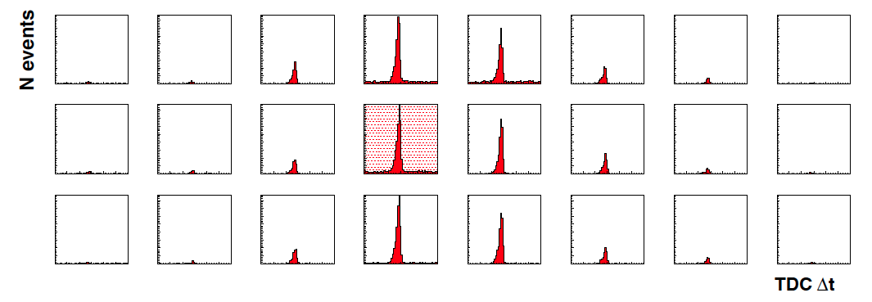
CLAS12 RICH Advances
World leading transparency
At such large n and volumes
Cooled SiPM as
good as PMTs
Contalbrigo M.
EIC eRD14, 19th September 2019
4
Notes:
Immagine electronic panel e scheda ottica

Slide 5
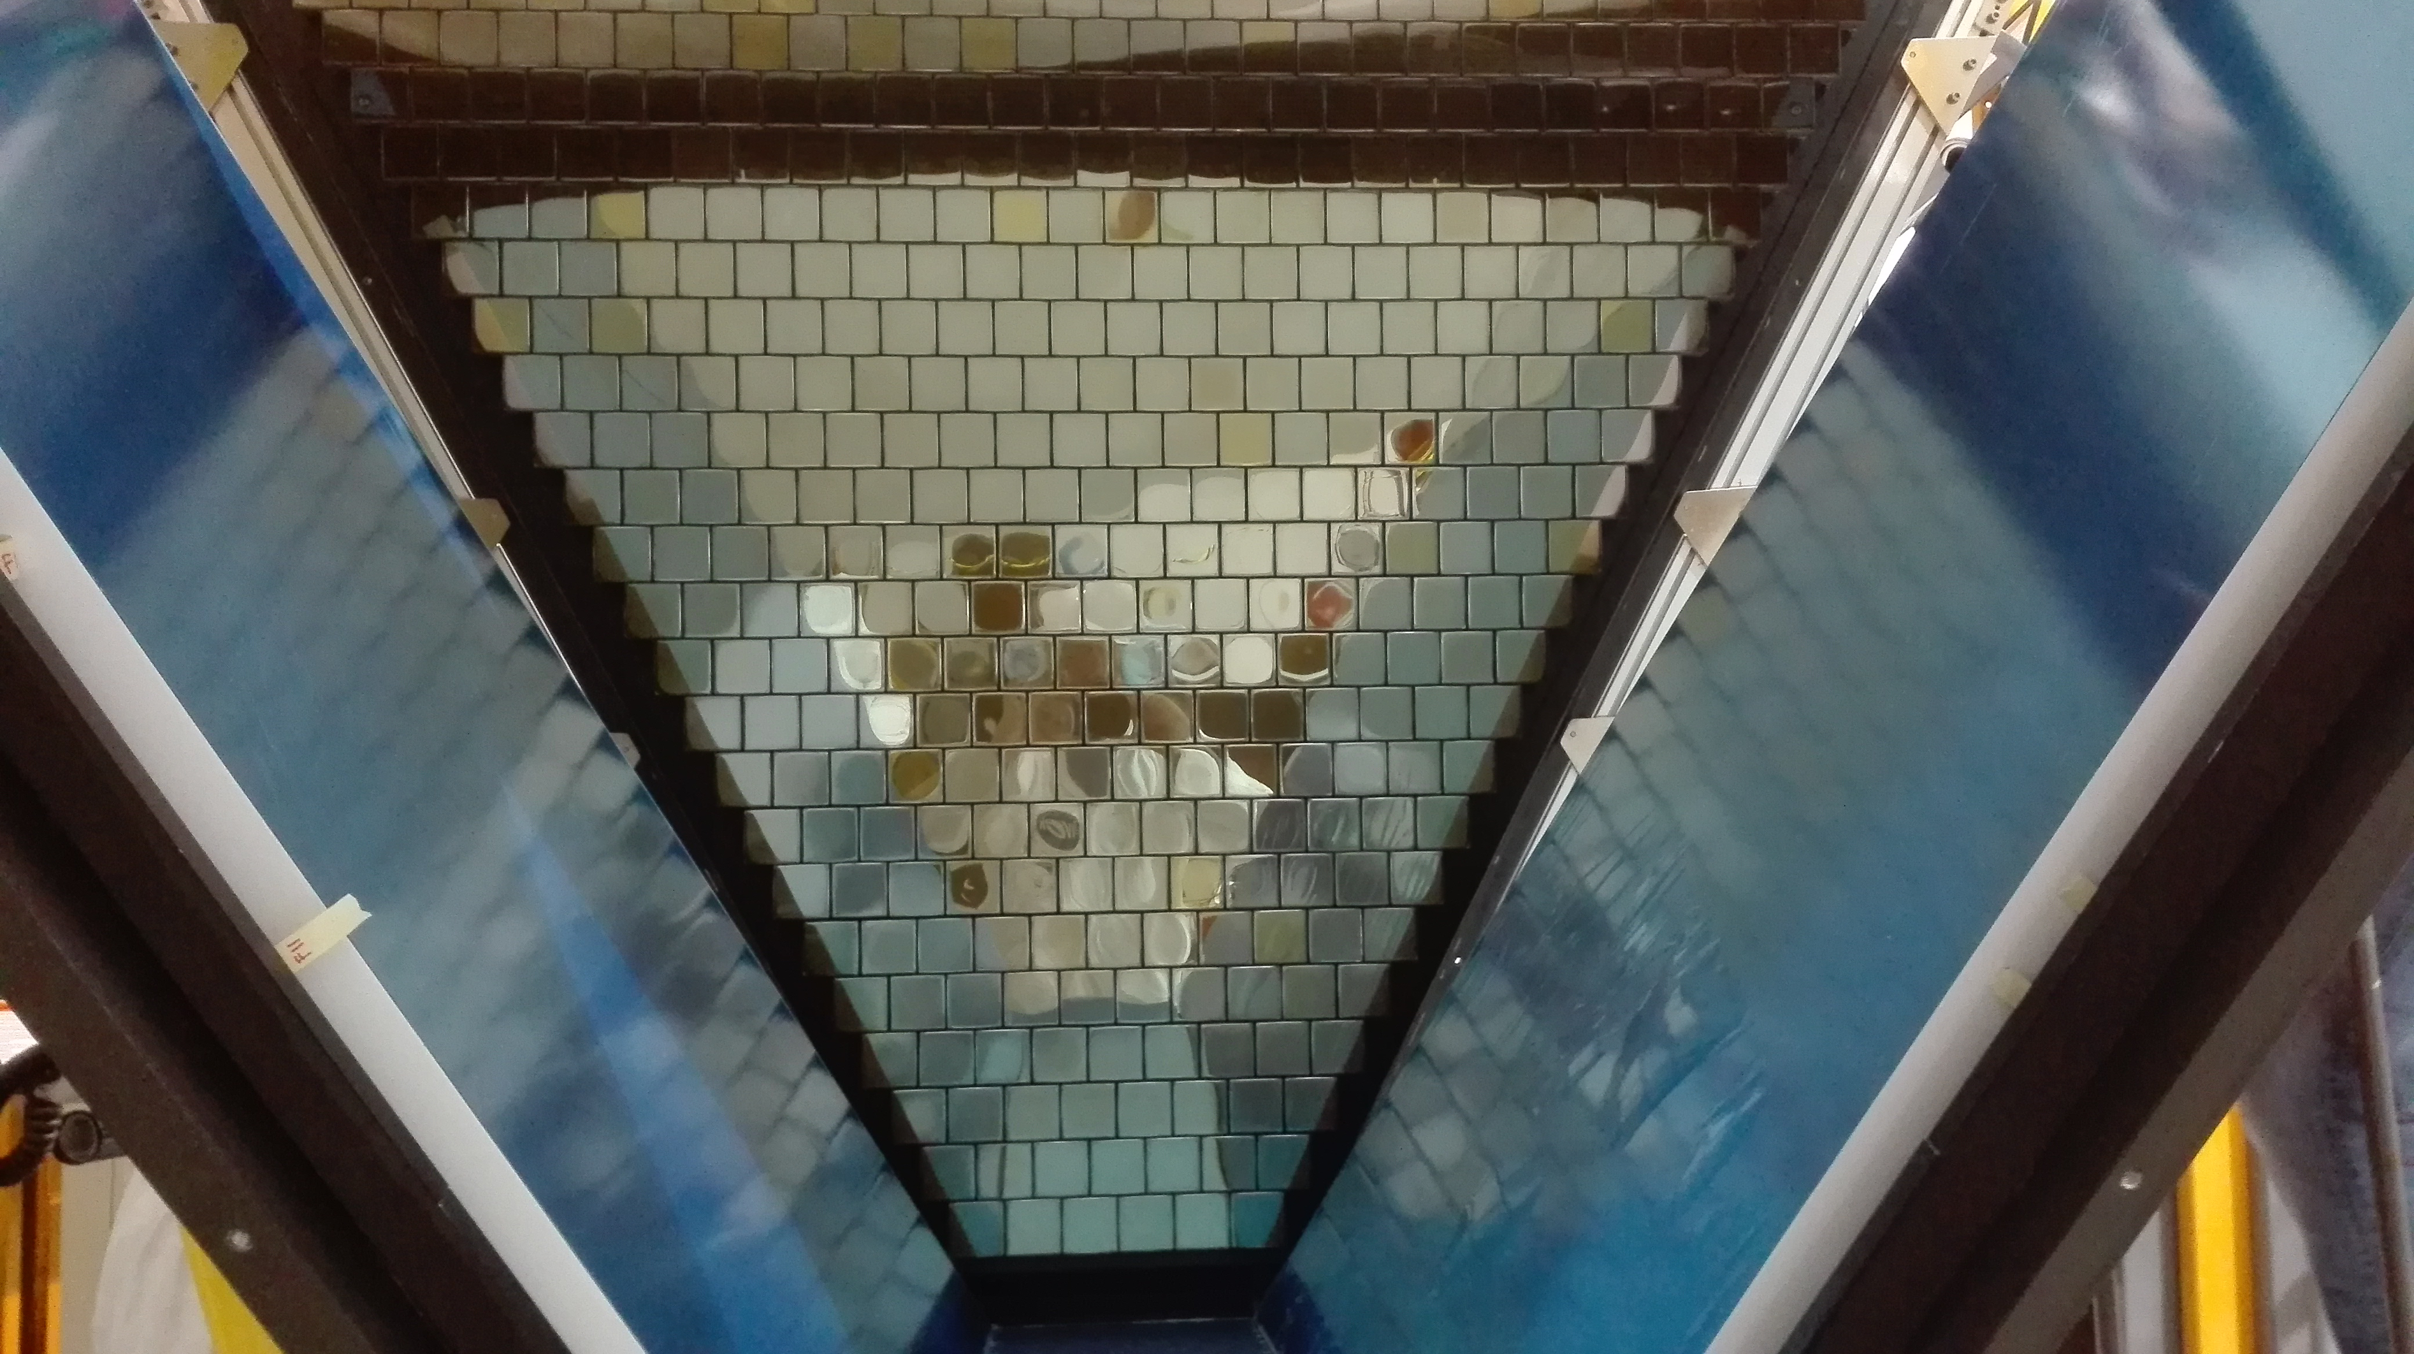
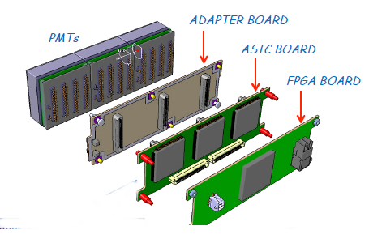
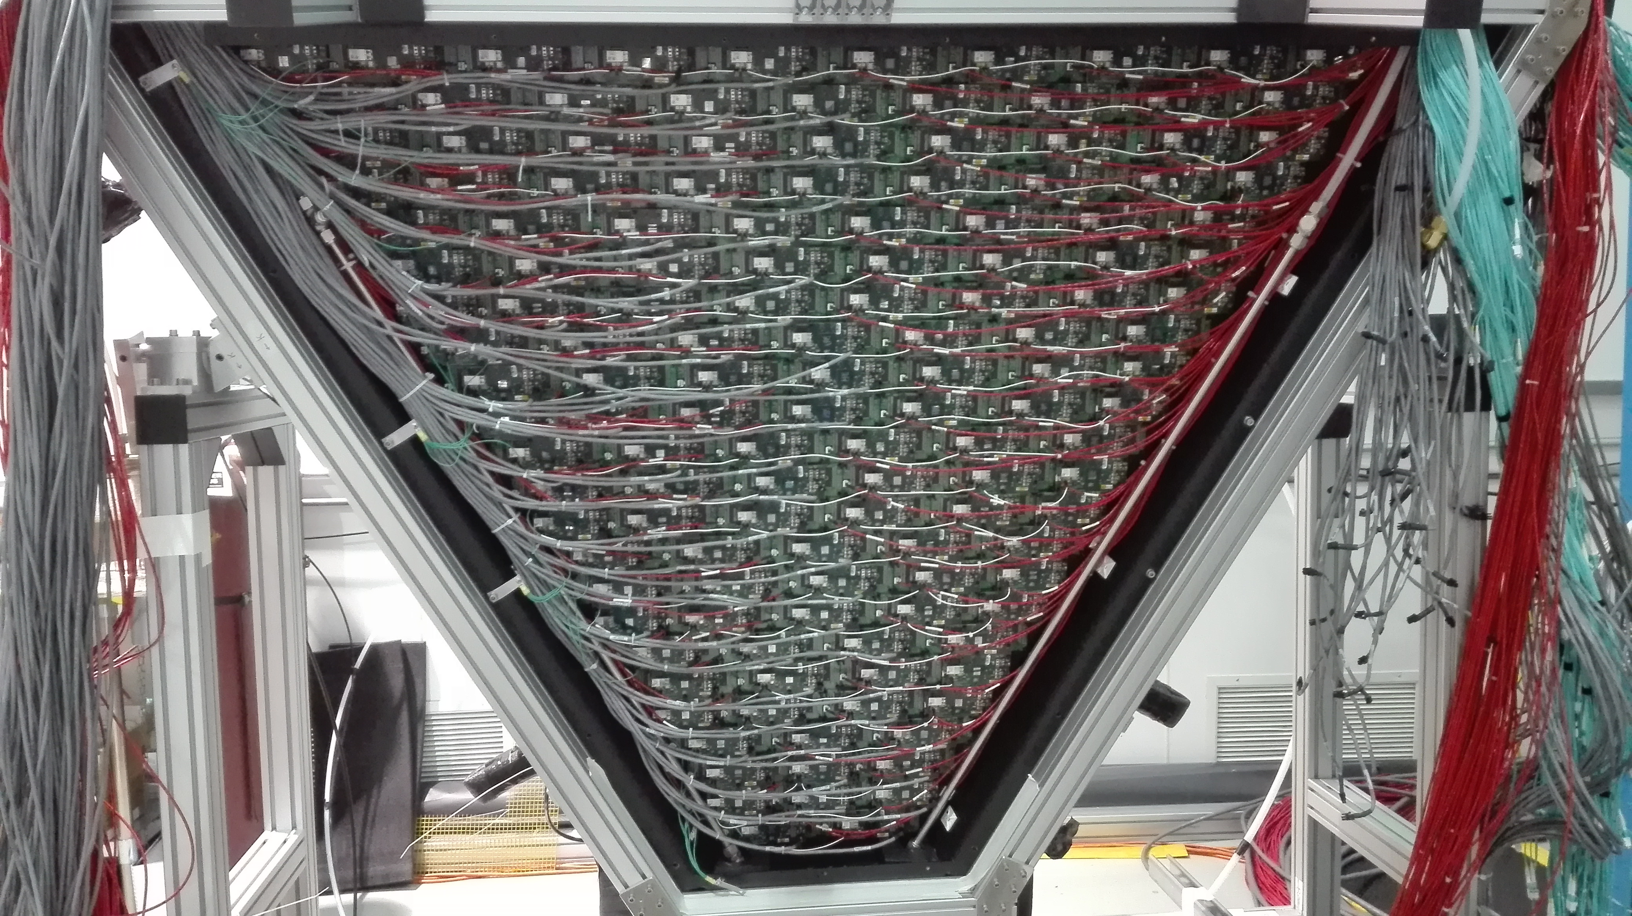
Front-end Electronics
Readout Electronics
Compact (matches sensor area)
Modular Front-End (Mechanical adapter, ASIC, FPGA)
Scalable fiber optic DAQ (TCP/IP or SSP)
Tessellated (common HV, LV and optical fiber)
Optical
Fiber
HV
LV
Applications:
- EIC R&D
- Gluex DIRC
- SOLID
- Medical Imaging
- Homeland Security
Contalbrigo M.
EIC eRD14, 19th September 2019
5
Notes:
Immagine electronic panel e scheda ottica

Slide 6
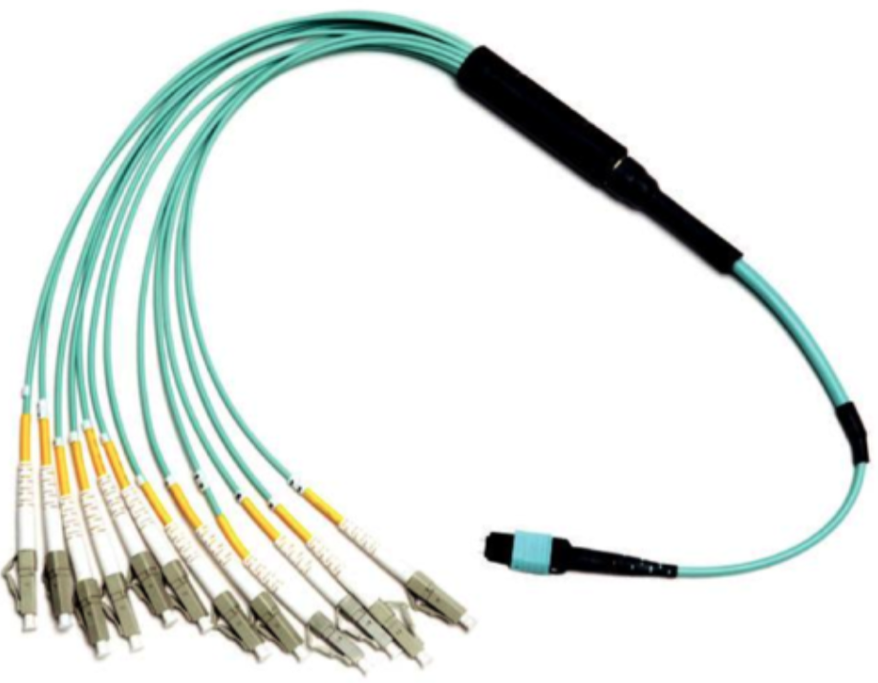
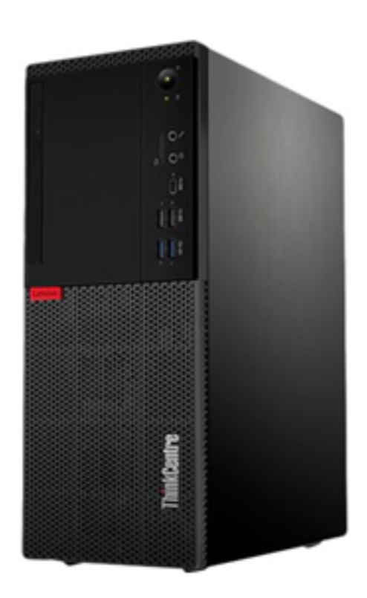
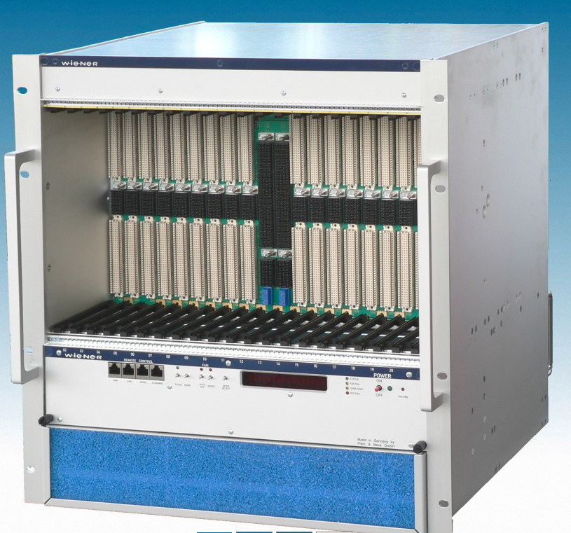
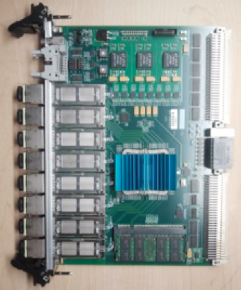
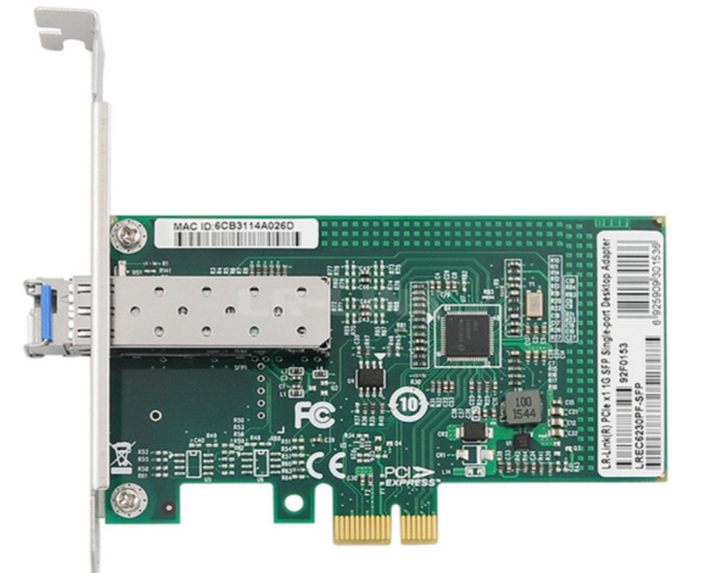
Back-end Electronics (JLab)
Optical bridge / PC Desktop
Few FPGA units ~ 500 channels
SSP board / VSX crate
2 RICH sectors ~ 50 k channels
Optical ethernet (2.5 Gbps)
Small setups:
TCP/IP
Optical bridge / PC Desktop
Full experiment:
SSP protocol
SSP board / VSX crate
Next:
Ethernet Switches
Contalbrigo M.
EIC eRD14, 19th September 2019
Contalbrigo M.
6
Notes:
Aggiungere range di validita’ per fattorizzazione GPDs

Slide 7
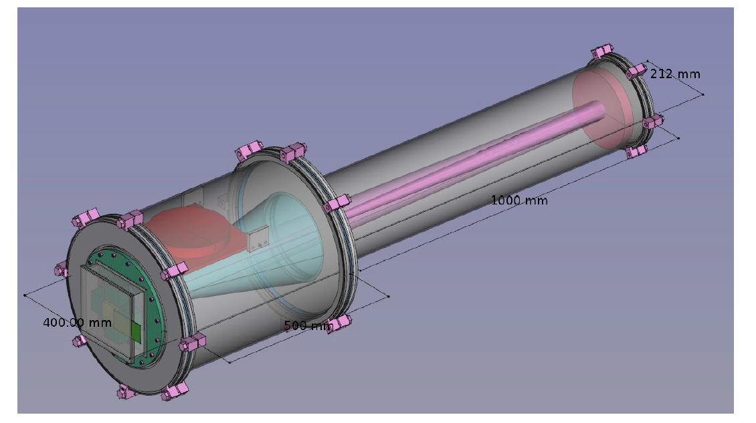
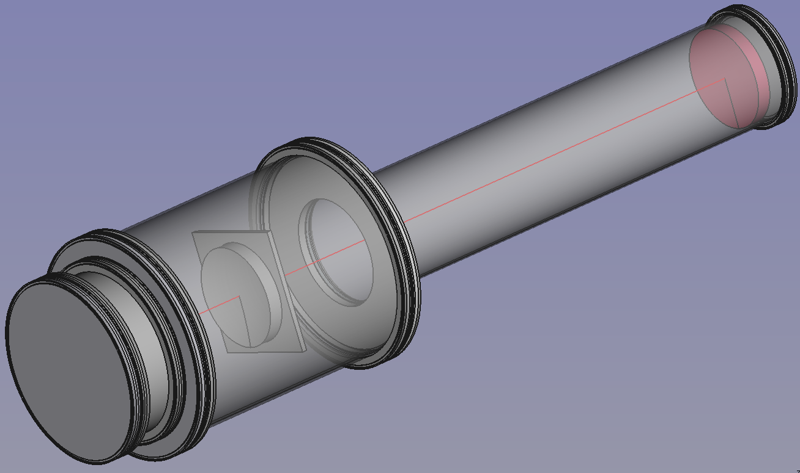
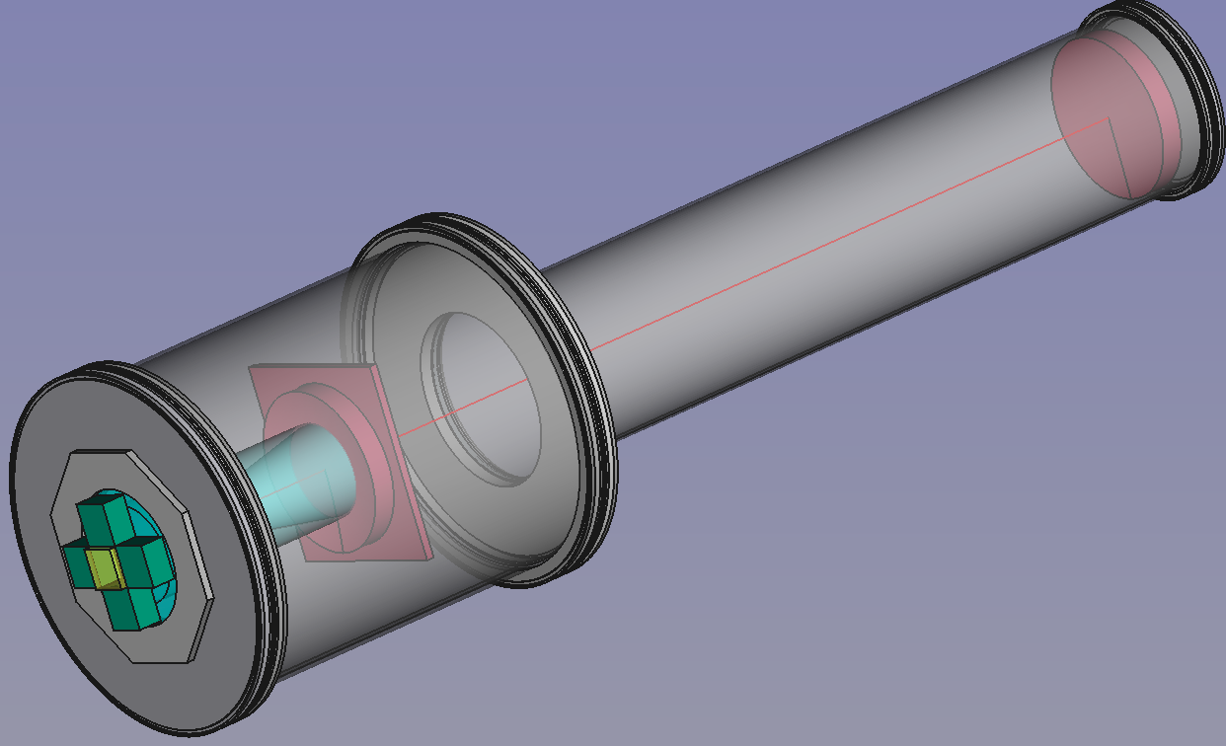
dRICH Prototype Design
Gas Exchange
Aerogel Conf.
Commercial vacuum technology for safety and cost effectiveness
Overlapping rings for parallel beam particles
Contalbrigo M.
EIC eRD14, 19th September 2019
Contalbrigo M.
7
Notes:
Fare una immagine del PMT sulla risoluzione

Slide 8
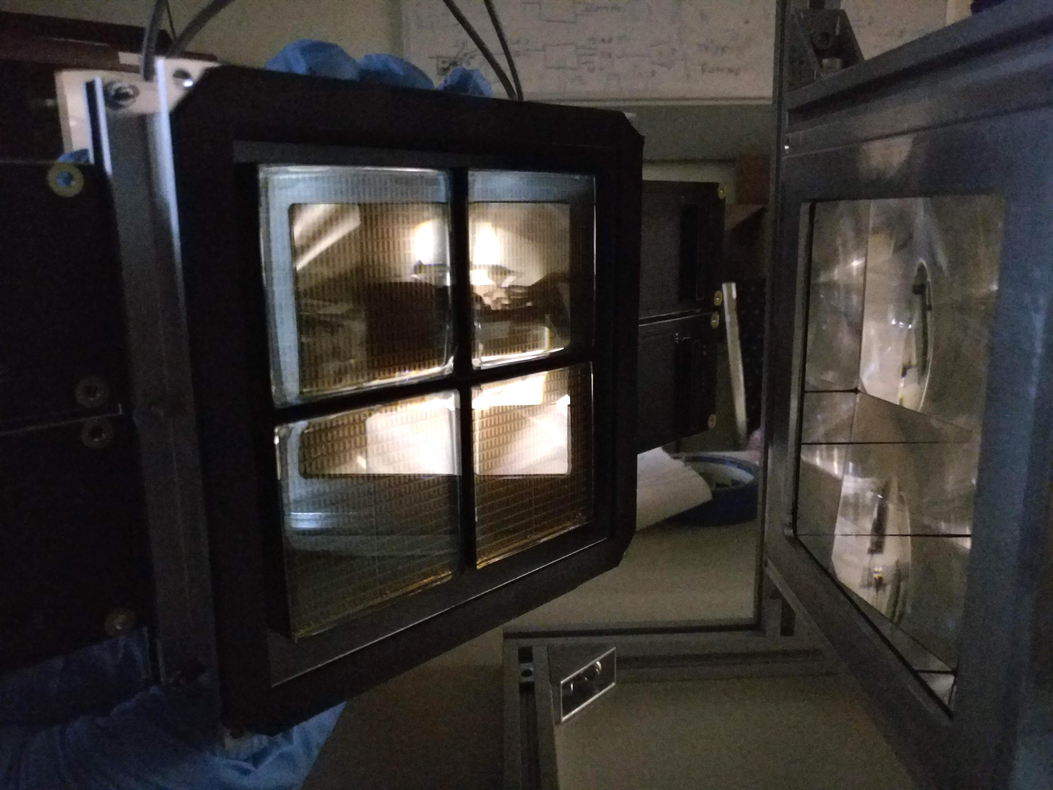
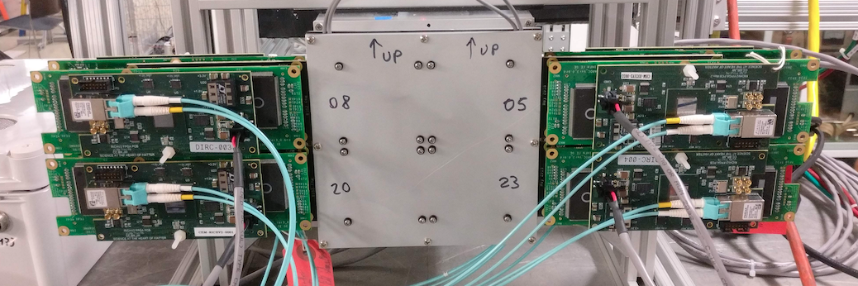
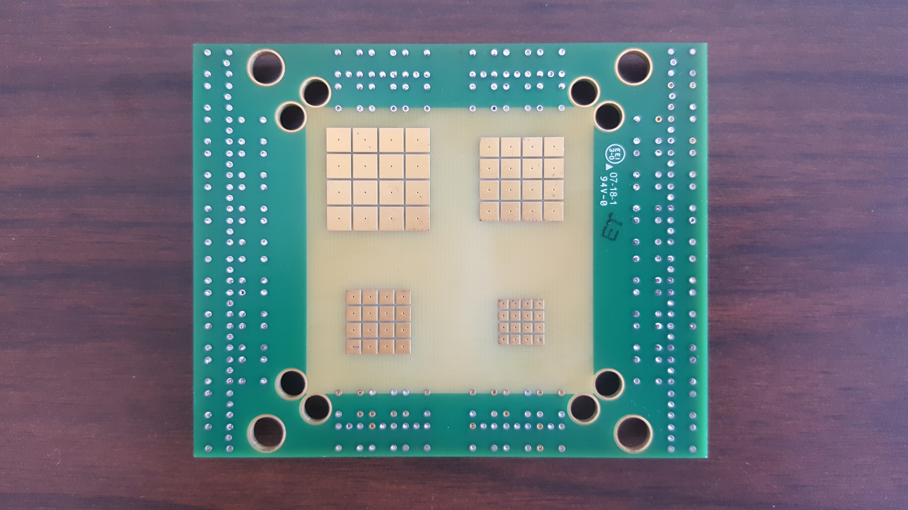
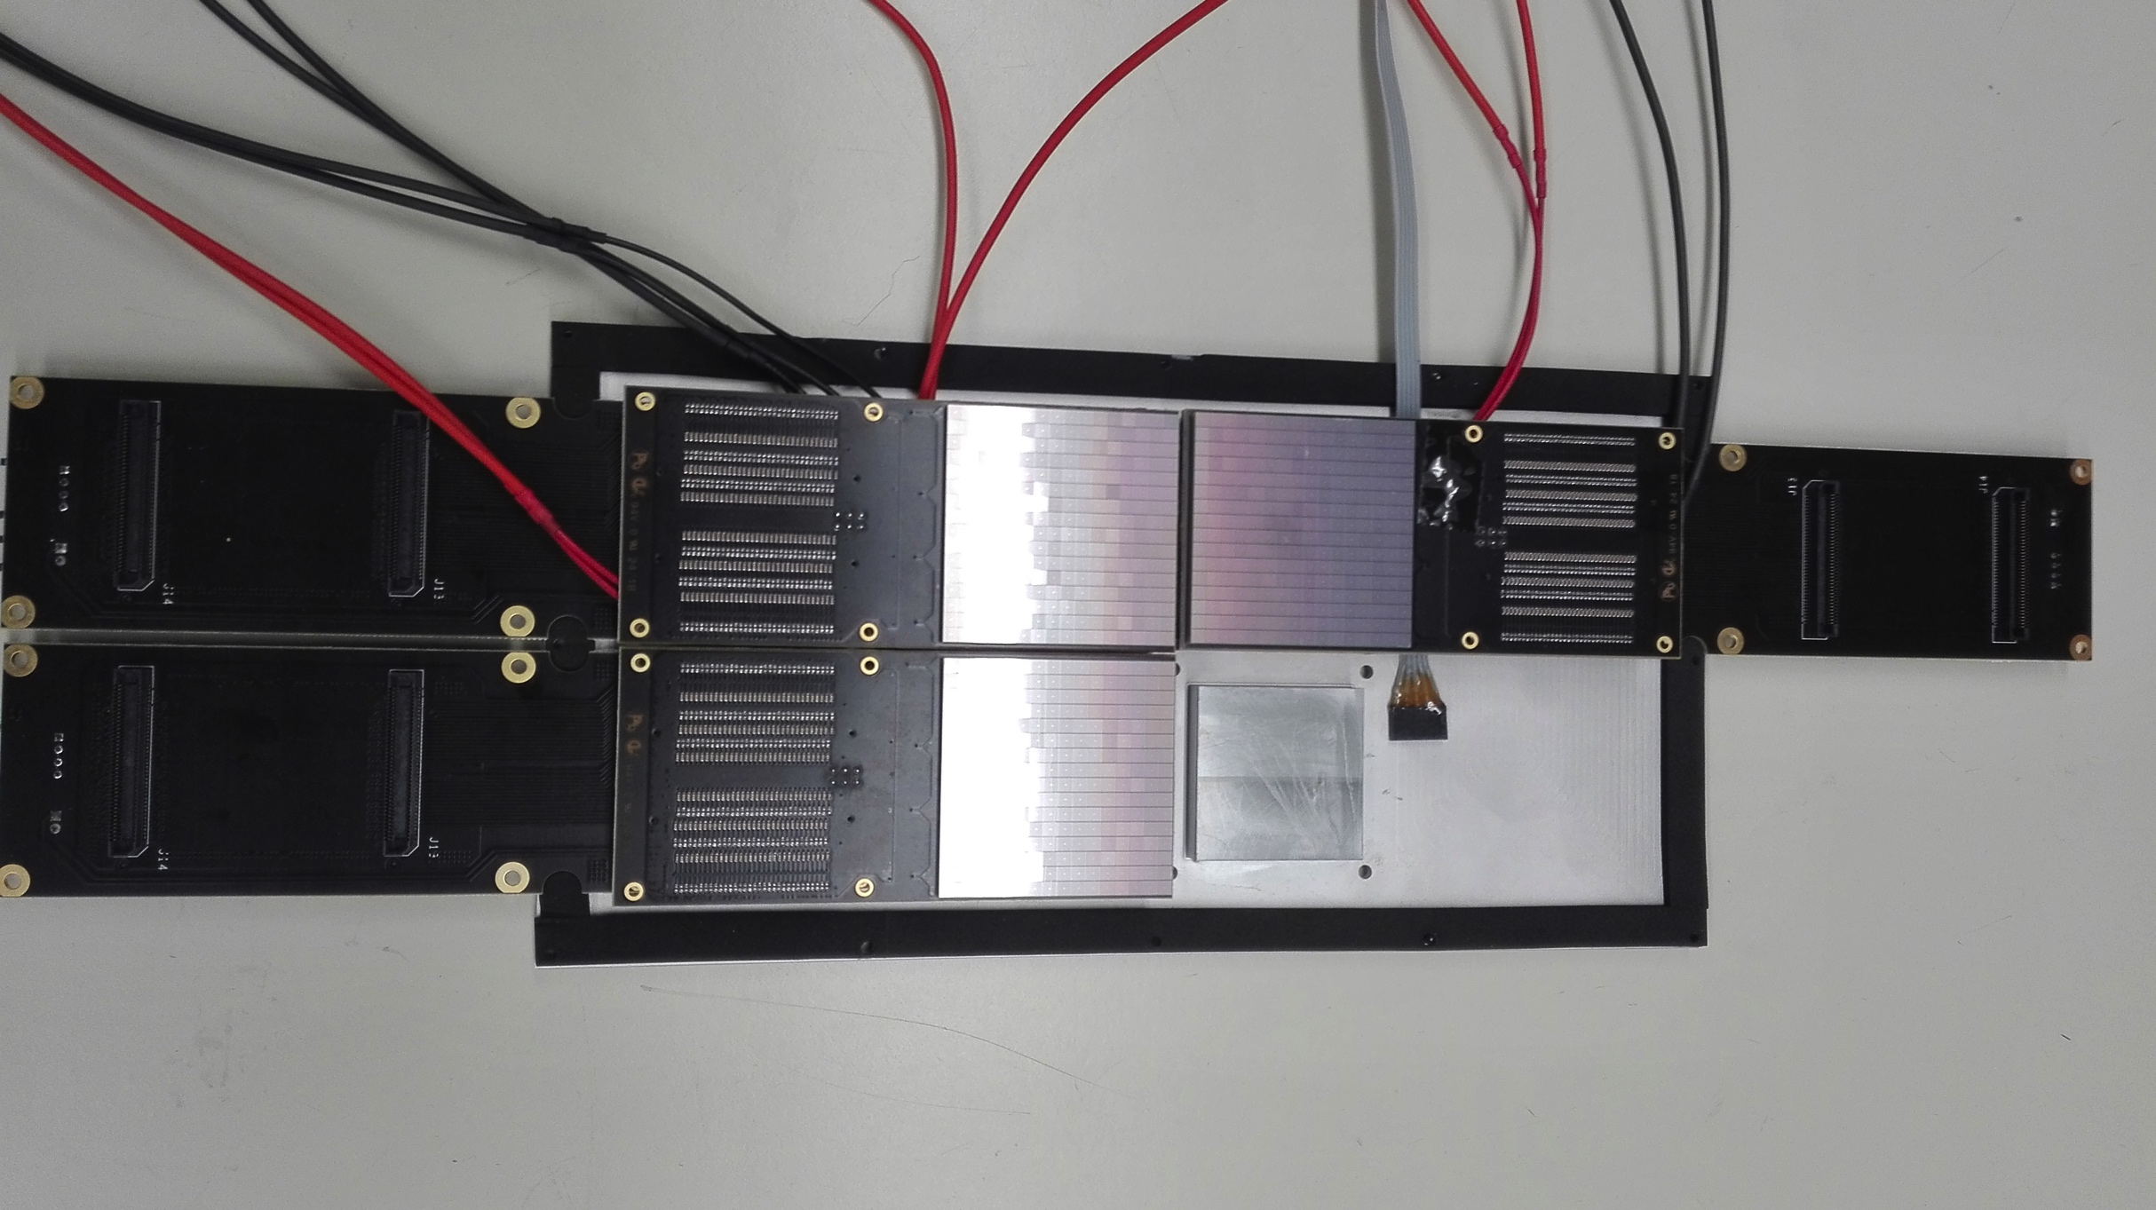
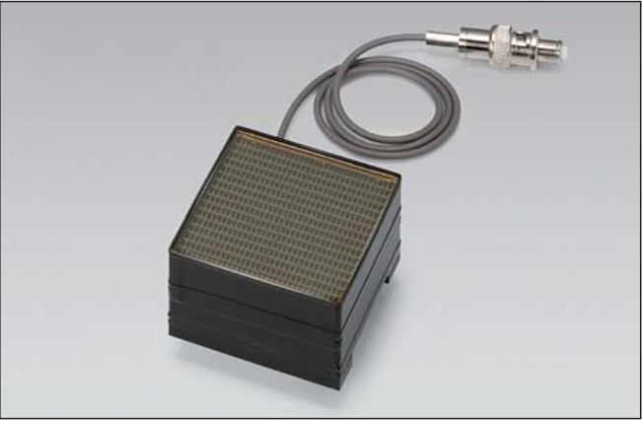
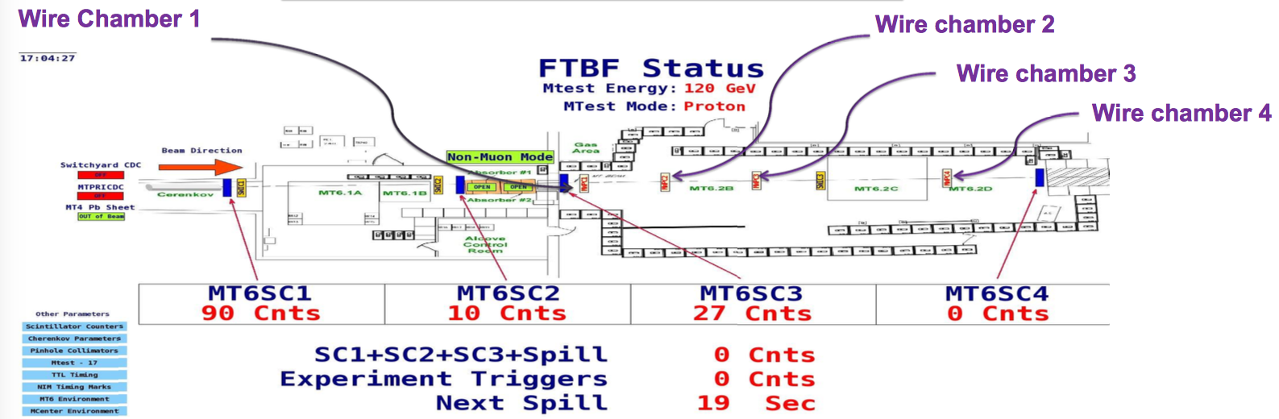
dRICH Prototype Test
Readout box
Independent element
for flexibility: supports
various detectors,
cooling, UV filters….
Sensors
Reference:
MA-PMTs
B-field tolerant:
MCP-PMTs (LAPPDs)
SiPMs
Ancillary Systems:
Gas Cherenkov for tagging (FTBF beam line)
MWPC chambers for tracking (FTBF beam line)
GEM chambers for tracking (basic version in house)
Gas recirculating circuit (optional)
Contalbrigo M.
EIC eRD14, 19th September 2019
Contalbrigo M.
8
Notes:
Fare una immagine del PMT sulla risoluzione

Slide 9
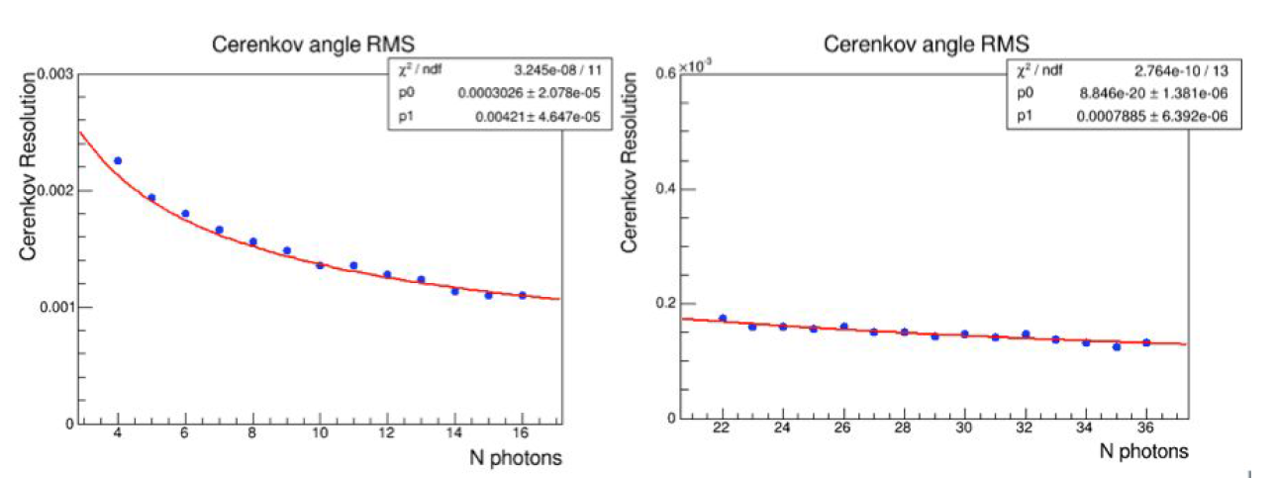
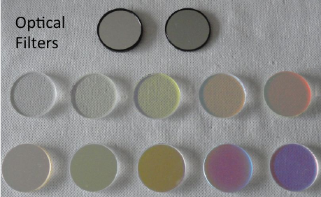
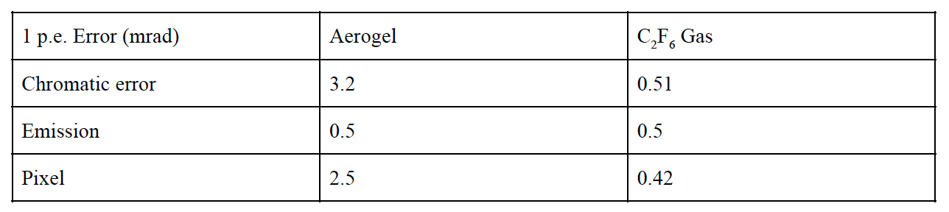
dRICH Prototype Performance
Montecarlo simulation
Aerogel
Gas
Filters to study and
control chromatic
dispersion
(2.9)
(0.5)
(0.5)
(0.8)
(1.2)
(0.5)
Contalbrigo M.
EIC eRD14, 19th September 2019
Contalbrigo M.
9
Notes:
Fare una immagine del PMT sulla risoluzione

Slide 10
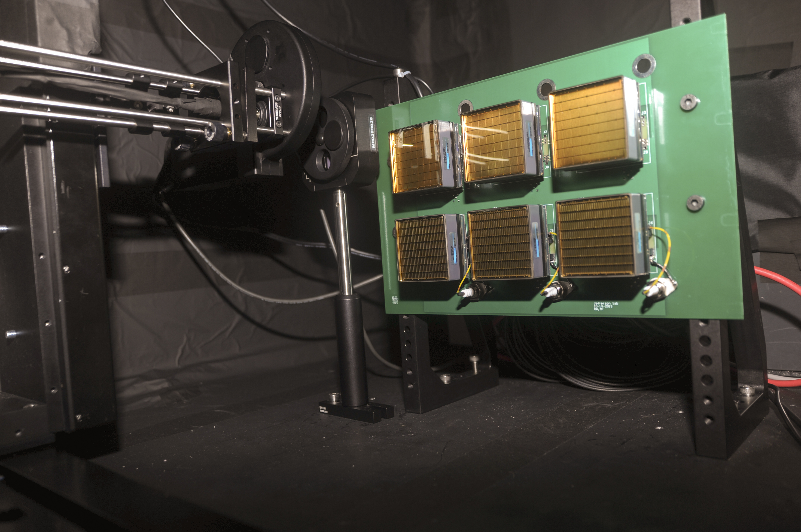
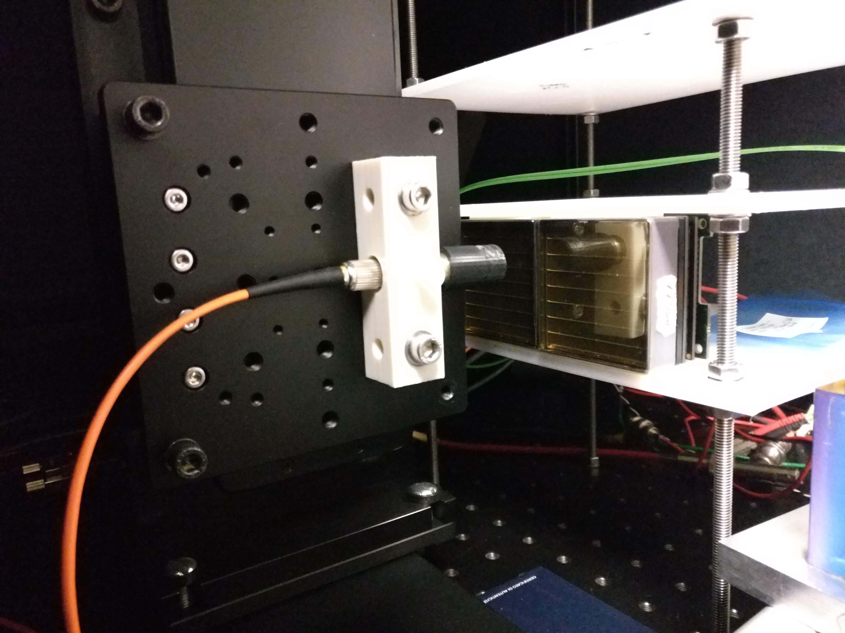
Pulsed Laser Test Benches
Detailed characterization
Sensors: gain, efficiency, cross-talk, radiation tolerance
Electronics: gain, cross-talk, thresholds, time resolution
JLab
632 nm picosecond pulsed laser light
Light diffuser to illuminate the whole MAPMT surface
Standardized system with CLAS12 electronics
H8500 6x6 mm² pixel sensor so far
Laser head +
diffuser
MAPMT holder
INFN
632 nm and 407 nm picosecond pulsed laser light
Light concentrator to scan the sensor surface
Flexible layout supporting various sensors and
Front-End electronics
Laser head +
collimator
MAPMT holder
Contalbrigo M.
EIC eRD14, 19th September 2019
Contalbrigo M.
10
Notes:
Fare una immagine del PMT sulla risoluzione

Slide 11
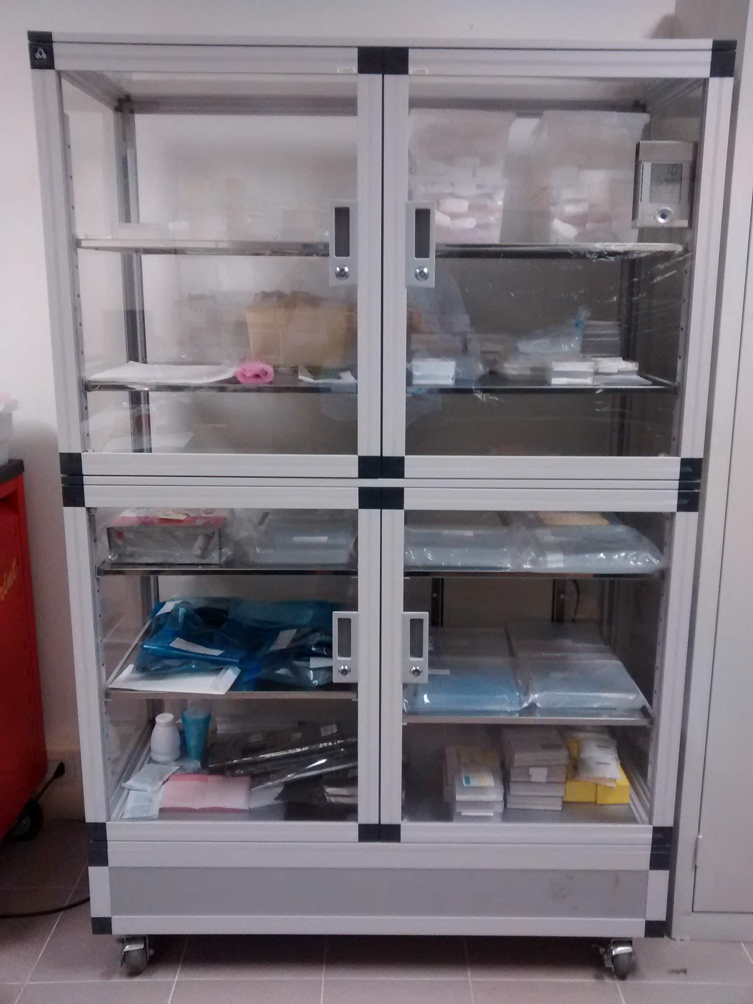
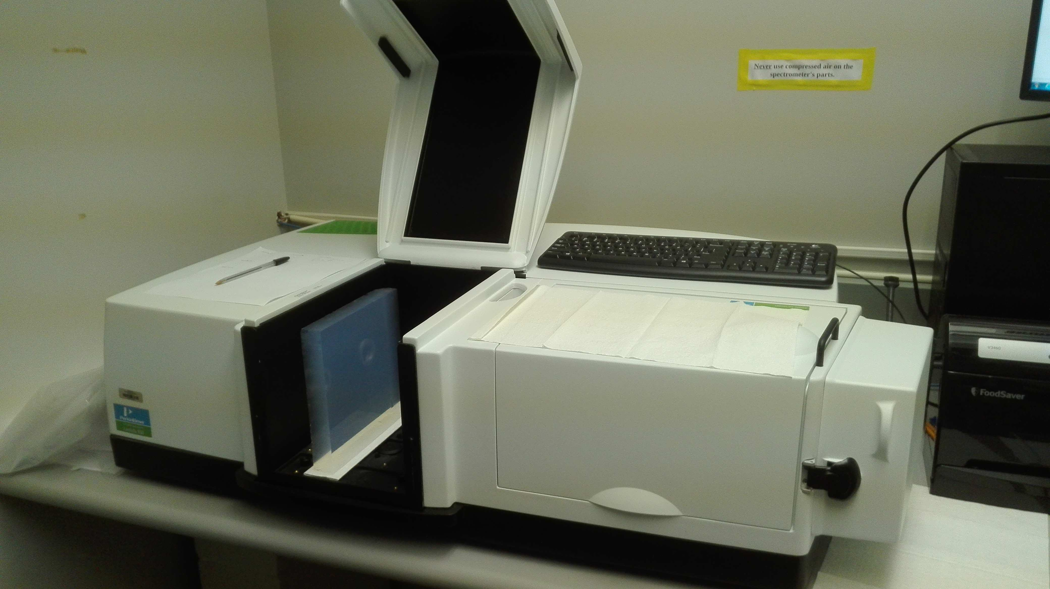
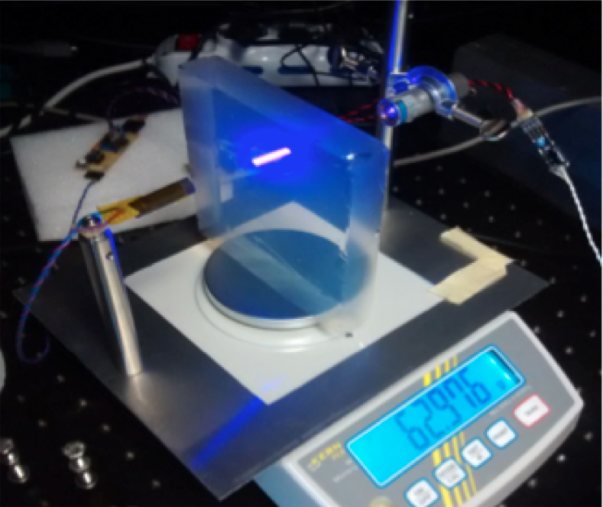
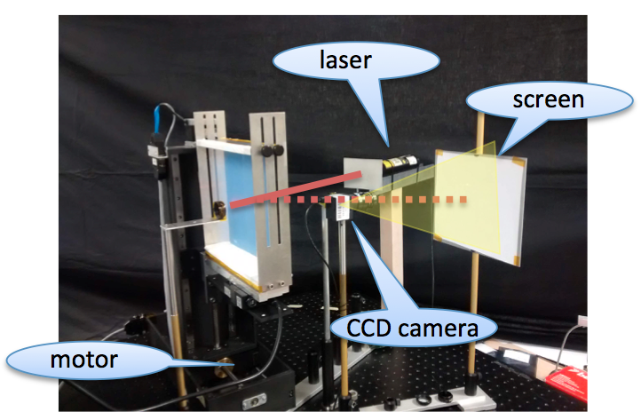
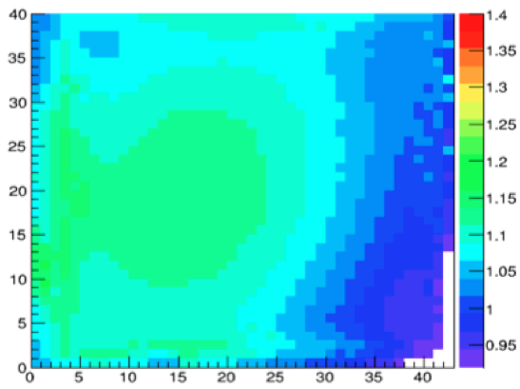
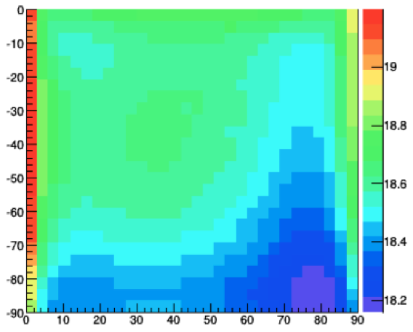
Aerogel Test Laboratory
Existing facility to study detailed aerogel optical properties
(refractive index, surface planarity, forward scattering)
safe handling and Interplay with gas radiator
Controlled storage
Spectrophotometer Characterization station
Surface map by laser setup vs touch machine
Contalbrigo M.
EIC eRD14, 19th September 2019
Contalbrigo M.
11
Notes:
Fare una immagine del PMT sulla risoluzione

Slide 12









Mirror Test Laboratory
Existing facility to study detailed mirror optical properties
(surface map, radius of curvature, reflectivity)
Planarity
Reflectivity
Shack-Hartmann: Aberrations
Point Image: Alignment
Contalbrigo M.
EIC eRD14, 19th September 2019
Contalbrigo M.
12
Notes:
Fare una immagine del PMT sulla risoluzione

Slide 13


EIC Detector Environment
Neutron Fluence
Under control outside the calo’s
Reference value ~ 10 ¹¹ n_{eq}/cm²
Magnetic Field
~ 1 T order of magnitude
Detector orientation to be tuned
dRICH
sensor
Contalbrigo M.
EIC eRD14, 19th September 2019
Contalbrigo M.
13
Notes:
Fare una immagine del PMT sulla risoluzione

Slide 14



SiPM Option
Viable solution with cooling
Pixel #
Pixel #
Peltier cell cooling
Down to -30º in N₂
Contalbrigo M.
EIC eRD14, 19th September 2019
Contalbrigo M.
14
Notes:
Fare una immagine del PMT sulla risoluzione

Slide 15





SiPM Radiation Tolerance
T. Tsang et al.
JINST 11 (2016) P12002
I. Balossino et al.
NIMA 876 (2017) 89
Paolo Carniti
@ RICH 2018
T= 25 C
10⁹ n_{eq} cm²
Annealing at 250 ºC
T= 0 C
few 10⁹ n_{eq} cm²
Contalbrigo M.
EIC eRD14, 19th September 2019
Contalbrigo M.
15
Notes:
Fare una immagine del PMT sulla risoluzione

Slide 16


SiPM Radiation Tolerance
General trend is that SiPMs with high
VB value have faster dark current
reduction with the temperature
Yu. Musienko @ DIRC2019
SiPMs with high cell density and
fast recovery time can operate up
to 3*10¹² neutrons/cm²
(gain change is< 25%).
+ Low/uniform field
+ Entrance window
+ Packaging (Dt, cooling)
+ ……..
Contalbrigo M.
EIC eRD14, 19th September 2019
Contalbrigo M.
16
Notes:
Fare una immagine del PMT sulla risoluzione

Slide 17
Activity 2020
FY | 20-1 | 20-2 | 20-3 | 20-4 | 21-1 | 21-2 | 21-3 | 21-4 | 22-1 | 22-2 | 22-3 | 22-4 | 23-1 | 23-2 | 23-3 | 23-4 | Tot | INFN
Post-doc (Hardware) |  |  |  | 20 |  |  |  | 50 |  |  |  | 50 |  |  |  |  | 120
Post-doc (Design) |  |  |  | 20 |  |  |  | 50 |  |  |  | 50 |  | 30 |  |  | 150
Travel (Test-beam) |  |  |  | 4 |  |  | 8 | 12 |  |  | 12 | 8 |  |  |  | 12 | 56 | 40
Mechanics |  |  |  | 5 |  |  | 10 |  |  |  |  | 5 |  |  |  |  | 20 | 15
Windows |  |  |  | 8 |  |  | 10 |  |  |  |  |  |  |  |  |  | 18
Gas system |  |  |  |  |  |  | 5 |  |  |  |  | 10 |  |  |  |  | 15
Electronics |  |  |  | 5 |  |  | 5 |  |  |  |  | 5 |  |  |  |  | 15 | 15
Tracking |  |  |  |  |  |  | 5 |  |  |  |  | 5 |  |  |  |  | 10 | 10
Shipment, Incidentals |  |  |  |  |  |  | 15 |  |  |  |  | 15 |  |  |  | 15 | 45
Mirrors |  |  |  |  |  |  | 5 |  |  |  |  | 20 |  |  |  | 40 | 65 | 5
Aerogel |  |  |  |  |  |  | 10 |  |  |  |  | 10 |  |  |  | 10 | 30 | 10
Gas |  |  |  |  |  |  | 5 |  |  |  |  | 10 |  |  |  |  | 15 | 5
MCP-PMTs (LAPPDs)
SiPMs |  |  |  |  |  |  | 30 |  |  |  |  | 30 |  |  |  | 15 | 75 | 30
SiPM Coolling |  |  |  |  |  |  | 10 |  |  |  |  | 10 |  |  |  | 10 | 30 | 20
Total personal |  |  |  | 44 |  |  |  | 120 |  |  |  | 120 |  |  |  | 42 | 326 | 40
Total material |  |  |  | 18 |  |  |  | 110 |  |  |  | 120 |  |  |  | 90 | 338 | 110
2020
Prototype design,
simulation and
implementation
Basic mechanics
Electronics
adaptation
Component test
and selection
Start of INFN funds
Contalbrigo M.
EIC eRD14, 19th September 2019
17
Notes:
Vanno messi studi innovativi e pubblicazioni

Slide 18
Activity 2021
FY | 20-1 | 20-2 | 20-3 | 20-4 | 21-1 | 21-2 | 21-3 | 21-4 | 22-1 | 22-2 | 22-3 | 22-4 | 23-1 | 23-2 | 23-3 | 23-4 | Tot | INFN
Post-doc (Hardware) |  |  |  | 20 |  |  |  | 50 |  |  |  | 50 |  |  |  |  | 120
Post-doc (Design) |  |  |  | 20 |  |  |  | 50 |  |  |  | 50 |  | 30 |  |  | 150
Travel (Test-beam) |  |  |  | 4 |  |  | 8 | 12 |  |  | 12 | 8 |  |  |  | 12 | 56 | 40
Mechanics |  |  |  | 5 |  |  | 10 |  |  |  |  | 5 |  |  |  |  | 20 | 15
Windows |  |  |  | 8 |  |  | 10 |  |  |  |  |  |  |  |  |  | 18
Gas system |  |  |  |  |  |  | 5 |  |  |  |  | 10 |  |  |  |  | 15
Electronics |  |  |  | 5 |  |  | 5 |  |  |  |  | 5 |  |  |  |  | 15 | 15
Tracking |  |  |  |  |  |  | 5 |  |  |  |  | 5 |  |  |  |  | 10 | 10
Shipment, Incidentals |  |  |  |  |  |  | 15 |  |  |  |  | 15 |  |  |  | 15 | 45
Mirrors |  |  |  |  |  |  | 5 |  |  |  |  | 20 |  |  |  | 40 | 65 | 5
Aerogel |  |  |  |  |  |  | 10 |  |  |  |  | 10 |  |  |  | 10 | 30 | 10
Gas |  |  |  |  |  |  | 5 |  |  |  |  | 10 |  |  |  |  | 15 | 5
MCP-PMTs (LAPPDs)
SiPMs |  |  |  |  |  |  | 30 |  |  |  |  | 30 |  |  |  | 15 | 75 | 30
SiPM Coolling |  |  |  |  |  |  | 10 |  |  |  |  | 10 |  |  |  | 10 | 30 | 20
Total personal |  |  |  | 44 |  |  |  | 120 |  |  |  | 120 |  |  |  | 42 | 326 | 40
Total material |  |  |  | 18 |  |  |  | 110 |  |  |  | 120 |  |  |  | 90 | 338 | 110
2021
Basic prototype
- basic tracking
- 1 radiator choice
- commercial mirror
- reference readout
Beam Test 1
- MA-PMTs, SiPMs
- Proton beam
- Critical aspects
Optical components
test and selection
SiPM program
radiation tolerance
and cooling program
Contalbrigo M.
EIC eRD14, 19th September 2019
18
Notes:
Vanno messi studi innovativi e pubblicazioni

Slide 19
Activity 2022
FY | 20-1 | 20-2 | 20-3 | 20-4 | 21-1 | 21-2 | 21-3 | 21-4 | 22-1 | 22-2 | 22-3 | 22-4 | 23-1 | 23-2 | 23-3 | 23-4 | Tot | INFN
Post-doc (Hardware) |  |  |  | 20 |  |  |  | 50 |  |  |  | 50 |  |  |  |  | 120
Post-doc (Design) |  |  |  | 20 |  |  |  | 50 |  |  |  | 50 |  | 30 |  |  | 150
Travel (Test-beam) |  |  |  | 4 |  |  | 8 | 12 |  |  | 12 | 8 |  |  |  | 12 | 56 | 40
Mechanics |  |  |  | 5 |  |  | 10 |  |  |  |  | 5 |  |  |  |  | 20 | 15
Windows |  |  |  | 8 |  |  | 10 |  |  |  |  |  |  |  |  |  | 18
Gas system |  |  |  |  |  |  | 5 |  |  |  |  | 10 |  |  |  |  | 15
Electronics |  |  |  | 5 |  |  | 5 |  |  |  |  | 5 |  |  |  |  | 15 | 15
Tracking |  |  |  |  |  |  | 5 |  |  |  |  | 5 |  |  |  |  | 10 | 10
Shipment, Incidentals |  |  |  |  |  |  | 15 |  |  |  |  | 15 |  |  |  | 15 | 45
Mirrors |  |  |  |  |  |  | 5 |  |  |  |  | 20 |  |  |  | 40 | 65 | 5
Aerogel |  |  |  |  |  |  | 10 |  |  |  |  | 10 |  |  |  | 10 | 30 | 10
Gas |  |  |  |  |  |  | 5 |  |  |  |  | 10 |  |  |  |  | 15 | 5
MCP-PMTs (LAPPDs)
SiPMs |  |  |  |  |  |  | 30 |  |  |  |  | 30 |  |  |  | 15 | 75 | 30
SiPM Coolling |  |  |  |  |  |  | 10 |  |  |  |  | 10 |  |  |  | 10 | 30 | 20
Total personal |  |  |  | 44 |  |  |  | 120 |  |  |  | 120 |  |  |  | 42 | 326 | 40
Total material |  |  |  | 18 |  |  |  | 110 |  |  |  | 120 |  |  |  | 90 | 338 | 110
2022
Refined prototype
- precision tracking / alignment
- various radiators
- custom mirrors
- gas system
- optimized readout
- online reconstruction
Beam Test 2
- MCP-PMTs, SiPMs
- Hadron beam
- Performance optimization
Optical components
test and selection
SiPM program
radiation tolerance
and cooling program
Contalbrigo M.
EIC eRD14, 19th September 2019
19
Notes:
Vanno messi studi innovativi e pubblicazioni

Slide 20
Activity 2023
FY | 20-1 | 20-2 | 20-3 | 20-4 | 21-1 | 21-2 | 21-3 | 21-4 | 22-1 | 22-2 | 22-3 | 22-4 | 23-1 | 23-2 | 23-3 | 23-4 | Tot | INFN
Post-doc (Hardware) |  |  |  | 20 |  |  |  | 50 |  |  |  | 50 |  |  |  |  | 120
Post-doc (Design) |  |  |  | 20 |  |  |  | 50 |  |  |  | 50 |  | 30 |  |  | 150
Travel (Test-beam) |  |  |  | 4 |  |  | 8 | 12 |  |  | 12 | 8 |  |  |  | 12 | 56 | 40
Mechanics |  |  |  | 5 |  |  | 10 |  |  |  |  | 5 |  |  |  |  | 20 | 15
Windows |  |  |  | 8 |  |  | 10 |  |  |  |  |  |  |  |  |  | 18
Gas system |  |  |  |  |  |  | 5 |  |  |  |  | 10 |  |  |  |  | 15
Electronics |  |  |  | 5 |  |  | 5 |  |  |  |  | 5 |  |  |  |  | 15 | 15
Tracking |  |  |  |  |  |  | 5 |  |  |  |  | 5 |  |  |  |  | 10 | 10
Shipment, Incidentals |  |  |  |  |  |  | 15 |  |  |  |  | 15 |  |  |  | 15 | 45
Mirrors |  |  |  |  |  |  | 5 |  |  |  |  | 20 |  |  |  | 40 | 65 | 5
Aerogel |  |  |  |  |  |  | 10 |  |  |  |  | 10 |  |  |  | 10 | 30 | 10
Gas |  |  |  |  |  |  | 5 |  |  |  |  | 10 |  |  |  |  | 15 | 5
MCP-PMTs (LAPPDs)
SiPMs |  |  |  |  |  |  | 30 |  |  |  |  | 30 |  |  |  | 15 | 75 | 30
SiPM Coolling |  |  |  |  |  |  | 10 |  |  |  |  | 10 |  |  |  | 10 | 30 | 20
Total personal |  |  |  | 44 |  |  |  | 120 |  |  |  | 120 |  |  |  | 42 | 326 | 40
Total material |  |  |  | 18 |  |  |  | 110 |  |  |  | 120 |  |  |  | 90 | 338 | 110
2023
TDR readiness
EIC configuration
engineering, realistic PID
Contingency:
Beam test 3
- Performance assessment
- Component optimization
Optical components
refinement and
cost reduction
SiPM program
radiation tolerance
and cooling program
Contalbrigo M.
EIC eRD14, 19th September 2019
20
Notes:
Vanno messi studi innovativi e pubblicazioni

Slide 21
Activity 20-23
FY | 20-1 | 20-2 | 20-3 | 20-4 | 21-1 | 21-2 | 21-3 | 21-4 | 22-1 | 22-2 | 22-3 | 22-4 | 23-1 | 23-2 | 23-3 | 23-4 | Tot | INFN
Post-doc (Hardware) |  |  |  | 20 |  |  |  | 50 |  |  |  | 50 |  |  |  |  | 120
Post-doc (Design) |  |  |  | 20 |  |  |  | 50 |  |  |  | 50 |  | 30 |  |  | 150
Travel (Test-beam) |  |  |  | 4 |  |  | 8 | 12 |  |  | 12 | 8 |  |  |  | 12 | 56 | 40
Mechanics |  |  |  | 5 |  |  | 10 |  |  |  |  | 5 |  |  |  |  | 20 | 15
Windows |  |  |  | 8 |  |  | 10 |  |  |  |  |  |  |  |  |  | 18
Gas system |  |  |  |  |  |  | 5 |  |  |  |  | 10 |  |  |  |  | 15
Electronics |  |  |  | 5 |  |  | 5 |  |  |  |  | 5 |  |  |  |  | 15 | 15
Tracking |  |  |  |  |  |  | 5 |  |  |  |  | 5 |  |  |  |  | 10 | 10
Shipment, Incidentals |  |  |  |  |  |  | 15 |  |  |  |  | 15 |  |  |  | 15 | 45
Mirrors |  |  |  |  |  |  | 5 |  |  |  |  | 20 |  |  |  | 40 | 65 | 5
Aerogel |  |  |  |  |  |  | 10 |  |  |  |  | 10 |  |  |  | 10 | 30 | 10
Gas |  |  |  |  |  |  | 5 |  |  |  |  | 10 |  |  |  |  | 15 | 5
MCP-PMTs (LAPPDs)
SiPMs |  |  |  |  |  |  | 30 |  |  |  |  | 30 |  |  |  | 15 | 75 | 30
SiPM Coolling |  |  |  |  |  |  | 10 |  |  |  |  | 10 |  |  |  | 10 | 30 | 20
Total personal |  |  |  | 44 |  |  |  | 120 |  |  |  | 120 |  |  |  | 42 | 326 | 40
Total material |  |  |  | 18 |  |  |  | 110 |  |  |  | 120 |  |  |  | 90 | 338 | 110
Contalbrigo M.
EIC eRD14, 19th September 2019
21
Notes:
Vanno messi studi innovativi e pubblicazioni

Slide 22
dRICH Summary
In good position to achieve TDR readiness in 2023
Increasing interest within INFN groups with hardware expertise
Feasibility study completed for EIC generic requirements
Sophisticated software tools developed for further optimization
Technical risks:
- Radiator quality and interplay
- Availability of sensor solution in 3T magnetic field (shared within eRD14)
- Availability of an advanced (fast sampling) readout electronics (shared within eRD14)
Mitigations:
Only possible with:
- a prototype and a stable program of component development and tests
- a steady funding plan accounting for the necessary prototype validation
and newly (cost-effective) technological solution assessments (SiPMs, mirrors)
Contalbrigo M.
EIC eRD14, 19th September 2019
22
Notes:
Vanno messi studi innovativi e pubblicazioni

Slide 23
BACKUP
Contalbrigo M.
23
Notes:
Vanno messi studi innovativi e pubblicazioni

Slide 24
Activity
FY | 20-1 | 20-2 | 20-3 | 20-4 | 21-1 | 21-2 | 21-3 | 21-4 | 22-1 | 22-2 | 22-3 | 22-4 | 23-1 | 23-2 | 23-3 | 23-4 | Tot | INFN
Post-doc (Back-end) |  |  |  | 20 |  |  |  | 50 |  |  |  | 50 |  | 30 |  |  | 150
Travel (Test-beam) |  |  |  | 4 |  |  | 4 | 6 |  |  | 6 | 4 |  |  |  | 4 | 28
Back-end |  |  |  | 10 |  |  |  | 50 |  |  |  | 30 |  |  |  | 20 | 110
Total personal |  |  |  | 24 |  |  |  | 60 |  |  |  | 60 |  |  |  | 34 | 178
Total material |  |  |  | 10 |  |  |  | 50 |  |  |  | 30 |  |  |  | 20 | 110
Contalbrigo M.
24
Notes:
Vanno messi studi innovativi e pubblicazioni

