Slide 1



The dRICH Project
The dual-radiator RICH has been a common reference in the forward region since EIC Yellow Report
Moving from generic EIC R&D (eRD14) to targeted EIC R&D (eRD102, eRD110, eRD…)
Detector-1
BA, BO, CS
CT, FE, GE,
LNF, LNS, RM1,
SA, TO, TS
p/A beam
e beam
p: 41 GeV, 100 to 275 GeV
e: 5 GeV to 18 GeV
Contalbrigo Marco - INFN Ferrara
Incontro Nazionale EIC_NET - 3th October 2022

Slide 2
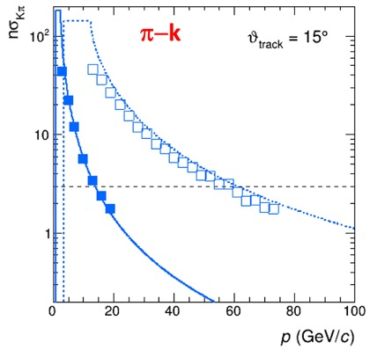
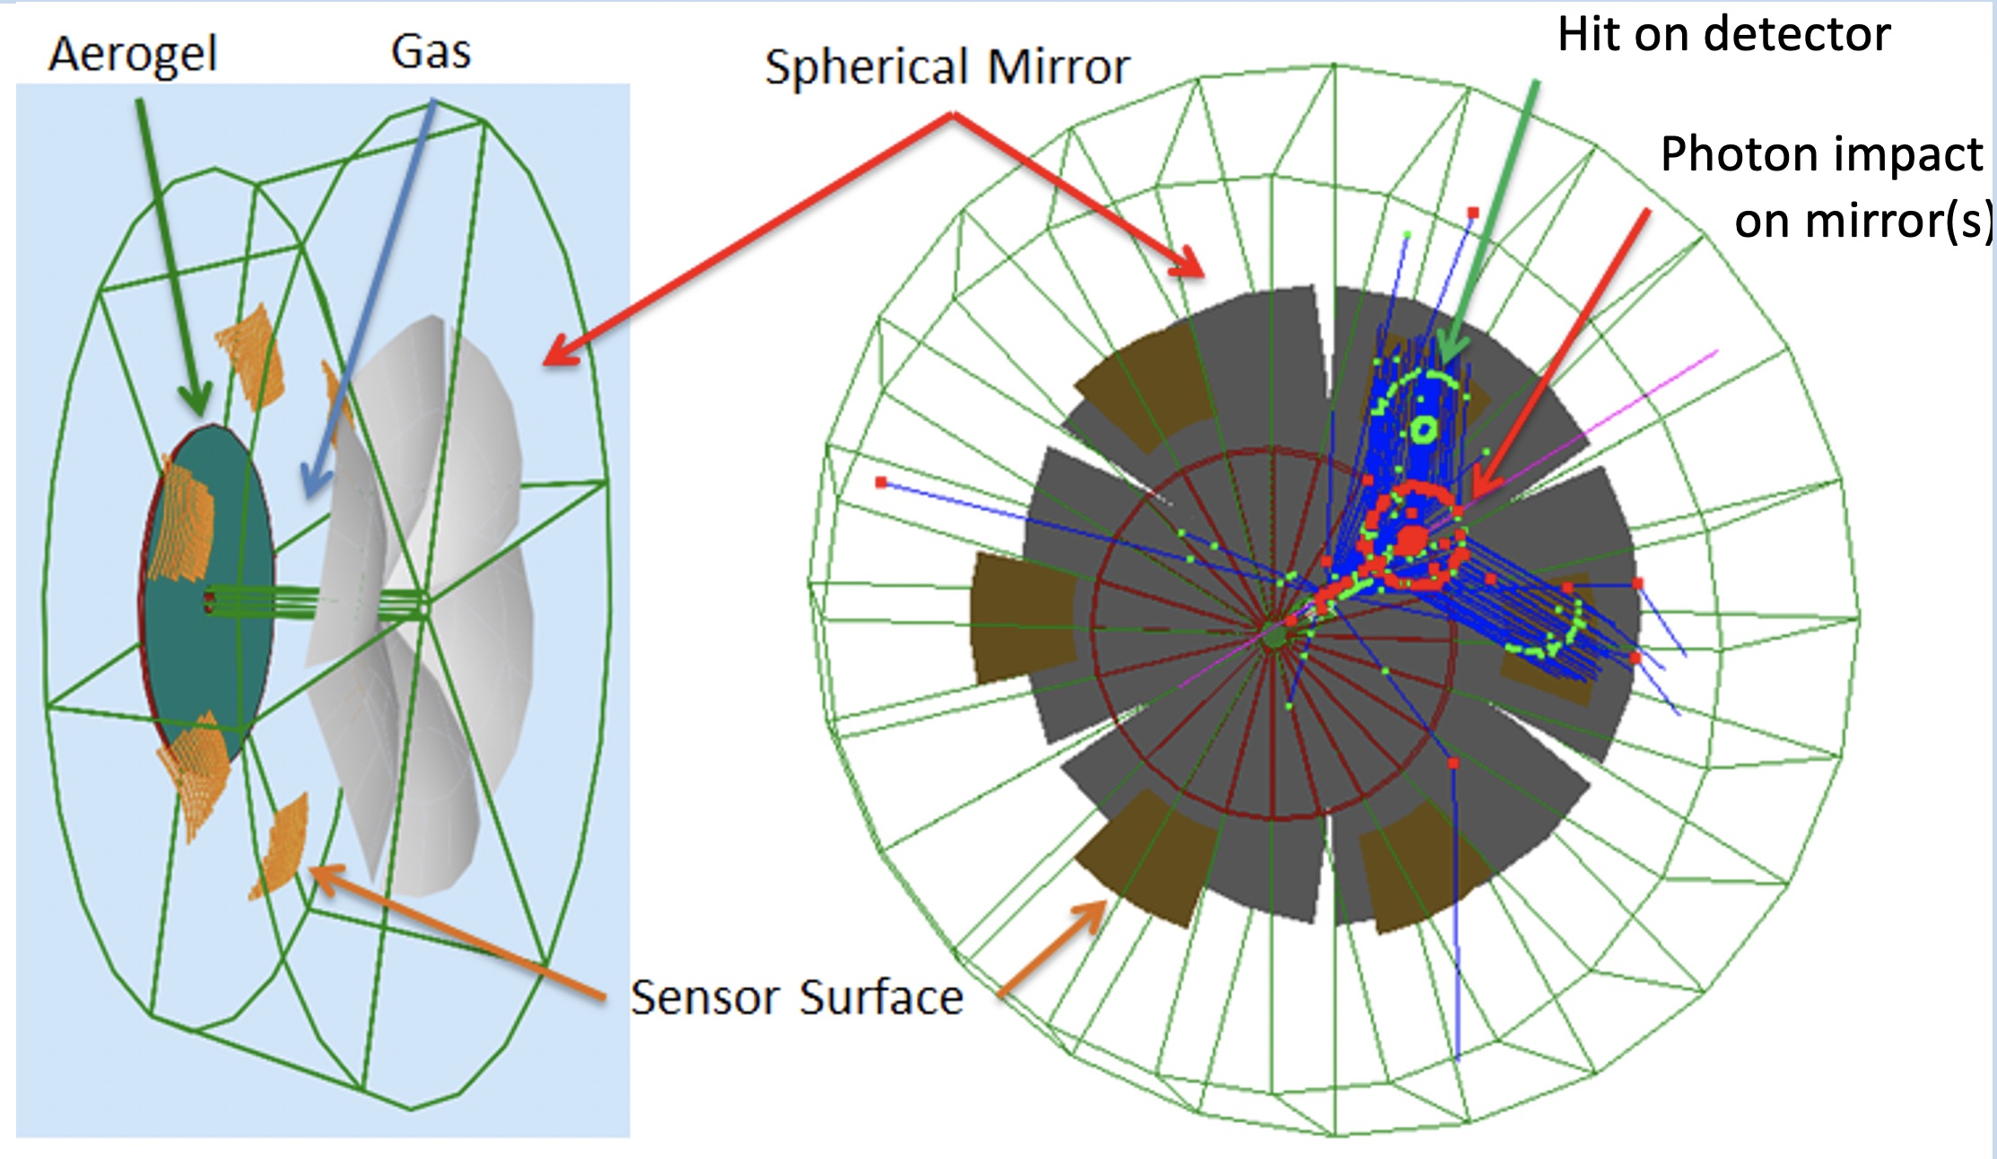
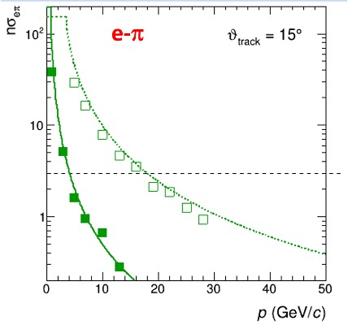
Dual Radiator RICH @ EIC
Two main : cover wide momentum range 3 - 60 GeV/c
challenges work in high (~ 1T) magnetic field
dRICH: effective solution, part of EIC reference detector
Radiators: Aerogel (n_{AERO}~1.02) + Gas (n_{C2F6} ~ 1.0008)
Detector: 0.5 m²/sector , 3x3 mm² pixel. → SiPM option
Phase Space:
- Polar angle: 5-25 deg
Momentum: 3-60 GeV/c
Incontro Nazionale EIC_NET - 3th October 2022

Slide 3
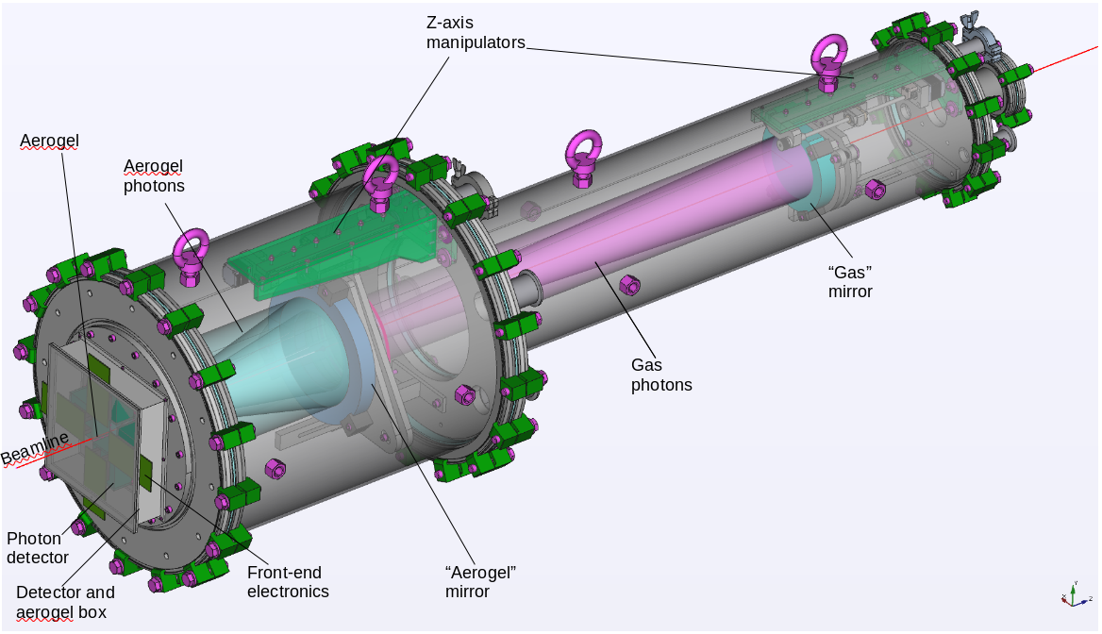
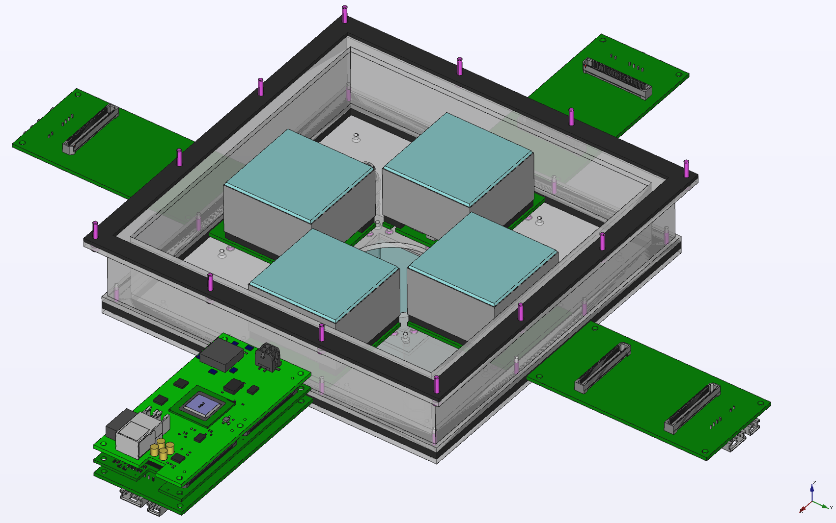
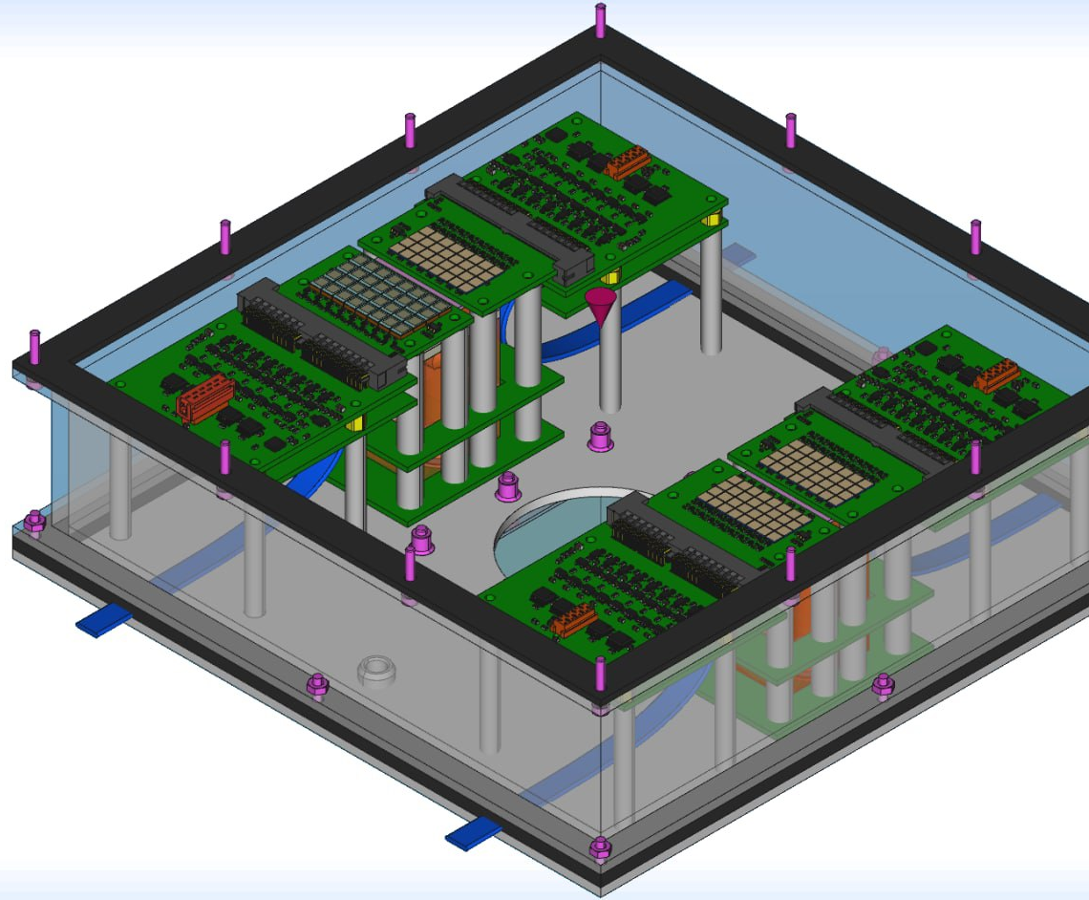
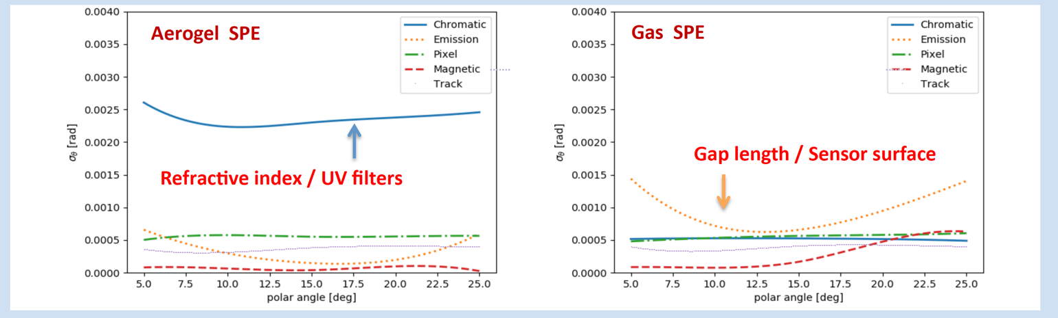
Targeted R&D eRD102
Prototipe to validate dual-radiator working principle,
study compatibility with B field and streaming readout,
optimize performance and define specifications for components
FY23 proposal
Just submitted
Reference detector
EIC driven detector
Incontro Nazionale EIC_NET - 3th October 2022

Slide 4
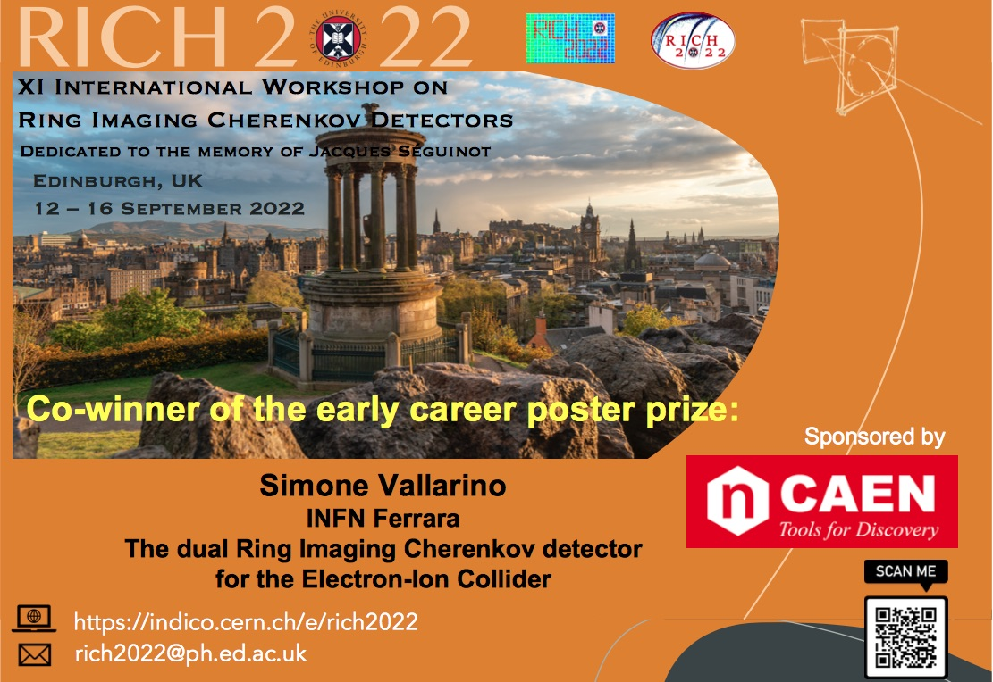
RICH2022
Incontro Nazionale EIC_NET - 3th October 2022

Slide 5
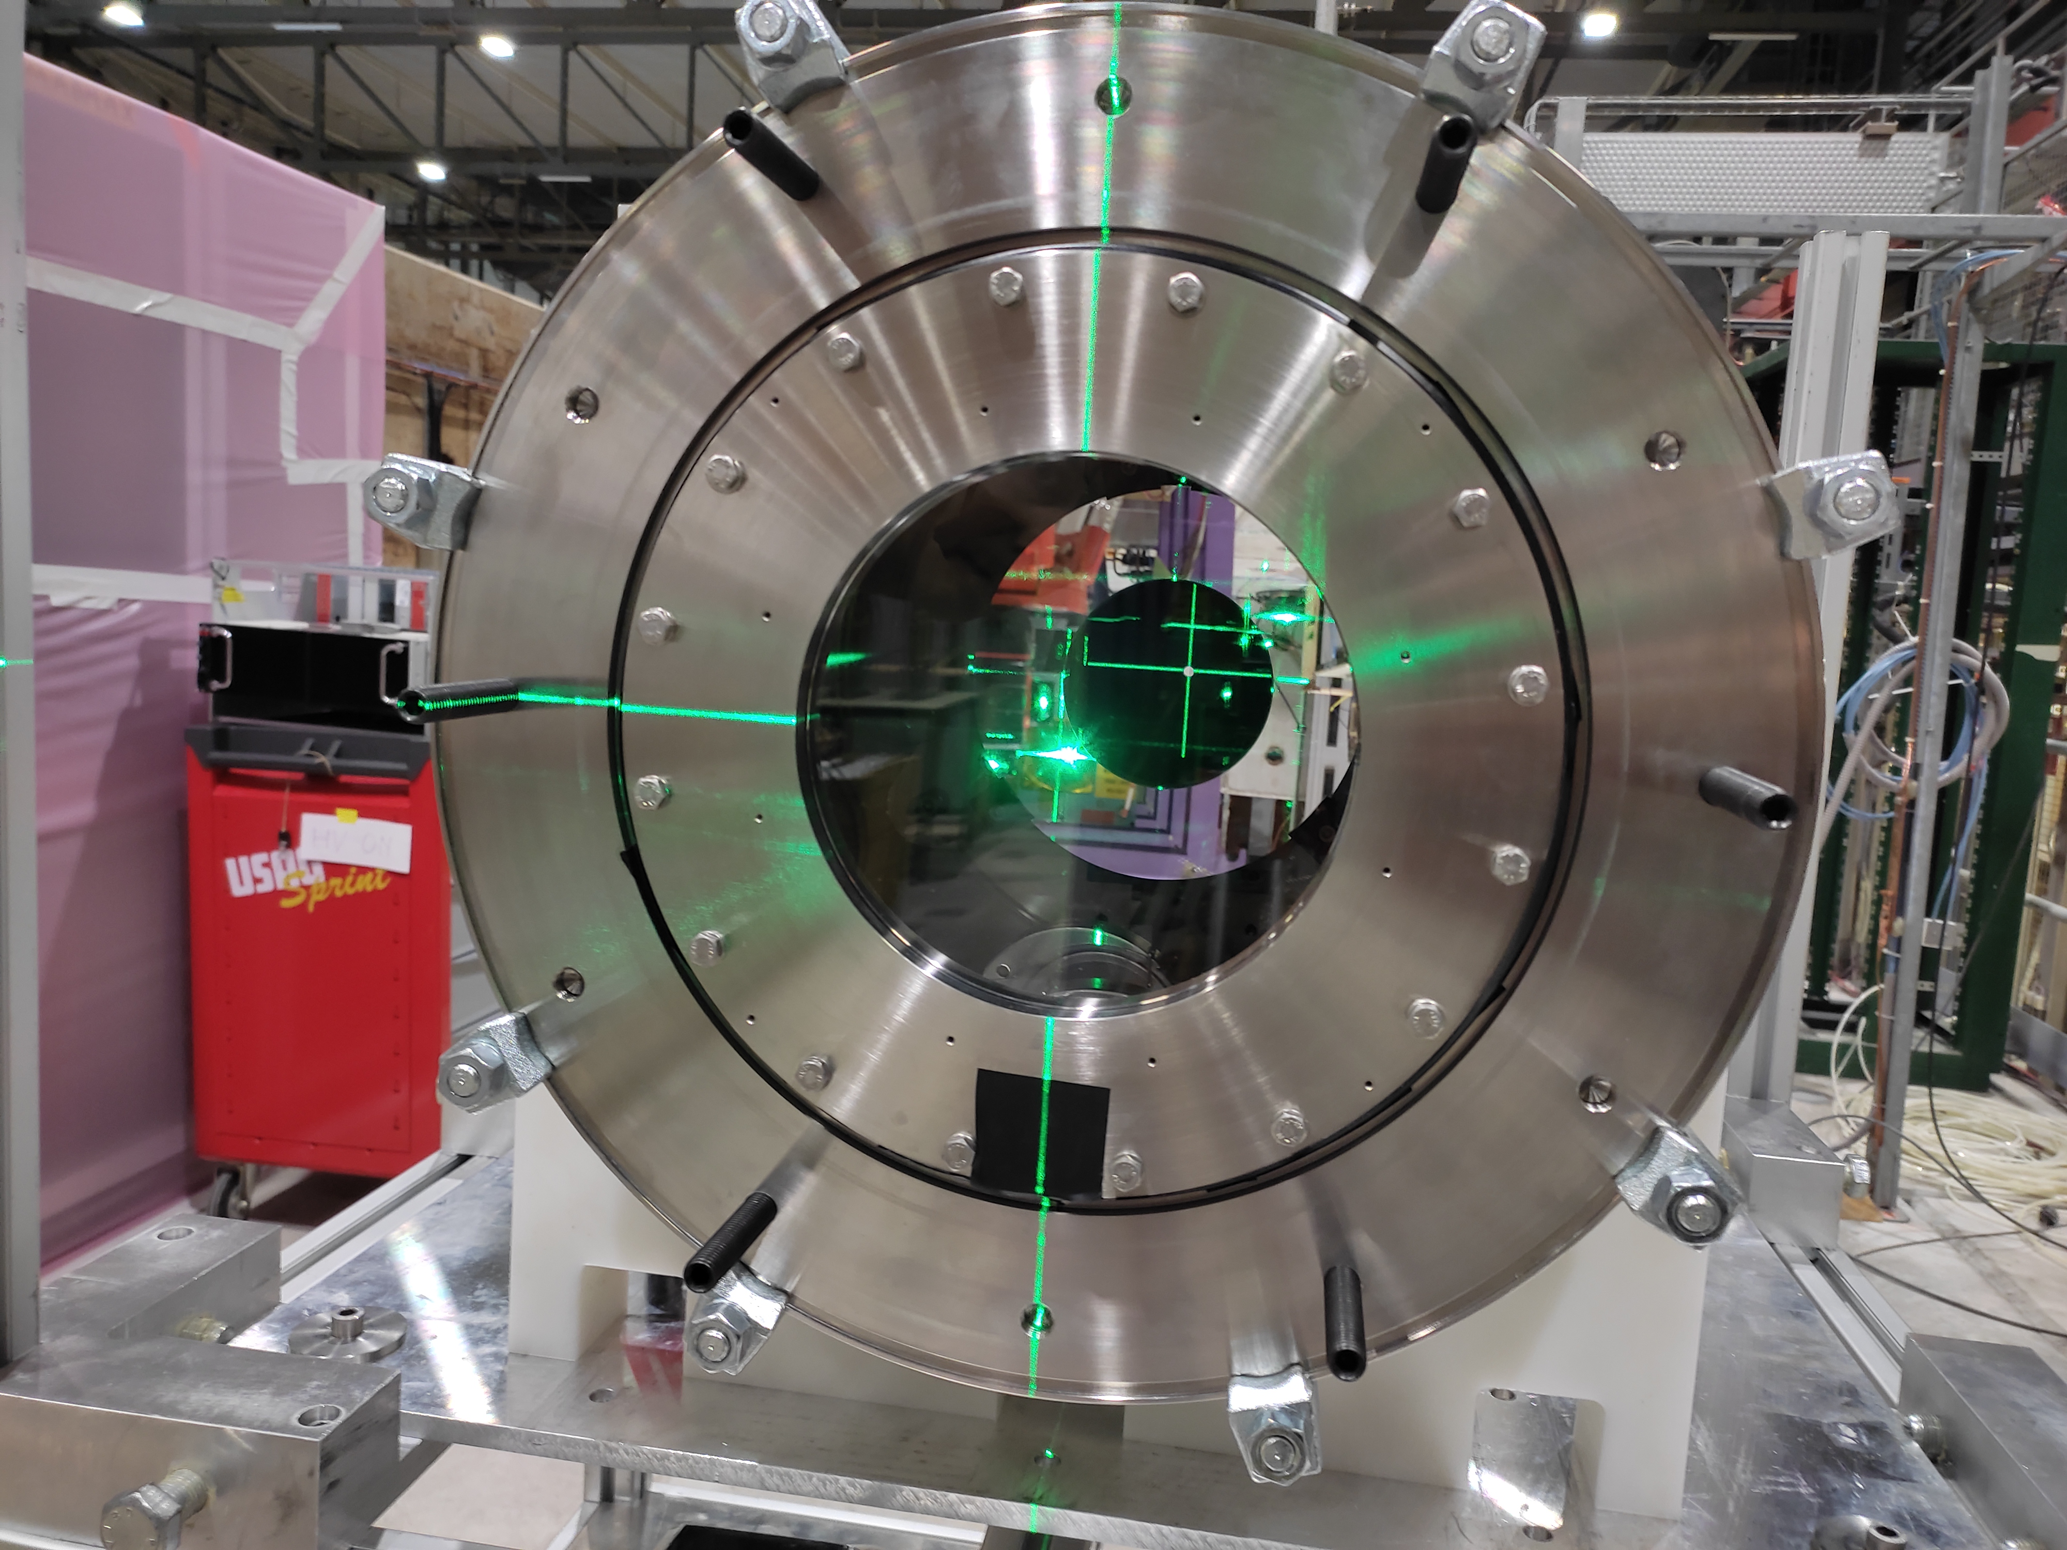
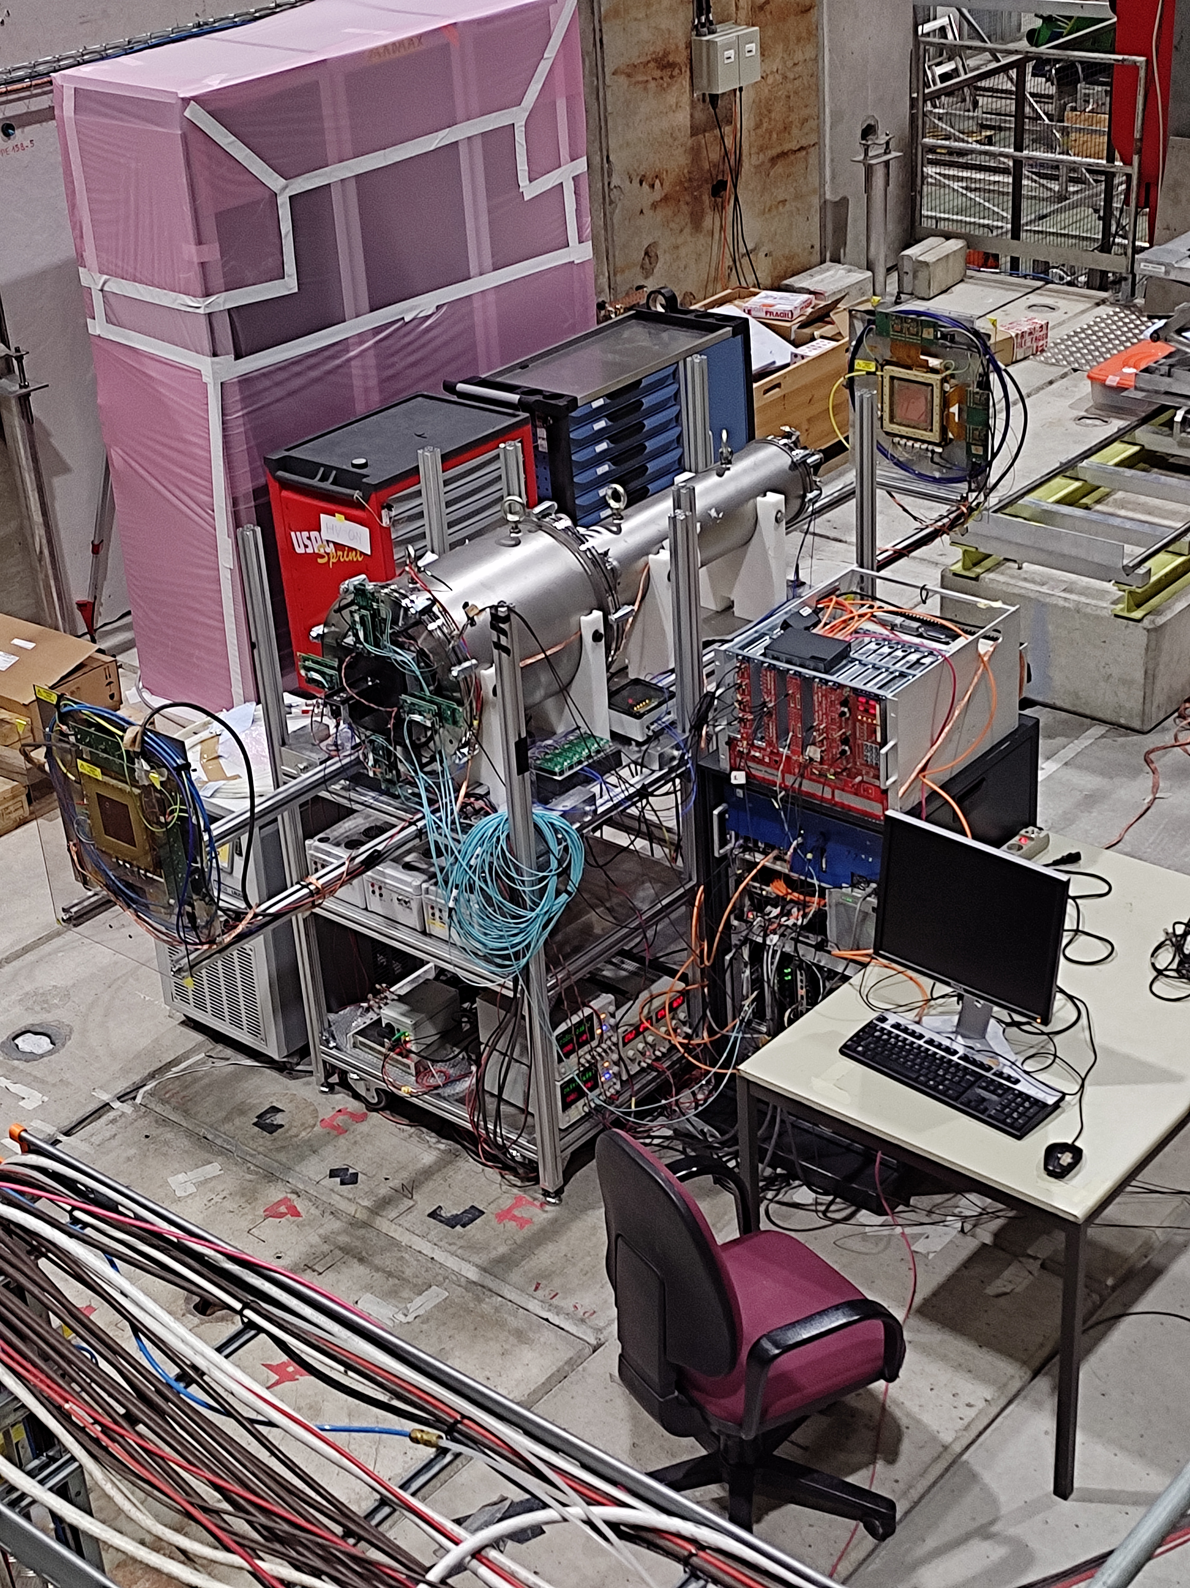
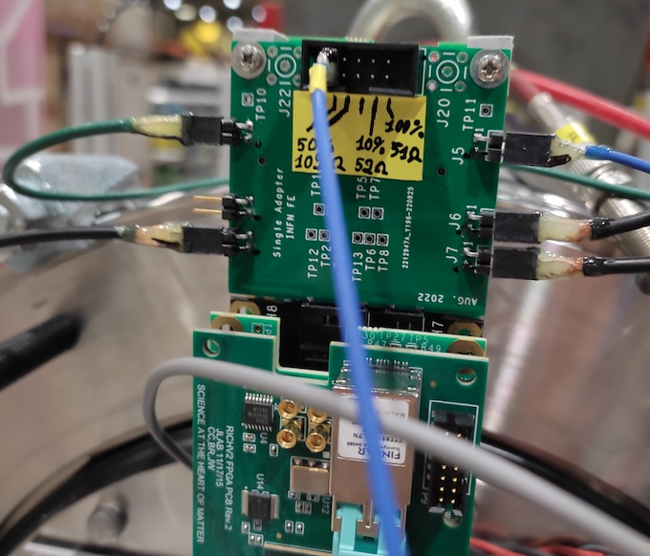
dRICH Prototype
Test beam @ PPE158 - SPS September 2022
Refined alignment tools and procedure
Beam information: time and Cherenkov tagging
Incontro Nazionale EIC_NET - 3th October 2022

Slide 6
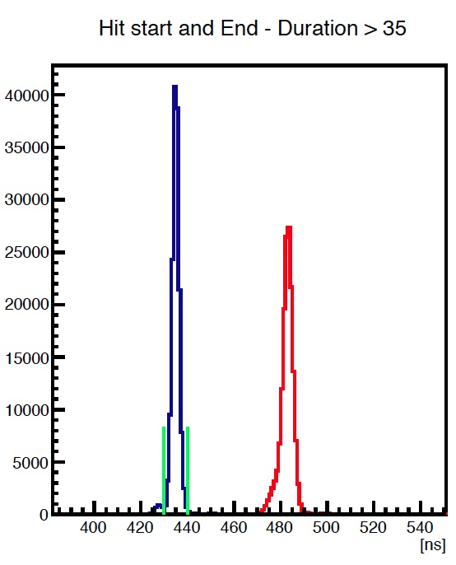
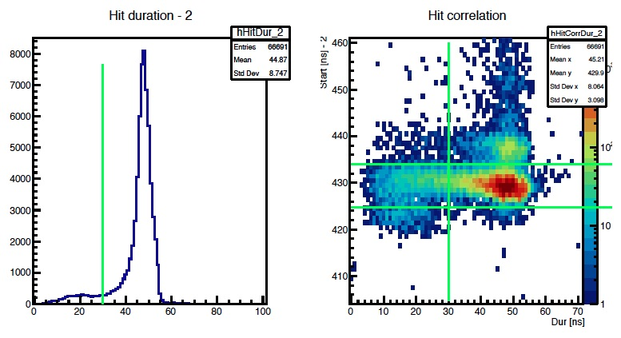
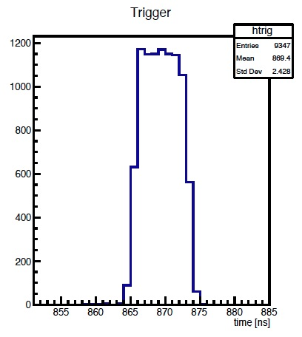
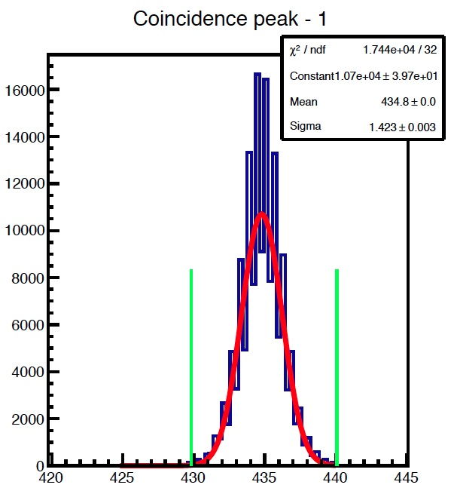
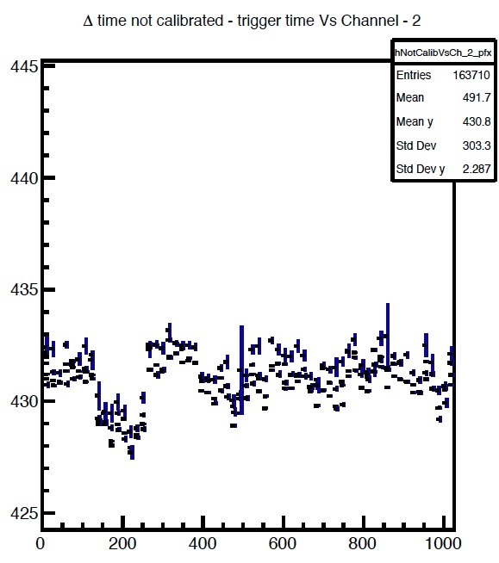
Time Analysis
Incontro Nazionale EIC_NET - 3th October 2022

Slide 7
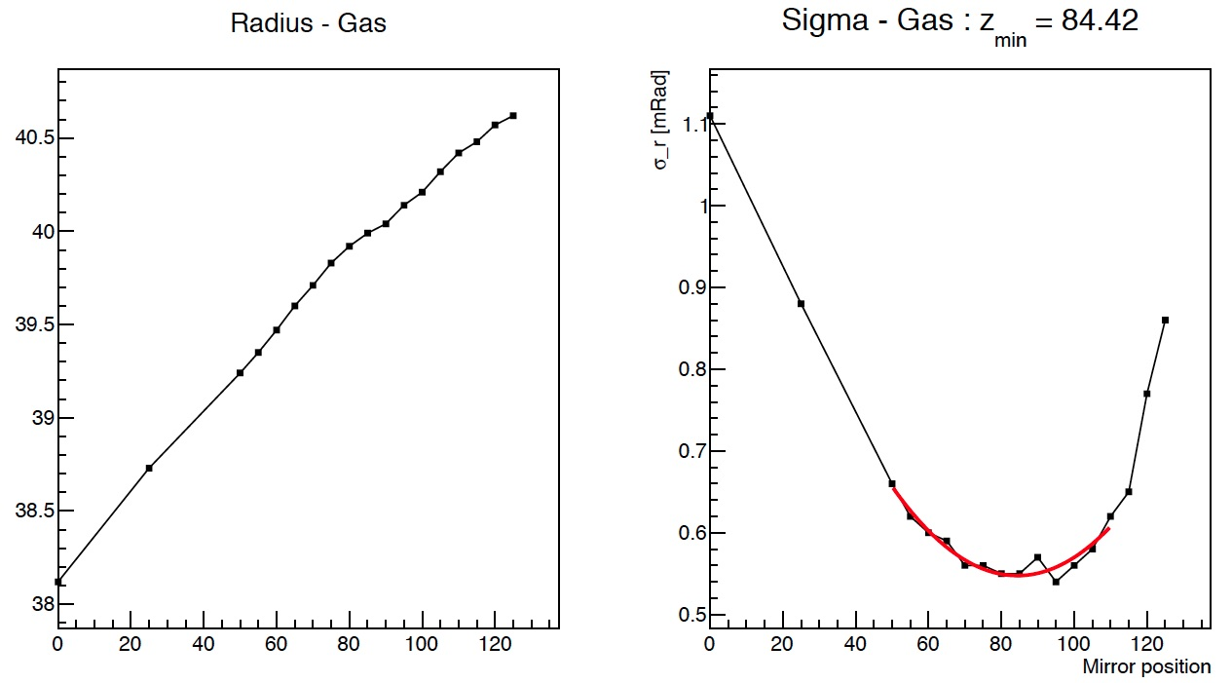
dRICH Gas
Scan the mirror position to align the focal plane on the sensor surface
Incontro Nazionale EIC_NET - 3th October 2022

Slide 8
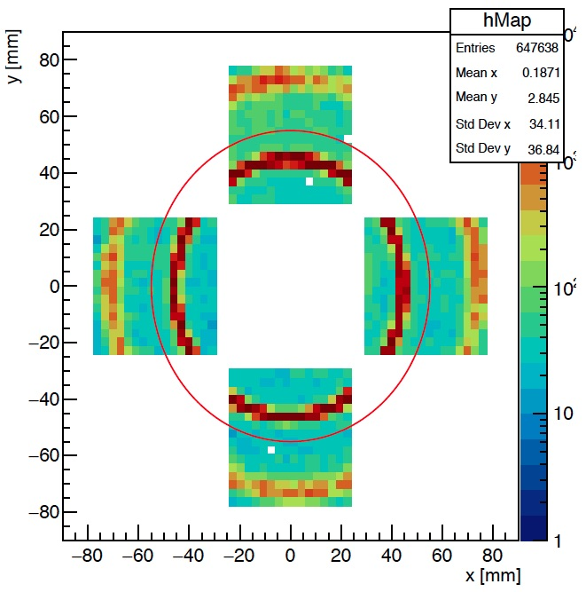
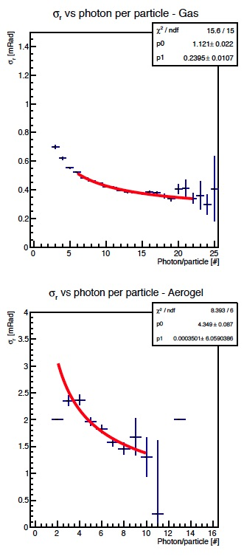
dRICH Prototype
Two radiators with 180 hadron beam with reference readout
Expected SPE ~ 1 mrad
Expected SPE ~ 3 mrad
Incontro Nazionale EIC_NET - 3th October 2022

Slide 9
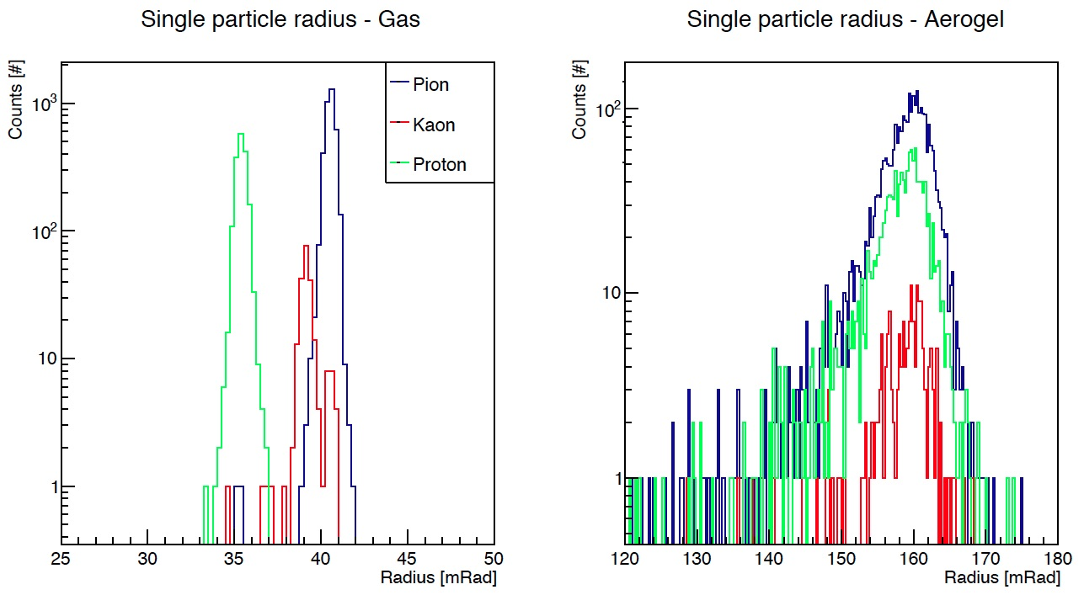
dRICH Prototype
Test at 50 GeV mixed hadron beam with tagging by beam instrumentation (3x gas Cherenkov)
Incontro Nazionale EIC_NET - 3th October 2022

Slide 10
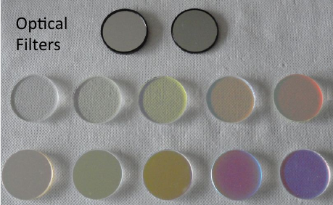
dRICH Aerogel
Chromatic dispersion measured
prototype with optical filters
Cherenkov angle (mrad)
Wavelength (nm)
Incontro Nazionale EIC_NET - 3th October 2022

Slide 11
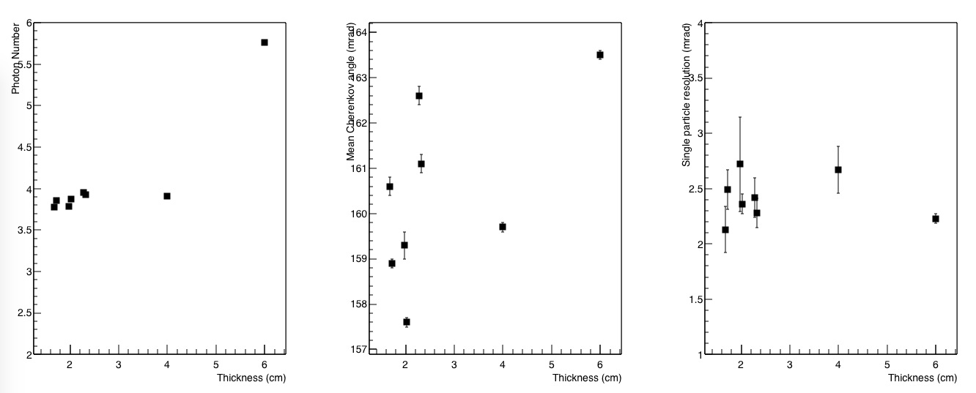
dRICH Aerogel
Compare single tile and stack of tiles ( from Aerogel Factory)
Single
3x Stack
Goals:
Compare surfaces of same tile (only exit surface matters)
Compare refractive index and photon yield among different tiles
Check tile stack performance
Incontro Nazionale EIC_NET - 3th October 2022

Slide 12
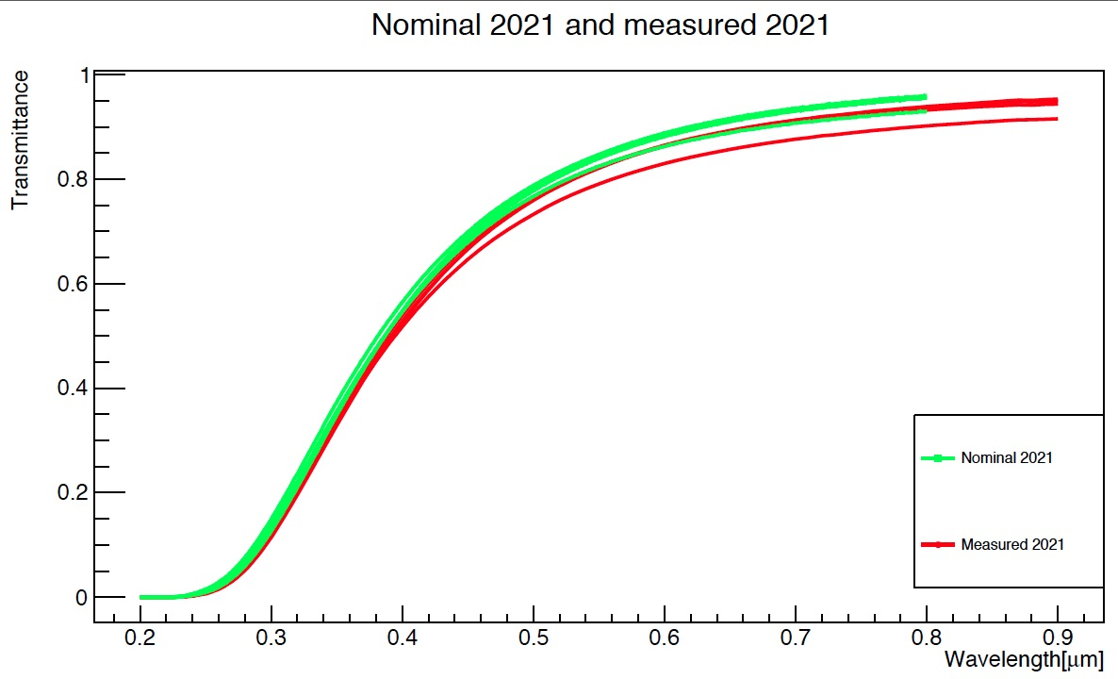
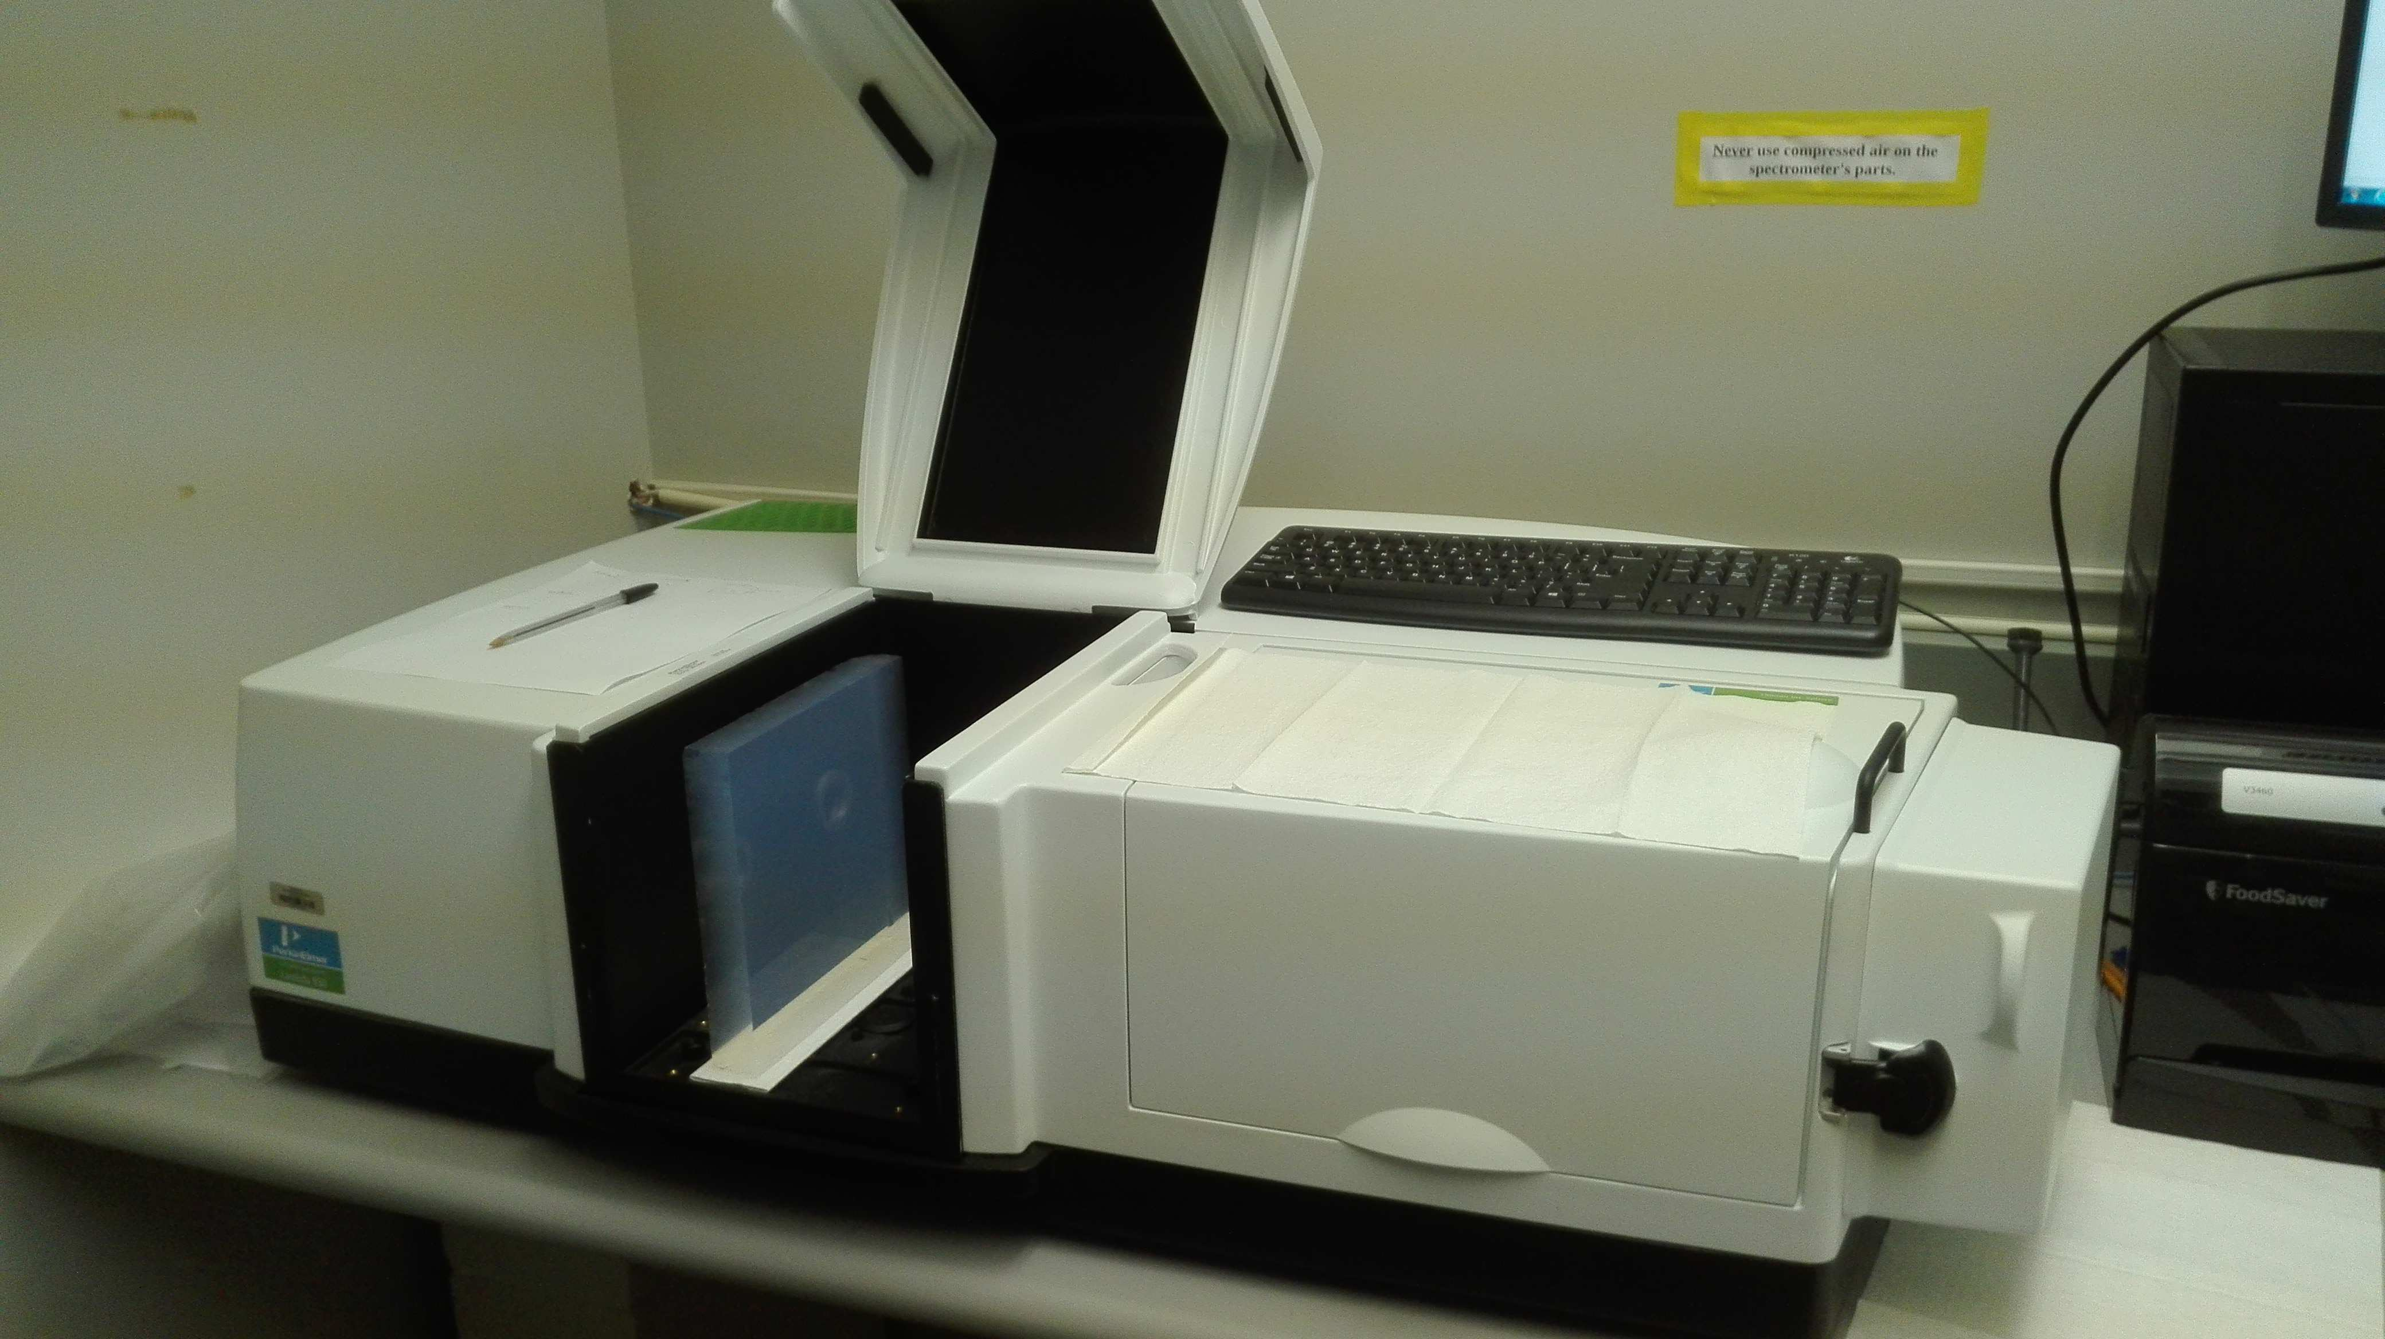
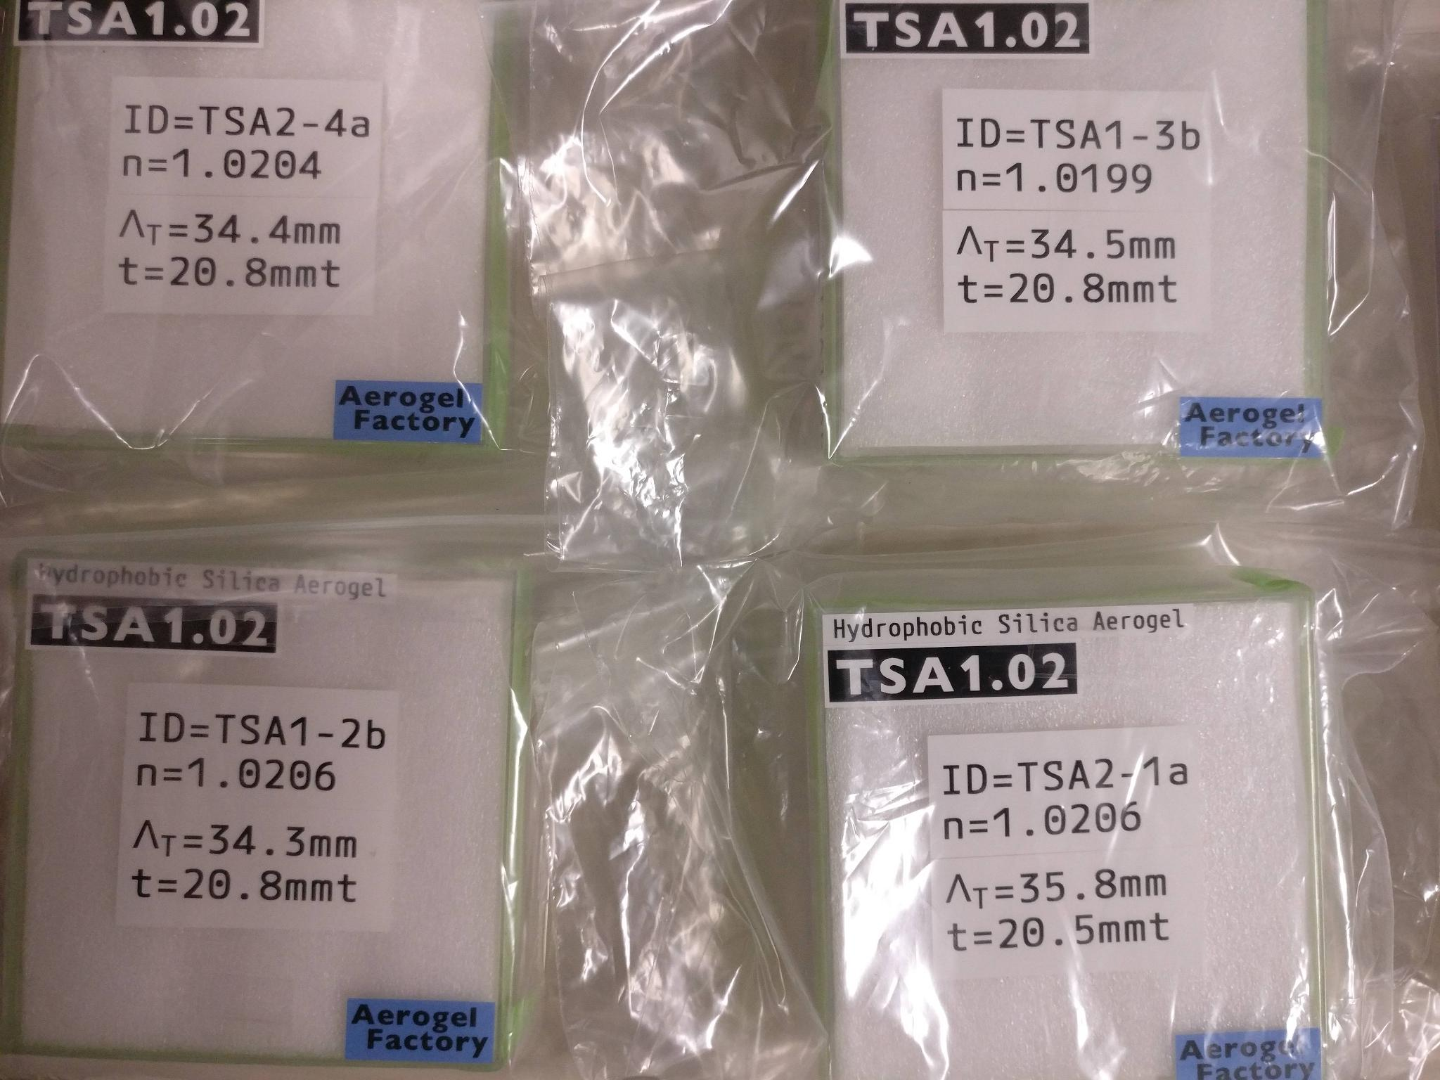
Next Steps: Aerogel
Existing facility to study detailed radiator
optical properties and alternatives
Aerogel:
Safe handling and characterization (refractive
index, surface planarity, forward scattering)
Interplay between radiators:
UV filters, refractive index optimization
INFN 2023: Funds for new samples
Aerogel Factory: negotiate production of large
goals: study reproducibility
1st batch: 1.0206, 1.0206, 1.0199, 1.0204
2nd batch: 1.0201, 1.0207, 1.0210, 1.0218
negotiate large (20x20 cm²) tiles with ALICE
ASPEN: initial contacts with CUA (Tanja Horn)
goal: obtain few samples at 1.02
Incontro Nazionale EIC_NET - 3th October 2022

Slide 13
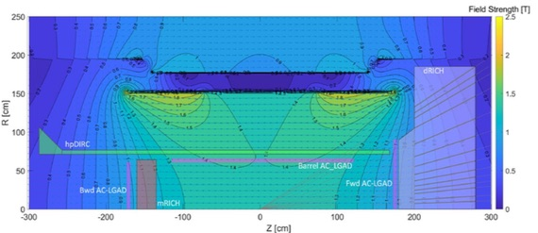
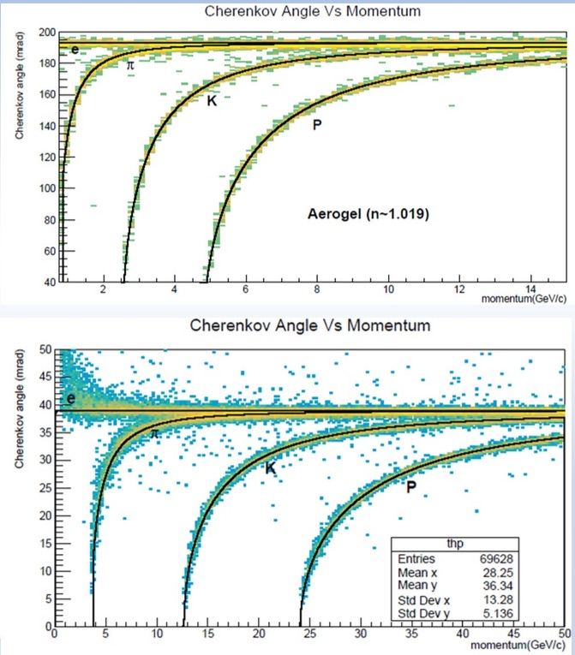
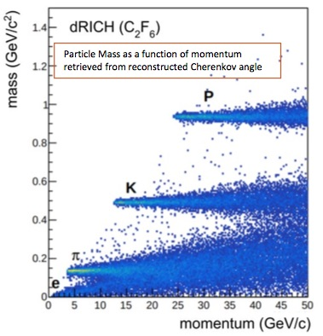
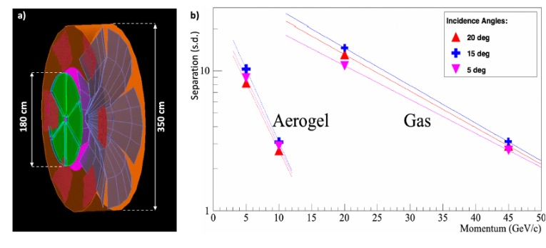
dRICH Simulations
Chandra @ RICH 2022
ECCE simulation
ATHENA simulation
Incontro Nazionale EIC_NET - 3th October 2022

Slide 14
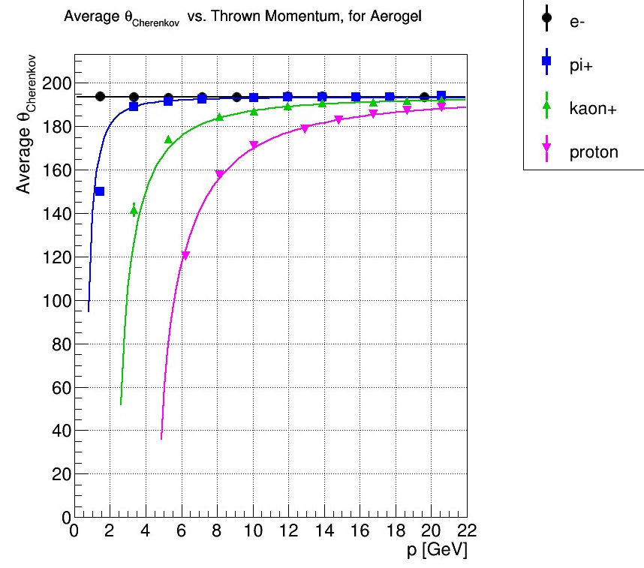
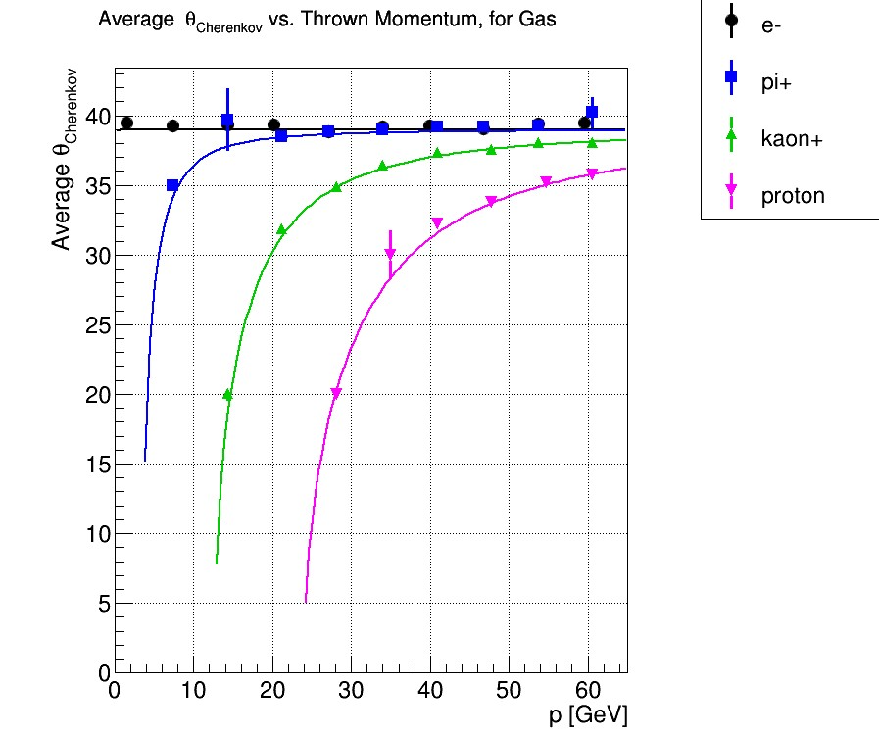
dRICH Simulations
dRICH simulation model was adapted to ATHENA and ECCE
Full simulation chain now implemented into EPIC
Inputs for a realistic model are becoming available from prototype
Incontro Nazionale EIC_NET - 3th October 2022

Slide 15
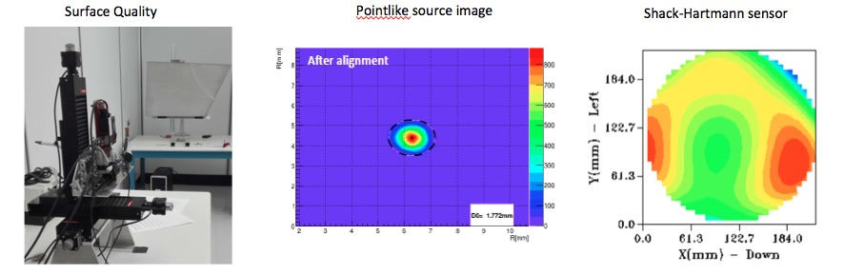
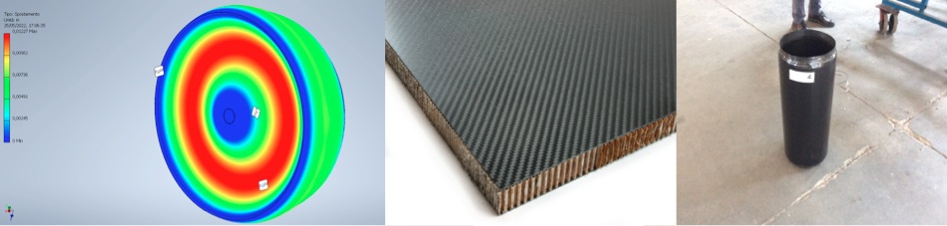
Next Steps: Mirror & Mechanics
INFN 2023: funds for a CFRP mirror demonstrator
INFN 2032: funds for a composite material study (targeted to over-pressure case)
Contacts with BNL and JLab for engineering support
Incontro Nazionale EIC_NET - 3th October 2022
Notes:
Fare una immagine del PMT sulla risoluzione

Slide 16
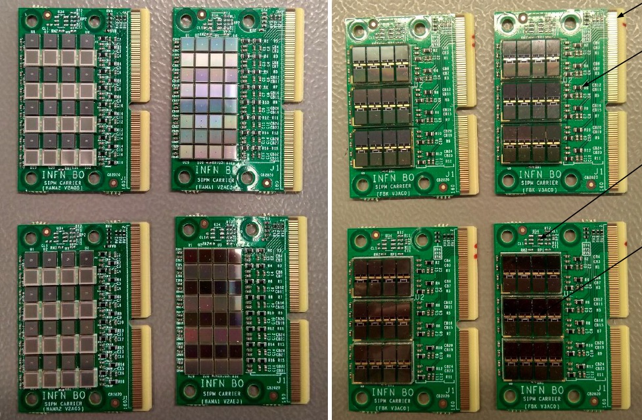
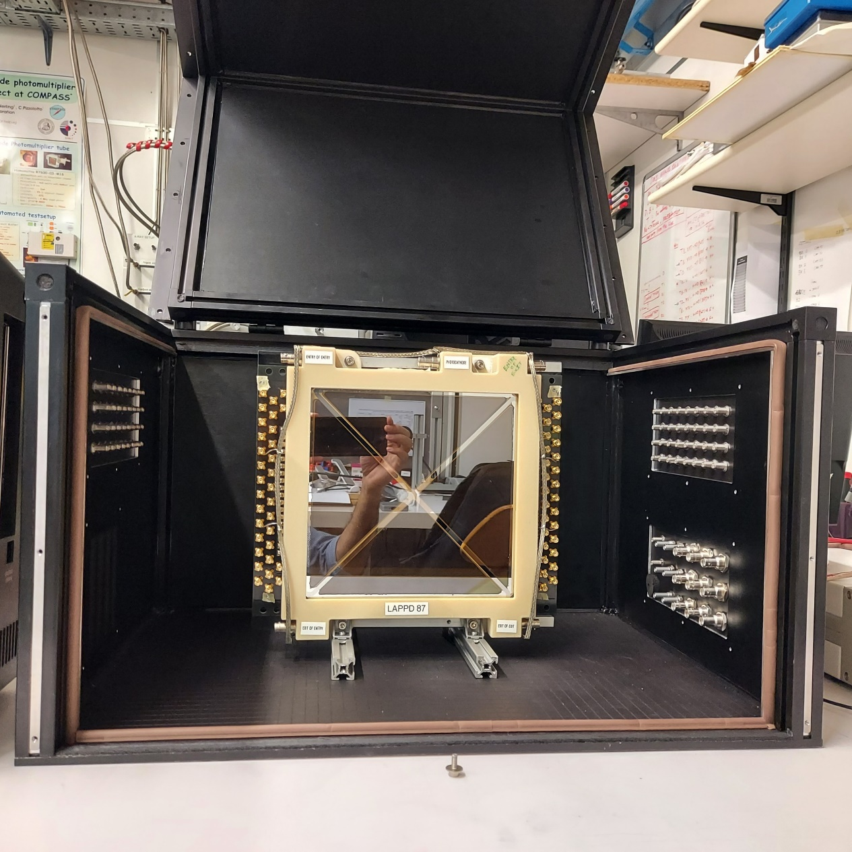
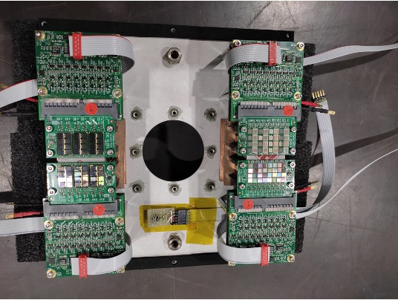
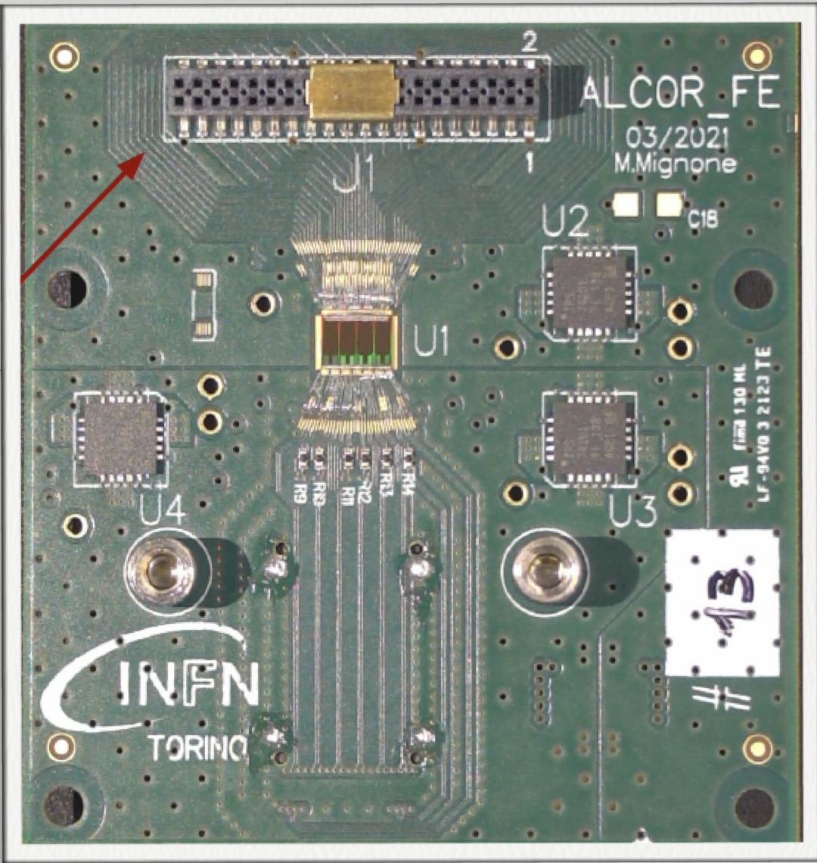
Photo-Sensors
Study solutions for single-photon detection within strong B-field
SiPM program: selection among various candidates
R&D dark count mitigation
LAPPD program
Test & guide developments @ Incom
INFN 2023: sensors, instrumentation, electronics, FBK R&D
local support at SA, CS, MS
INFN 2023: rent, instrumentation
Incontro Nazionale EIC_NET - 3th October 2022

Slide 17
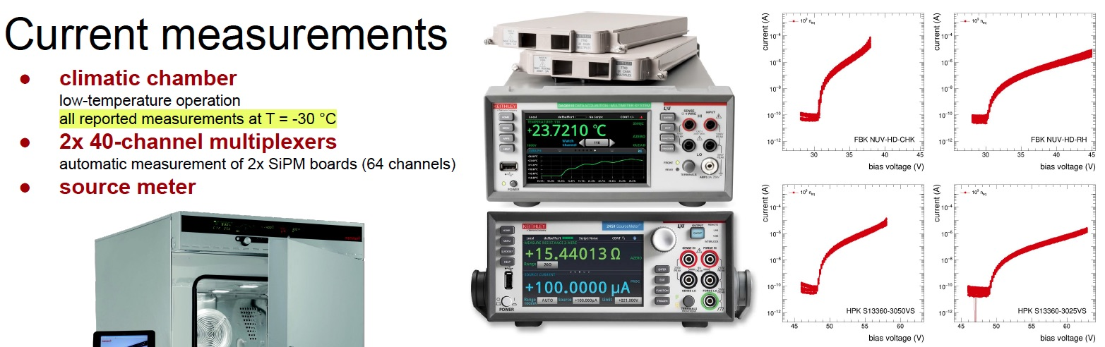
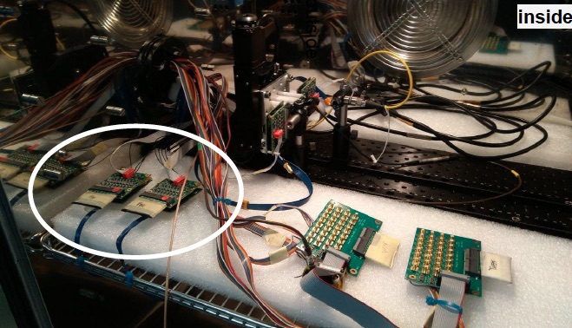
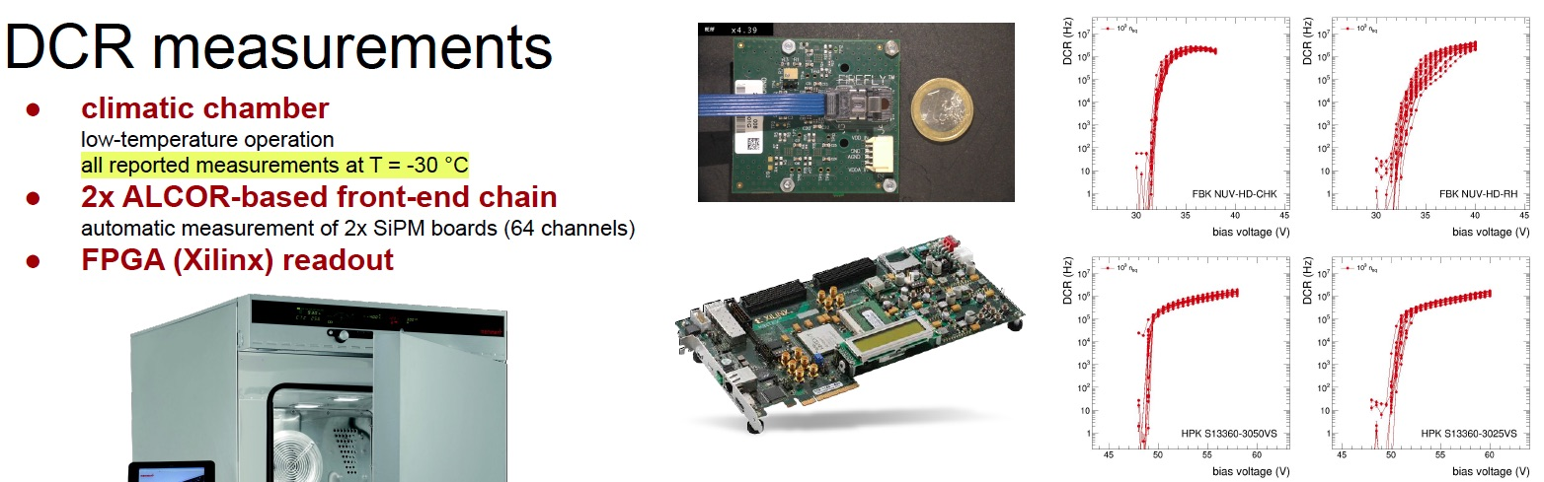
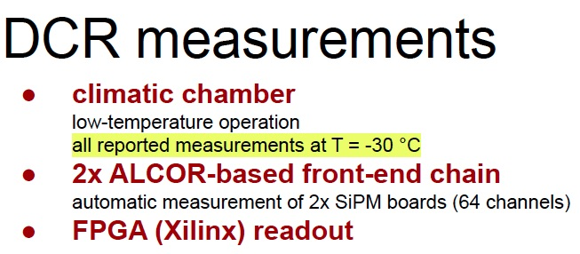
SiPM Test Station
Roberto @ RICH2022
Incontro Nazionale EIC_NET - 3th October 2022

Slide 18
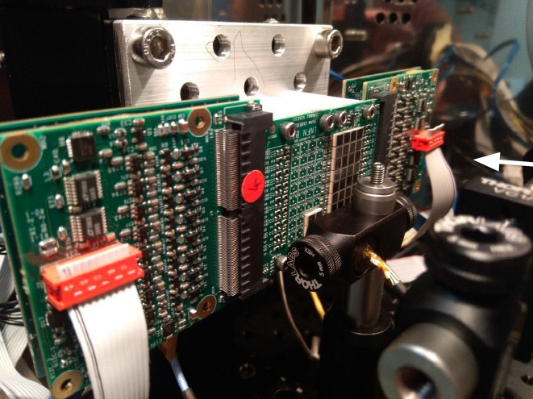
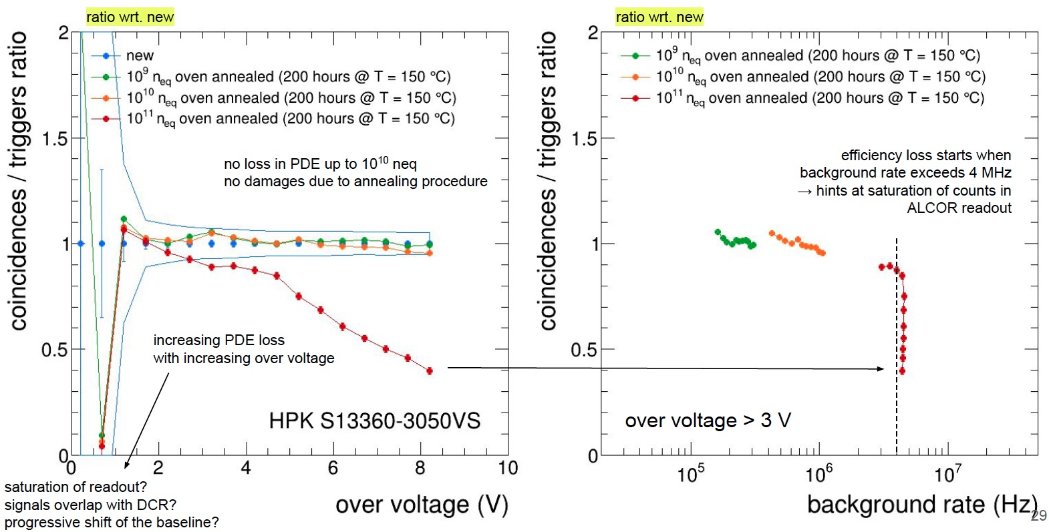
SiPM + ALCOR Light Response
Pulsed LED providing a relative PDE measurement
- compare different sensors
- compare before and after irradiation and annealing
- awaiting ALCORv2
Roberto @ RICH2022
Incontro Nazionale EIC_NET - 3th October 2022

Slide 19
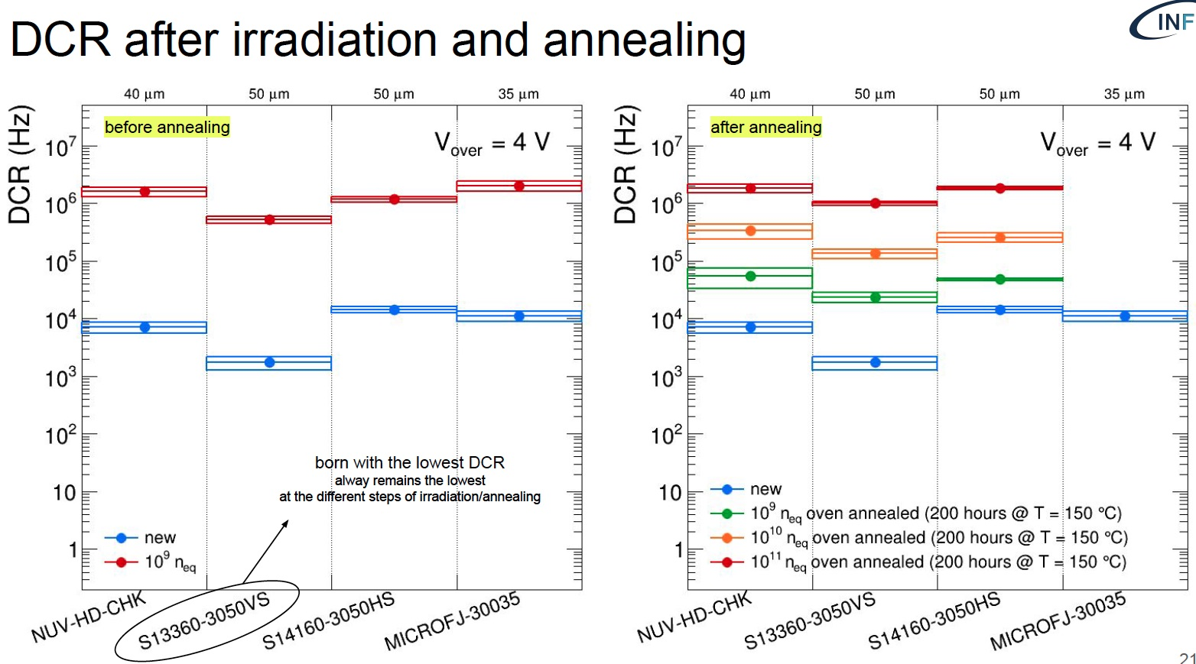
SiPM Dark Count Rate
Compare sensor response to irradiation + annealing. S13360-3050VS most promising for the moment.
Roberto @ RICH2022
Incontro Nazionale EIC_NET - 3th October 2022

Slide 20
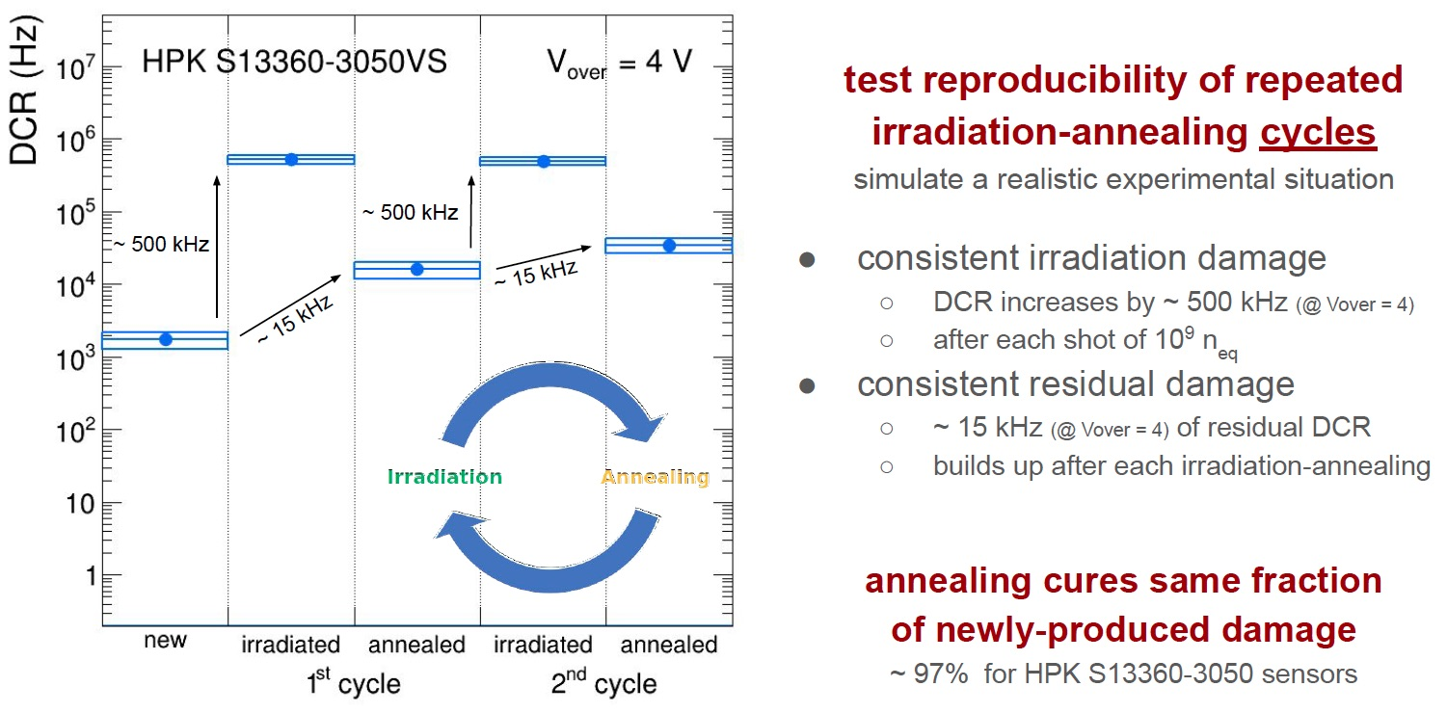
SiPM Irradiation-Annealing Cycles
Realistic study of sensor life with irradiation and annealing cycles
Roberto @ RICH2022
Incontro Nazionale EIC_NET - 3th October 2022

Slide 21
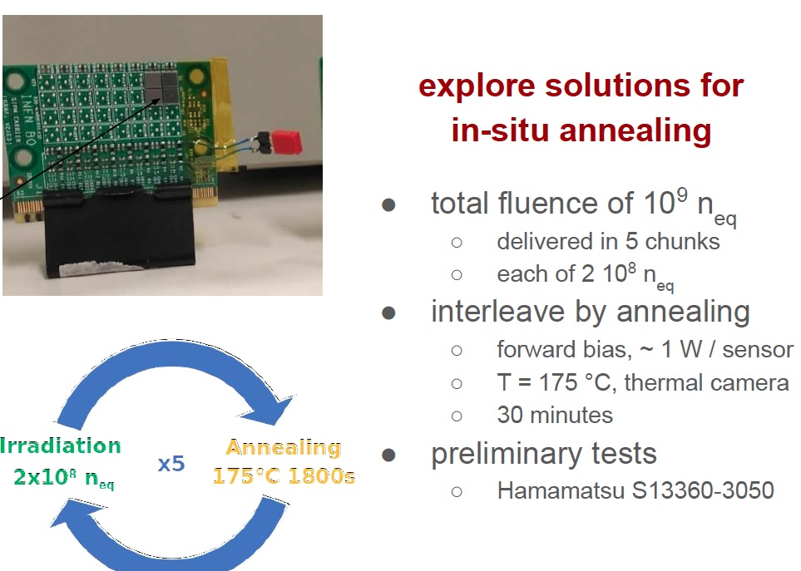
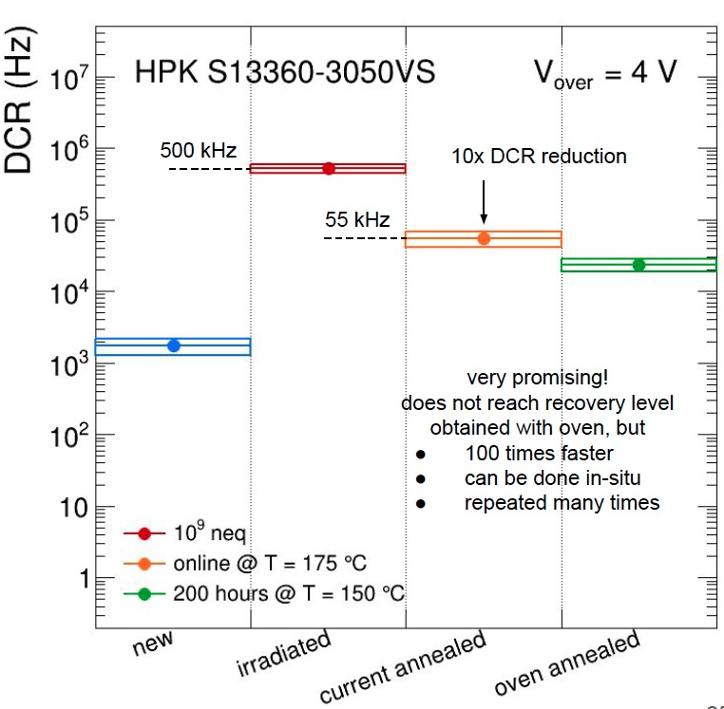
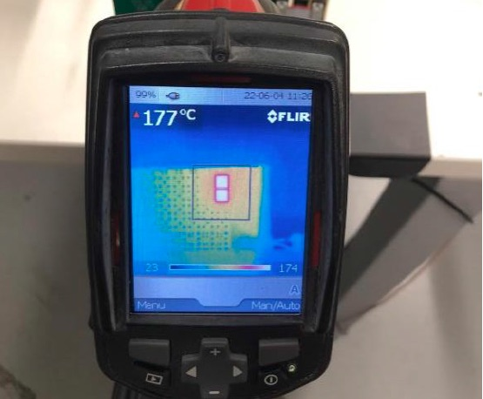
SiPM In-Situ Operations
Study solutions for rapid and repeated annealing
Preparing for beam test (12-19 October 2022)
Roberto @ RICH2022
Incontro Nazionale EIC_NET - 3th October 2022

Slide 22
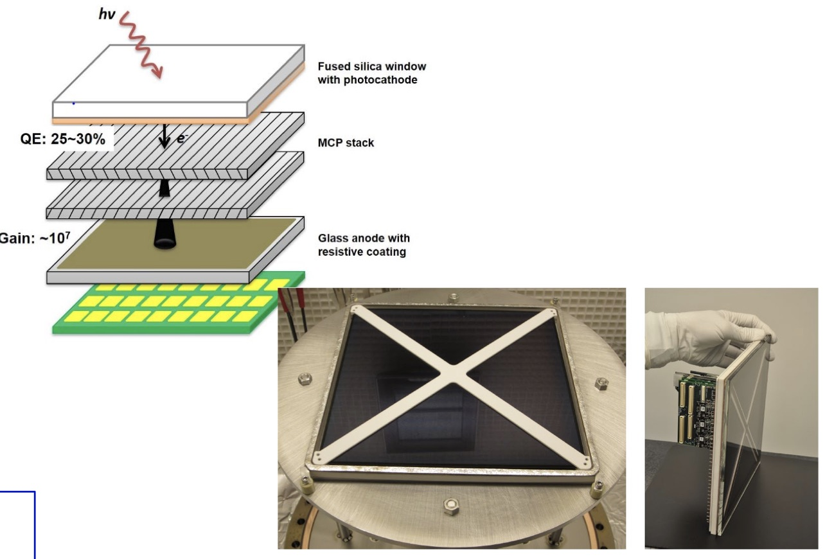
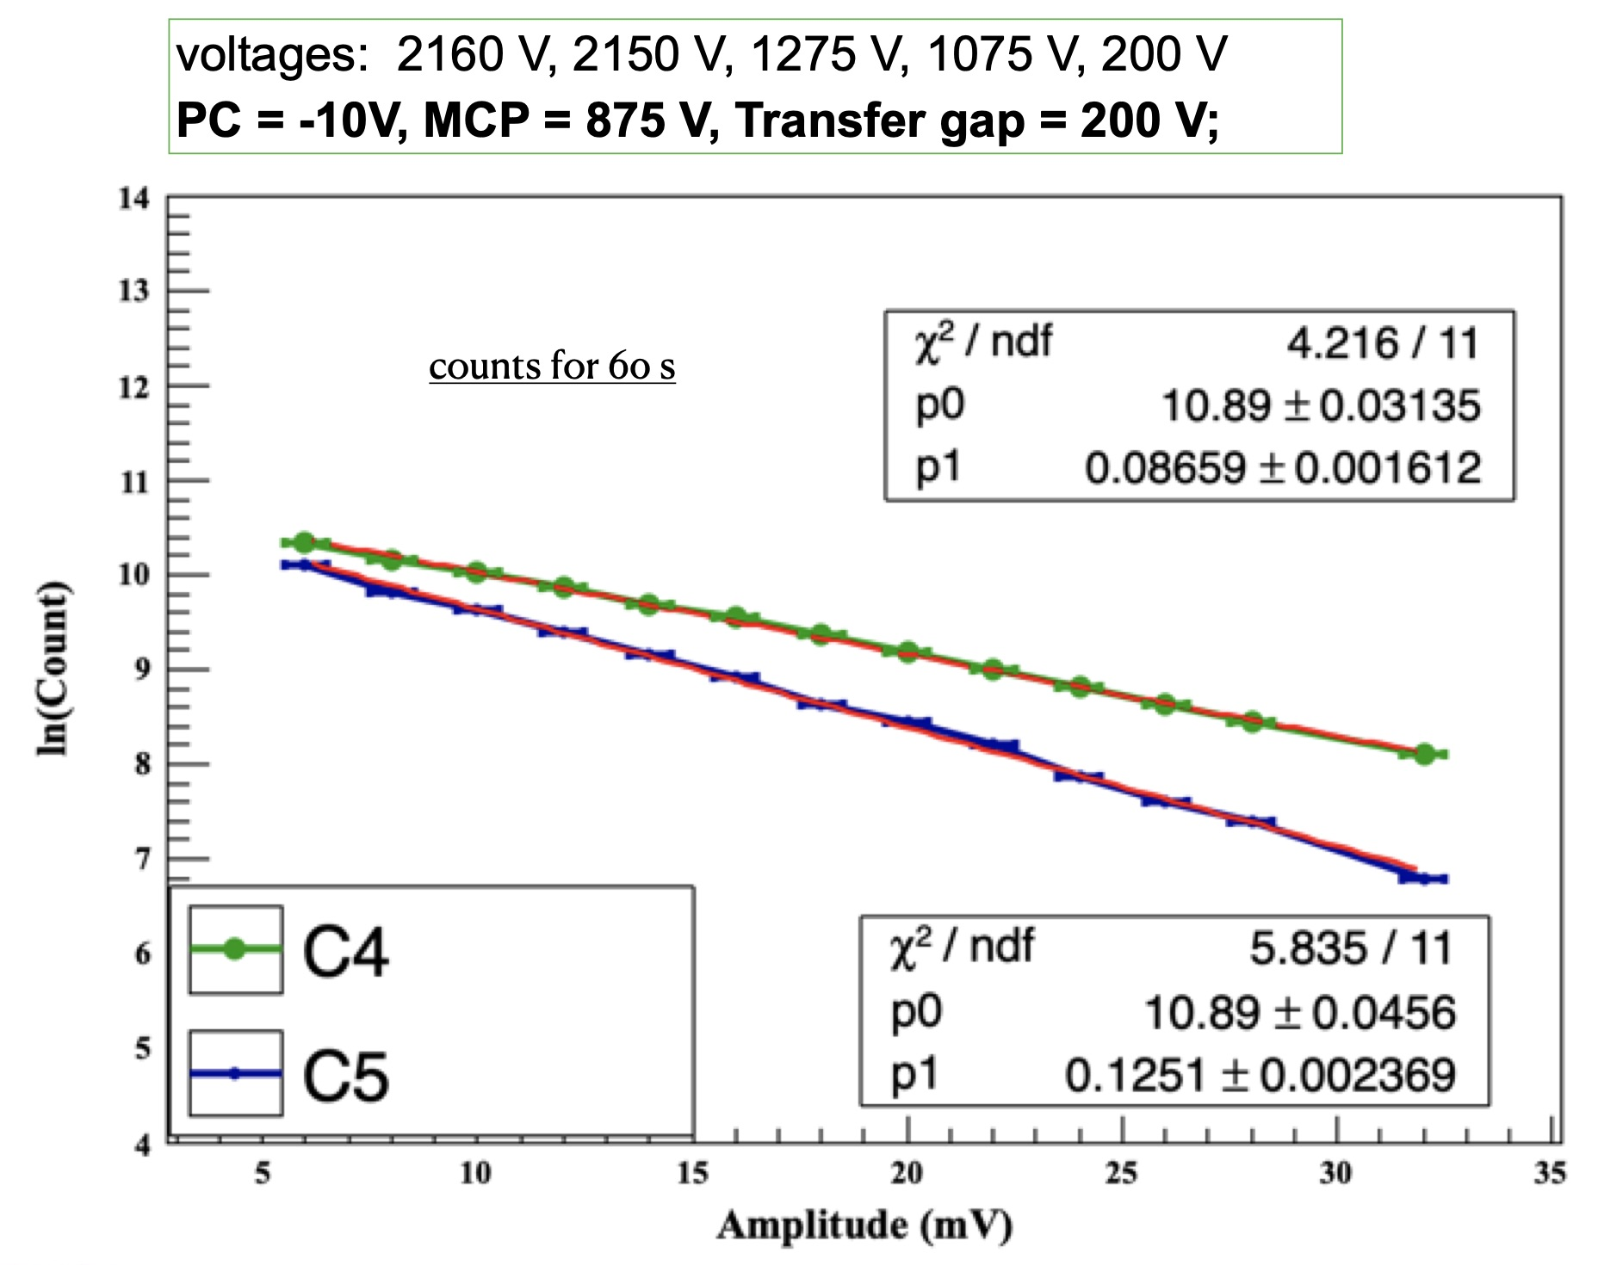



LAPDDs
Large-area
cost effective
micro-channel
plate detector
Measured dark rate: 140 Hz/m² at room temperature
Test station
in Trieste
Preparing single-photon response characterization
Incontro Nazionale EIC_NET - 3th October 2022

Slide 23

LAPDDs @ INFN
Test-beam 5-19 October 2022
CERN PS line T10
Goal: Single photon time resolution
LAPPD photodetector
Quartz lens to produce Cherenkov light
Fast beam monitor MCP and SiPM
Incontro Nazionale EIC_NET - 3th October 2022

Slide 24
Conclusions
dRICH project aims to address crucial PID aspects at EIC
cost-effective compact solution for hadron PID in the forward region in a wide kinematic range
investigation of novel single-photon detector solution to be operated in high magnetic field
The dual-radiator RICH has been a common reference in the forward region since EIC Yellow Report
Moving from generic EIC R&D (eRD14) to targeted EIC R&D (eRD102, eRD110, eRD109, ….)
INFN leading an international effort
Quite broad program (optics, sensors, electronics, mechanics, cooling, ….)
Many opportunities for contributions at the cutting edge of detector technology
Incontro Nazionale EIC_NET - 3th October 2022

