Slide 1
Particle Identification
Lesson 1 - Detectors
M. Contalbrigo – INFN Ferrara
2nd European School on the Physics of the EIC and Related Topics, 22th June – 2nd July, 2025
M. Contalbrigo
2nd European School on EIC Physics, 22th June – 2nd July, 2025
1

Slide 2
Arguments
Particle-ID Detectors based on Tracking Passage through massive absorbers
Calorimetry Kinematics
Energy momentum balance
Shower shape
Particle-ID Detectors as Tracking by-product Ionization Energy Loss
Transition Detection
Particle-ID Sensors Multi-Anode Photomultipliers
Micro-channel Plates
Silicon Photomultipliers
Low Gain Avalanche Photodiode
Specific Particle-ID Detectors Time-of-Flight
Cherenkov Radiation
M. Contalbrigo
2nd European School on EIC Physics, 22th June – 2nd July, 2025
2
Notes:
Vanno messi studi innovativi e pubblicazioni

Slide 3
PID from Tracking & Calorimetry
M. Contalbrigo
2nd European School on EIC Physics, 22th June – 2nd July, 2025
3

Slide 4
Tracking / Calorimetry
Process | Particle | Equipment
Passage through massive absorbers | Muons | Tracking
Kinematics (exclusive topology in decays or final state) | Hadrons | Tracking
Energy-momentum balance | Electrons / Gammas | Tracking / Calorimetry
Shower shape in calorimeters | Electrons / Gammas | Calorimetry
Energy only | Neutrals | Calorimetry
M. Contalbrigo
2nd European School on EIC Physics, 22th June – 2nd July, 2025
4

Slide 5
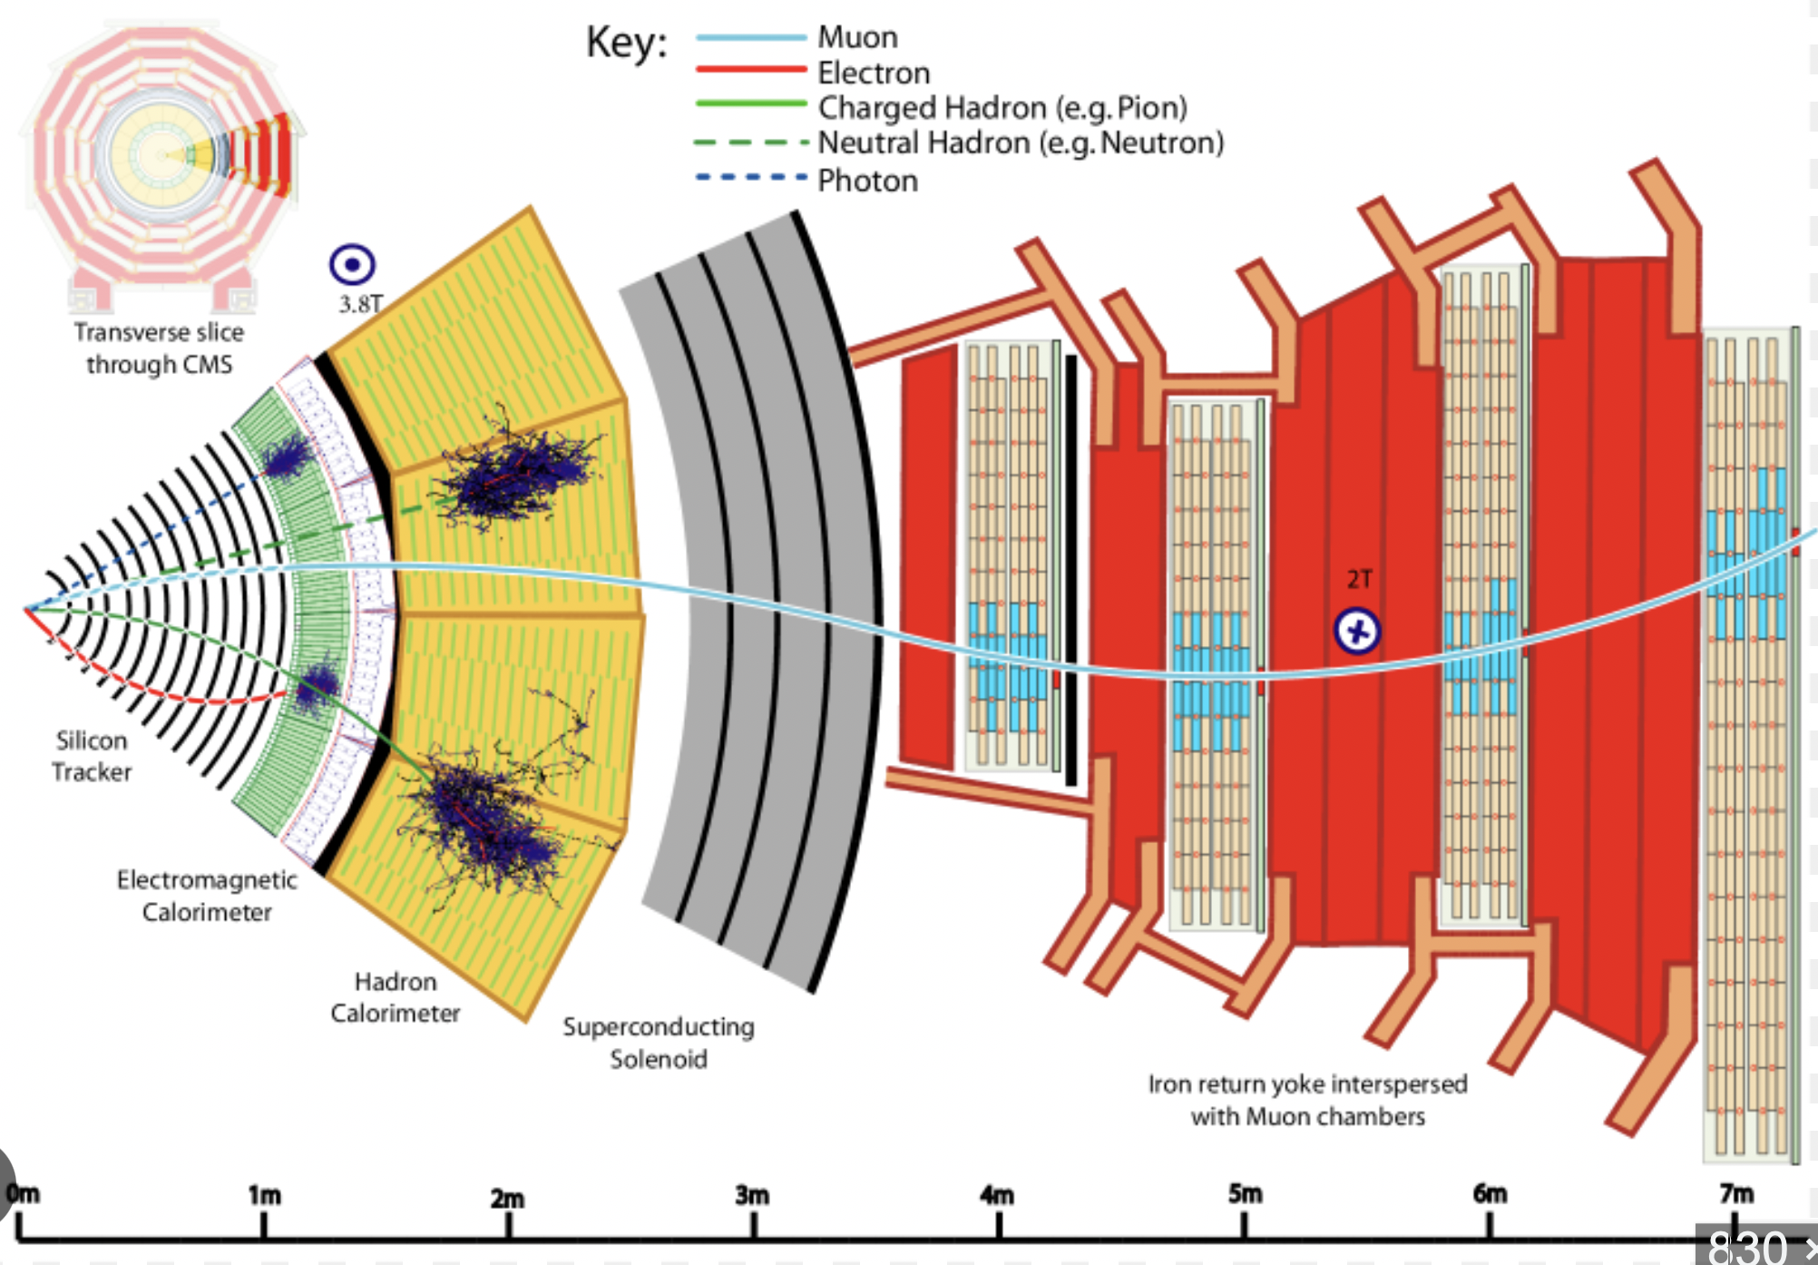
Tracking
Process | Particle | Equipment
Passage through massive absorbers | Muons | Tracking
CMS
M. Contalbrigo
2nd European School on EIC Physics, 22th June – 2nd July, 2025
5

Slide 6
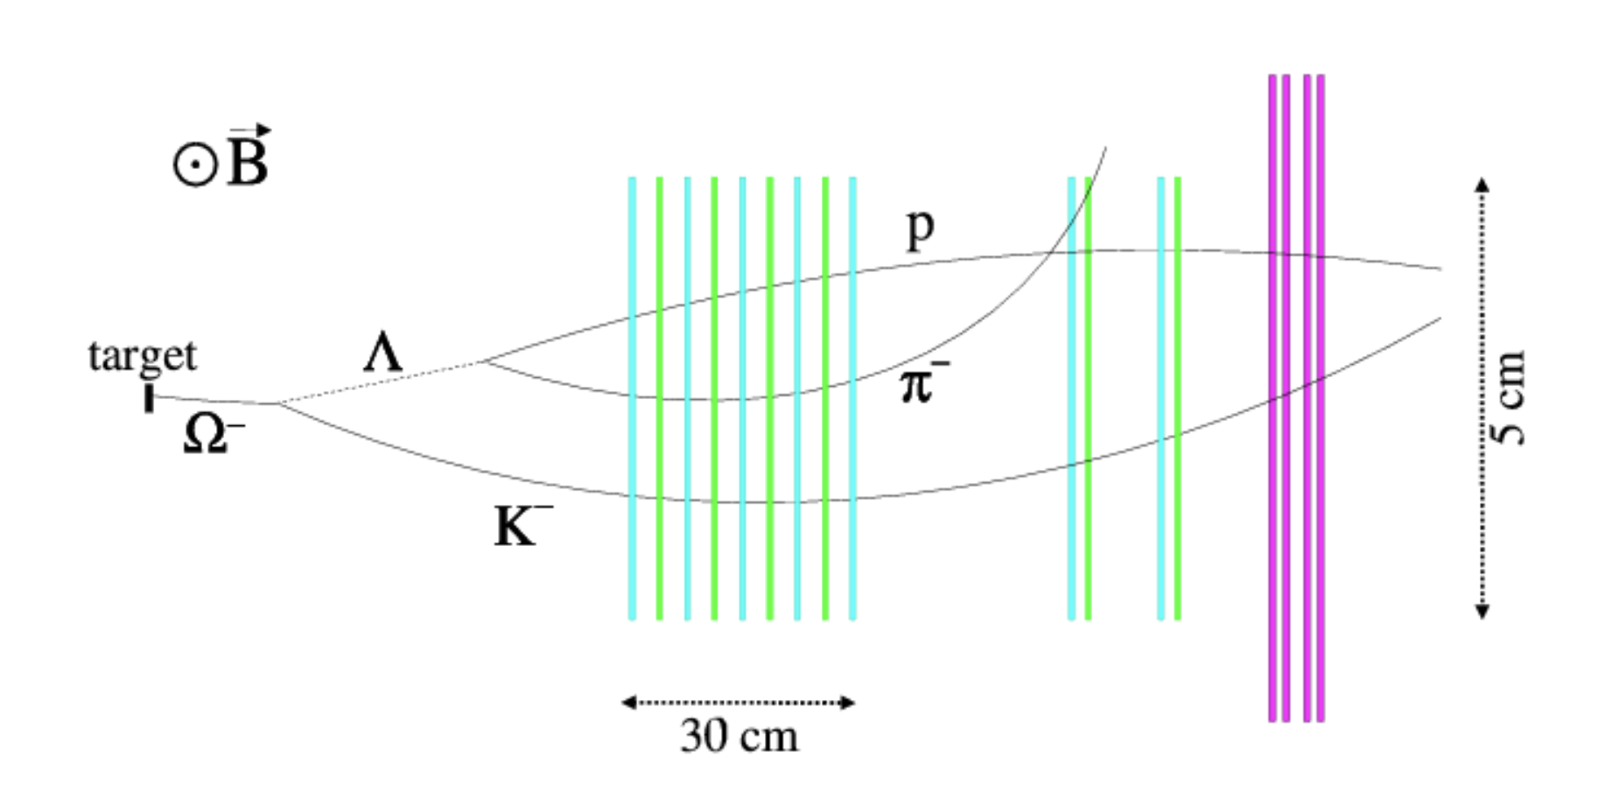
Tracking
Process | Particle | Equipment
Kinematics (exclusive topology in decays or final state) | Hadrons | Tracking
M. Contalbrigo
2nd European School on EIC Physics, 22th June – 2nd July, 2025
6

Slide 7
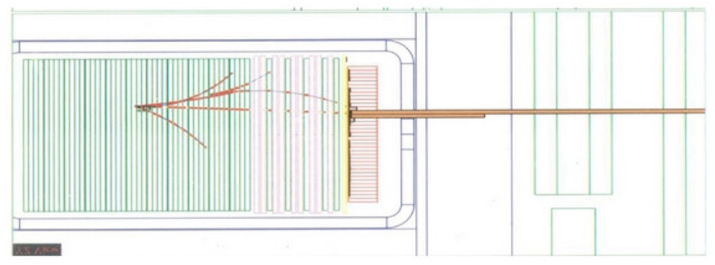
Tracking / Calorimetry
Process | Particle | Equipment
Energy-momentum balance | Electrons / Gammas | Tracking / Calorimetry
NOMAD
Tracking
TRD
ECAL
M. Contalbrigo
2nd European School on EIC Physics, 22th June – 2nd July, 2025
7

Slide 8
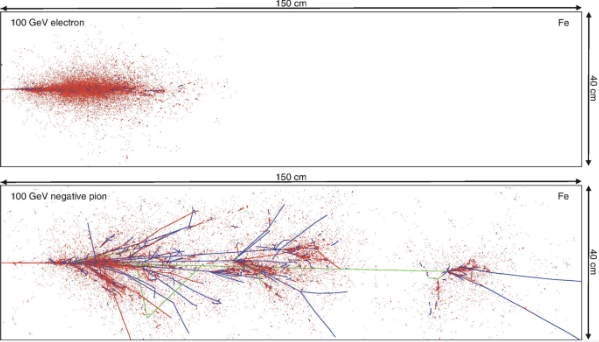
Calorimetry
Process | Particle | Equipment
Shower shape in calorimeters | Electrons / Gammas | Calorimetry
e.m.
hadronic
M. Contalbrigo
2nd European School on EIC Physics, 22th June – 2nd July, 2025
8

Slide 9
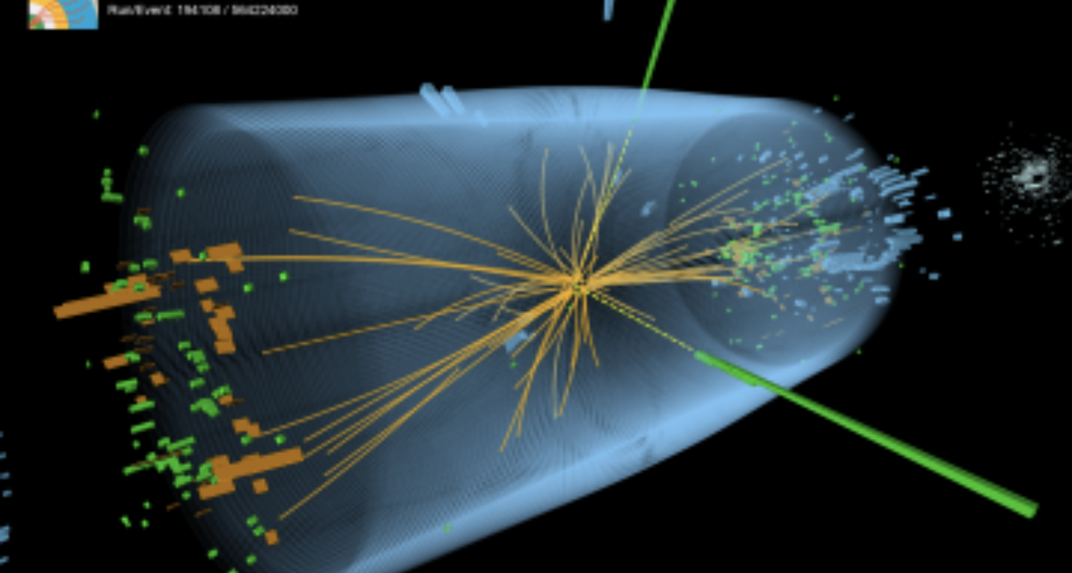
Calorimetry
Process | Particle | Equipment
Energy only | Neutrals | Calorimetry
M. Contalbrigo
2nd European School on EIC Physics, 22th June – 2nd July, 2025
9

Slide 10
PID as Tracking By-product
M. Contalbrigo
2nd European School on EIC Physics, 22th June – 2nd July, 2025
10

Slide 11
PID by Tracking
Assume to know the momentum (by tracking the bending in a magnetic field)
Get the mass by measuring the velocity (βc)
p = γ m βc
Process | Particle | Equipment
Energy Loss (dE/dx) | Hadrons | Tracking
Transition Radiation (TDR) | Electrons | Tracking sensitive to X-ray
Time-of-Flight (TOF) | Hadrons | Timing
Cherenkov Radiation | Hadrons | Cherenkov
M. Contalbrigo
2nd European School on EIC Physics, 22th June – 2nd July, 2025
11

Slide 12
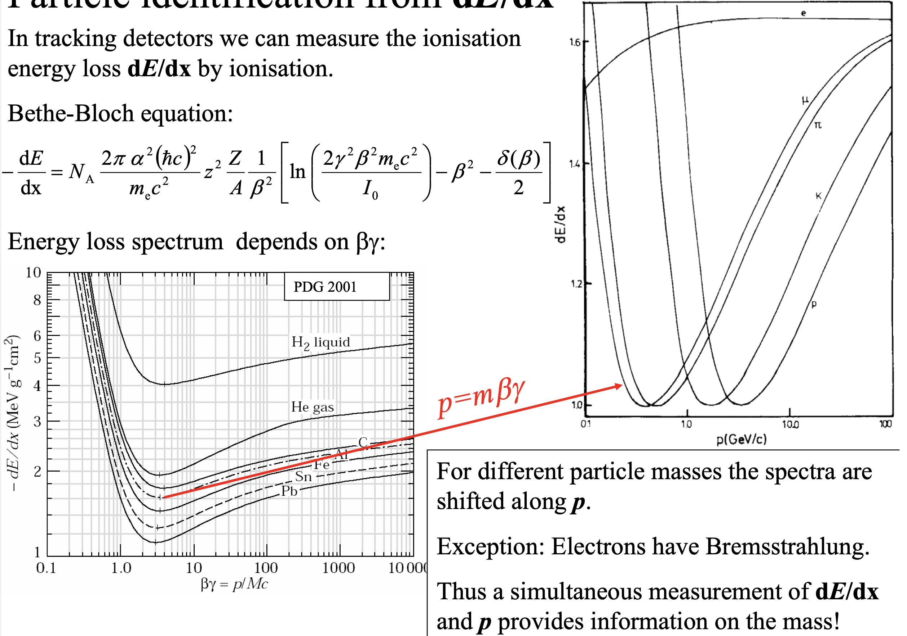
Energy Loss
M. Contalbrigo
2nd European School on EIC Physics, 22th June – 2nd July, 2025
12

Slide 13
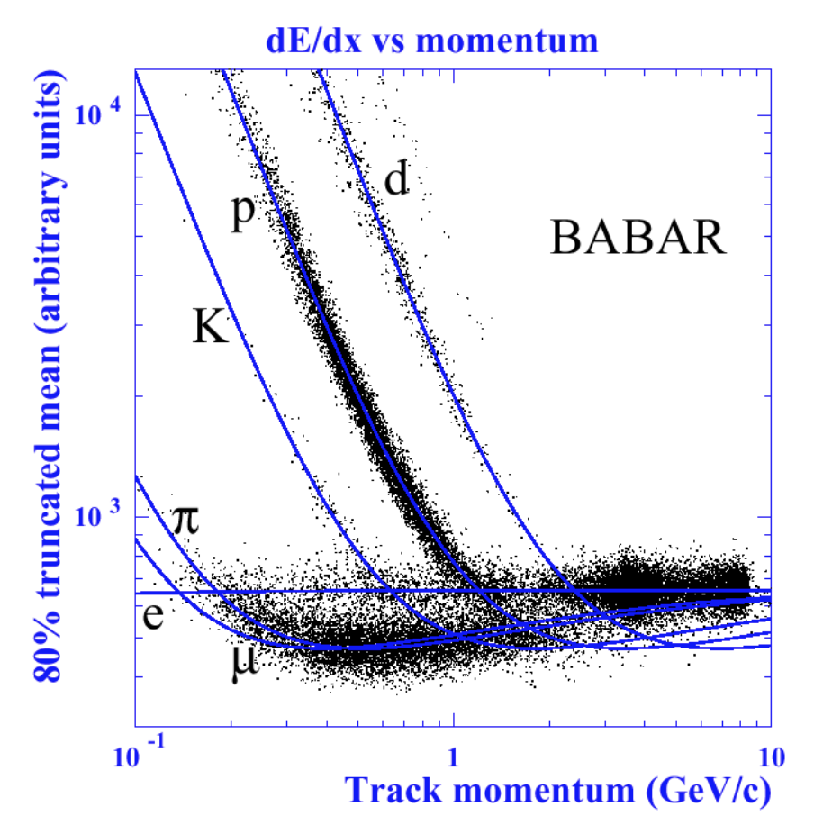
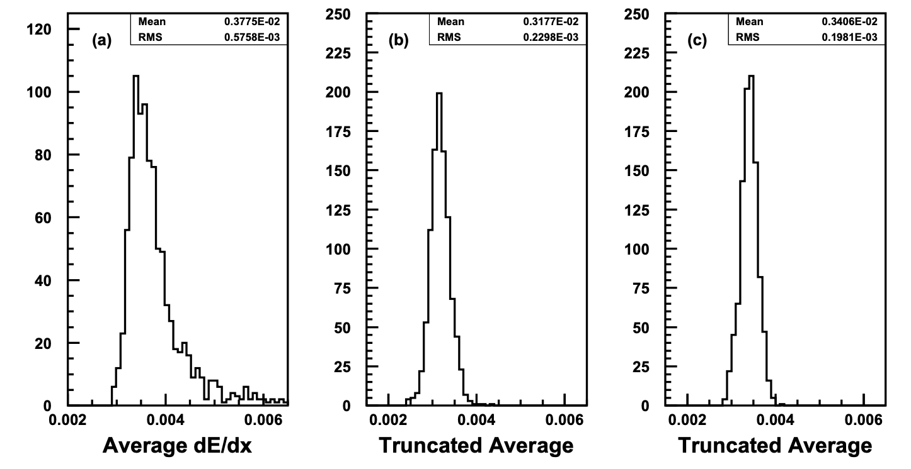
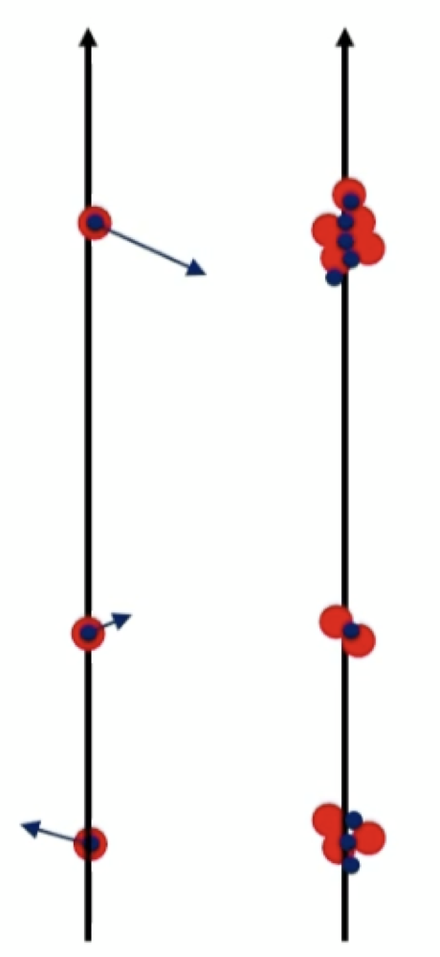
dE/dx
A by-product of a tracking detector
Average over several signals:
- many layers (straw tubes, silicon detctors)
- many electrodes over a big volume (TPC)
Different particles creates distinctive bands in
the dE/dx vs p correlation plane
Identification is possible where the bands do
not overlap (low energy)
A truncated mean is used to reject fluctuations
1st
Tot
M. Contalbrigo
2nd European School on EIC Physics, 22th June – 2nd July, 2025
13

Slide 14
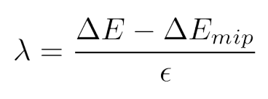
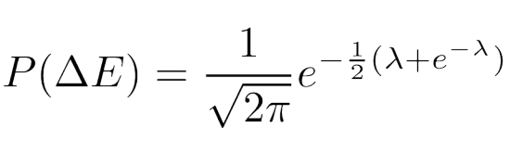
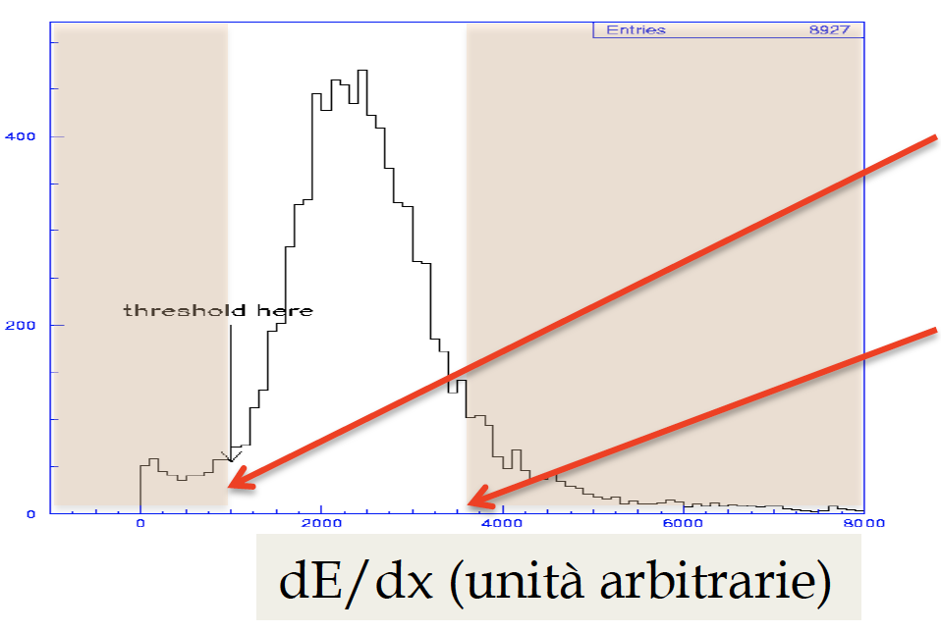
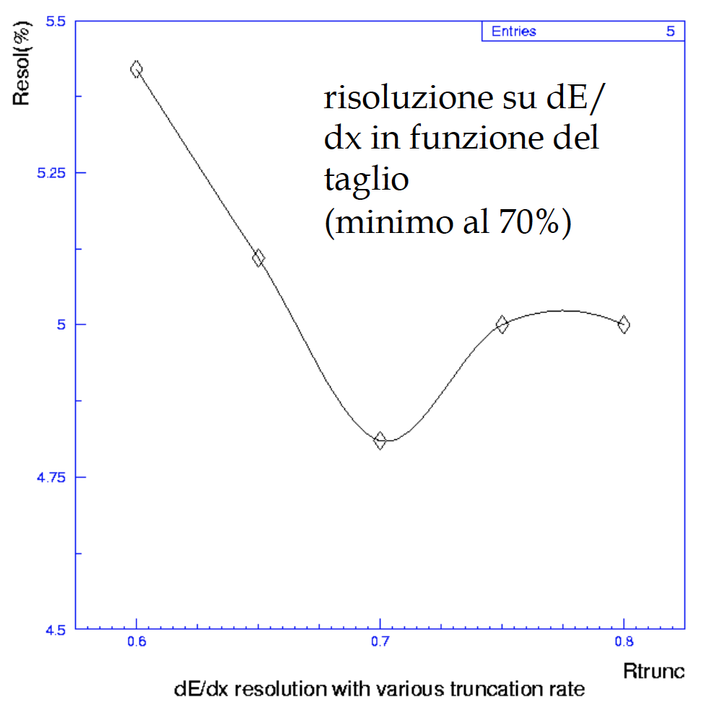
Truncated Mean
For thick layers or large sampling the dE distribution is approximated by a gaussian
For thin layers of small sampling rare hard-collisions matter (δ-rays, knock on electrons,
bremmssthralung) and the dE distribution is described by a Landau distribution
A truncated mean is used to reject fluctuations or δ-rays and increase resolution
To remove
background
dE/dx resolution as a function
of the truncation level
To remove
fluctuations
Best at 70%
dE/dx (arbitrary units)
M. Contalbrigo
2nd European School on EIC Physics, 22th June – 2nd July, 2025
14

Slide 15
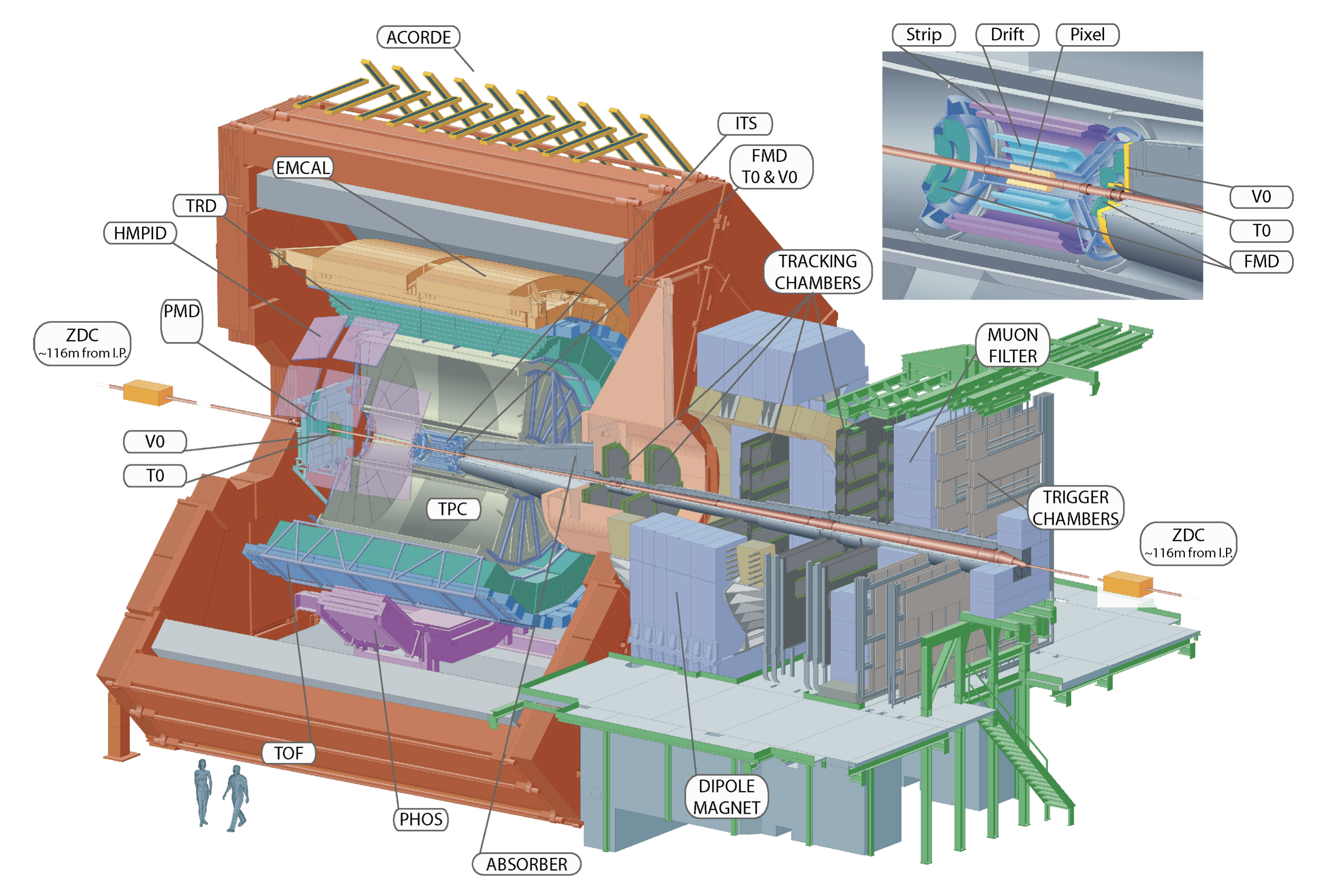
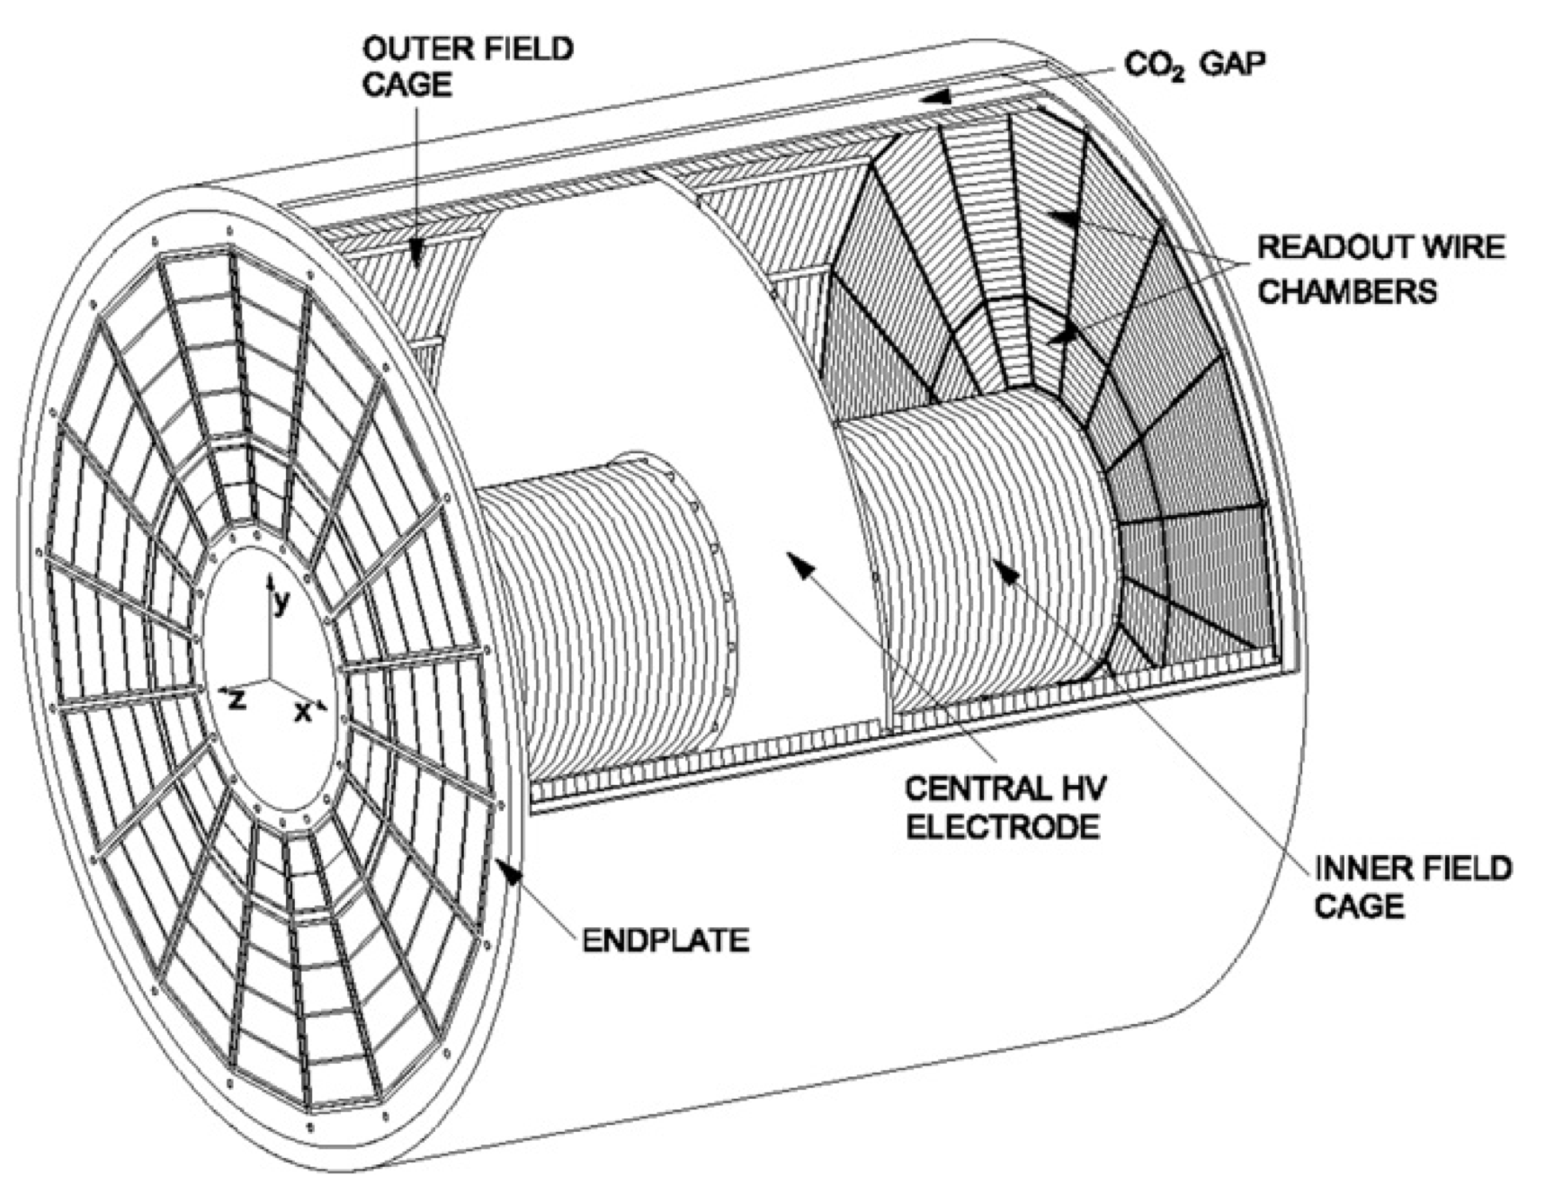
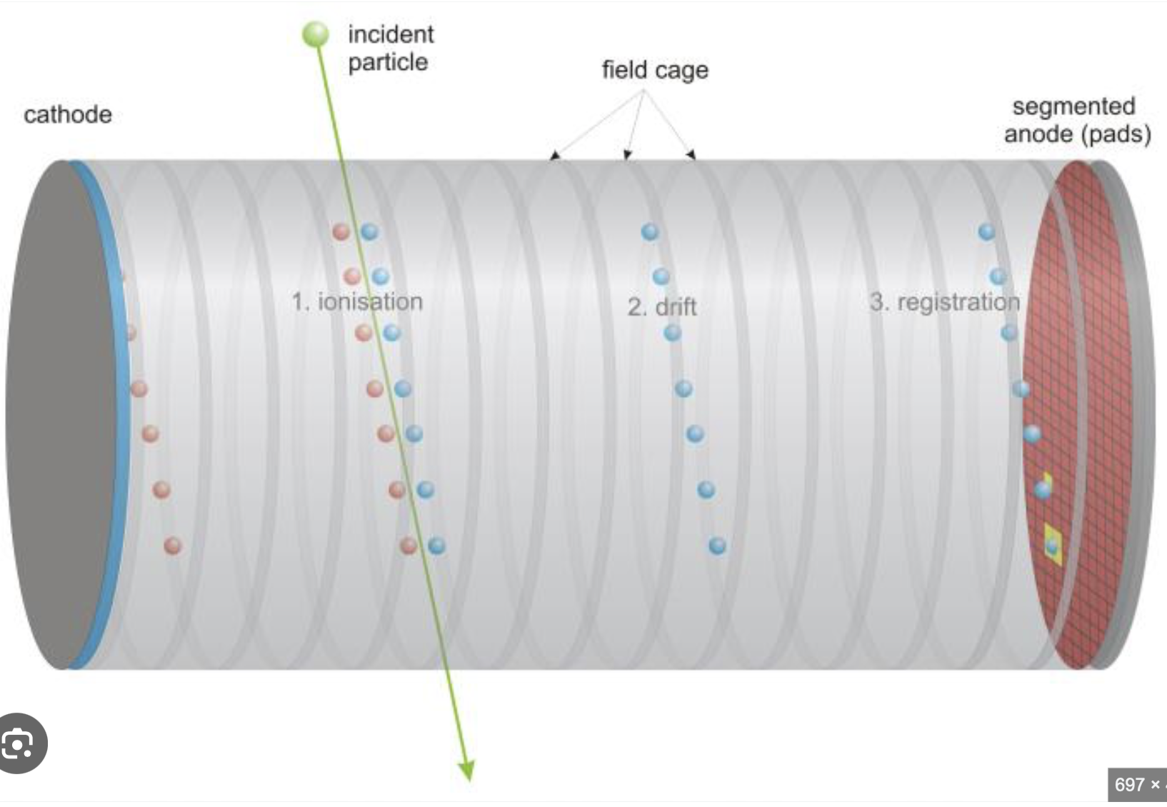
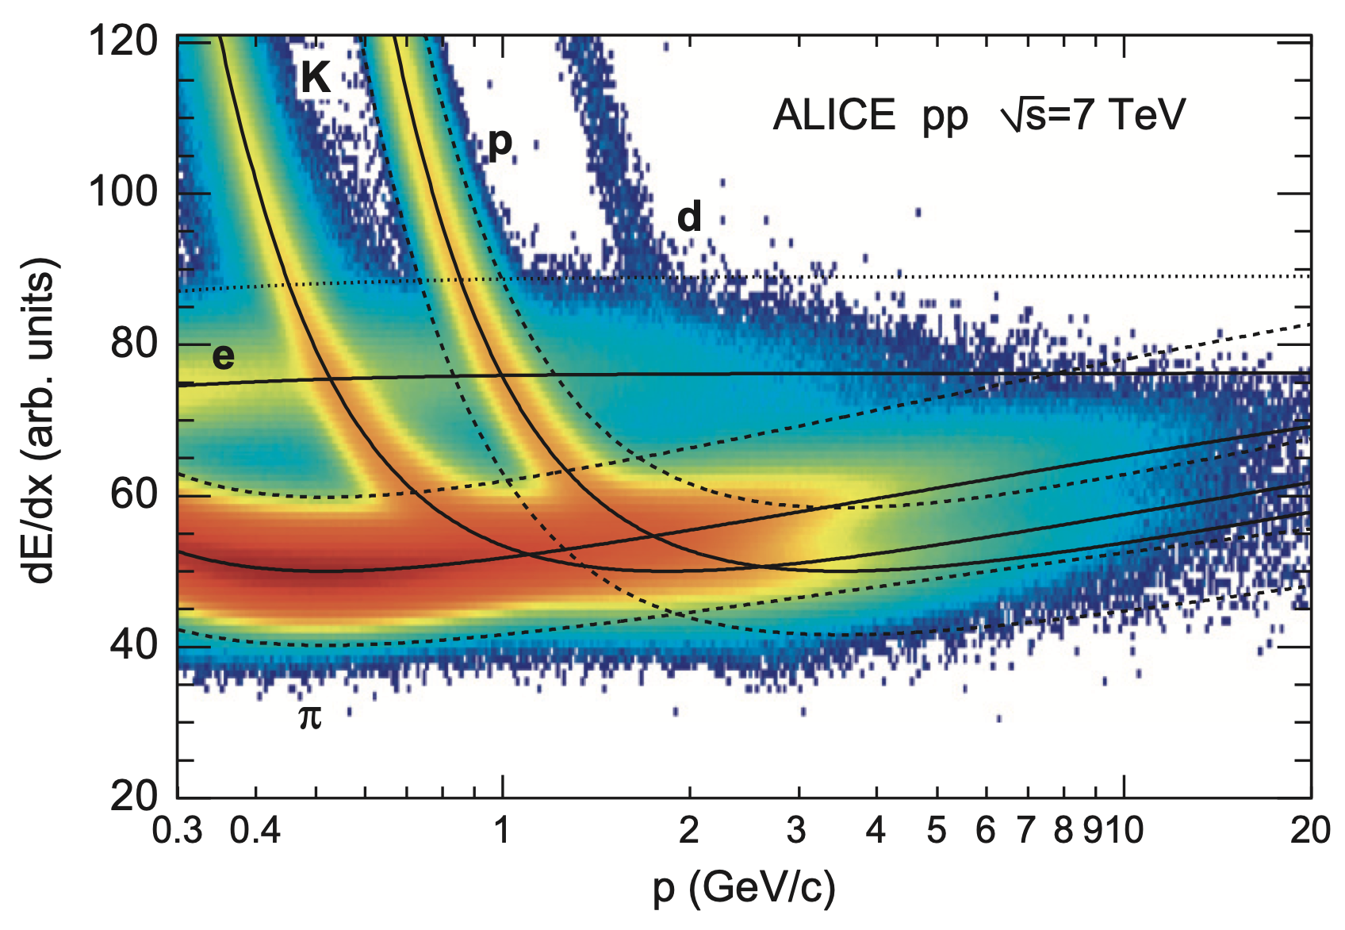
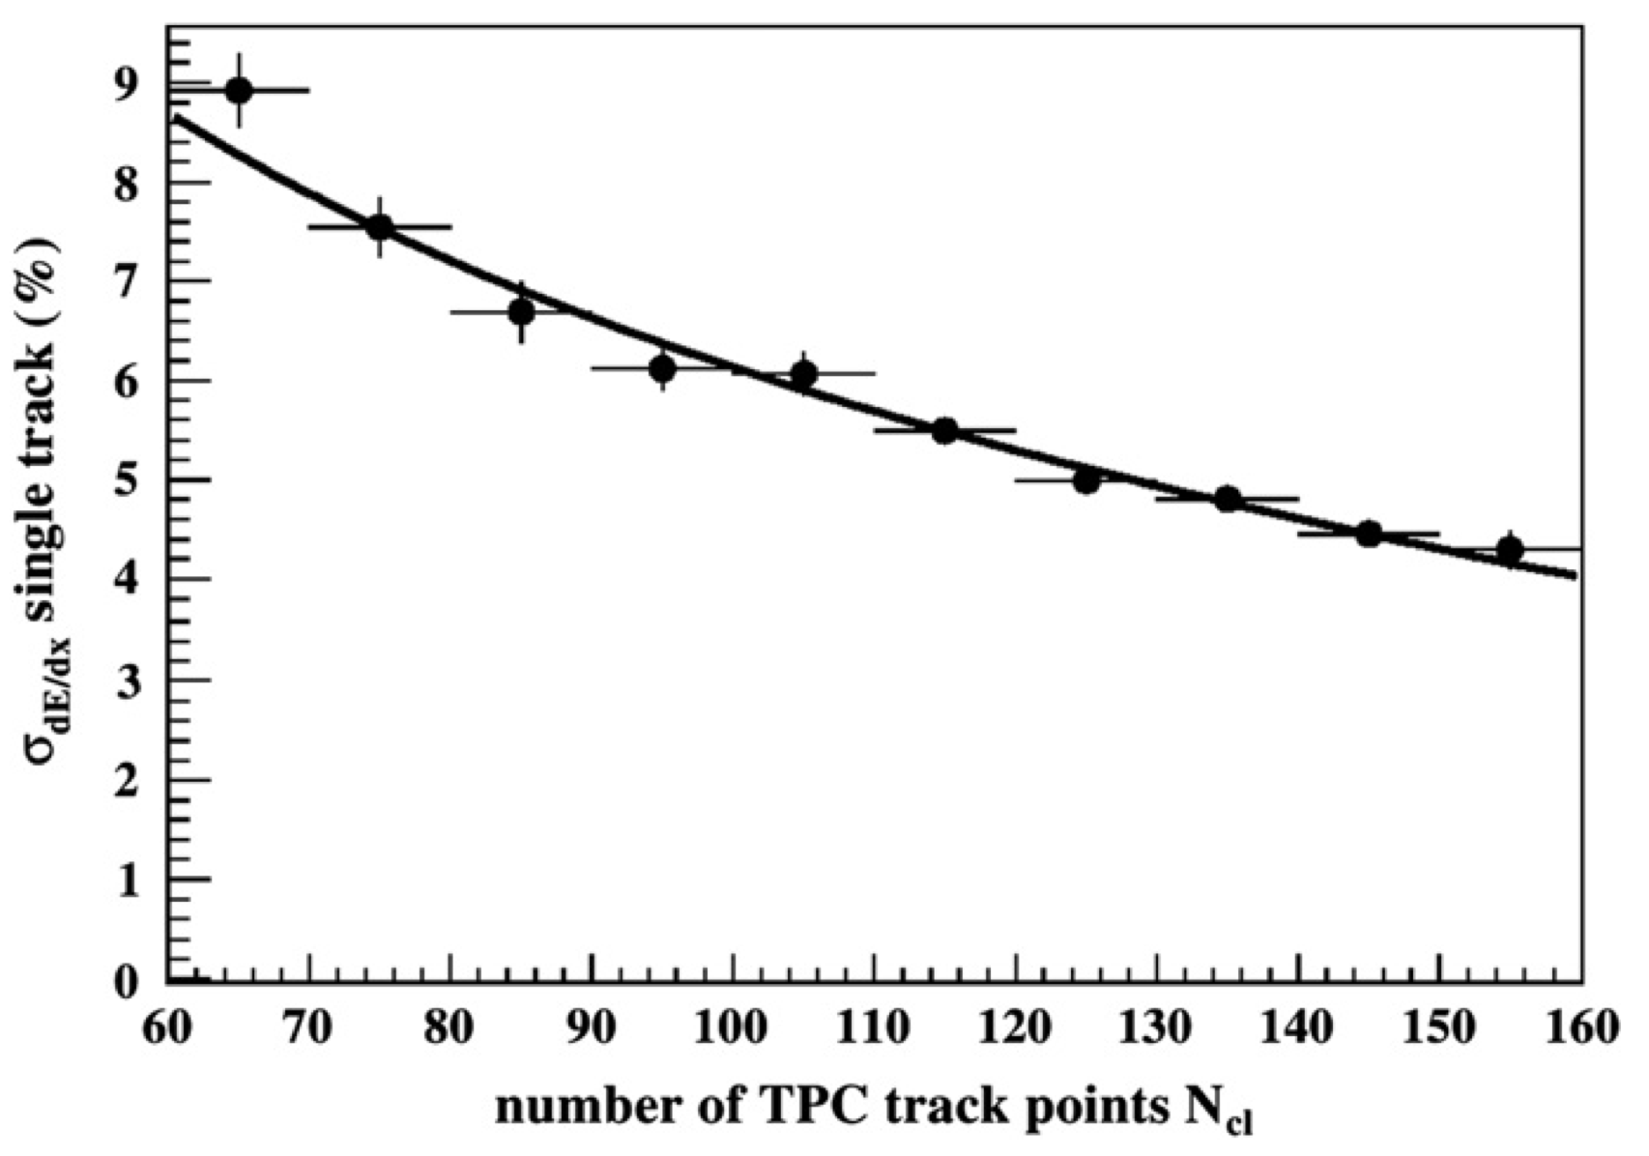
ALICE TPC
ALICE: Quark-gluon plasma in heavy ion collisions
Time projection chamber
M. Contalbrigo
2nd European School on EIC Physics, 22th June – 2nd July, 2025
15

Slide 16
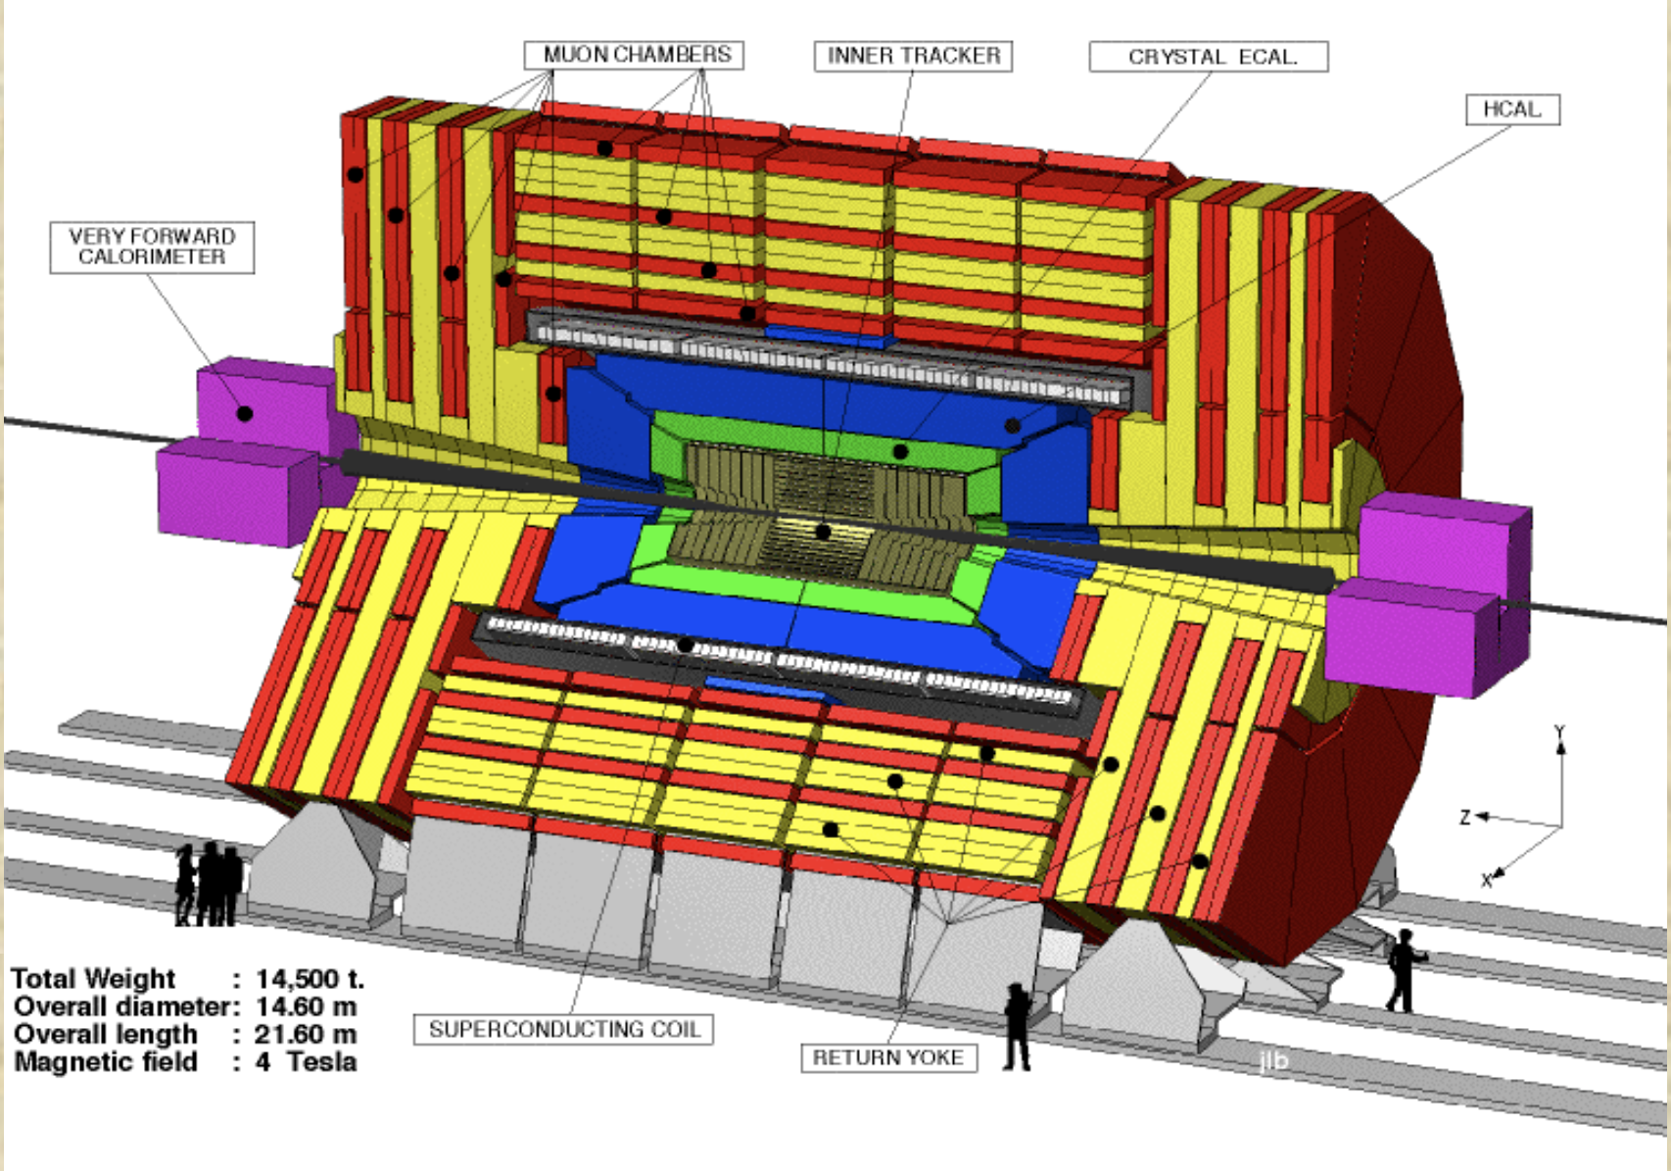
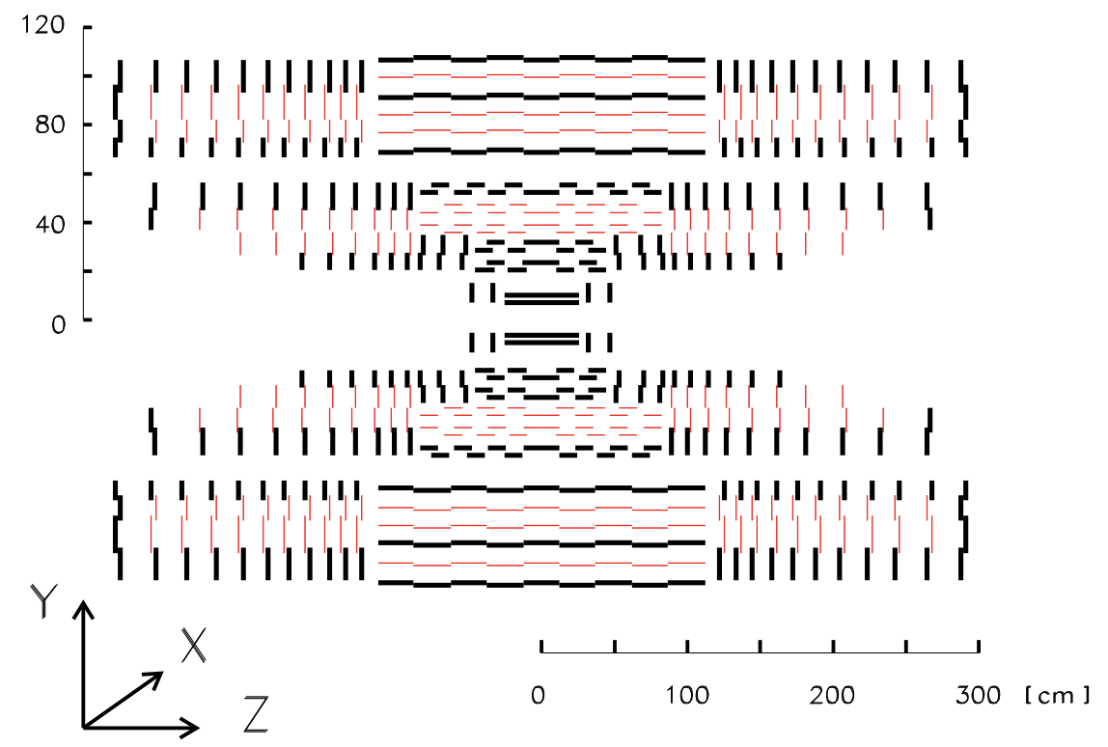
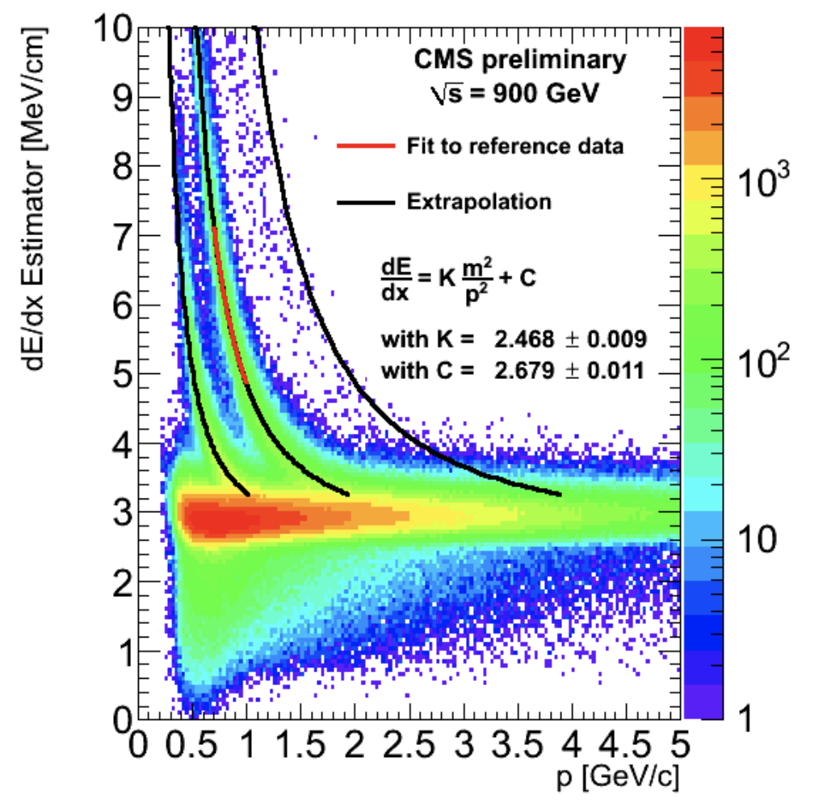
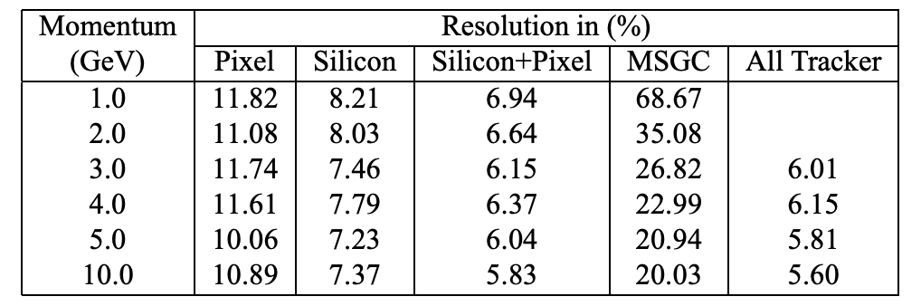
CMS Tracker
CMS: Higg boson and BSM search
Inner Tracker System
Micro-Strip Gas Chamber
Silicon Strip Detector
Silicon Pixel Detector
M. Contalbrigo
2nd European School on EIC Physics, 22th June – 2nd July, 2025
16

Slide 17
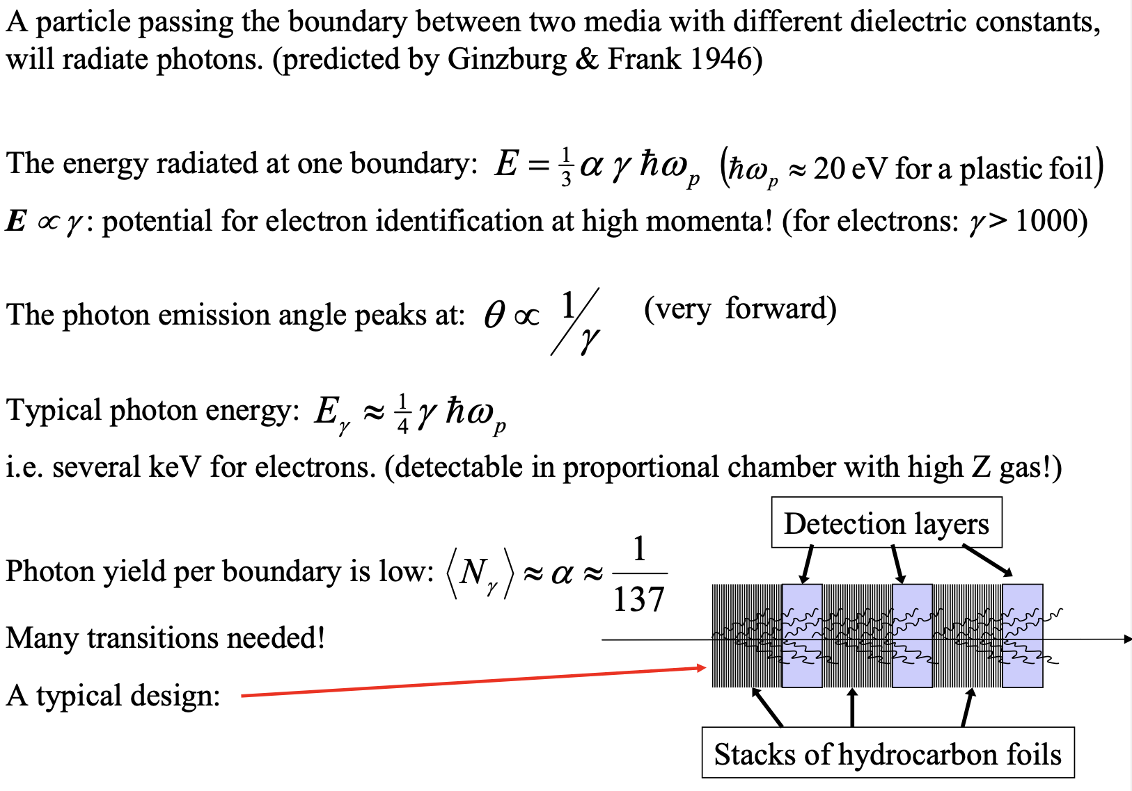
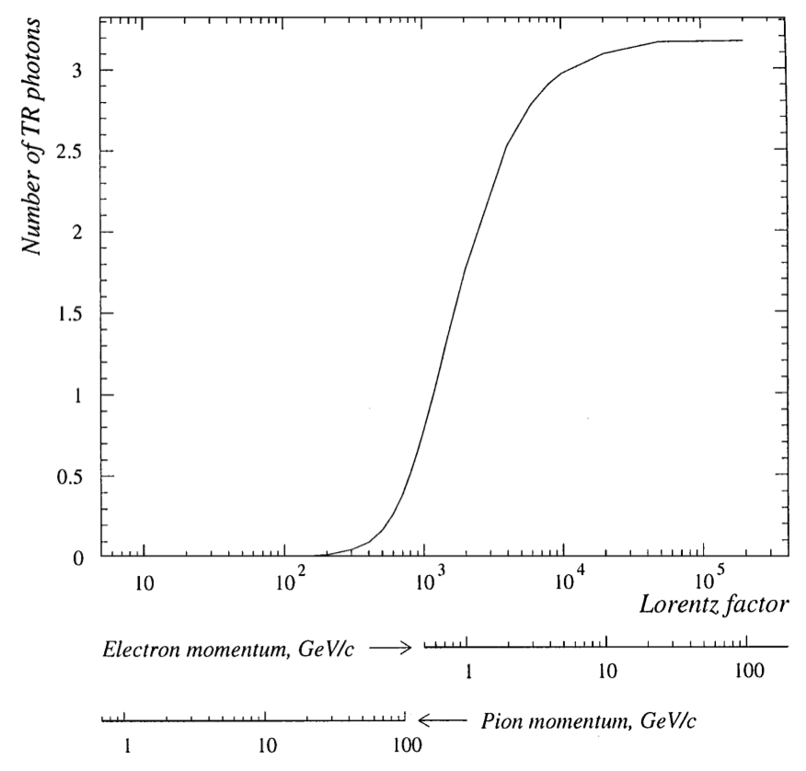
Transition Radiation
M. Contalbrigo
2nd European School on EIC Physics, 22th June – 2nd July, 2025
17

Slide 18
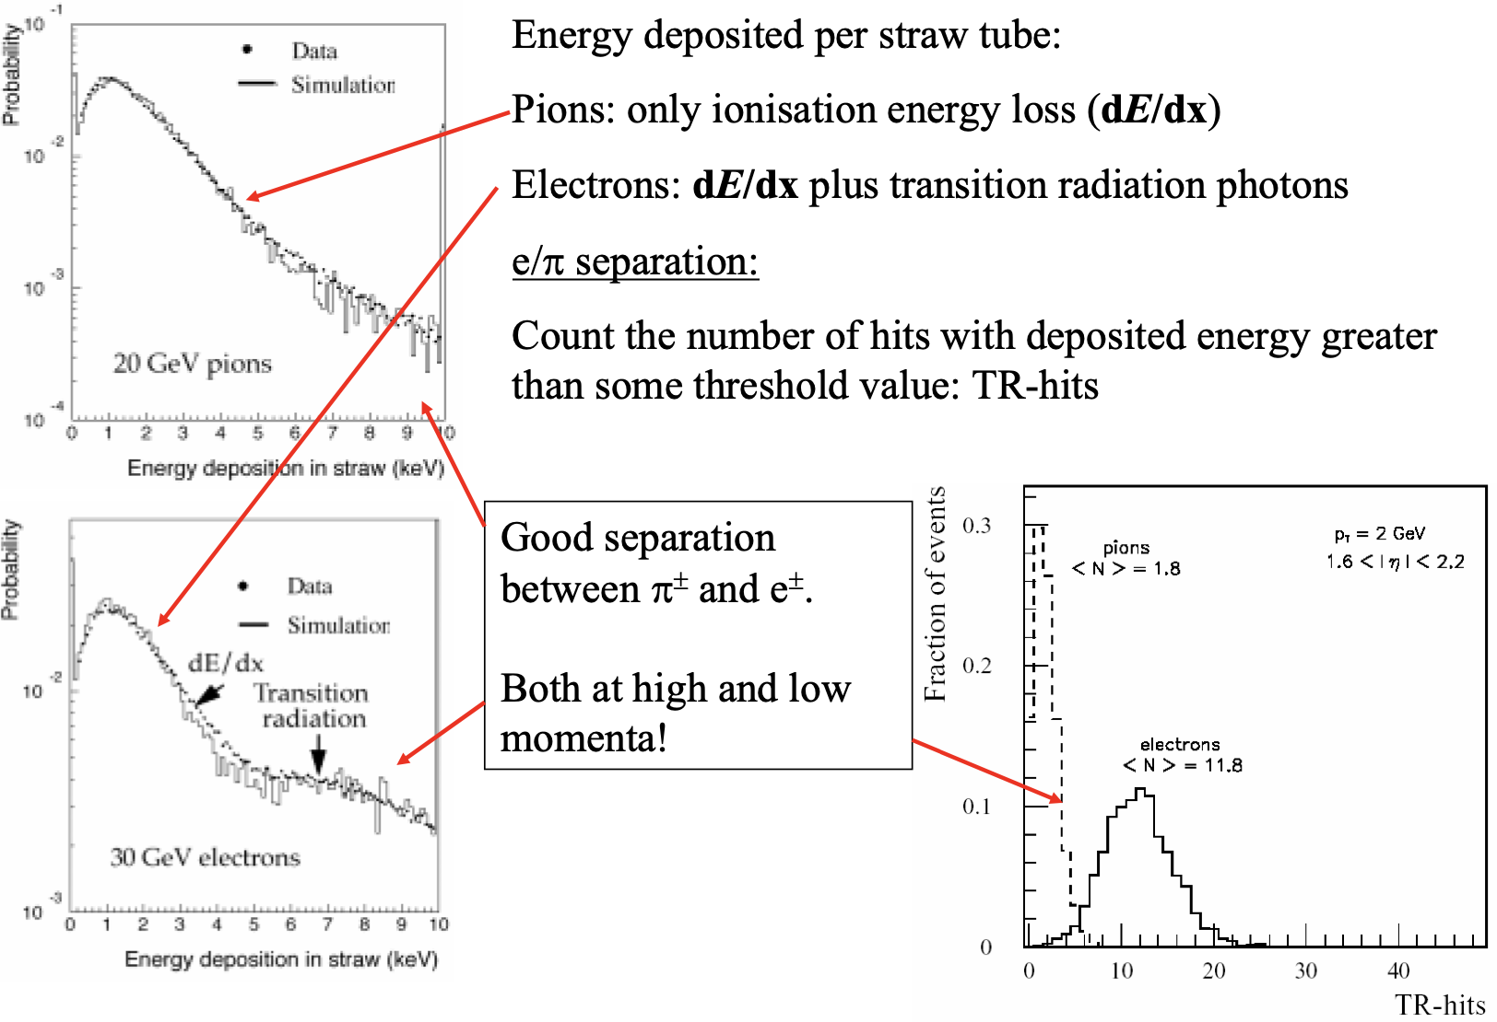
Transition Radiation
layer
M. Contalbrigo
2nd European School on EIC Physics, 22th June – 2nd July, 2025
18

Slide 19
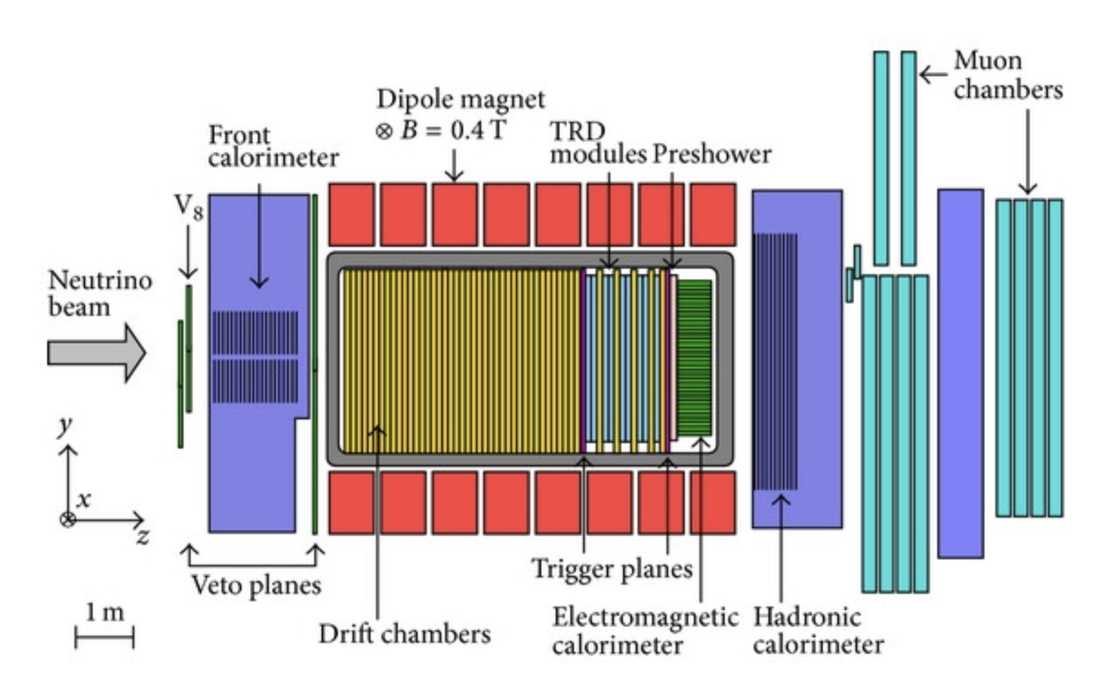
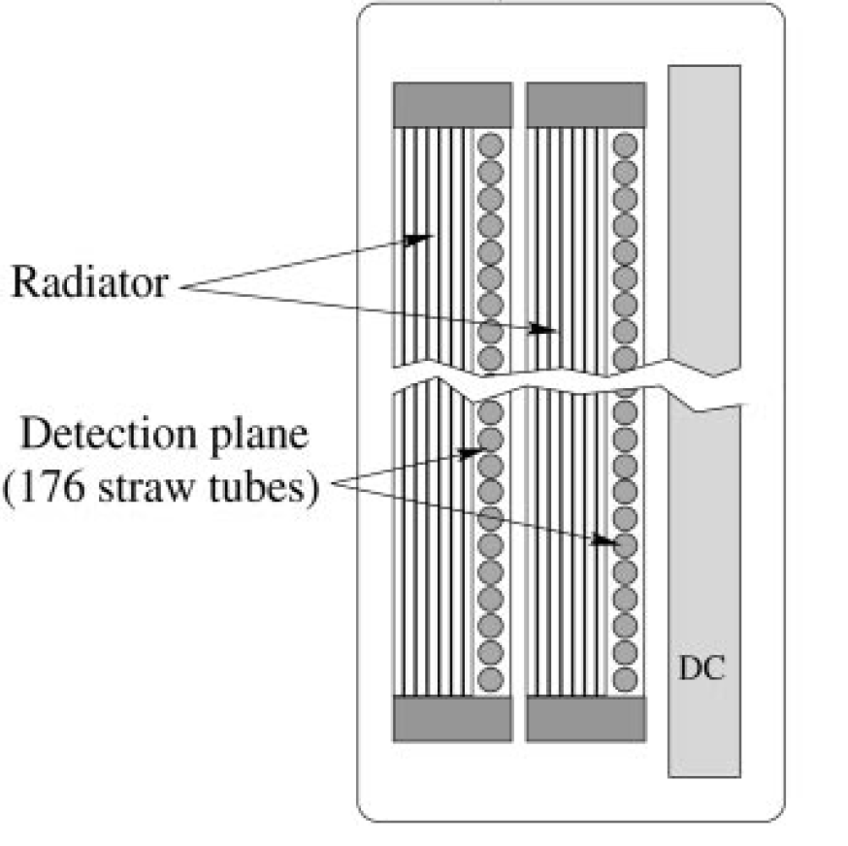
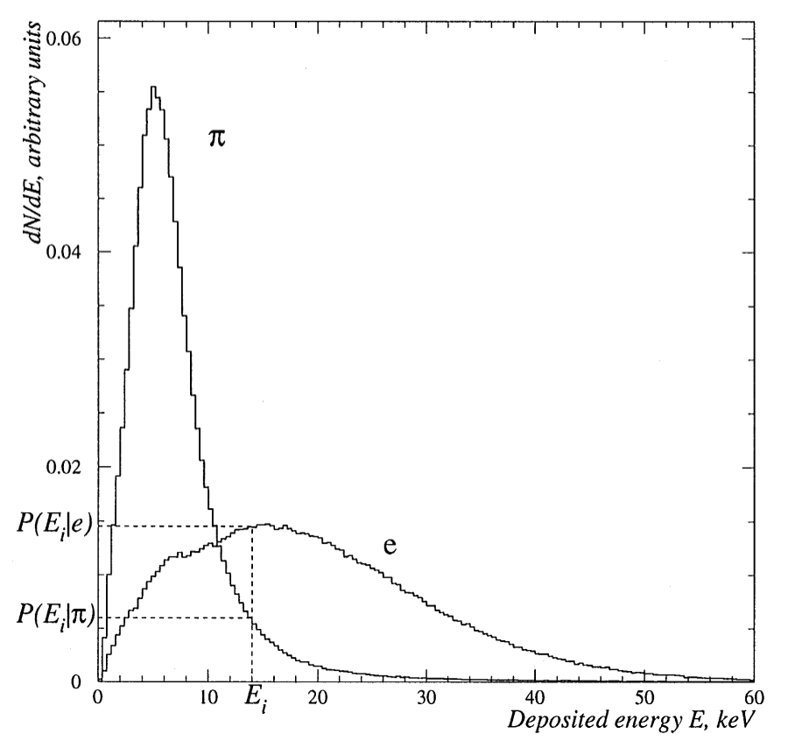
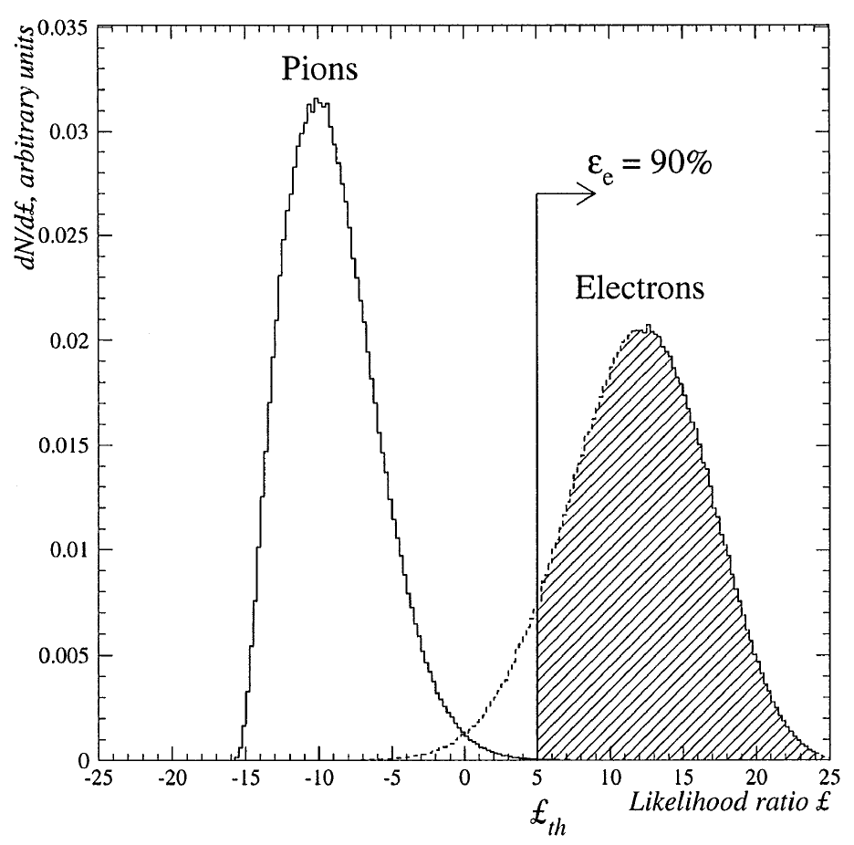
NOMAD TRD
NOMAD: ν_{u}--> ν_{e} neutrino oscillations
Transition Radiation Detector
9x modules
315 x 15 μm
polypropylene foils
176 x 15 mm
Straw tubes
80% Xe + 20% CH₄
1 module
9x modules
ε_{π} < 10⁻³
M. Contalbrigo
2nd European School on EIC Physics, 22th June – 2nd July, 2025
19

Slide 20
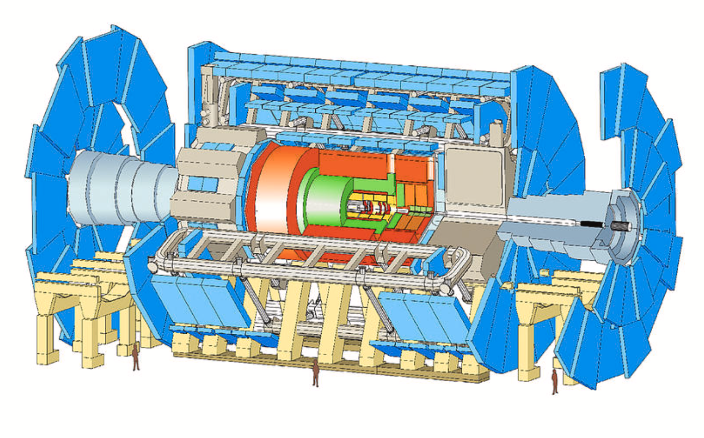
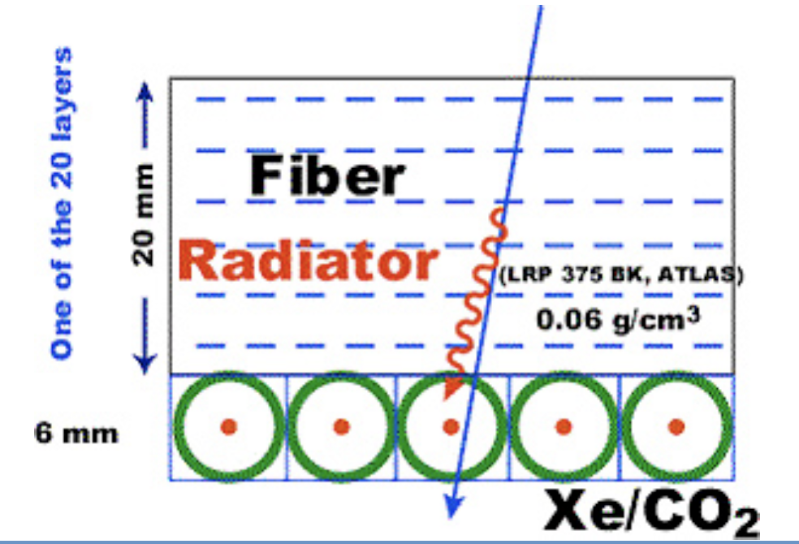
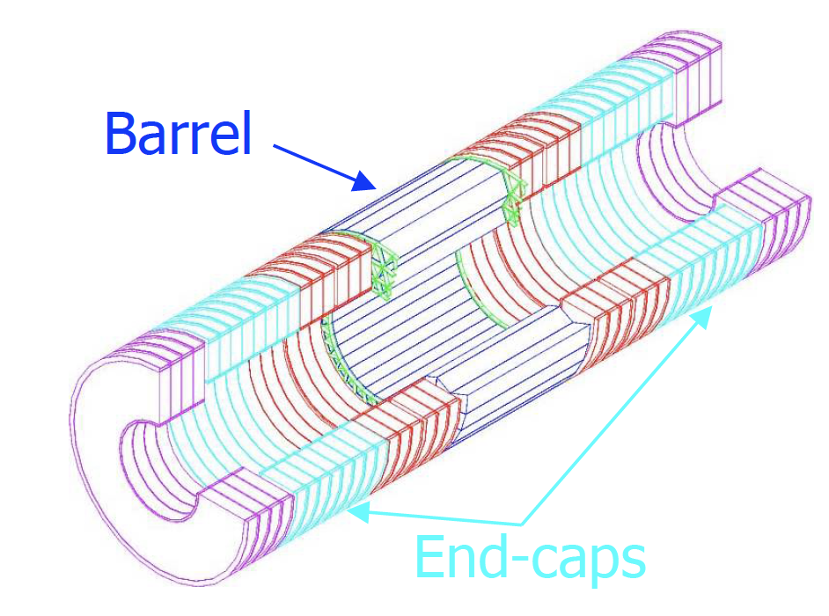
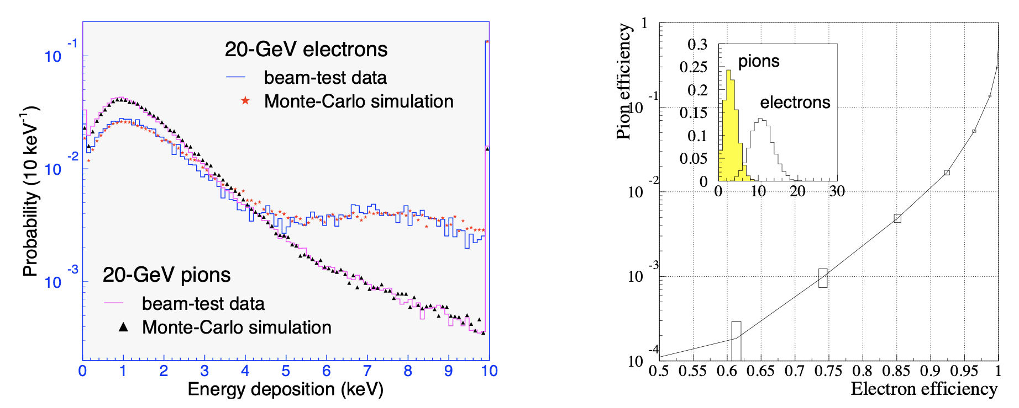
ATLAS TRT
ATLAS: Higg boson and BSM search
Tracking and transition radiation detector
M. Contalbrigo
2nd European School on EIC Physics, 22th June – 2nd July, 2025
20

Slide 21
PID Sensors
M. Contalbrigo
2nd European School on EIC Physics, 22th June – 2nd July, 2025
21

Slide 22
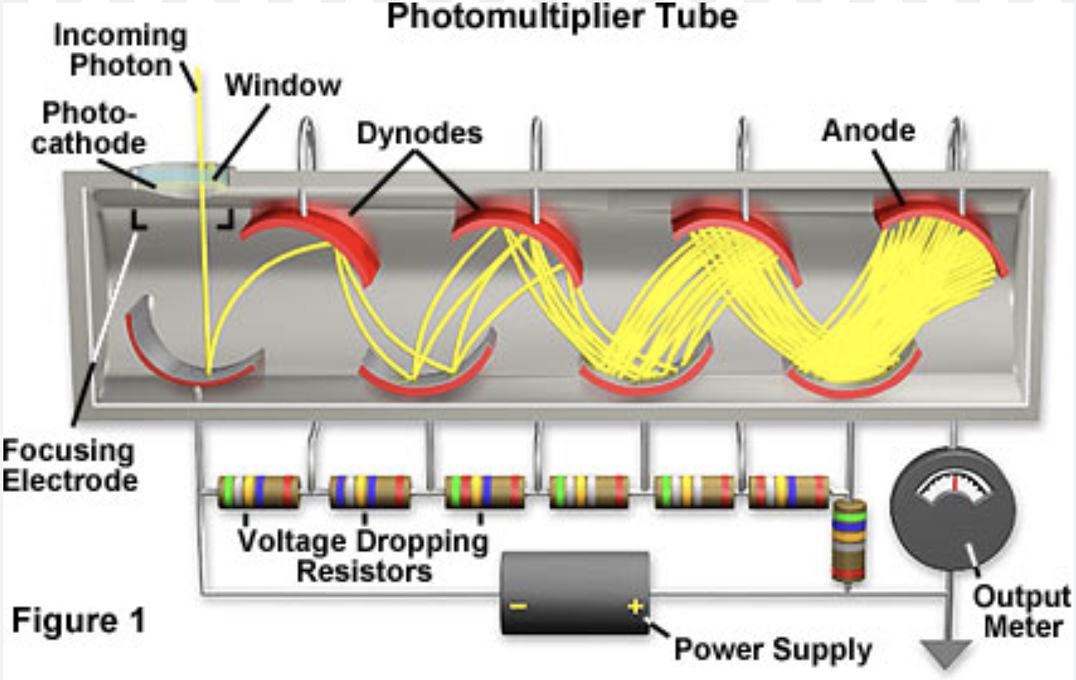
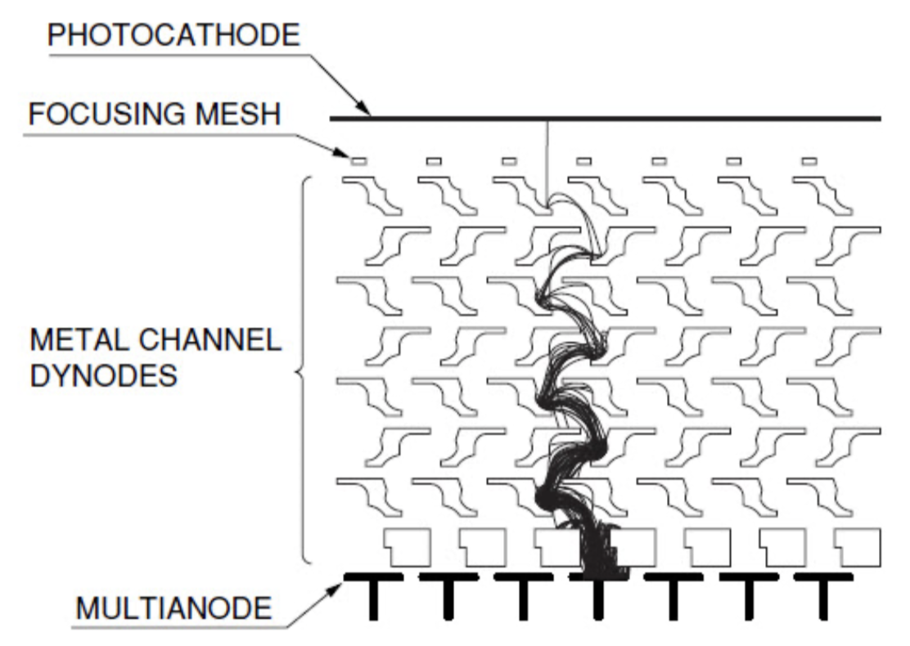
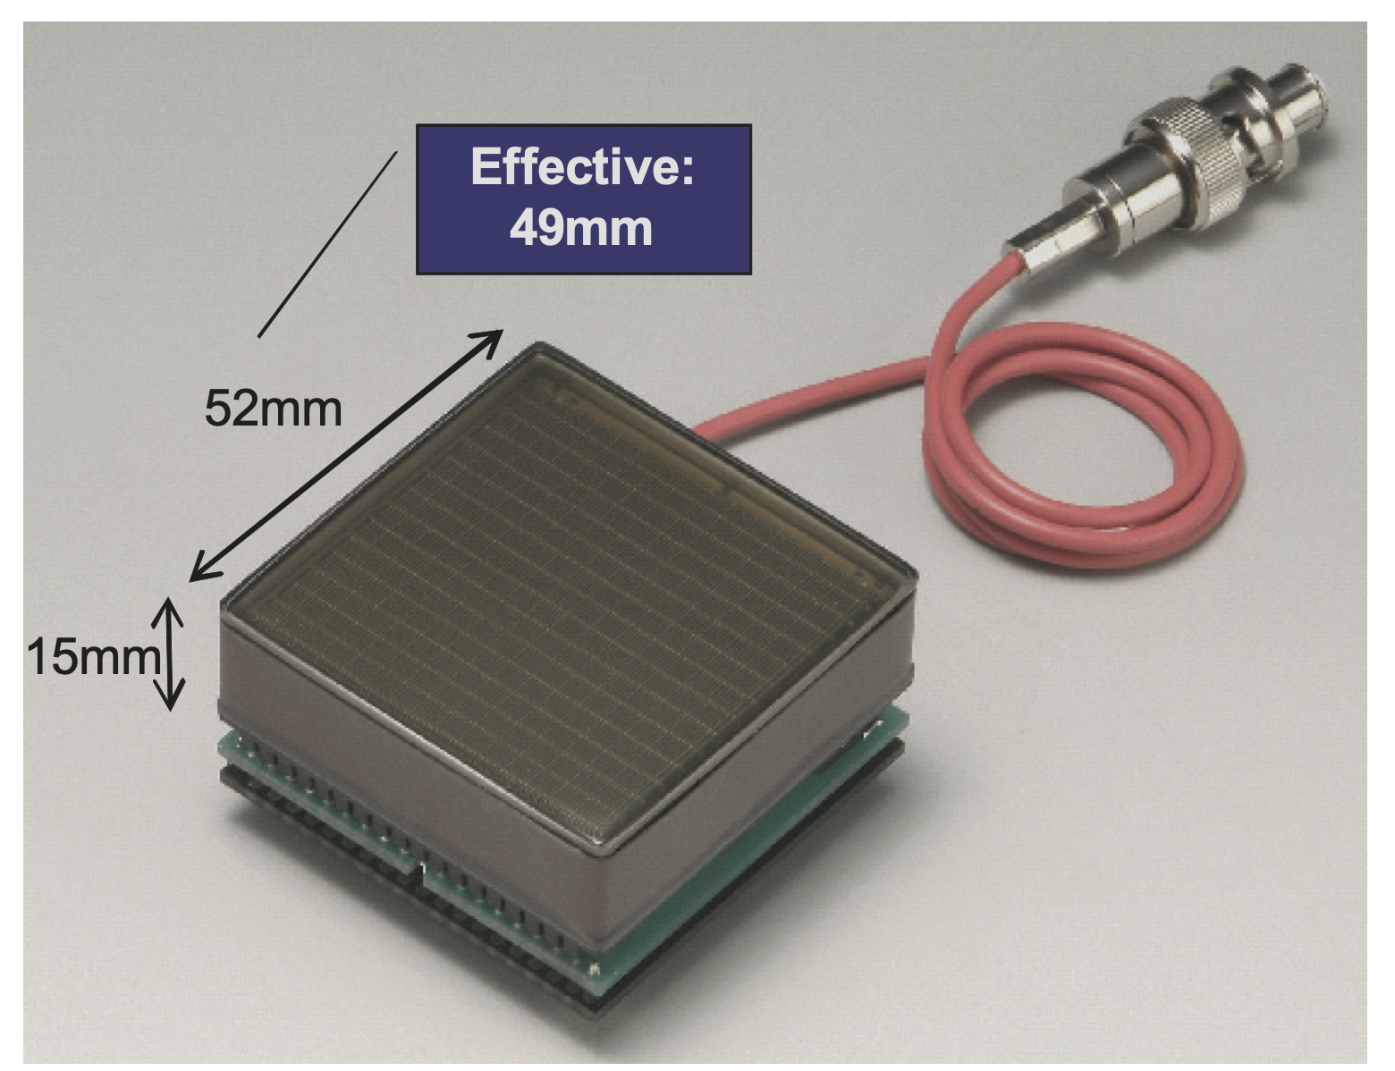


Multi-Anode Photomultiplier (MA-PMT)
H8500 Flat Panel PMT
Pros.
Compact Layout
Cost-effective
High packing-factor
Position sensitive
Fast, O(100 ps) TTS
Low dark count
Cons.
Complex Layout
Magnetic Field Sensitive
High-Voltage (~1 kV)
M. Contalbrigo
2nd European School on EIC Physics, 22th June – 2nd July, 2025
22

Slide 23
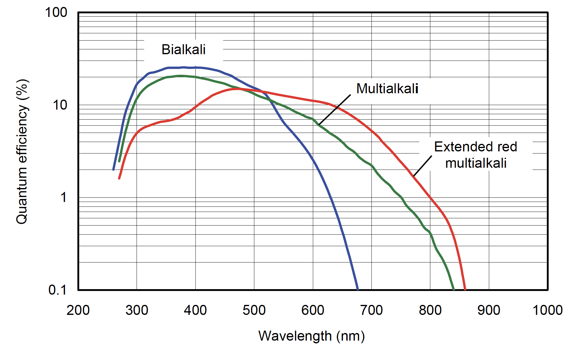
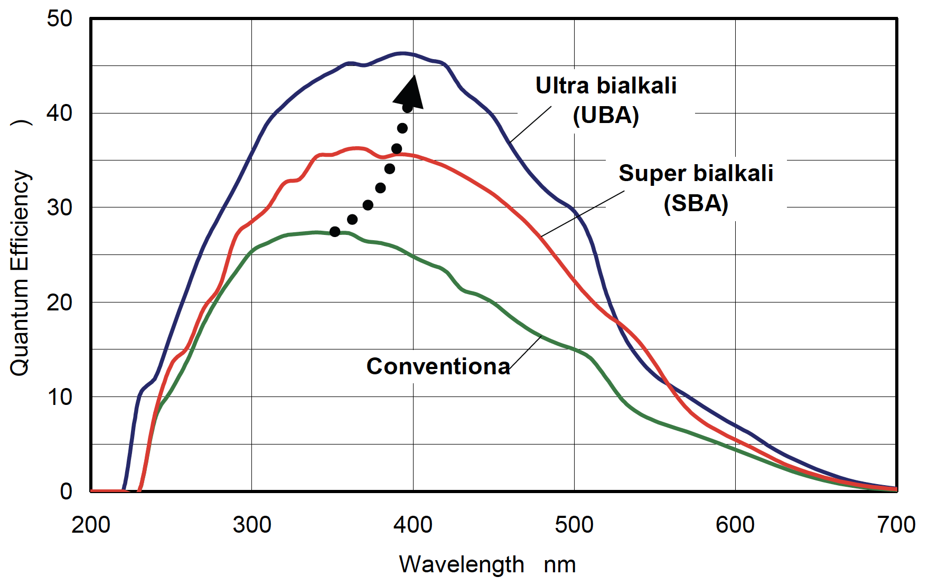
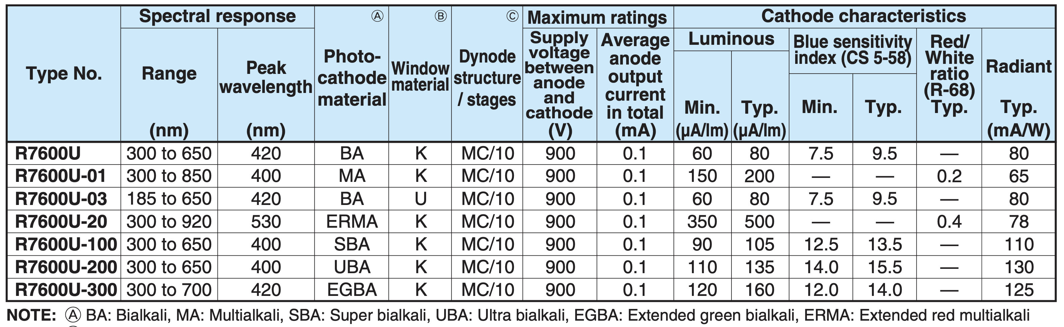
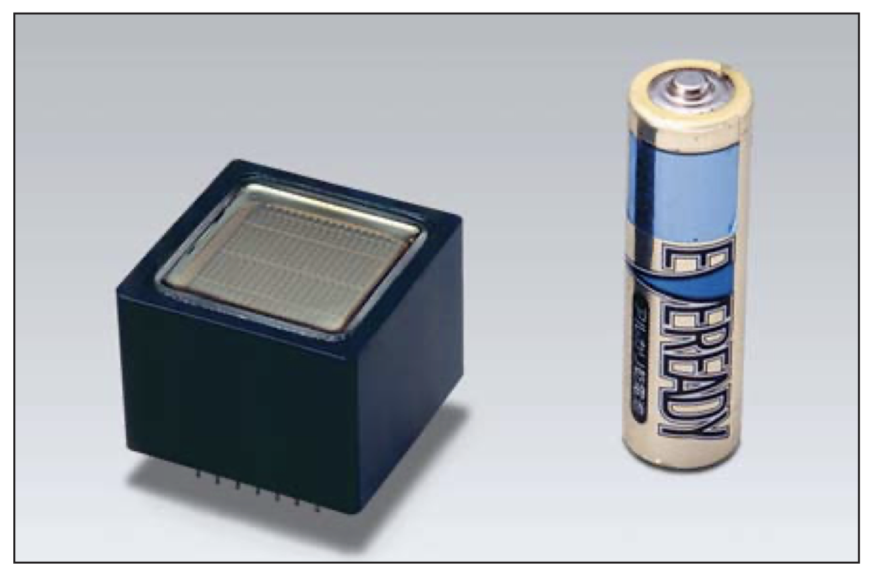
PMT Photocatode
Thin layer of alkali metal (mix) with very low work function in vacuum (to prevent contaminatino)
Photocatode optimization depends on
the detail structure of PMTs
R7600
Compact
2x2 cm² area
M. Contalbrigo
2nd European School on EIC Physics, 22th June – 2nd July, 2025
23

Slide 24
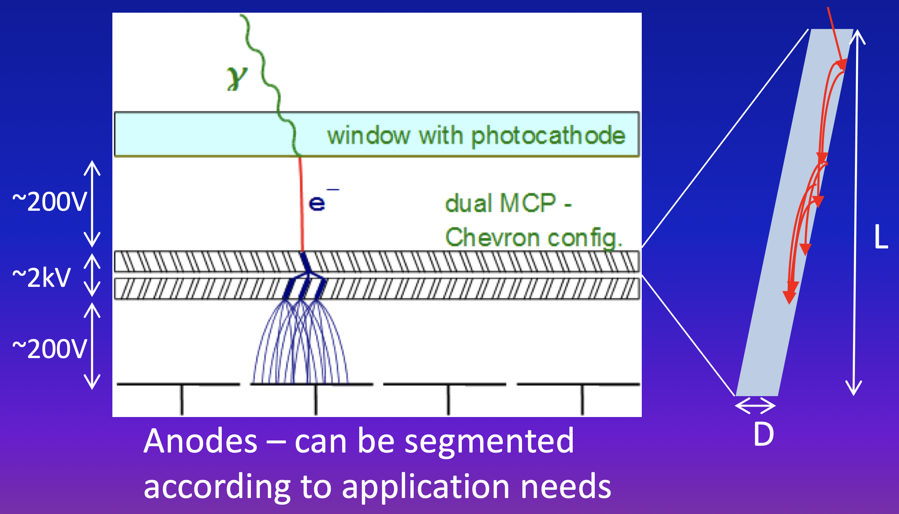
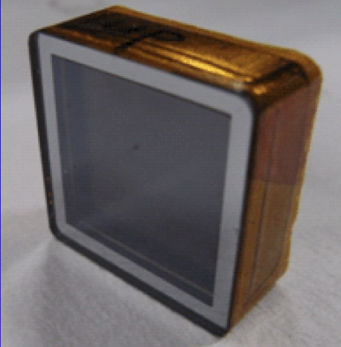
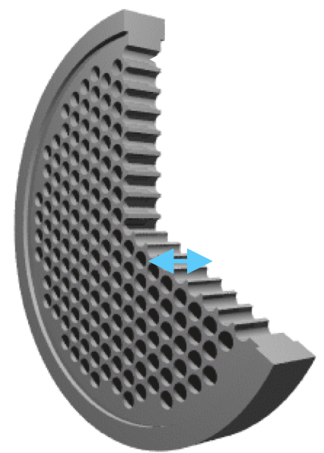
Micro-Channel Plate Photomultiplier (MCP-PMT)
Similarly of ordinary PMT – dynode structure is substitute by MCP
MCP: thin glass plate with an array of holes (10-100 μm diameter) continous dynode structure
Pros.
Cons.
Expensive
(Ageing)
Gain 10⁶ --> single photon
Collection efficiency 60%
Small thickness
High E field
Segmented anode
--> Position sensitive
Small transit time spread (~ 30 ps)
Works in magnetic field
M. Contalbrigo
2nd European School on EIC Physics, 22th June – 2nd July, 2025
24

Slide 25
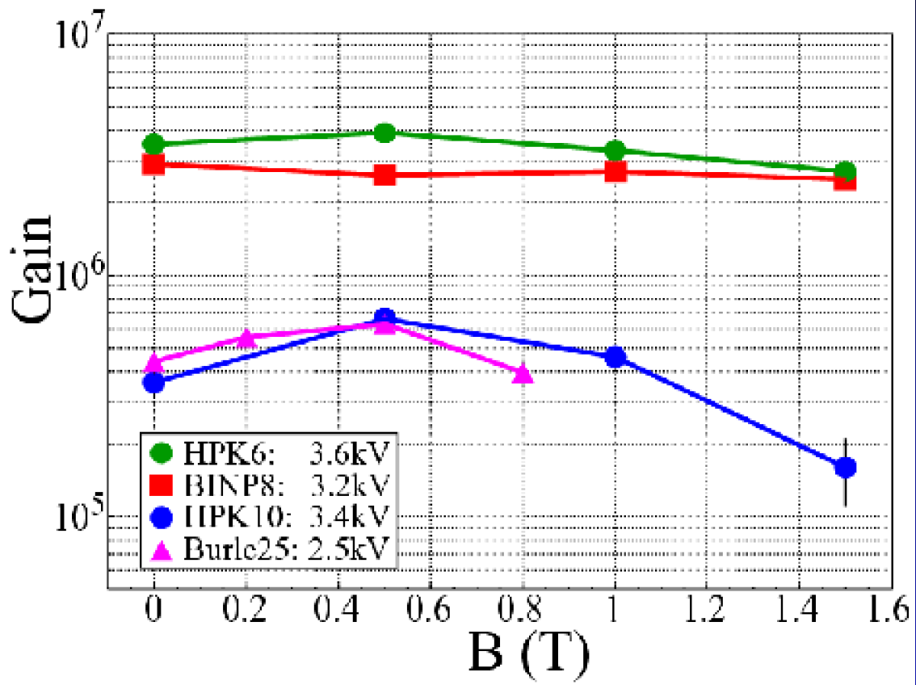
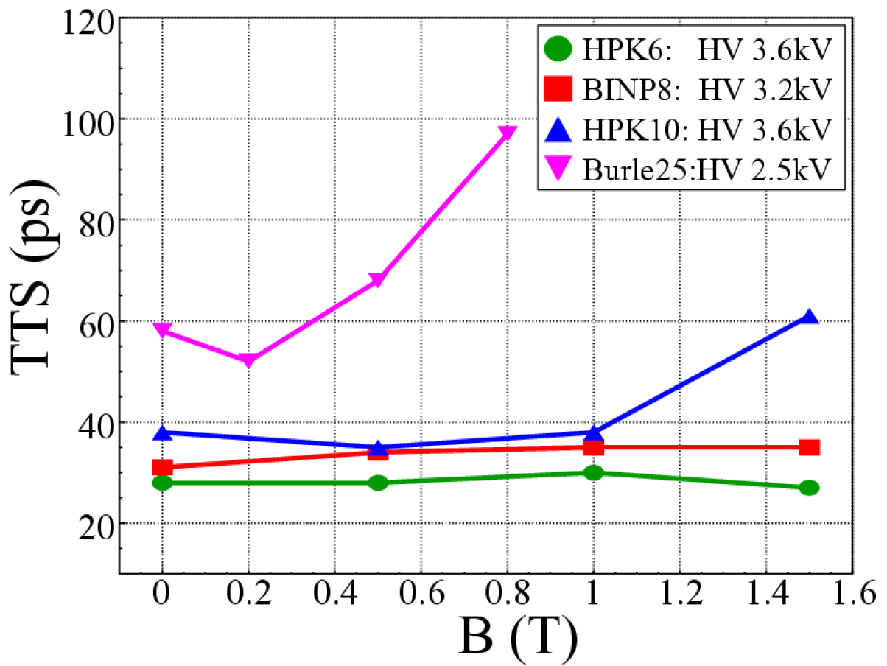
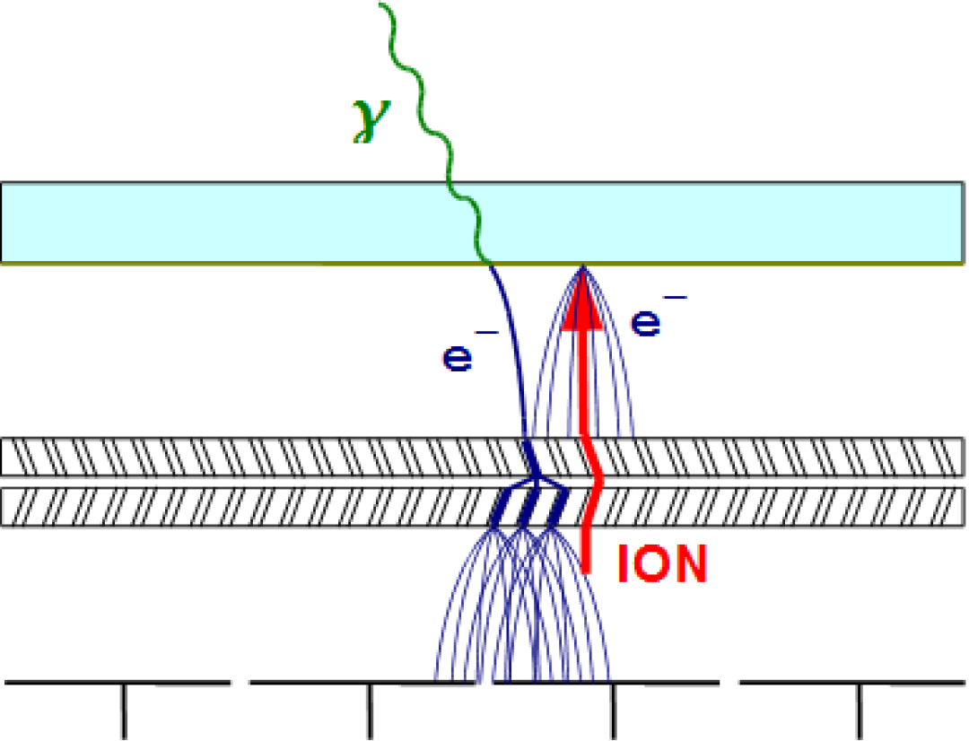
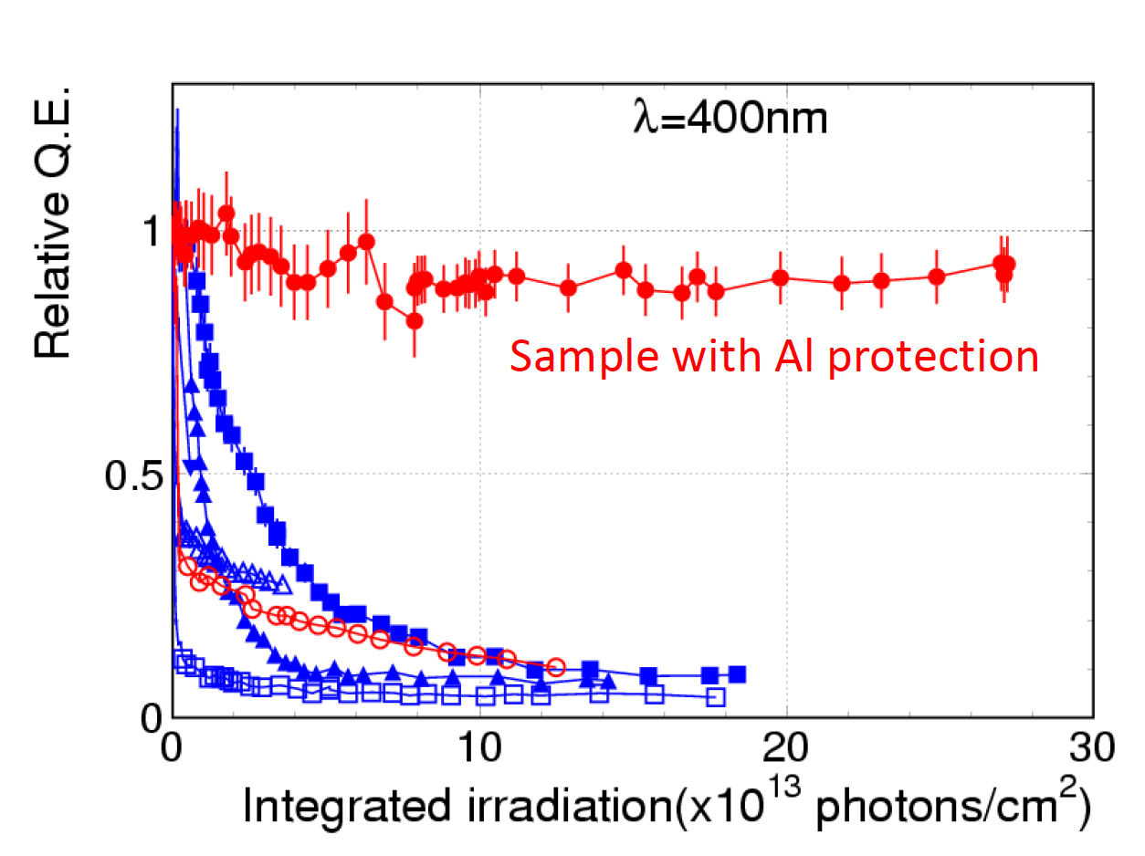
Micro-Channel Plate (MCP-PMT)
Narrow amplification channel sustains
magnetic field (axial direction)
Backscattering reduced
Timing degraded
Residual gas ionization
QE degradation due to ion
bombardment
Thin Al foil (few μm) block
Ion feedback and ½ electrons
1 yr at super B-factories
M. Contalbrigo
2nd European School on EIC Physics, 22th June – 2nd July, 2025
25

Slide 26
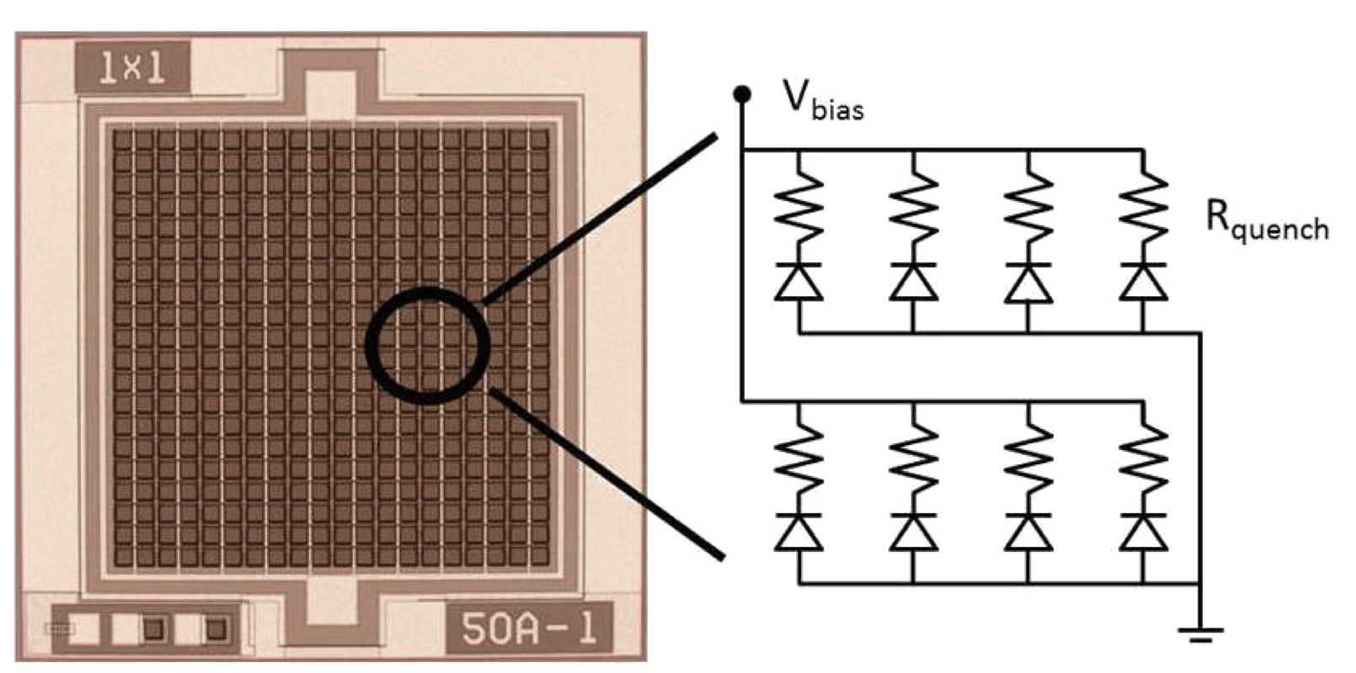
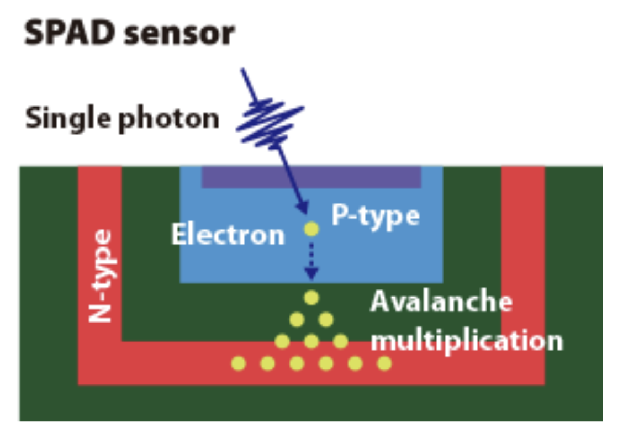
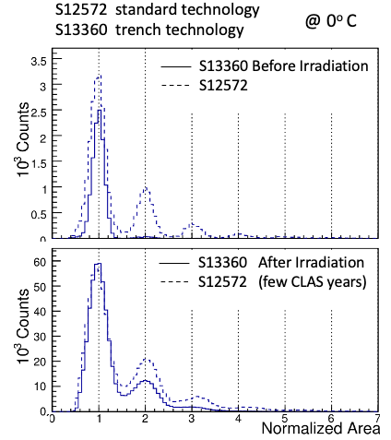


Silicon Photomultiplier (SiPM)
SPAD array on a common Si substrate
SPAD: single photon avalanche diode
working in Geiger mode
R: quench resitor to stop the avalanche
Fast rise (discharge) and slow recharge
Intrinsic high dark-count rate due to thermal electron
(indistinguishable from single-photon)
Possibility of
- single-photon detection
- photon counting
M. Contalbrigo
2nd European School on EIC Physics, 22th June – 2nd July, 2025
26

Slide 27



Silicon Photomultiplier (SiPM)
SPAD array on a common Si substrate
SPAD: single photon avalanche diode
working in Geiger mode
R: quench resitor to stop the avalanche
1 mm
Compact & robust layout
Cost-effective production process
High photon efficiency (40-50%)
Good time resolution (~ 100 ps)
Insensitive to magneti field (used for NMR)
5 cm
High dark count rates
Radiation sensitive
Cooling
Timing
Annealing
M. Contalbrigo
M. Contalbrigo
2nd European School on EIC Physics, 22th June – 2nd July, 2025
27

Slide 28


Silicon Photomultiplier (SiPM)
Dark counts can be mitigated by working at low temperature (about 0.5x every 10 degrees)
Radiation damage can be cured with high-temperature annealing cycles
At -30 ºC after annealing
M. Calvi et al., NIMA 922 (2019) 243
M. Contalbrigo
2nd European School on EIC Physics, 22th June – 2nd July, 2025
28

Slide 29
Specific PID Detectors
M. Contalbrigo
2nd European School on EIC Physics, 22th June – 2nd July, 2025
29

Slide 30
ePIC dRICH
Use momentum (tracking) to get the mass p = γ m βc
Process | Particle | Equipment
Energy Loss (dE/dx) | Hadrons | Tracking
Transition Radiation (TDR) | Electrons | Tracking sensitive to X-ray
Time-of-Flight (TOF) | Hadrons | Timing
Cherenkov Radiation | Hadrons | Cherenkov
M. Contalbrigo
2nd European School on EIC Physics, 22th June – 2nd July, 2025
30

Slide 31



Time of Flight
Δt = TOF
L = flight distance
Start time t and distance L should be known*
Arrival time difference goes with m²
drops as p²
if
then
* With negligible uncertainty
M. Contalbrigo
2nd European School on EIC Physics, 22th June – 2nd July, 2025
31

Slide 32




Time-of-flight
$$n σ= \frac{Δt_{1}−Δt_{2}}{σ}= \frac{L}{2cσ}\frac{(m_{1}^{2}−m_{2}^{2})}{p^{2}}$$
c ~ 10⁸ m/s = 0.3 m/ns = 0.03 m / 100 ps
Reference requirement is a at least 3σ separation
To double the reach in momentum one needs to
quadruplicate distance or time precision
With typical values
leverage L of 1 m
time resolution σ $≲$ 100 ps
n σ
σ = 100 ps
σ = 20 ps
p-k
raw limits are
e-π $≲$ 1 GeV/c
k-π $≲$ 3 GeV/c
p-k $≲$ 5 GeV/c
k-π
e-π
P (GeV/c)
M. Contalbrigo
M. Contalbrigo
2nd European School on EIC Physics, 22th June – 2nd July, 2025
32

Slide 33





CLAS12 FTOF
CLAS12: Nucleon structure
and spectroscopy
Scintillator bar + PMT
PMT
M. Contalbrigo
2nd European School on EIC Physics, 22th June – 2nd July, 2025
33

Slide 34


Scintillating TOF Resolution
σ₀ intrinsic electronics resolution of the readout chain, independent of light level
σ₁ time jitter in the combined single-photon response of the scintillation counter and PMT
σ₂ path length variations in the light collection, that scales with distance from source
For large bars, the variations in path length are
the dominant contribution to the resolution
λ₀ reference attenuation length
L₀ length of the shorter bar
F PMT collection efficiency (active fractional area)
M. Contalbrigo
2nd European School on EIC Physics, 22th June – 2nd July, 2025
34

Slide 35




Compact TOF
M. Bohm et al., JINST 11 (2016) C05018 – PANDA TOF
T. Rostomyan, Nucl. Instrum. Meth. A
986 (2021) 164801 – MUSE experiment
Option to cover the rod rims with SiPMs connected in series (full coverage with 1 readout channel)
M. Contalbrigo
2nd European School on EIC Physics, 22th June – 2nd July, 2025
35

Slide 36



ALICE TOF
ALICE: Quark-gluon plasma in heavy ion collisions
Multigap resistive plate chamber
Fem mm gas gaps with
local streamer discharge
(position sensitive)
M. Contalbrigo
2nd European School on EIC Physics, 22th June – 2nd July, 2025
36

Slide 37













Cherenkov Radiation
Momentum threshold:
Scales with particle mass
Decreases with n
Photon yield:
M. Contalbrigo
2nd European School on EIC Physics, 22th June – 2nd July, 2025
37

Slide 38

Cherenkov Radiators
1 m
Real PID
starts at
3x (kaon)
few
cm
(1.015-1.08)
M. Contalbrigo
M. Contalbrigo
2nd European School on EIC Physics, 22th June – 2nd July, 2025
38

Slide 39



Photon Detection
Proximity focusing
Photon detector
Focusing mirror
M. Contalbrigo
2nd European School on EIC Physics, 22th June – 2nd July, 2025
39

Slide 40


Photon Yield
Spectrum of Cherenkov photons
Typical sensitivity (quantum efficiency) of a PMT
4 eV
3 eV
2 eV
4 eV
3 eV
2 eV
M. Contalbrigo
2nd European School on EIC Physics, 22th June – 2nd July, 2025
40

Slide 41



Chromatic Dispersion
Gas Radiator
Aerogel Radiator
X
Refractive index as a function of the Cherenkov light wavelength for the aerogel with n = 1.05 and trad = 20 mm obtained selecting pions with 8 GeV/c momentum.
X
Sellmeier parameterization
M. Contalbrigo
2nd European School on EIC Physics, 22th June – 2nd July, 2025
41

Slide 42


Cherenkov Resolution
$σ_{CH} \text{=}$ $\sqrt{σ_{Co}^{2}+\frac{σ_{em}^{2} + σ_{ch }^{2}+{ σ}_{px}^{2}}{N_{pe}}}$
σ_{co} correlated uncertainty (tracking, misalignment, magnetic bending, multiple scattering, ….)
σ_{em} uncertainty on the photon emission point (radiator depth)
σ_{ch} radiator chromatic dispersion
σ_{px} sensor spatial resolution (pixel size)
Q(λ) Sensor quantum efficiency ε_{pe} detection efficiency (sensor and mirror)
Λ(λ) Radiator transmission length t_{rad} radiator thickness
M. Contalbrigo
2nd European School on EIC Physics, 22th June – 2nd July, 2025
42

Slide 43





CLAS12 RICH
X
Electrons: direct vs planar reflection
Electrons: direct vs spherical reflection
95 % kaon efficiency (<1% pion mis-ID)
X
M. Contalbrigo
M. Contalbrigo
2nd European School on EIC Physics, 22th June – 2nd July, 2025
43

Slide 44






BELLE ARICH
1.045
1.055
Limited space --> Proximity focusing & radiator focusing
High B field (1.5T) --> Custom Hybrid photon detector
Super bialkali photocatode
Gain 4.5 10⁶
PDE ~ 28 %
17 cm
D⁰--> K⁻π⁺ 0.5-3.5 GeV/c
M. Contalbrigo
M. Contalbrigo
2nd European School on EIC Physics, 22th June – 2nd July, 2025
44

Slide 45





LHCb RICH
LHCb B physics
LHCb Precisin measurements of B-decays
and search fro BSM signals
RICH1: Aerogel (5 cm) n=1.03
2-10 GeV/c
C₄F₁₀ (85 cm) n=1.0014
up to 70 GeV/c
RICH2: CF₄ (196 cm) n=1.0005
up to 100 GeV/c
Hybrid photomultiplier
Photocatode @ - 20 kV
Silicon sensor 2.5x2.5 mm²
QE ~ 25%
M. Contalbrigo
M. Contalbrigo
2nd European School on EIC Physics, 22th June – 2nd July, 2025
45

Slide 46





DIRC
Babar
Belle-II
B factory
X
X
B factory
Detection by internal reflection: compact detection volume (thickness)
Critical aspects: quartz surface quality (parallelism, roughness)
proper imaging system
2D imaging - Babar
X
X
Air
1D i+time maging – Belle-II
M. Contalbrigo
M. Contalbrigo
2nd European School on EIC Physics, 22th June – 2nd July, 2025
46

Slide 47




CsI Photocatode
ALICE: Quark-gluon plasma in heavy ion collisions
COMPASS: Nucleon structure and spectroscopy
Large instrumented area
Multi-wired proportional chambers with a CsI photocatode
Quantum efficiency is around 16-24% at 170 nm
High-Momentum PID
RICH
A = 11 m²
A = 5.3 m²
M. Contalbrigo
2nd European School on EIC Physics, 22th June – 2nd July, 2025
47

Slide 48



Cosmic Rays
A cosmic gamma ray generates a particle shower in the atmosphere
Showering charged particles generates Cherenkov radiation
The number of detected photons is proportional to the initial energy
Air refractive index is n = 1.00028
Threshold energy is 4.4 GeV for muons and 21 MeV for electrons
Cherenkov angle is 23 mrad ~ 1.3º
The shower maximum is at 10 km and generates a cone of 230 m
Extended detection pattern in
space and time gives the direction
M. Contalbrigo
M. Contalbrigo
2nd European School on EIC Physics, 22th June – 2nd July, 2025
48

Slide 49
Arguments
Particle-ID Detectors based on Tracking Passage through massive absorbers
Calorimetry Kinematics
Energy momentum balance
Shower shape
Particle-ID Detectors as Tracking by-product Ionization Energy Loss
Transition Detection
Particle-ID Sensors Multi-Anode Photomultipliers
Micro-channel Plates
Silicon Photomultipliers
Low Gain Avalanche Photodiode
Specific Particle-ID Detectors Time-of-Flight
Cherenkov Radiation
M. Contalbrigo
2nd European School on EIC Physics, 22th June – 2nd July, 2025
49
Notes:
Vanno messi studi innovativi e pubblicazioni

